Slide 1


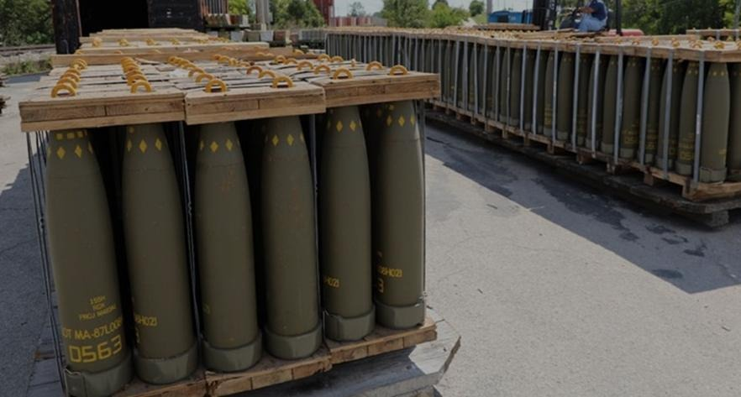
Mac Jee At a Glance
Mac Jee Investment Thesis
Business Units and Portfolio
Financials
Potential | Mac Jee Munitions
MUNITIONS
The installed base scales first — US$ 18 mm to US$ 361 mm on the lightest growth capex of the three units
Gross revenue by driver — US$ mm
What moves the curve
18
110
183
241
293
343
361
1
155 mm ER FB BB artillery shell
From nothing to 50k rounds a year at US$ 3.6–4.2k — 65% of 2027 revenue. Even at 50k the line runs at 42% of the 120k/year capacity the CIM already declares.
2
Armadillo MRLS
5 units in 2028 to 35 in 2031 at US$ 1.7–2.1 mm each. Adds US$ 72 mm by 2032 — 20% of the unit — from a standing start.
3
Smart-weapons tail
Dagger, 70 mm rocket and fuzes reach US$ 14 mm by 2032. Small in revenue, but they defend the margin as the shell dilutes it.
THE ARGUMENT
Munitions is the only unit already producing at scale. The model takes it to US$ 361 mm on US$ 33 mm of growth capex — 12% of the group total — because the lines already exist. The question is not whether it can produce, but whether the 155 mm order book converts at 50k rounds a year.
▲
42%
$
12%
155 mm capacity used, 2032
of group growth capex
USD 110 mm
USD 33 mm
◆
41% → 35%
■
US$ 550 mm
Revenue in 2027E
2027 growth capex
Gross margin to 2032
Gross profit 2027–32
A
Source: Mac Jee financial model v025, Base case (FX R$ 5.1733/US$). Gross revenue.
Confidential

Slide 2
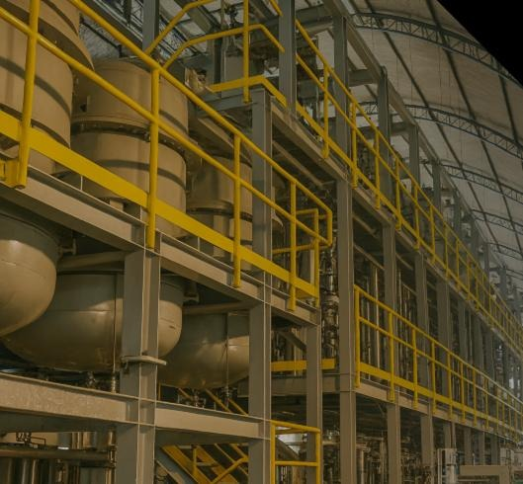
Mac Jee At a Glance
Mac Jee Investment Thesis
Business Units and Portfolio
Financials
Potential | Mac Jee Energetics
ENERGETICS
The curve falls after 2029 because the model counts only contracts already identified — not because the plants stop
Gross revenue by contract — US$ mm
Why the curve falls
25
115
128
150
103
40
45
1
Five country contracts, finite by construction
Azerbaijan ends 2027, ICOR and Malaysia 2029, UAE 2030, Canada 2031 — 100% of 2027 revenue, and zero by 2032.
2
Only two lines survive the horizon
HMX reaches US$ 15 mm in 2032. “New contracts” — the replacement line — is set at US$ 10.5 mm and US$ 25 mm. That is the entire renewal assumption.
3
The CIM’s own pipeline is not in the model
Page 41 of the CIM shows a US$ 900 mm 2027 pipeline for Energetics. The model books US$ 35 mm of new contracts across 2031–32. That gap is the upside.
THE ARGUMENT
Energetics converts contracts, it does not sell a catalogue — and the model reflects exactly that. Revenue peaks at US$ 150 mm in 2029 and falls to US$ 45 mm because five named country contracts run off and the Base case replaces them with US$ 25 mm. The plants do not run off. That gap is the whole upside, and it is not in the numbers.
▲
100%
$
US$ 253 mm
of 2027 revenue
Gross profit 2026–32
USD 115 mm
USD 25 mm
◆
43%
■
2029
Revenue in 2027E
2027 growth capex
Gross margin, flat
Peak, then run-off
B
Source: Mac Jee financial model v025, Base case (FX R$ 5.1733/US$). Gross revenue. “New contracts” is the model’s own replacement line, not an IGC estimate.
Confidential

Slide 3
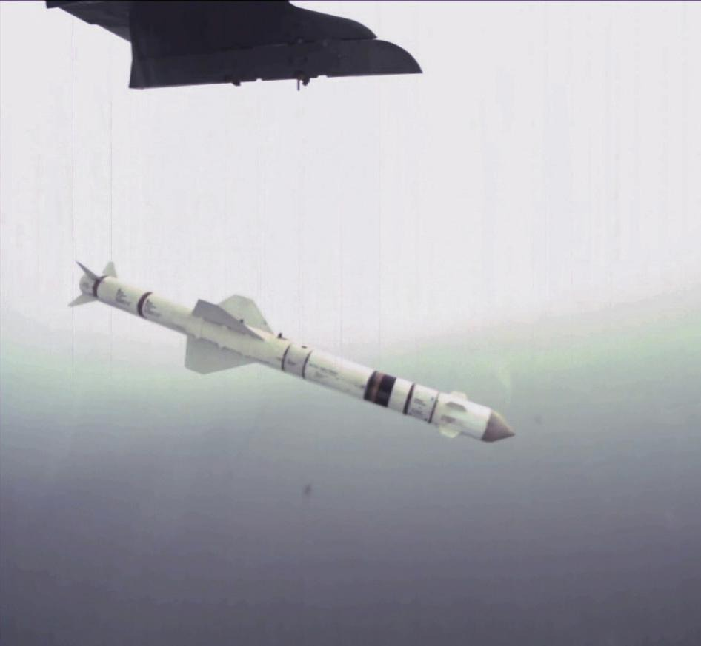
Mac Jee At a Glance
Mac Jee Investment Thesis
Business Units and Portfolio
Financials
Potential | Mac Jee Missile
MISSILE
From zero to the group’s largest unit — and the destination of 78% of the growth capex
Gross revenue by programme — US$ mm
Where the value sits
0
34
107
213
351
515
711
1
GGM Cruise Missile 300 is the unit
15 units in 2027 to 150 in 2032, at US$ 1.9 mm rising to US$ 2.55 mm each. Alone it is 54% of the unit in 2032 and 34% of the group.
2
US$ 210 mm of capex, all in 2027
78% of the group’s US$ 268 mm total, committed in a single year — years before the volume that repays it. Nothing else in the plan is this front-loaded.
3
The only expanding margin in the group
49% in 2028 to 52% in 2032 — the only unit whose margin expands across the plan. Mix, not price: missile programmes run near 50% gross margin.
THE ARGUMENT
Missile carries the equity story: nothing in 2026, US$ 711 mm and 64% of group revenue by 2032, at the only expanding gross margin in the group. It is also where the money goes — US$ 210 mm of growth capex in 2027 alone, spent before the first GGM units ship at scale. The unit is the thesis and the risk in the same line.
$
78%
◆
50% → 52%
of group growth capex
Margin, expanding
USD 34 mm
USD 210 mm
▲
64%
■
8 programmes
Revenue in 2027E
2027 growth capex
of group revenue 2032E
from zero in 2026
C
Source: Mac Jee financial model v025, Base case (FX R$ 5.1733/US$). Gross revenue.
Confidential

