Slide 1

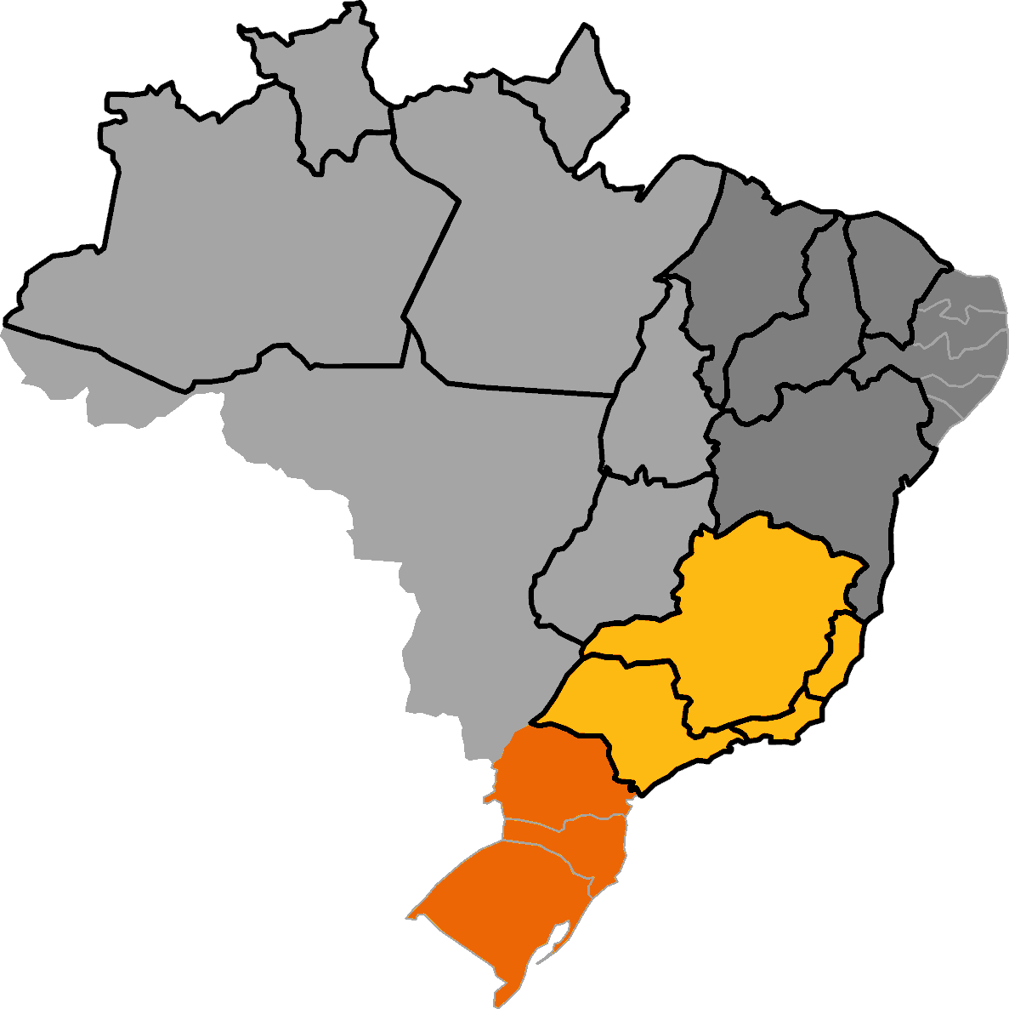
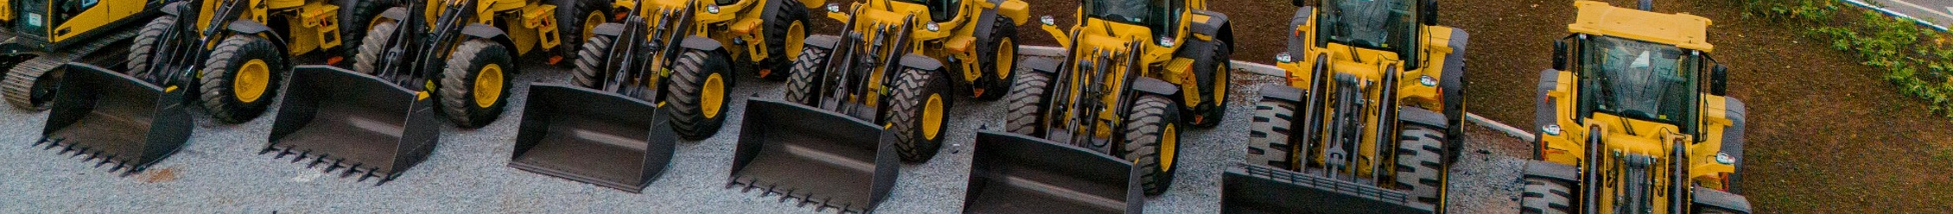
Project Yellow
01.
02.
03.
Nationwide multi-brand distribution
#2 heavy-equipment dealer in Brazil across all brands, serving eight sectors from mining to agriculture
Aftermarket-led service platform
Two thirds of the workforce in after-sales, an ~85% absorption rate and +100k SKUs in parts e-commerce
Digital and connected operations
Fleet telemetry and 24/7 autonomous stores converting an installed base of +8.6k units into recurring demand
The Company is one of Brazil’s largest equipment distributors,
combining nationwide reach with an aftermarket-led, digital operation
Business Overview
Geographic Index
Multi-brand distributor of construction, mining, forestry and agricultural equipment, operating across Brazil for 59 years on an aftermarket-led model built on parts e‑commerce, fleet telemetry and 24/7 autonomous stores
North and Middle West
Northeast
Construction
Forest
Agriculture
Agriculture
Logistics
Construction
Infrastructure
South
Southeast
Agriculture
Forest and mining
Industry
Agriculture
Forest
Industry
Construction
Construction
Key Highlights
Shading by region · outline marks main operating states
BRL 2.6 Bn
Net revenues 2025⁽¹⁾
BRL 123 Mn
EBITDA 2025⁽¹⁾
#2
Dealer in heavy equipment
36
Locations⁽²⁾
+1,000
Employees⁽²⁾
8
Sectors served
For any further questions please contact:
Bruno Iervolino
Bruno.iervolino@igcp.com.br
+55 11 3815 3533
Gabriel Brito
Gabriel.brito@igcp.com.br
+55 11 3815 3533
Pedro Grando
Pedro.grando@igcp.com.br
+55 11 3815 3533
Source: Information Memorandum (Jul-2026) and Company materials. (1) Sum of two separately reported perimeters: heavy equipment BRL 1,200 Mn / BRL 65 Mn and agriculture BRL 1,360 Mn / BRL 58 Mn (net revenues / EBITDA); not audited consolidated. (2) 23 + 13 locations; 470 + 600 employees; overlap to be confirmed.
Disclaimer:
All information contained in this material has been prepared based on the documents and/or information provided by the Company or obtained directly by IGC through legal sources and/or through independent researches. No liability is or shall be attributed to the members of IGC, including its partners, directors, employees, agents or advisers, in connection with the accuracy or completeness of the information contained herein or in connection with any other written or oral information made available to the recipient or its advisor. In particular, no representation or warranty is given as to the achievement or reasonableness of any future projections, management estimates, prospects or returns. This material belongs to IGC and shall not be copied, reproduced and/or distributed or disclosed to any third party without the prior consent of IGC. By receiving this material, the recipient agrees to return it as soon as requested by IGC, without retaining any copies.

