Slide 1
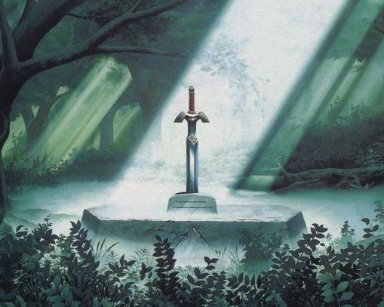
Zelda AI Rules
Pedro Sampaio

Slide 2
Basic Rules
The agent starts in the entrance of the Lost Woods (environment). The adventure ends when Link (agent) is able to get the real Master Sword that is located somewhere in the Lost Woods.
The agent can walk through grass, but can't walk through the trees.
Initially the agent has zero knowledge about the environment, so he must explore and gather information through his sensors.

Slide 3
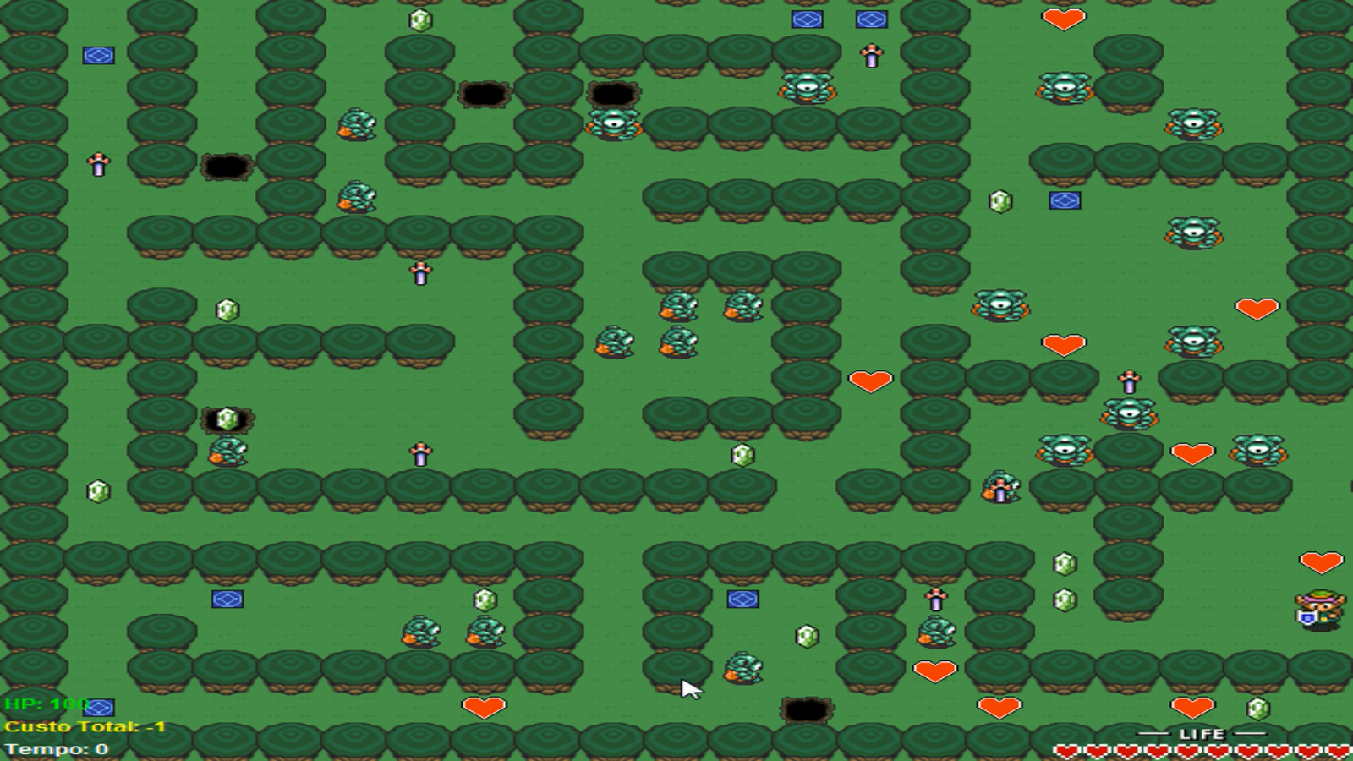
Starting Position

Slide 4


Environment Elements
Holes – if the agent falls on a hole he dies immediately;
Monsters – the agent dies immediately if he enters a field where a monster exists;
Fake Master Swords –are identical to the real Master Sword and the agent only realizes that it is fake after taking it from the ground;
Spatial Vortexes – when entering a spatial vortex the agent is teleported to some other random field of Lost Woods (including holes or fields with monsters

Slide 5



Environment Elements
Hearts – hearts that are used to recover the energy of the agent;
Rupees – rupees that give extra points to the agent;
Master Sword – the real Master Sword (main goal of the agent).

Slide 6


Agent Sensors
On fields adjacent to holes, excluding diagonal fields, the agent feels a light breeze;
On fields adjacent to monsters, excluding diagonal fields, the agent hears noises issued by the enemy;
On fields adjacent to spatial vortexes, excluding diagonal fields, the agent notices spatial distortions;

Slide 7
Agent Sensors
On fields where a Master Sword (real or fake) exists, the agent notices an increase in the glow issued by the virtue pendant;
On fields where a heart exists, the agent feels the presence of fairies;
On fields where a rupee exists, the agent notices the glow of the rupee.

Slide 8
Agent Actions
Move Ahead;
Turn Right (90° rotation);
Turn Left (90° rotation);
Attack – To strike with the sword in the direction that the character is looking at;

Slide 9
Agent Actions
Take Heart – To take the heart that is used to recover energy of the agent. The action can only be executed once per field with a heart;
Take Rupee –To take an existing rupee in a field where the agent is standing. The action can only be executed once per field with a rupee;
Take Master Sword – To take a Master Sword (real or fake). The action can only be executed on fields that have a Master Sword (real or fake).

Slide 10
Actions Cost
Move Ahead = -1;
Turn Right = -1;
Turn Left = -1;
Attack = -5;
Take Heart = -10;
Take Rupee = +10;
Take Master Sword = -100;
Fall into a Hole = -10000;
Get Attacked by a Monster = -10000;

Slide 11
Final Remarks
Besides the cost of each action, Link also has a specific amount of energy. The inital energy value is 100.
When attacking a monster with his sword, Link loses -10 energy points and the monster is defeated.
When taking a heart, Link recovers +50 energy points.
The adventure ends when the agent finds the real Master Sword or when the agent dies by falling into a hole, get attacked by a monster or loses all energy points
Challenge: find the real Master Sword while maintaining the lowest cost you are able to.

