Slide 1

PRACTICA SASS + BOOTSTRAP

Slide 2

LOGO

Slide 3



ICONOS

Slide 4
NAVEGADOR

Slide 5
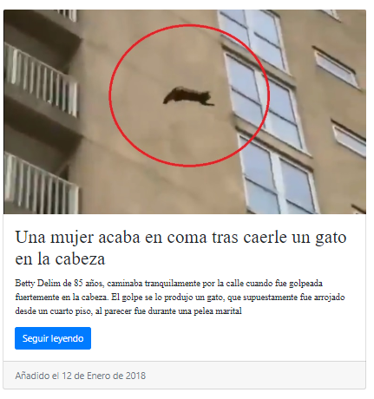
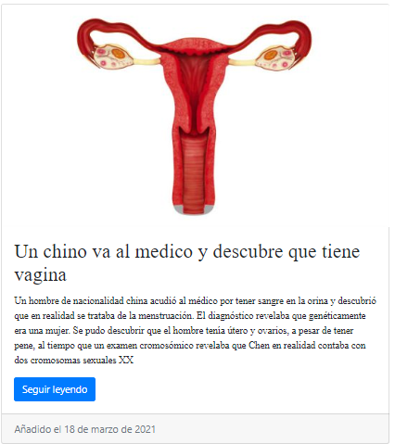

ARTICULOS

Slide 6
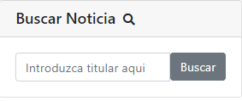
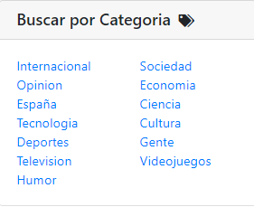
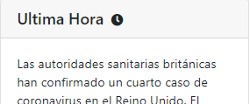
ASIDE

Slide 7
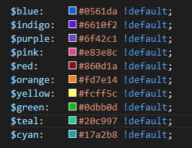
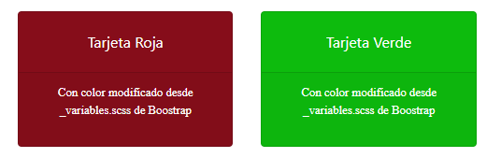
VARIABLES.SCSS

Slide 8
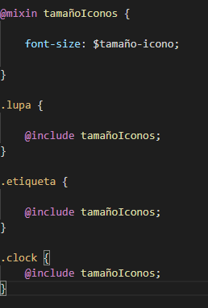

MIXIN E INCLUDE

Slide 9
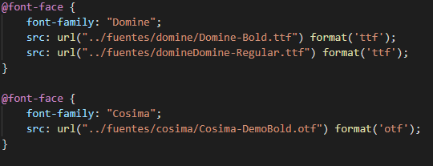
TIPOGRAFIA

Slide 10
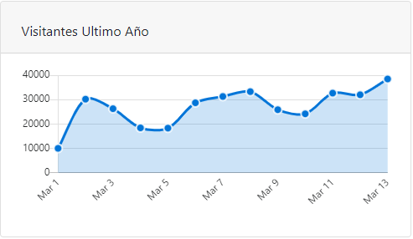
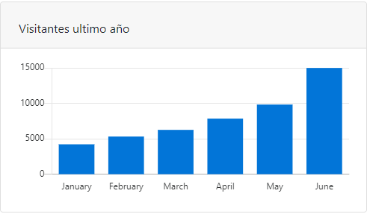
PLUGINS

Slide 11
ENLACE
https://github.com/pedroj98/sass

