Slide 1

Do near venues affect students’ performance?
Pedro Chacon

Slide 2
Introduction
Between Colombian parents there is the conception that schools nearby bars, clubs, stores and other recreational places are worst for their children, because it increasing the distractions and the probability of their children to skip classes to go to those places.
That’s why in the present project we will look if there is really a relationship the kind of establishments near schools in Bogotá, Colombia, and the results of its students in the national standardized academic test, ICFES, similar to the American SAT, which measure the competence of students in different academic areas.

Slide 3
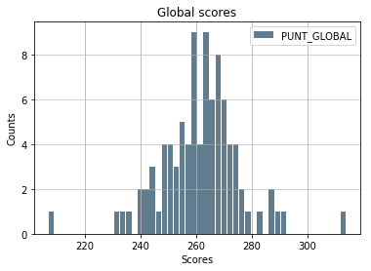
The Data
We use the following data from datos.gob.co:
Schools location
ICFES score average by school
And get the nearby venues categories from Foursquare API

Slide 4

Results
The venues that have the higher impact in the score are the following, next to their correlation
Venue Category | Correlation
Car Wash | 0.145766066257
Chinese Restaurant | -0.0606510097239
Comfort Food Restaurant | -0.127732430463
Flea Market | -0.08288025501
Food | 0.0182476942593
Gastropub | 0.0590529981259
Gay Bar | -0.0117665688057
Roof Deck | 0.0896350974092
Shopping Plaza | 0.0896350974092
Wings Joint | -0.140851116428

Slide 5
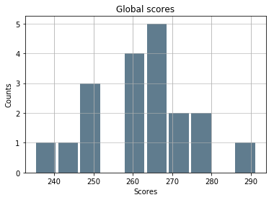
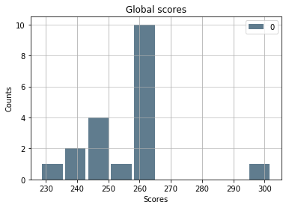
Results
The results of our model are the following
Mean Absolute Error | 17.2136571016
Mean Squared Error | 518.503733809
Root Mean Squared Error | 22.7706770608
Actual results
Predicted results

Slide 6
Discussion
Based on the results we can say that there is not any strong correlation between the venues categories and the average ICFES students’ scores, and that’s why the regression model has a high error, bigger than the standard deviation.
Therefore, we could recommend parents that they should look for other attributes of the school of their children and not for the venues nearby.

Slide 7
Conclusion
After analyzing the average scores of around one hundred schools in Bogotá, Colombia, we can conclude that, at least in the aforementioned city, there is no relationship between the category of the venues nearby a schools and the school’s student’s performance.

Slide 8

Thank You

