Slide 1
Sensitivity analysis of burnup performance and Pu mass balance by changing core and blanket fuel design of SFR for flexible Pu management options
International Conference on Nuclear Engineering, July 22th – 26th, 2018; London, UK
¹Rie Fujioka*, ¹Hiroshi Sagara and ¹Chi Young Han
¹Tokyo Institute of Technology, Tokyo, JAPAN
fujioka.r.ab@m.titech.ac.jp

Slide 2
Outline
Introduction
Methodologies of numerical neutronics analysis
Fundamental characteristics of the FRs for two Pu management options
FR core design for rapid reduction of separated Pu
Mass balance and non-proliferation features
Conclusions

Slide 3
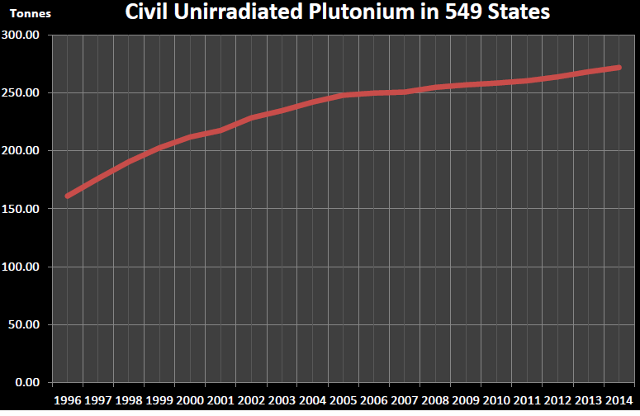
Separated Pu concern and countermeasure
Separated Pu concern for proliferation
Total amount of civil unirradiated Pu in 10 countries¹
Proper balance would be strongly desired to reduce the potential nuclear proliferation concerns by states or non-state actors.
275 t of separated Pu in 2014
¹ Albright D, etc. Civil Plutonium Stocks Worldwide End of 2014. U.S. Institute for Science and International Security; 2015
Pu management option to alleviate proliferation concern
Separated Pu concern
Dilution
Separated Pu reduction
Secured storage
Physical requirement
Managerial requirement
Pu reduction by nuclear transmutation
Separated Pu conversion to an irradiated form
Previous study of FR design
This study of FR design
Notes:
In nuclear security and safeguards regulations [4, 5], the irradiation of the separated Pu in a nuclear reactor leads to a downgrade of the categories and potentially to an abatement of nuclear proliferation concerns.

Slide 4
Objectives
The fundamental characteristics of FRs for two Pu management options are evaluated.
Rapid conversion of separated Pu to an irradiated form
Pu reduction by nuclear transmutation
An innovative FR core design is proposed enabling rapid reduction of separated Pu, as well as presenting equivalent operation and safety performance of a typical FR.
Impact of the innovative FR core design is evaluated on mass balance and non-proliferation features.

Slide 5
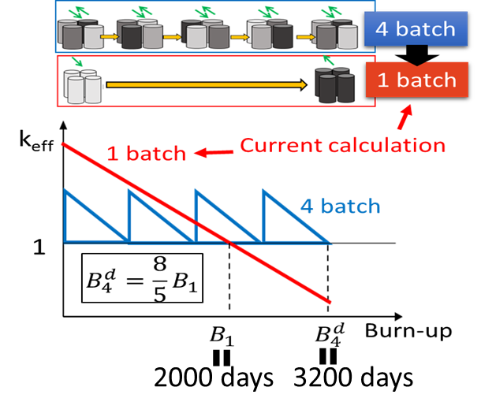
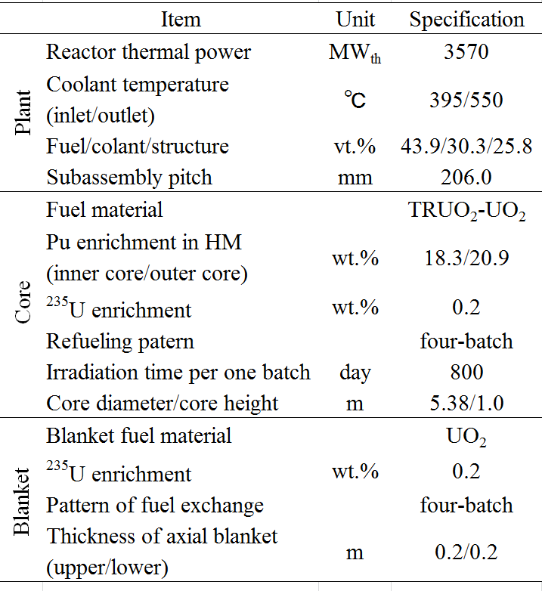
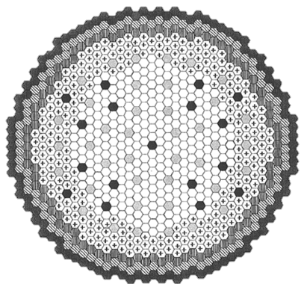
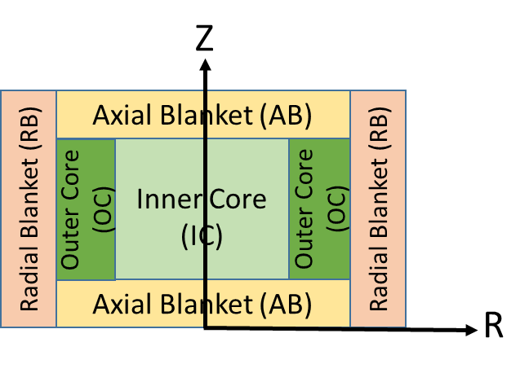
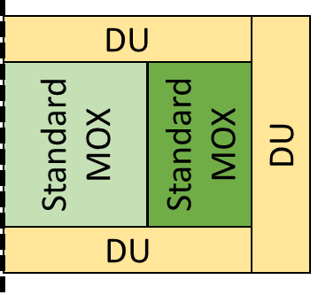
Calculation condition for reference FR (REF)
Core model
Japan sodium-cooled fast reactor (JSFR)
High internal conversion type²
Calculation method
Calculation tool：SLAROM-UF, JOINT-FR, CITATION
Cross section library：UFLIB-J4.0
Simplification: Simulating 4 batch burn-up by 1 batch³
Calculation condition²(REF)
Core model¹
Fuel TRU composition
Z
REF
² M. Naganuma, et al., JNC-TN9400 2005-051 (2005)
³ H.W. Graves, NUCLEAR FUEL MANAGEMENT, October 1983
Notes:
Demonstration reactor (FR)のことを言う

Slide 6
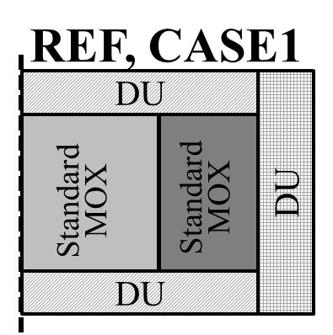
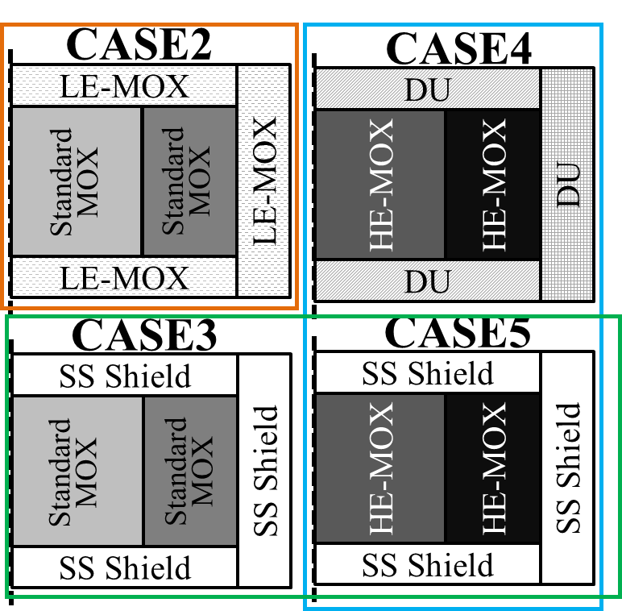
FR design for two Pu management options
1. Fundamental characteristics of FRs for two Pu management options
Rapid conversion of separated Pu to an irradiated form
Pu reduction by nuclear transmutation
High Pu loading amount
High Pu reduction ratio(ΔM_{Pu}/M_{Pu,BOC})
LE-MOX in the blanket
No fuel in the blanket
Core model
Fuel TRU composition of CASE1, 2, 3, 4
LE-MOX: Pu low-enriched MOX (5 wt.%)
HE-MOX: Pu high-enriched MOX (IC/OC=45.8/50.0 wt.%)
DU: Depleted Uranium
SS: Stainless Steel
HE-MOX in the core
Constant of heating power in core
Notes:
From two Pu management options, this study use two index.

Slide 7

Result: Pu mass balance features of 5 core designs
1. Fundamental characteristics of FRs for two Pu management options
CASE 5
CASE 2
CASE 4
CASE 3
CASE 1
Blanket: DU→LE-MOX
REF
Blanket: DU→SS Shielding
Core: standard MOX→HE-MOX
The highest Pu loading and Pu reduction ratio
A core design with the blanket fuel regions removed and a higher–enriched loading of MOX fuel in core regions

Slide 8
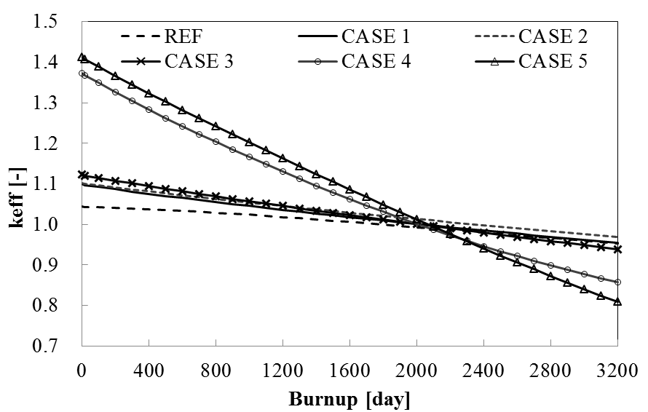
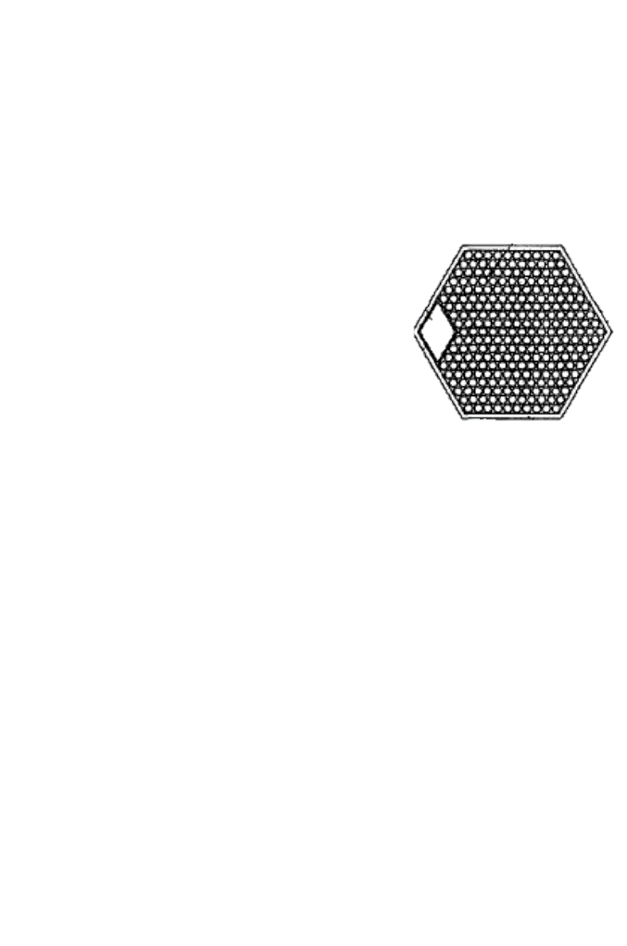
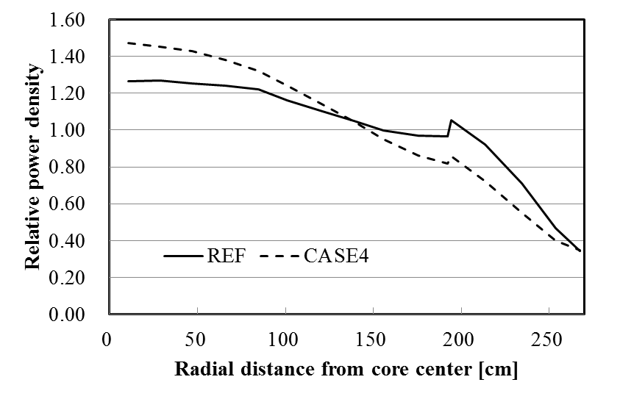
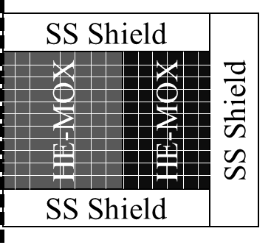
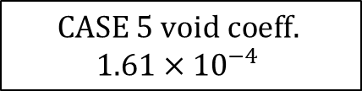


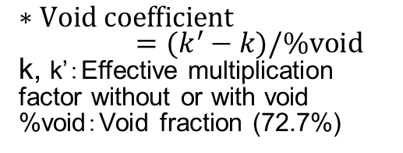
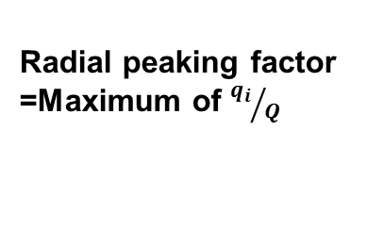
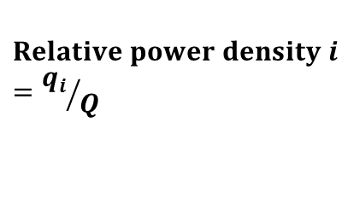

Result: Technical challenges in CASE 5
1. Fundamental characteristics of FRs for two Pu management options
Initial excess reactivity
Void reactivity
Gap
$$CASE 5 void coeff.$$
$$1.61×{10}^{−4}$$
33%
Void area
Inner duct
$$∗Void coefficient=(k^{′}−k)/\%void$$
k, k’：Effective multiplication factor without or with void
%void：Void fraction (72.7%)
Fuel assembly cross section
Higher initial excess reactivity than REF
Positive void reactivity
Power peaking factor
Radial peaking factor in REF: 1.27
Radial peaking factor in CASE5: 1.47
Average power density in entire core $Q$
$$Relative power density i$$
$$={q_{i}}/Q$$
$$i$$
Radial peaking factor =Maximum of ${q_{i}}/Q$
5
Average power density in $i$ line $q_{i}$
R
Higher peaking factor than REF

Slide 9
Core design goal for rapid reduction of separated Pu
2. FR core design for rapid reduction of separated Pu
Core design goal
Rapid separated Pu conversion to an irradiated form
Pu reduction by nuclear transmutation
FR core for rapid reduction of separated Pu
with equivalent operation and safety performance of REF
CASE 5: core design with removing the blanket fuel regions and loading higher-enriched MOX fuel in core regions
Technical challenges
Three approaches
High initial excess reactivity
Positive void reactivity
High peaking factor
The age impact of MOX fuel
Placement of gas plenum in the axial blanket
Pu enrichment zoning gradually dense in the outer core
Notes:
タイトルにcore designが入るように

Slide 10
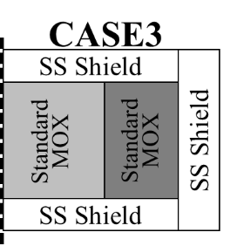
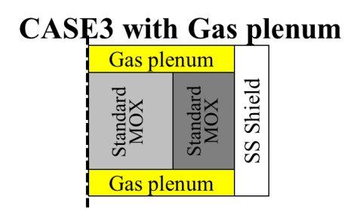

2. FR core design for rapid reduction of separated Pu
Result: The age impact of MOX fuel
2)Result: Placement of gas plenum in the axial blanket
High initial excess reactivity
Worse void reactivity
Use of separated Pu stored for a long term
(Reprocessing was started from 1960s) ⇒Increasing burnable poison of ²⁴¹Am
Replacement of gas plenum from SS shield in axial blanket
⇒Increasing neutron leakage
²⁴¹Pu($β$⁻,${ T}_{1/2}=14.3 y$)→ ²⁴¹Am
The effect of long storage fuel specification
21%
CASE 3
4.5% decrease
30%worse
CASE 3 with Gas plenum in the axial blanket
Pro. Low excess reactivity
Con. worse void reactivity
Improved void reactivity
Notes:
Worldwide, separated Pu has been produced from irradiated fuels by reprocessing since about the 1960s. Therefore, the separated Pu is assumed to be stored on long-term for 50 years after reprocessing and extracted from the irradiated fuels in Capture 3.

Slide 11
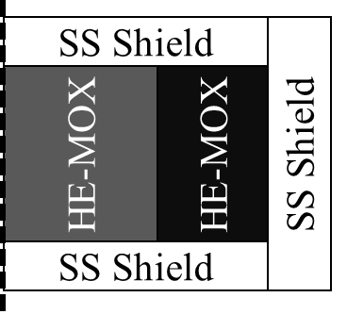
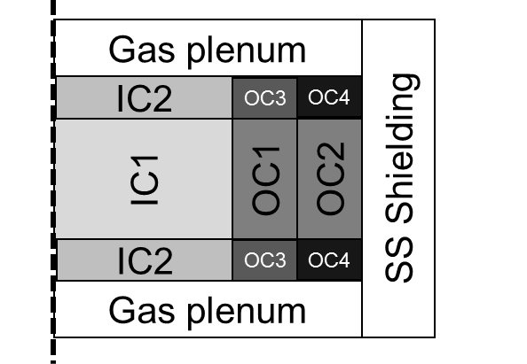
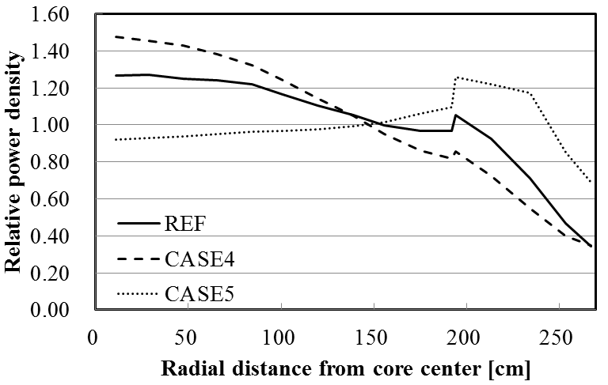
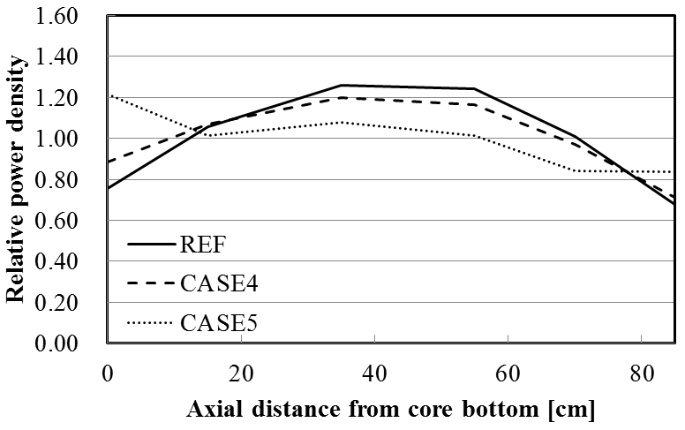
3) Result: Pu enrichment zoning gradually dense in the outer core
2. FR core design for rapid reduction of separated Pu
High peaking factor because of high power density in inner core
Pu enrichment zoning with a gradual increase in density in the outer core
Radial relative power density
Axial relative power density
Radial peaking factor
REF: 1.27
Proposed FR: 1.26
Axial peaking factor
REF: 1.27
Proposed FR: 1.26
5
5
Proposed FR
Proposed FR
R
Z
Power peaking factor equivalent to REF with high Pu enrichment
Notes:
出力密度が低い炉心外周部のPu富化度をピーキング係数が基本炉心程度の範囲内で増大

Slide 12
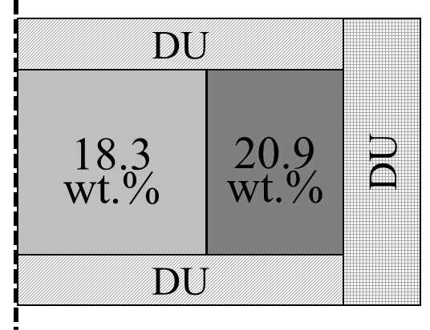
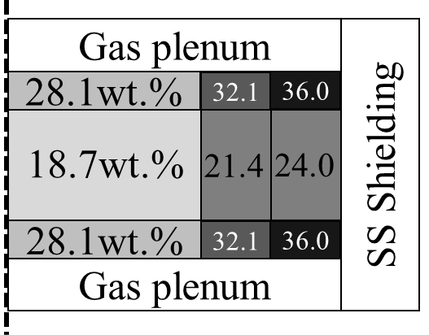
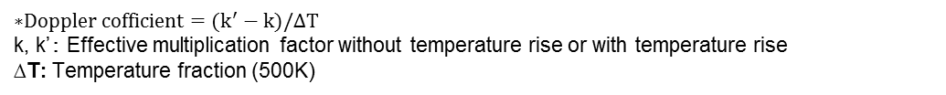
Summary of proposal FR core design for rapid reduction performance
2. FR core design for rapid reduction of separated Pu
REF
Proposed FR
MOX fuel after 5 years from reprocessing
MOX fuel after 50 years from reprocessing
Characteristics of REF and proposed FR
Proposed FR
initial 17.5 t Pu loading
0.17 Pu reduction ratio
&
Equivalent operation and safety performance of a typical FR
$$\text{∗}Doppler cofficient=(k^{′}−k)/∆T$$
k, k’： Effective multiplication factor without temperature rise or with temperature rise
∆T: Temperature fraction (500K)
Notes:
6分50秒

Slide 13
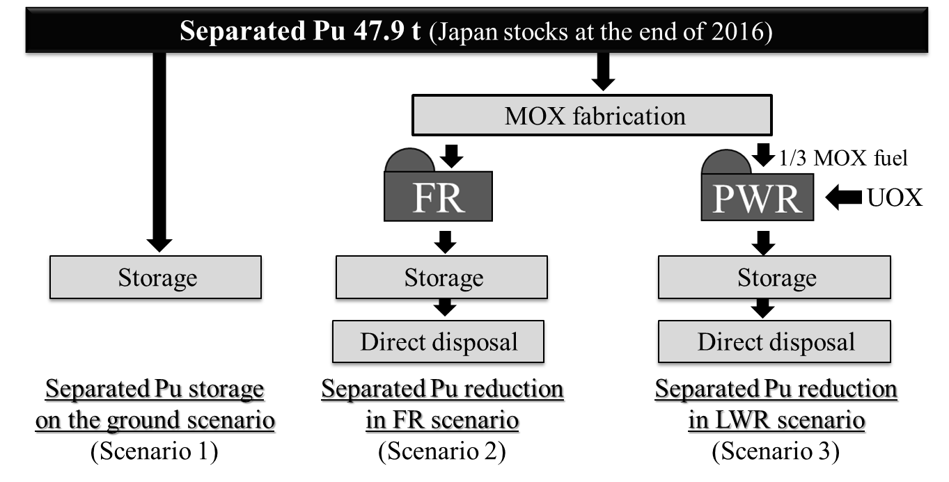
Comparison of Pu management scenario
3. Mass balance and non-proliferation features
Proposed FR
Standard PWR
MOX powder from in container

Slide 14
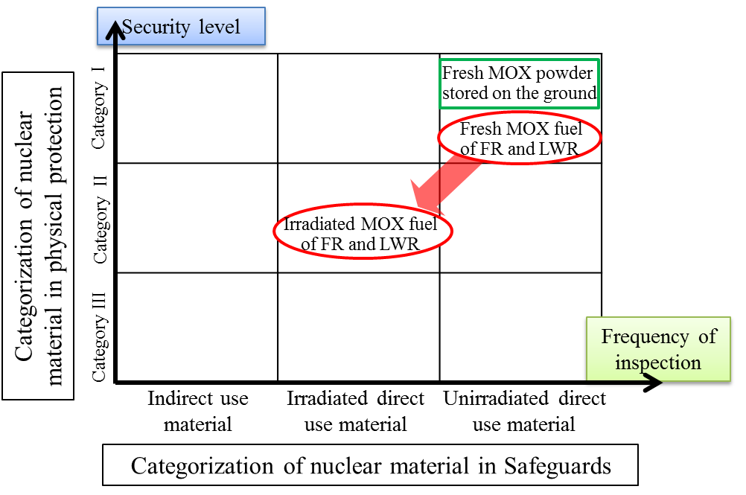
Result: Mass balance and non-proliferation features
3. Mass balance and non-proliferation features
Mass balance feature
Non-proliferation feature
(Nuclear material attractiveness)
47.9 t separated Pu (equivalent in Japan)
Pu reduction time
Long storage
One unit of
FR
One unit of PWR
N/A
19.5 y
86.5 y
Shorter by 1/5th
The Categories of MOX fuel irradiated in the FR or the LWR were downgraded in 1-step and the same as those of conventional spent nuclear fuel that exists abundantly worldwide.

Slide 15
Conclusions
The fundamental characteristics of FRs for two Pu management options were clarified;
A core design with the blanket fuel regions removed and a higher–enriched loading of MOX fuel in core regions caused the highest Pu loading and Pu reduction ratio.
The innovative FR core design was proposed enabling high initial 17.5t Pu loading and 0.17 Pu reduction ratio, as well as presenting equivalent operation and safety performance as typical FR.
MOX fuel (including 47.9t Pu) irradiated in the innovative FR was the downgraded category within 19.5y and the same as those of conventional spent nuclear fuel that exists abundantly worldwide.

Slide 16
Thank you for your kind attention

Slide 17
Evaluation of fundamental characteristics of FRs for Pu loading and Pu reduction

Slide 18
FR core design for rapid reduction of separated Pu

Slide 19
Impact of the innovative FR core on mass balance and non-proliferation

Slide 20
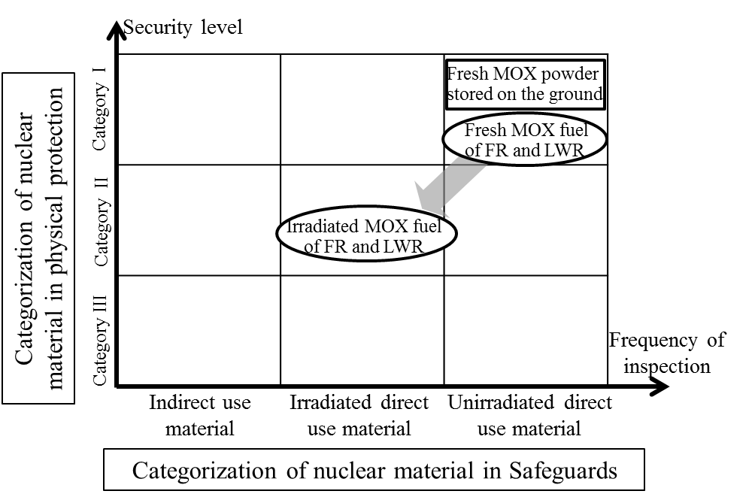

Mass balance and non-proliferation features
2. FR core design for rapid reduction of separated Pu
Mass balance feature
$∞$y by storage
Total accumulated weight of Actinides and FP in the irradiated MOX FA is 40% smaller than PWR.
47.9 t separated Pu equivalent in Japan
Pu reduction time
19.5 y by proposed FR
86.5 y by standard PWR
Non-proliferation feature
MOX fuel irradiated in the FR or the LWR was the downgraded category and the same as those of conventional spent nuclear fuel that exists abundantly worldwide.

Slide 21
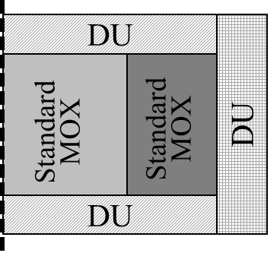
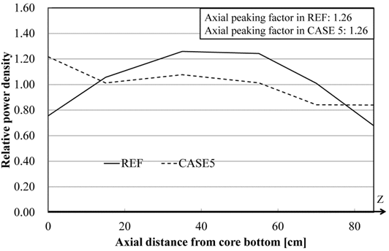
3) Pu enrichment zoning gradually dense in the outer core
2. FR core design for rapid reduction of separated Pu
CASE5
High peaking factor because of high power density in inner core
SS Shield
SS Shield
HE-MOX
HE-MOX
Pu enrichment zoning with a gradual increase in density in the outer core
SS Shield
Pros. Power peaking coeff. Same as Ref. core, Increasing Pu enrichment
Con. Large amount of excess reactivity
Notes:
出力密度が低い炉心外周部のPu富化度をピーキング係数が基本炉心程度の範囲内で増大

Slide 22
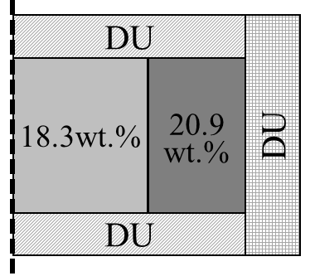
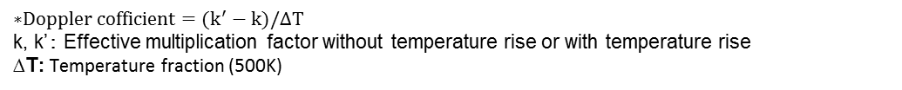
Result of proposal FR for rapid reduction
2. FR core design for rapid reduction of separated Pu
REF
LCFR core
Fuel:
MOX fuel after 5 years from reprocessing
Fuel MOX fuel after 50 years from reprocessing
Items
Ref. core
LCFR core
Pu enrichment
[wt.%]
Amount of Pu loading
14t → 17.2t
Average
&
Pu amount in all core [t]
Axial peaking coefficient (BOC)
Radial peaking coefficient (BOC)
Reactivity coefficient and controllability is same as Ref. core
Initial excess reactivity (CR can control until 1.07)
Void coefficient (BOC)
*
*Doppler coefficient (BOC)
(Core design by JAEA）
$$\text{∗}Doppler cofficient=(k^{′}−k)/∆T$$
k, k’： Effective multiplication factor without temperature rise or with temperature rise
∆T: Temperature fraction (500K)
Notes:
6分50秒

Slide 23
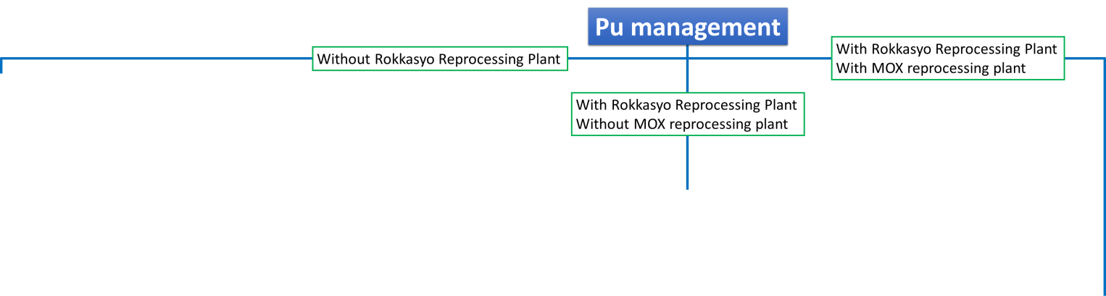
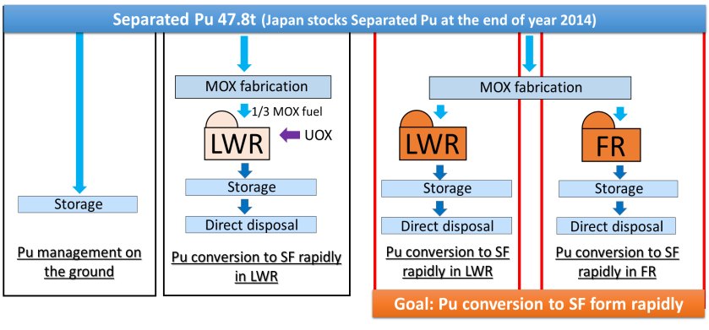
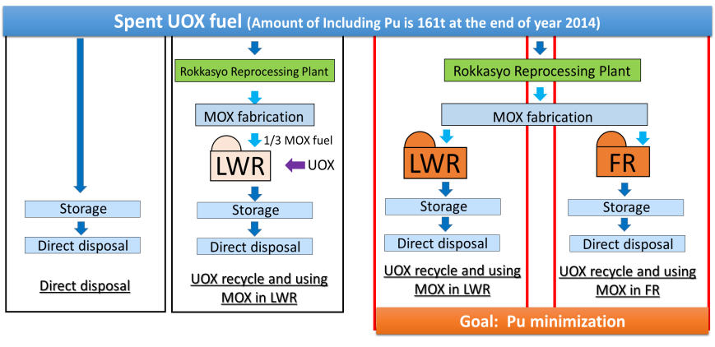
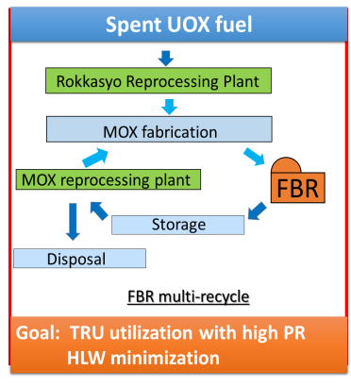
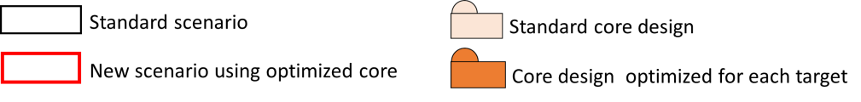
Chap.2 Pu management scenarios
(Focus on Japan case)
Short term scenario
Middle term scenario
(Without Rokkasyo Reprocessing plant)
With Rokkasyo Reprocessing plant
Without MOX reprocessing
Long term scenario
Issue: Separated Pu 47.8t
With MOX reprocessing
Continuation to use nuclear power
Issue: Large amount of Pu in Spent fuel
Separated Pu conversion to SF rapidly
Issue: Large amount of Pu utilization in fuel cycle
Pu minimization in SF
TRU utilization with high PR HLW minimization
Notes:
Fast I decided Pu management scenarios. In Japanese government nuclear policy, they selected TBR multi-recycle finally. But after fukusima accident, All nuclear power plants were stopped and now few NPP were restarted. So Nuclear policy is not clear. So I extracted the possible 3 background situations. Fast……., second……, third……..
From these, I decided 3 targets and scenarios.

Slide 24
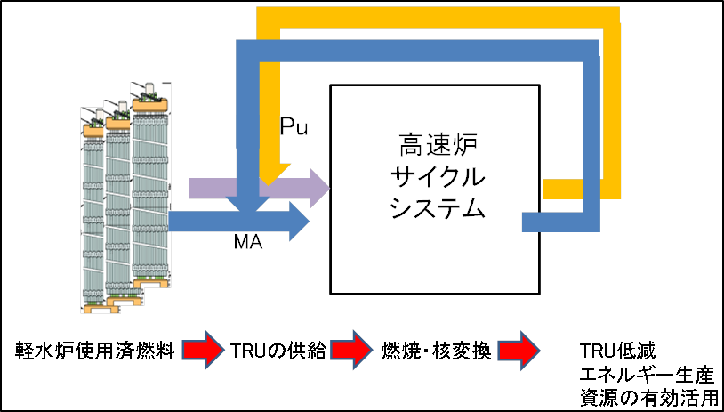
Three Pu management targets
Separated Pu conversion to an irradiated form downgrading its category required from nuclear security and safeguards regulationsｖ
Methods of decreasing non-proliferation concern of Pu
Separated Pu
Pu stock in spent fuel
Rapid conversion of separated Pu to an irradiated form
Pu reduction by nuclear transmutation
Fast spectrum reactors for Pu management
Due to the high performance of neutron economy in fast spectrum reactors, it has technical margins of core designing to respond to the social demands of Pu burning/sustaining flexibly.
Notes:
どうしてこの３つのPu management targetを選んだのか、これをどうしてFRの炉心で達成しようとするのかをイントロで書きたい
FRの理由
Due to the high performance of neutron economy in fast spectrum reactors, it has technical margins of core designing to respond to the social demands of Pu burning/sustaining flexibly.

Slide 25
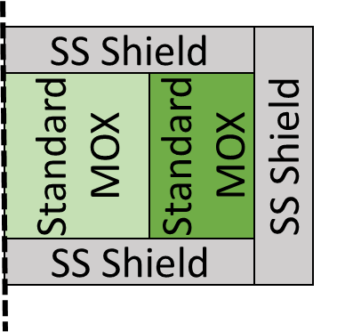


3) Pu enrichment zoning gradually dense in the outer core
2. FR core design for rapid reduction of separated Pu
Low power density
Increase Pu enrichment
（Peaking coeff. same as Ref. core)
Power peaking coeff.
Power peaking coeff.
Ref. core
Base core：before fitting enrichment
Base core：after fitting enrichment
Ref. core
Base core：before fitting enrichment
Base core：after fitting enrichment
Upper
Lower
Center
Outer
Power density ratio distribution in the Axial direction (BOC)
Power density ratio distribution in the Radial direction (BOC)
Pros. Power peaking coeff. Same as Ref. core, Increasing Pu enrichment
Con. Large amount of excess reactivity
Notes:
出力密度が低い炉心外周部のPu富化度をピーキング係数が基本炉心程度の範囲内で増大

Slide 26
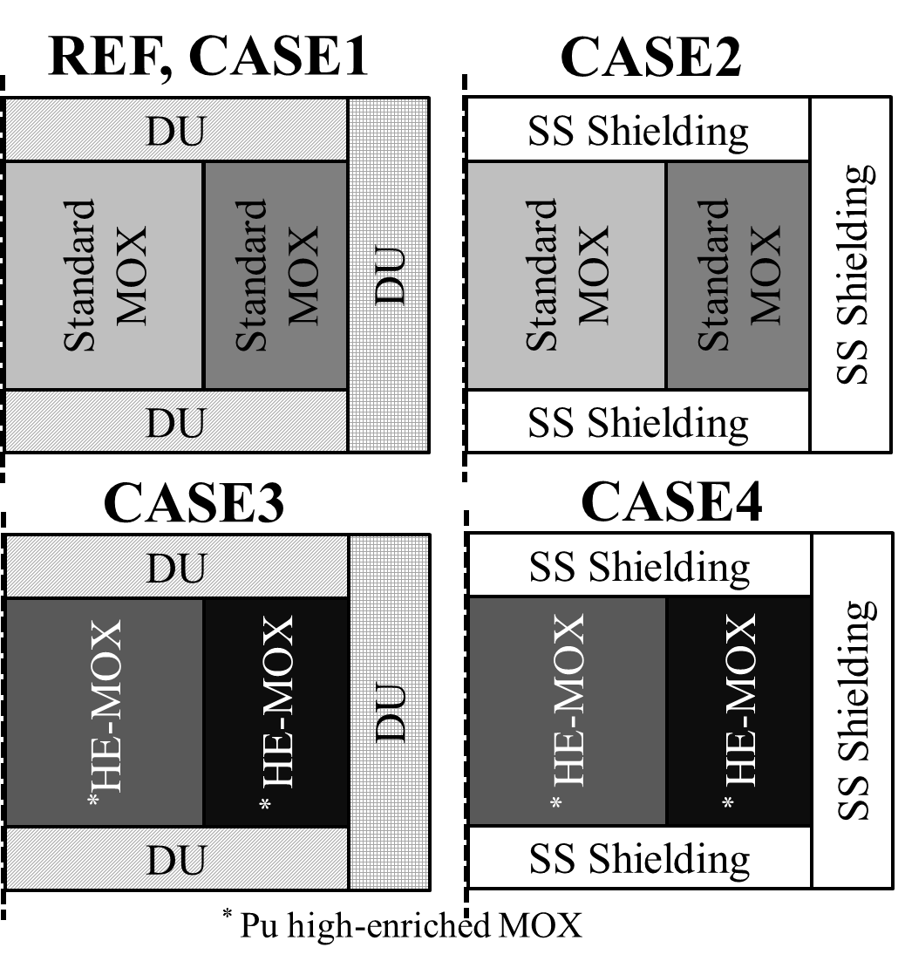
7 core design for for two Pu management options
1 Fundamental characteristics of FRs
Constant of heating power in core
Core model
No fuel in the blanket
Z
HE-MOX in the core
HE-MOX: Pu high-enriched MOX
DU: Depleted Uranium SS: Stainless Steel

Slide 27
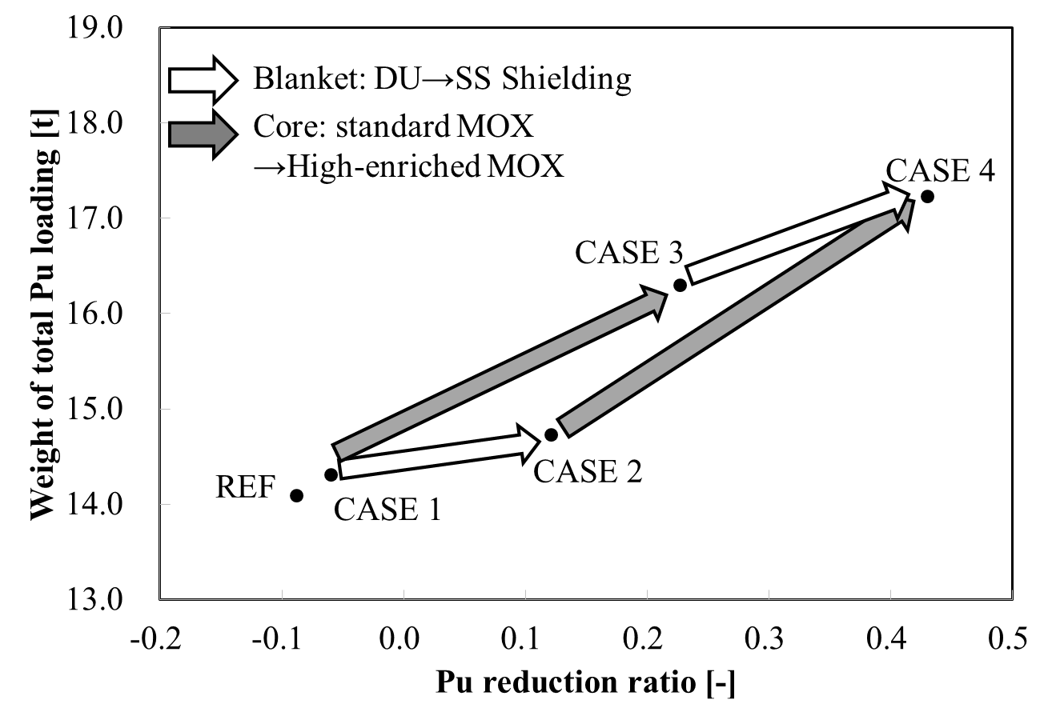
Pu mass balance features of 5 core designs
1 Fundamental characteristics of FRs
The highest Pu loading and Pu reduction ratio
A core design with the blanket fuel regions removed and a higher–enriched loading of MOX fuel in core regions

Slide 28
CASE2
CASE4
SS Shield
SS Shield
LE-MOX
LE-MOX
DU
DU
HE-MOX
HE-MOX
HE-MOX
HE-MOX
Standard MOX
Standard MOX
SS Shield
LE-MOX
DU
REF, CASE1
CASE3
CASE5
DU
DU
SS Shield
SS Shield
SS Shield
SS Shield
HE-MOX
HE-MOX
Standard MOX
Standard MOX
Standard MOX
Standard MOX
DU
SS Shield
SS Shield
CASE3 with Gas plenum
CASE 5
IC2
Gas plenum
SS Shield
Gas plenum
SS Shielding
OC3
OC4
Standard MOX
Standard MOX
IC1
OC1
OC2
IC2
Gas plenum
OC3
OC4
Gas plenum

Slide 29
DU
DU
28.1wt.%
Gas plenum
SS Shielding
32.1
36.0
18.3
wt.%
20.9
wt.%
18.7wt.%
21.4
24.0
28.1wt.%
32.1
36.0
DU
Gas plenum

Slide 30
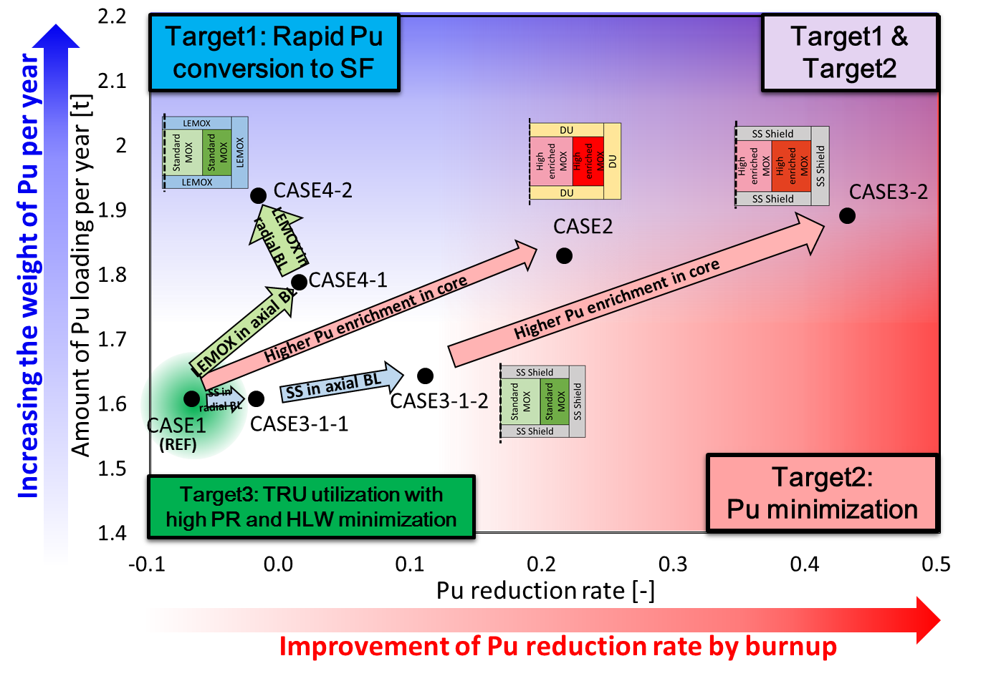
Pu mass balance features of 7 core design
1 Fundamental characteristics of FRs
Target1: Rapid separated Pu conversion
Target2:
Pu reduction
High Pu enrichment in core: Good for Rapid Pu conversion to SF and Pu minimization
SS in BL: Good for Pu minimization
Low Pu enrichment in BL: Good for Rapid Pu conversion to SF

Slide 31
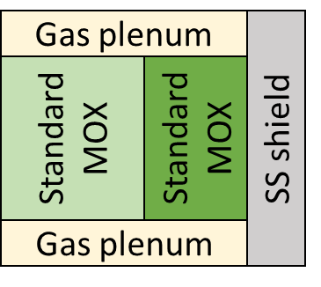
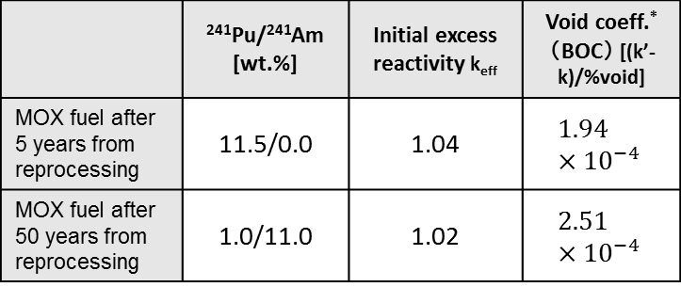
2 FR core design for rapid reduction of separated Pu
1) the age impact of MOX fuel
2) Placement of gas plenum in the axial blanket
Issue in ①: High excess reactivity
Issue in ②: worse void coeff.
Countermeasure
Countermeasure
Use of separated Pu stored for a long term ⇒²⁴¹Am decrease excess reactivity
Axial SS shield is replaced to Gas plenum
⇒Increasing neutron leakage
The effect of change fuel specification
 | ²⁴¹Pu/²⁴¹Am [wt.%] | Initial excess reactivity k_{eff} | Void coeff.* （BOC） [(k’-k)/%void]
MOX fuel after 5 years from reprocessing | 11.5/0.0 | 1.04 | $$1.94×{10}^{−4}$$
MOX fuel after 50 years from reprocessing | 1.0/11.0 | 1.02 | $$2.51×{10}^{−4}$$
Void generated in core and blanket
About 26%
Gap
Void area
Base core
Inner duct
Base core with using Gas plenum
2.2% decrease
30%worse
Fuel assembly cross section
Void coefficient
Pro. Low excess reactivity
Con. worse void coeff.
Improved void coeff.
$$\text{∗}Void coefficient=(k^{′}−k)/\%void$$
k, k’：Effective multiplication factor without void or with void %void：Void fraction (72.7%)

Slide 32
Security level
Fresh MOX powder stored on the ground
Category I
Fresh MOX fuel of FR and LWR
Categorization of nuclear material in physical protection
Category II
Irradiated MOX fuel of FR and LWR
Category III
Frequency of inspection
Indirect use material
Irradiated direct use material
Unirradiated direct use material
Categorization of nuclear material in Safeguards

