Slide 1
widgets.TextInput
filter_text_intput
widgets.Button
filter_button
layout.Column
filter_panel
widgets.MultiSelect
filter_sex
widgets.MultiSelect
filter_passenger_class
layout.Row
(“Root”)
widgets.MultiSelect
filter_survived
pane.Matplotlib
age_boxplot_panel
pane.Matplotlib
passenger_by_class_panel
layout.Column
data_visualization_panel
layout.Row
pane.Matplotlib
ages_hist_panel
widgets.DataFrame
df_panel
pane.Matplotlib
survivors_by_gender_and_class_panel

Slide 2
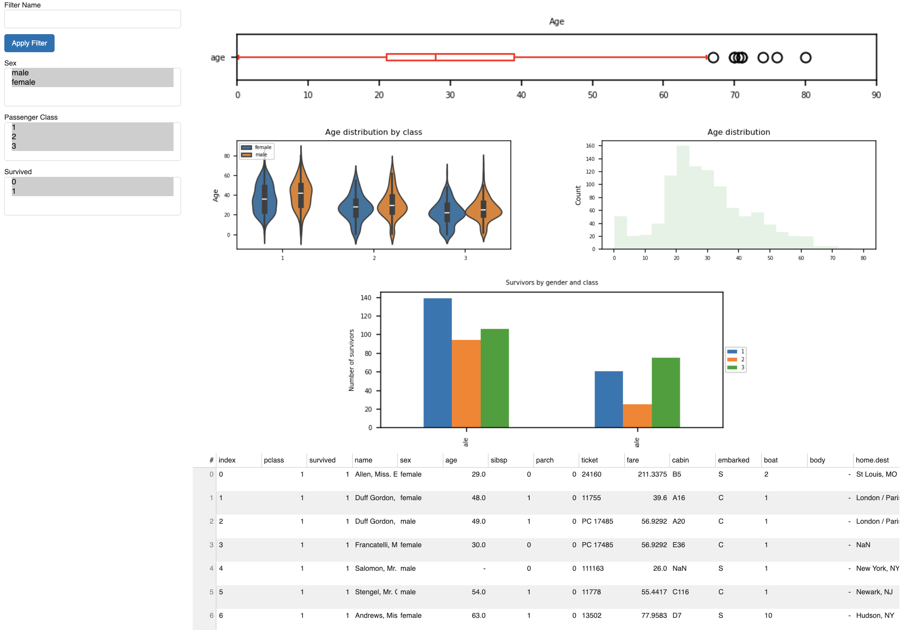

Slide 3
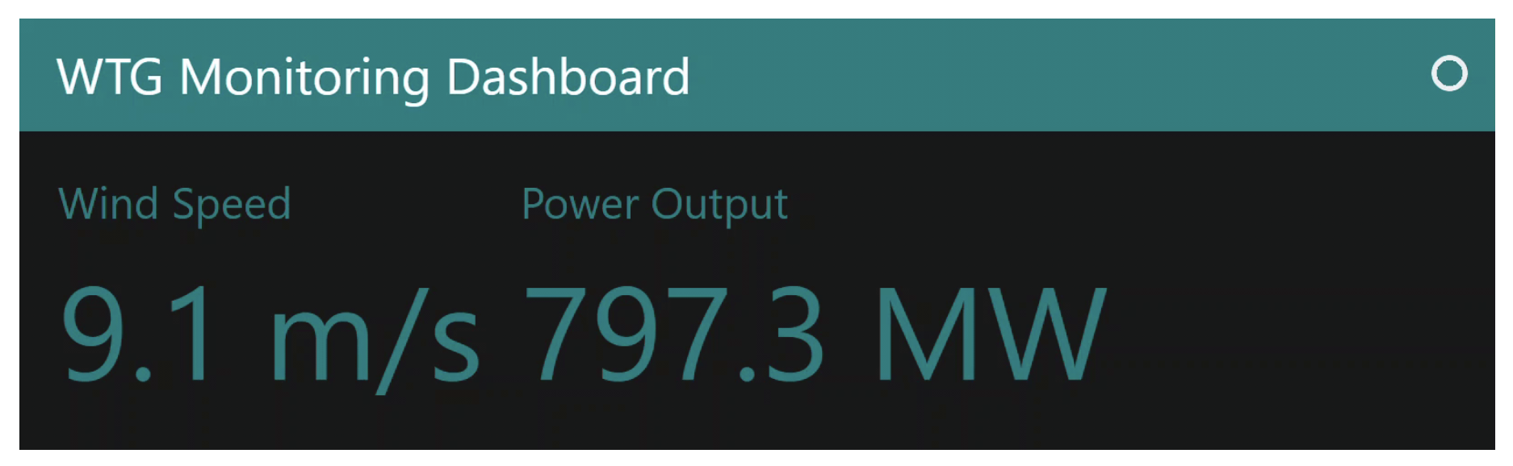

Slide 4
