Slide 1
Calculus of Variations Approach to Social Distancing

Slide 2
## Loading required package: ggplot2
## Loading required package: viridis
## Loading required package: viridisLite
## Loading required package: ggthemes
## Loading required package: rootSolve
## Loading required package: latex2exp
## Loading required package: ggrepel
## ## Attaching package: 'dplyr'
## The following objects are masked from 'package:stats': ## ## filter, lag
## The following objects are masked from 'package:base': ## ## intersect, setdiff, setequal, union
## Loading required package: spam
## Spam version 2.10-0 (2023-10-23) is loaded. ## Type 'help( Spam)' or 'demo( spam)' for a short introduction ## and overview of this package. ## Help for individual functions is also obtained by adding the ## suffix '.spam' to the function name, e.g. 'help( chol.spam)'.
## ## Attaching package: 'spam'
## The following objects are masked from 'package:base': ## ## backsolve, forwardsolve
## ## Try help(fields) to get started.
## ## Attaching package: 'Bolstad2'
## The following object is masked from 'package:fields': ## ## describe
## ## Attaching package: 'gridExtra'
## The following object is masked from 'package:dplyr': ## ## combine
## ## Attaching package: 'cowplot'
## The following object is masked from 'package:ggpubr': ## ## get_legend
## The following object is masked from 'package:ggthemes': ## ## theme_map
d <- rbind(multR015,multR03,multR045,multR06)
d <- d %>% mutate(finalEpi = 1-s, distCost = Cost-finalEpi, scaledDistCost = distCost/c)
f <- function(x,R0){exp(-R0*(1-x))-x}
Sinf1.5 <- multiroot.1D(f=f,start = .5,nspec= 1,R0=1.5)[["root"]] S1.5max <- 1/1.5
aux$c[aux$c == 0.025] <- "Suppression" aux$c[aux$c == 0.4] <- "Mitigation (Herd Immunity)" require(tidyr)
## Loading required package: tidyr
## ## Attaching package: 'tidyr'
## The following object is masked from 'package:reshape2': ## ## smiths
aux$c[aux$c == 0.025] <- "Suppression" aux$c[aux$c == 0.4] <- "Mitigation (Herd Immunity)" x <- seq(0.01,1,.01) y <- -log(x)+x-1 p <- as.data.frame(cbind(x,y)) g <- ggplot(p,aes(x=x,y=y))+geom_line()+theme_bw()+scale_x_continuous(breaks = c(0,.2,.4,.6,.8,1),labels = c(0, "0.2","0.4","0.6","0.8","1"))+xlab("RD")+ylab("g(x)")+xlab("x")+scale_y_continuous(breaks= c(0,1,2,3),labels = c(0, "1", "2","3")) g

Slide 3
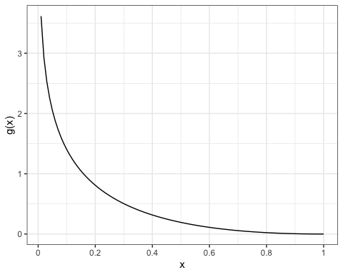

Slide 4
ann_text <- data.frame(tau=c(45,40),value = c(S1.5max,Sinf1.5),label=c("Max Suceptibles\n for Herd Immunity","Suceptibles Remaining in \n an Uncontrolled Epidemic"),key=c("s","s"),c=c("Mitigation","Mitigation")) g1 <- ggplot(aux.long[aux.long$key %in% c("i","s"),], aes(x = tau,y = value,linetype=key))+geom_line()+xlab(TeX(r'($\tau$)'))+scale_y_continuous(limits = c(0,1))+facet_grid(.~c)+ylab("Proportion of Population")+geom_hline(yintercept=Sinf1.5,linetype="dashed",color="red")+geom_hline(yintercept=S1.5max,linetype="dashed",color="red")+scale_linetype(name="",labels=list(TeX(r'($i$)'),TeX(r'($s$)')))+geom_label(data=ann_text,aes(label=label),size=2.2,label.size = .1,label.padding=unit(.1,"lines"),label.r = unit(.1,"lines"))+theme(legend.position = "bottom") #+annotate("label",x=40,y=Sinf1.5,label="Suceptibles Remaining in \n an Uncontrolled Epidemic")+annotate("label",x=50,y=S1.5max,c="Mitigation",label="Max Suceptibles\n for Herd Immunity") g1

Slide 5
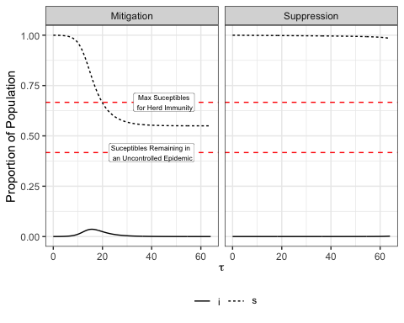

Slide 6
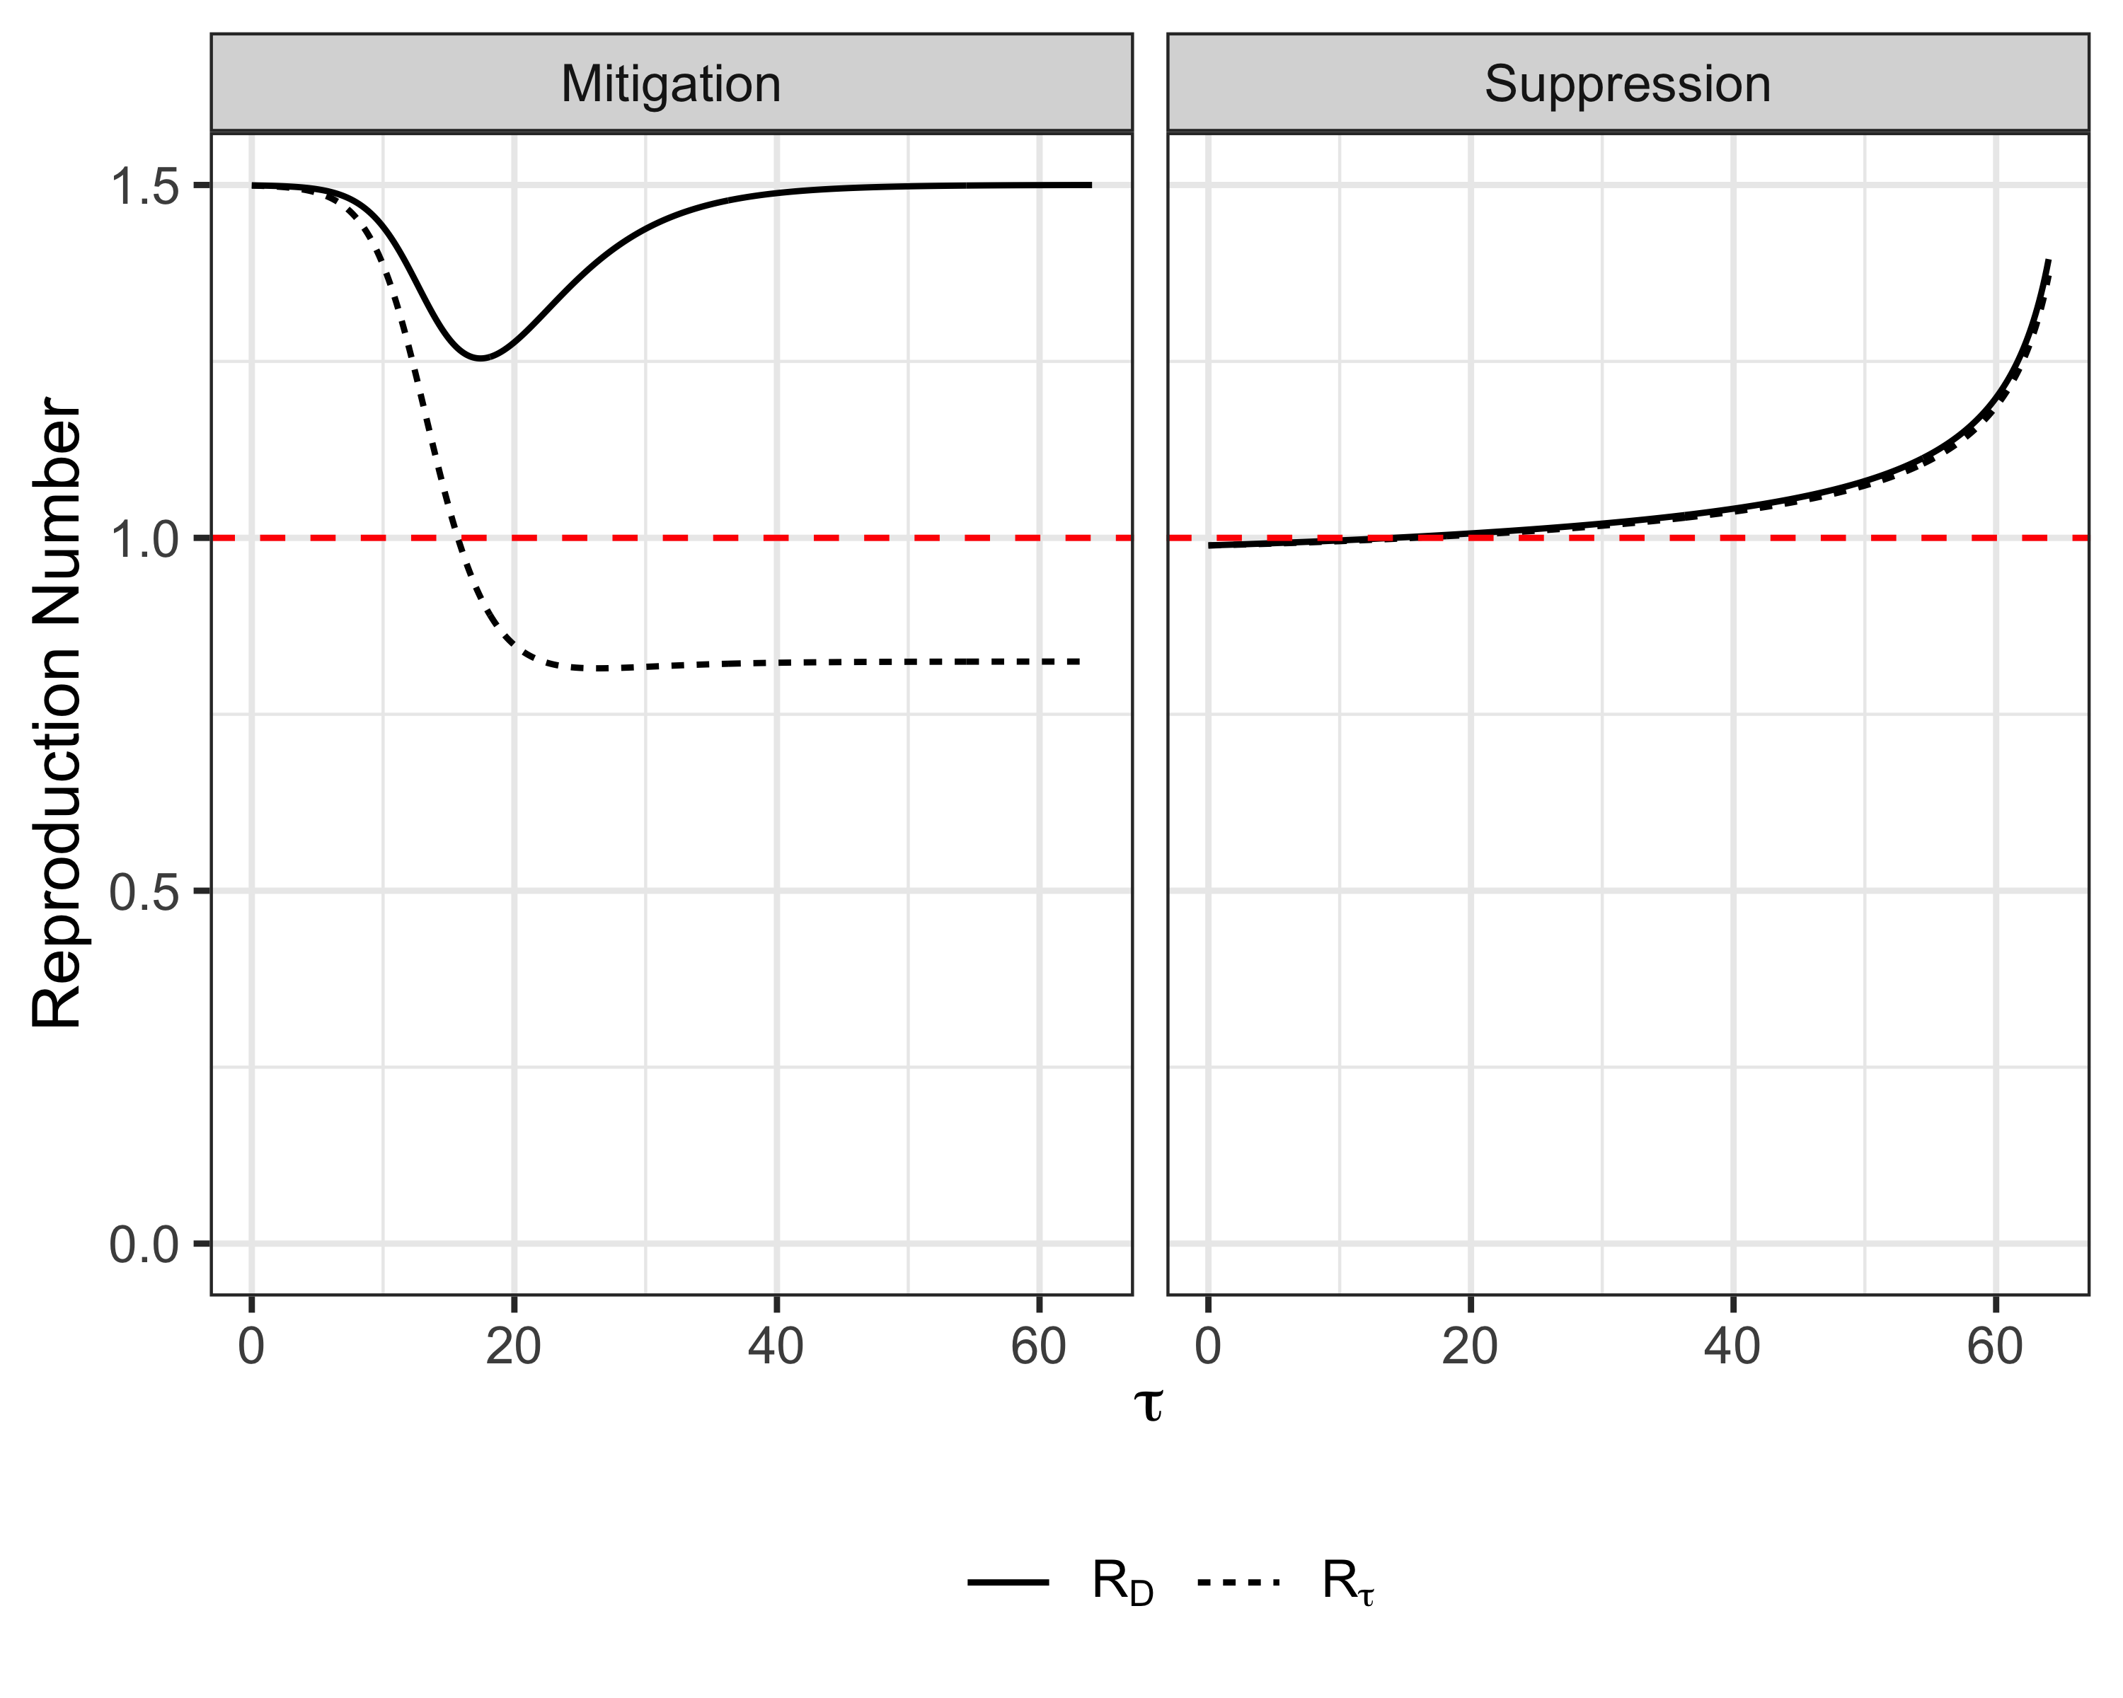

Slide 7
tFinal.vec <- seq(12,80,by=4) g3 <- d %>% filter(tau == tFinal & is.min == TRUE & tFinal %in% tFinal.vec& R0 %in% c(1.5,3,4.5)) %>% mutate(lab="Initial Outbreak",lab2 = "R0") %>% ggplot(mapping= aes(x = tFinal, y = c,fill=finalEpi)) + geom_tile() + scale_fill_viridis_c(name="Final\nEpidemic\nSize")+xlab(TeX(r'($\tau_{final}$)'))+theme(legend.position = "bottom")+facet_wrap(.~ as.factor(i0))+facet_grid(as.factor(i0)~as.factor(R0))+ylab(TeX(r'($c$)'))+facet_nested(lab+as.factor(i0)~lab2+as.factor(R0))+theme(legend.position = "bottom") g3

Slide 8
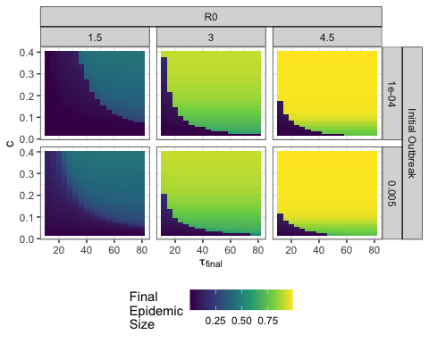

Slide 9
d_cost <- d %>% filter(tau == tFinal & is.min == TRUE & tFinal %in% tFinal.vec& R0 %in% c(1.5,3,4.5))
tFinal.vec <- seq(12,80,by=4) g4 <- d %>% filter(tau == tFinal & is.min == TRUE & tFinal %in% tFinal.vec& R0 %in% c(1.5,3,4.5)) %>% mutate(lab="Initial Outbreak",lab2 = "R0") %>% ggplot(mapping= aes(x = tFinal, y = c,fill=Cost)) + geom_tile() + scale_fill_viridis_c(name="Total\nCost",option="A")+xlab(TeX(r'($T_{final}$)'))+theme(legend.position = "bottom")+facet_wrap(.~ as.factor(i0))+facet_grid(as.factor(i0)~as.factor(R0))+ylab(TeX(r'($c$)'))+facet_nested(lab+as.factor(i0)~lab2+as.factor(R0))+theme(legend.position = "bottom") g4

Slide 10
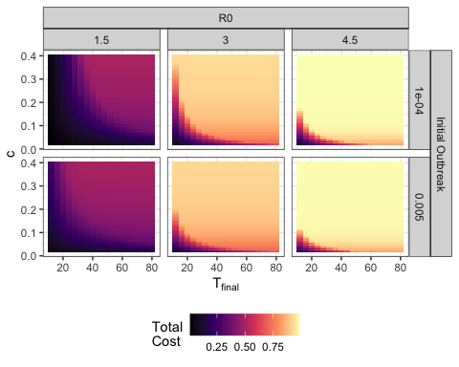

Slide 11
my_cost <- read.csv("INTERMEDIATE/myopic_with_cost.csv") my_cost$my_cost <- my_cost$cost my_cost$cost <- NULL my_cost$split.var <- NULL my_cost$X <- NULL my_cost$total.epi.myopic <- my_cost$total.epi my_cost$total.epi <- NULL
merged <- merge(my_cost,d_cost) merged$ratio <- merged$my_cost/merged$Cost merged$cost.diff <- merged$my_cost-merged$Cost dim(merged)
## [1] 2338 28
merged.long <- pivot_longer(merged,cols=c("finalEpi","total.epi.myopic")) merged.long$name[merged.long$name=="finalEpi"] <- "KTH Policy" merged.long$name[merged.long$name=="total.epi.myopic"] <- "Myopic\nPolicy" g2a <- merged.long %>% mutate(lab2="R0") %>% ggplot(mapping= aes(x = tFinal, y = c,fill=value,z=value)) + geom_tile() + scale_fill_viridis(name="Final\nEpidemic\nSize")+xlab(TeX(r'($T_{final}$)'))+theme(legend.position = "bottom")+facet_nested(name~lab2+as.factor(R0))+ylab(TeX(r'($c$)'))+ggtitle("(a) Infection Cost\n(Final Epidemic Size)") g2a

Slide 12
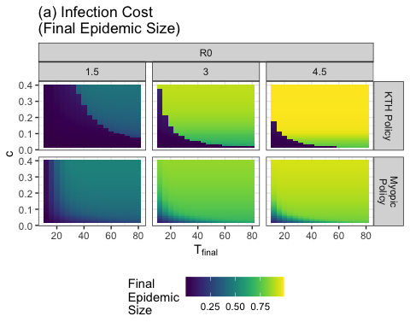

Slide 13
library(colorspace) merged$epi.diff <- merged$total.epi.myopic-merged$finalEpi g2b <- merged %>% mutate(lab="Initial Outbreak",lab2 = "R0") %>% ggplot(mapping= aes(x = tFinal, y = c,fill=epi.diff)) + geom_tile() + scale_fill_continuous_divergingx(palette = 'PuOr', mid = 0,name="Infection\nCost\nDifference\n(Myopic-KTH)")+ xlab(TeX(r'($T_{final}$)'))+theme(legend.position = "bottom")+facet_grid(.~as.factor(R0))+ylab(TeX(r'($c$)'))+facet_nested(.~lab2+as.factor(R0))+theme(legend.position = "bottom")+ggtitle("(b) Infection Cost Difference") g2b

Slide 14
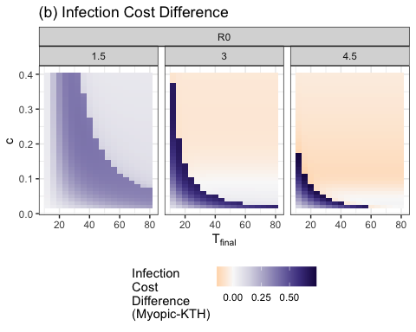

Slide 15
merged$distCost_myopic <- merged$my_cost-merged$total.epi.myopic merged$distDiff <- merged$distCost_myopic-merged$distCost merged.long2 <- pivot_longer(merged,cols=c("distCost","distCost_myopic")) merged.long2$name[merged.long2$name=="distCost"] <- "KTH Policy" merged.long2$name[merged.long2$name=="distCost_myopic"] <- "Myopic\nPolicy" g3a <- merged.long2 %>% mutate(lab="Initial Outbreak",lab2 = "R0") %>% ggplot(mapping= aes(x = tFinal, y = c,fill=value)) + geom_tile() + scale_fill_viridis_c(name="Total\nDistancing\nCost",option="c")+xlab(TeX(r'($T_{final}$)'))+theme(legend.position = "bottom")+facet_nested(name~lab2+as.factor(R0))+ylab(TeX(r'($c$)'))+theme(legend.position = "bottom")+ggtitle("(a) Distancing Cost")
## Warning in viridisLite::viridis(n, alpha, begin, end, direction, option): ## Option 'c' does not exist. Defaulting to 'viridis'.
g3a

Slide 16
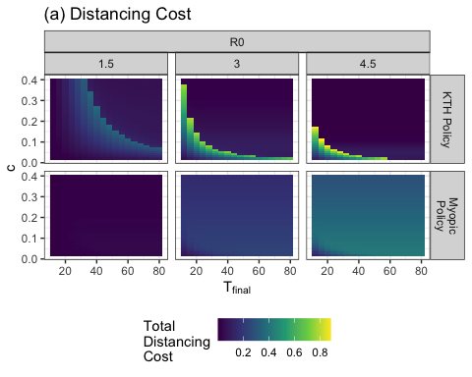

Slide 17
library(colorspace) g3b <- merged %>% mutate(lab="Initial Outbreak",lab2 = "R0") %>% ggplot(mapping= aes(x = tFinal, y = c,fill=distDiff)) + geom_tile() + scale_fill_continuous_divergingx(palette = 'PuOr', mid = 0,name="Distancing\nCost\nDifference\n(Myopic-KTH)")+ xlab(TeX(r'($T_{final}$)'))+theme(legend.position = "bottom")+facet_grid(.~as.factor(R0))+ylab(TeX(r'($c$)'))+facet_nested(.~lab2+as.factor(R0))+theme(legend.position = "bottom")+ggtitle("(b) Distancing Cost Difference") g3b

Slide 18
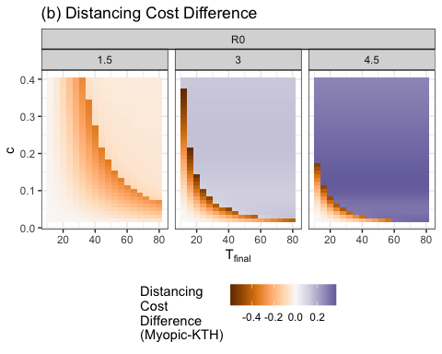

Slide 19
merged.long3 <- pivot_longer(merged,cols=c("Cost","my_cost")) merged.long3$name[merged.long3$name=="Cost"] <- "KTH Policy" merged.long3$name[merged.long3$name=="my_cost"] <- "Myopic\nPolicy" g4a <- merged.long3 %>% mutate(lab="Initial Outbreak",lab2 = "R0") %>% ggplot(mapping= aes(x = tFinal, y = c,fill=value)) + geom_tile() + scale_fill_viridis_c(name="Cost",option="c",limits=c(0,1.25),breaks=seq(0,1.25,by=.25),labels=seq(0,1.25,by=.25))+xlab(TeX(r'($T_{final}$)'))+theme(legend.position = "bottom")+facet_nested(name~lab2+as.factor(R0))+ylab(TeX(r'($c$)'))+ggtitle("(a) Total Cost")
## Warning in viridisLite::viridis(n, alpha, begin, end, direction, option): ## Option 'c' does not exist. Defaulting to 'viridis'.
g4a

Slide 20
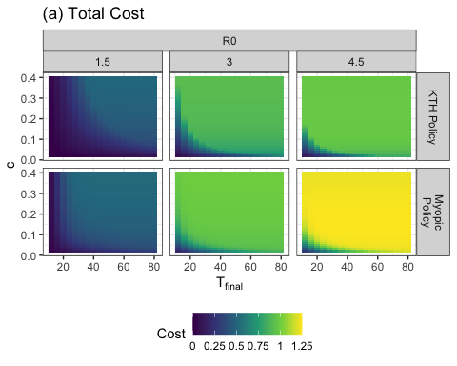

Slide 21
g4b <- merged %>% mutate(lab="Initial Outbreak",lab2 = "R0") %>% ggplot(mapping= aes(x = tFinal, y = c,fill=cost.diff)) + geom_tile() + scale_fill_viridis_c(name="Cost\nDifference\n(Myopic-KTH)",option="A")+xlab(TeX(r'($T_{final}$)'))+theme(legend.position = "bottom")+facet_grid(.~as.factor(R0))+ylab(TeX(r'($c$)'))+facet_nested(.~lab2+as.factor(R0))+theme(legend.position = "bottom")+ggtitle("(b) Cost Difference") g4b

Slide 22
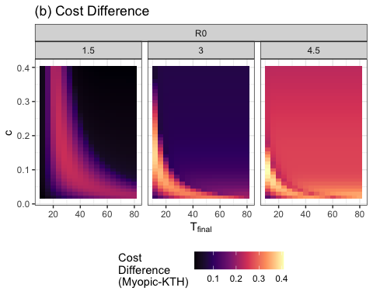

Slide 23
g5 <- merged %>% mutate(lab="Initial Outbreak",lab2 = "R0") %>% ggplot(mapping= aes(x = tFinal, y = c,fill=ratio)) + geom_tile() + scale_fill_viridis_c(name="Cost\nRatio",option="A")+xlab(TeX(r'($T_{final}$)'))+theme(legend.position = "bottom")+facet_grid(.~as.factor(R0))+ylab(TeX(r'($c$)'))+facet_nested(.~lab2+as.factor(R0))+theme(legend.position = "bottom") g5

Slide 24
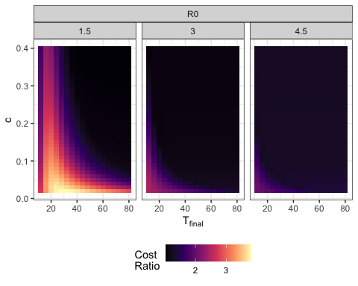

Slide 25
tFinal.vec <- seq(8,80,by=4) g <- d %>% filter(tau == tFinal & is.min == FALSE & tFinal %in% tFinal.vec) %>% mutate(finalEpi = 1-s) %>% ggplot(mapping= aes(x = tFinal, y = c,fill=finalEpi)) + geom_tile() + scale_fill_viridis_c(name="Final\nEpidemic\nSize")+xlab(TeX(r'($T_{final}$)'))+theme(legend.position = "bottom")+facet_grid(as.factor(i0)~as.factor(R0)) g

Slide 26
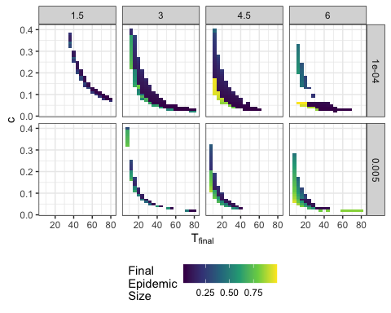

Slide 27
g <- d %>% filter(tFinal %in% c(44)&tFinal==tau&i0==0.0001&R0==1.5) %>% ggplot(mapping=aes(x=c,y=Cost,color=as.factor(tFinal))) + geom_point() g

Slide 28
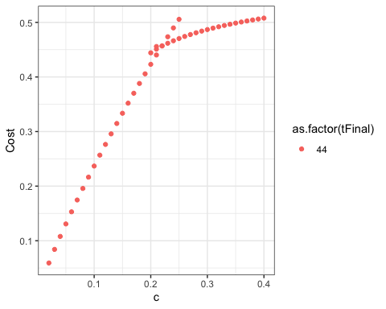

Slide 29
mult.sol <- d %>% filter(tFinal %in% c(40)&tFinal==tau&i0==0.0001&R0==1.5) %>% group_by(c,tFinal) %>% summarize(count=n()) %>% filter(count>1) %>% as.data.frame()
## `summarise()` has grouped output by 'c'. You can override using the `.groups` ## argument.
g <- d %>% filter(tFinal==tau&i0==0.0001&R0==1.5 &tFinal %in% tFinal.vec) %>% ggplot(mapping=aes(x=finalEpi,y=scaledDistCost,shape=is.min)) + geom_line(span=.1,aes(group=as.factor(tFinal)),size=.1)+geom_point(aes(color=c))+ scale_color_viridis_c(name="c")+geom_label_repel(aes(label=tFinal))
## Warning: Using `size` aesthetic for lines was deprecated in ggplot2 3.4.0. ## ℹ Please use `linewidth` instead. ## This warning is displayed once every 8 hours. ## Call `lifecycle::last_lifecycle_warnings()` to see where this warning was ## generated.
## Warning in geom_line(span = 0.1, aes(group = as.factor(tFinal)), size = 0.1): ## Ignoring unknown parameters: `span`
g
## Warning: ggrepel: 795 unlabeled data points (too many overlaps). Consider ## increasing max.overlaps

Slide 30
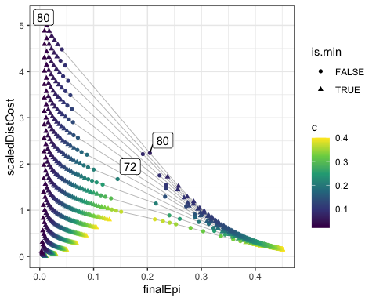

Slide 31
g <- d %>% filter(tFinal==tau&i0==0.0001&R0==1.5 &tFinal ==36) %>% ggplot(mapping=aes(x=finalEpi,y=scaledDistCost,shape=is.min)) +geom_point(aes(color=c))+ scale_color_viridis_c(name="Relative Cost\nof Social\nDistancing")+ylab("Total Distancing")+xlab("Proportion Infected")+scale_shape(name="Global Min\n(Given c)")+ggtitle("Pareto-Optimum") g

Slide 32
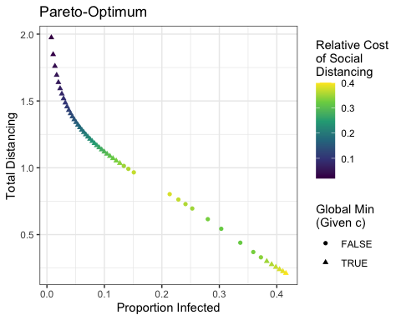

Slide 33
g <- d %>% filter(tFinal==tau&i0==0.0001&R0==1.5 &tFinal ==36) %>% ggplot(mapping=aes(x=finalEpi,y=scaledDistCost)) +geom_point()+ scale_color_viridis_c(name="Relative Cost\nof Social\nDistancing")+ylab("Distancing Cost\n(Arbitrary Units)")+xlab("Proportion Infected")+ggtitle("Pareto-Optimum") g

Slide 34
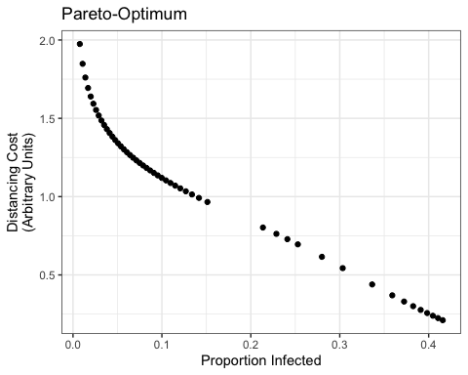

Slide 35
d %>% filter(tFinal==tau&i0==0.0001&R0==1.5 &tFinal ==36) %>% group_by(c)%>% summarise(count = n())
## # A tibble: 39 × 2 ## c count ## <dbl> <int> ## 1 0.02 1 ## 2 0.03 1 ## 3 0.04 1 ## 4 0.05 1 ## 5 0.06 1 ## 6 0.07 1 ## 7 0.08 1 ## 8 0.09 1 ## 9 0.1 1 ## 10 0.11 1 ## # ℹ 29 more rows
d1 <- d %>% filter(tFinal %in% c(44)&tFinal==tau&i0==0.0001&R0==1.5 & c %in% mult.sol$c) d1$costDiff <- d1$scaledDistCost - d1$finalEpi
mod <- lm(d1,formula = 'scaledDistCost~finalEpi') resid <- resid(mod) plot(d1$finalEpi,resid)

Slide 36
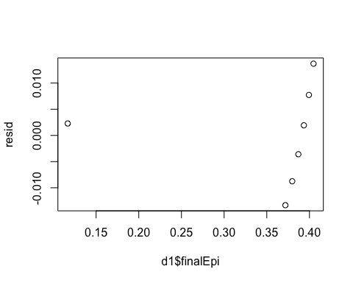

Slide 37
g <- d %>% filter(tFinal %in% c(40)&tFinal==tau&i0==0.0001&R0==1.5 & c %in% mult.sol$c) %>% ggplot(mapping=aes(x=finalEpi,y=distCost,size=is.min,color=as.factor(c))) + geom_point()+geom_abline(intercept=.45,slope=-1)+scale_alpha_discrete(range=c(0.5,1)) + scale_color_viridis_d(name="c")
## Warning: Using alpha for a discrete variable is not advised.
g
## Warning: Using size for a discrete variable is not advised.

Slide 38
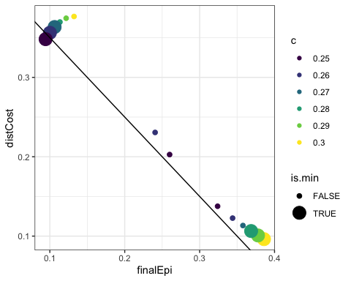

Slide 39
aux <- d %>% filter(tFinal %in% c(40)&tFinal==tau,i0==0.0001&R0==1.5) table(aux$c)
## ## 0.02 0.03 0.04 0.05 0.06 0.07 0.08 0.09 0.1 0.11 0.12 0.13 0.14 0.15 0.16 0.17 ## 1 1 1 1 1 1 1 1 1 1 1 1 1 1 1 1 ## 0.18 0.19 0.2 0.21 0.22 0.23 0.24 0.25 0.26 0.27 0.28 0.29 0.3 0.31 0.32 0.33 ## 1 1 1 1 1 1 1 3 3 2 2 2 2 1 1 1 ## 0.34 0.35 0.36 0.37 0.38 0.39 0.4 ## 1 1 1 1 1 1 1
g <- d %>% filter(tFinal %in% c(40)&i0==0.0001&c==0.27&R0==1.5) %>% ggplot(mapping=aes(x=tau,y=s,color=as.factor(case.id.c))) + geom_point() g

Slide 40
