Slide 1
Calculus of Variations Approach to Social Distancing

Slide 2
## Loading required package: ggplot2
## Loading required package: viridis
## Loading required package: viridisLite
## Loading required package: ggthemes
## Loading required package: rootSolve
## Loading required package: latex2exp
## ## Attaching package: 'dplyr'
## The following objects are masked from 'package:stats': ## ## filter, lag
## The following objects are masked from 'package:base': ## ## intersect, setdiff, setequal, union
## Loading required package: spam
## Spam version 2.10-0 (2023-10-23) is loaded. ## Type 'help( Spam)' or 'demo( spam)' for a short introduction ## and overview of this package. ## Help for individual functions is also obtained by adding the ## suffix '.spam' to the function name, e.g. 'help( chol.spam)'.
## ## Attaching package: 'spam'
## The following objects are masked from 'package:base': ## ## backsolve, forwardsolve
## ## Try help(fields) to get started.
## ## Attaching package: 'Bolstad2'
## The following object is masked from 'package:fields': ## ## describe
## Loading required package: arules
## Loading required package: Matrix
## ## Attaching package: 'Matrix'
## The following object is masked from 'package:spam': ## ## det
## ## Attaching package: 'arules'
## The following object is masked from 'package:dplyr': ## ## recode
## The following objects are masked from 'package:base': ## ## abbreviate, write
## Loading required package: egg
## Loading required package: gridExtra
## ## Attaching package: 'gridExtra'
## The following object is masked from 'package:dplyr': ## ## combine
## Loading required package: scales
## ## Attaching package: 'scales'
## The following object is masked from 'package:viridis': ## ## viridis_pal
## Loading required package: cowplot
## ## Attaching package: 'cowplot'
## The following object is masked from 'package:ggthemes': ## ## theme_map
## Loading required package: stargazer
## ## Please cite as:
## Hlavac, Marek (2022). stargazer: Well-Formatted Regression and Summary Statistics Tables.
## R package version 5.2.3. https://CRAN.R-project.org/package=stargazer
## Loading required package: ggpubr
## ## Attaching package: 'ggpubr'
## The following object is masked from 'package:cowplot': ## ## get_legend
## The following object is masked from 'package:egg': ## ## ggarrange
multR015 <- read.csv("INTERMEDIATE/multR015.csv") multR03 <- read.csv("INTERMEDIATE/multR03.csv") multR045 <- read.csv("INTERMEDIATE/multR045.csv") multR06 <- read.csv("INTERMEDIATE/multR06.csv")
d <- rbind(multR015,multR03,multR045,multR06)
d <- d %>% mutate(finalEpi = 1-s, distCost = Cost-finalEpi, scaledDistCost = distCost/c)
f <- function(x,R0){exp(-R0*(1-x))-x}
Sinf1.5 <- multiroot.1D(f=f,start = .5,nspec= 1,R0=1.5)[["root"]] S1.5max <- 1/1.5
aux$c[aux$c == 0.025] <- "Suppression" aux$c[aux$c == 0.4] <- "Mitigation (Herd Immunity)" require(tidyr)
## Loading required package: tidyr
## ## Attaching package: 'tidyr'
## The following objects are masked from 'package:Matrix': ## ## expand, pack, unpack
## The following object is masked from 'package:reshape2': ## ## smiths
aux$c[aux$c == 0.025] <- "Suppression" aux$c[aux$c == 0.4] <- "Mitigation (Herd Immunity)" x <- seq(0.01,1,.01) y <- -log(x)+x-1 p <- as.data.frame(cbind(x,y)) g <- ggplot(p,aes(x=x,y=y))+geom_line()+theme_bw()+scale_x_continuous(breaks = c(0,.2,.4,.6,.8,1),labels = c(0, "0.2","0.4","0.6","0.8","1"))+xlab("RD")+ylab("g(x)")+xlab("x")+scale_y_continuous(breaks= c(0,1,2,3),labels = c(0, "1", "2","3")) g

Slide 3
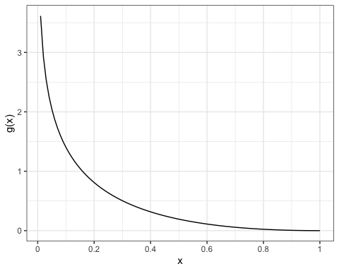

Slide 4
ann_text <- data.frame(tau=c(45,40),value = c(S1.5max,Sinf1.5),label=c("Max Suceptibles\n for Herd Immunity","Suceptibles Remaining in \n an Uncontrolled Epidemic"),key=c("s","s"),c=c("Mitigation","Mitigation")) g1 <- ggplot(aux.long[aux.long$key %in% c("i","s"),], aes(x = tau,y = value,linetype=key))+geom_line()+xlab(TeX(r'($\tau$)'))+scale_y_continuous(limits = c(0,1))+facet_grid(.~c)+ylab("Proportion of Population")+geom_hline(yintercept=Sinf1.5,linetype="dashed",color="red")+geom_hline(yintercept=S1.5max,linetype="dashed",color="red")+scale_linetype(name="",labels=list(TeX(r'($i$)'),TeX(r'($s$)')))+geom_label(data=ann_text,aes(label=label),size=2.2,label.size = .1,label.padding=unit(.1,"lines"),label.r = unit(.1,"lines"))+theme(legend.position = "bottom") #+annotate("label",x=40,y=Sinf1.5,label="Suceptibles Remaining in \n an Uncontrolled Epidemic")+annotate("label",x=50,y=S1.5max,c="Mitigation",label="Max Suceptibles\n for Herd Immunity") g1

Slide 5
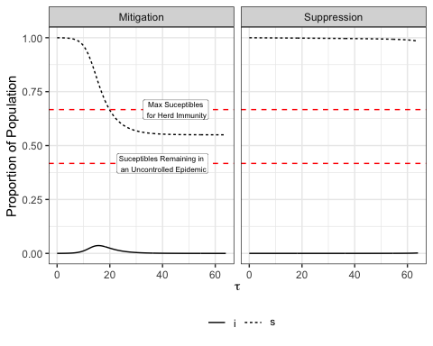

Slide 6
d2$optimization <- "full" dm$optimization <- "myopic"
common.names <- intersect(names(d2),names(dm))
d2 <- subset(d2,is.min==TRUE) d <- rbind(d2[,common.names],dm[,common.names])
fR0 <- function(x,R0){exp(-R0*(1-x))-x} Sinf1.5 <- multiroot.1D(f=fR0,R0=1.5,start = .5,nspec= 1)[["root"]] Sinf3 <- multiroot.1D(f=fR0,R0=3,start = .5,nspec= 1)[["root"]] Sinf4.5 <- multiroot.1D(f=fR0,R0=4.5,start = .5,nspec= 1)[["root"]] Sinf6 <- multiroot.1D(f=fR0,R0=6,start = .5,nspec= 1)[["root"]] S1.5max <- 1/1.5 S3max <- 1/3 S4.5max <- 1/4.5 S6max <- 1/6 epi.size <- cbind(R0 = c(1.5,3,4.5,6),EpiInf = c(1-Sinf1.5,1-Sinf3,1-Sinf4.5,1-Sinf6),EpiMin = c(1-S1.5max,1-S3max,1-S4.5max,1-S6max)) all_cases = read.csv("INTERMEDIATE/sol.explore.all.csv") all_cases2 <- read.csv("INTERMEDIATE/parallel.output2.csv") all_cases3 <- read.csv("INTERMEDIATE/parallel.output3.csv") all_casesR03 <- read.csv("INTERMEDIATE/output-R03.csv") all_casesR045 <- read.csv("INTERMEDIATE/output-R045.csv") all_cases4 <- d myopic_data = read.csv("INTERMEDIATE/sol.explore-myopic20210730.csv") %>% dplyr::select(tau, s, i, R_tau, Rt, case.id) myopic_exp_design = read.csv("INTERMEDIATE/exper.design-round13.csv") %>% dplyr::select(case.id, c, R0, i0, tFinal) myopic_data <- left_join(myopic_data,myopic_exp_design)
## Joining with `by = join_by(case.id)`
myopic_data$optimization <- "myopic" common.names2 <- intersect(names(myopic_data),names(d)) d<- rbind(d[,common.names2],myopic_data[,common.names2])
myopic_final_data = myopic_data %>% dplyr::filter(tFinal == tau&case.id>417) %>% mutate(EpiSize = 1-s)
theme_set(theme_bw()) g <- ggplot(d[d$R0 %in% c(1.5,3,4.5)&d$i0==1e-04&d$c%in% c(0.05,.4)&d$tFinal %in% c(4,8,16,32,64),], aes(x = tau,y = R_tau,color=as.factor(c),linetype=as.factor(optimization)))+geom_line()+facet_grid(R0~tFinal,scales="free",space="free")+theme(legend.position = "bottom")+xlab(TeX(r'($\tau$)'))+ylab(TeX(r'($R_D$)'))+scale_x_continuous(breaks = c(8,16,32,64))+scale_fill_manual(values=viridis(6)[c(5,1)],aesthetics = "color",name="c") g

Slide 7
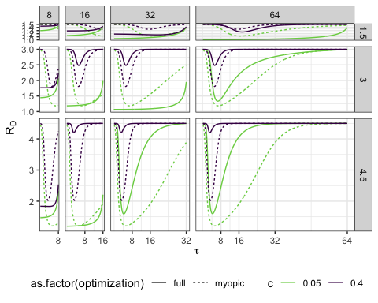

Slide 8
d$c2 <- paste("c =",d$c) d$R02 <- paste("R0 =",d$R0)
theme_set(theme_bw()) d$Rrel <- d$R_tau/d$R0 g <- ggplot(d[d$R02 %in% c("R0 = 1.5","R0 = 3","R0 = 4.5")&d$i0==1e-04&d$c2%in% c("c = 0.05","c = 0.1","c = 0.2")&d$tFinal %in% c(60),], aes(x = tau,y = Rrel,linetype=as.factor(optimization)))+geom_line()+facet_grid(R02~c2,space="free")+theme(legend.position = "bottom")+xlab(TeX(r'($\tau$)'))+ylab(TeX(r'($R_D/R_0$)'))+scale_linetype(name="Optimization type") g

Slide 9
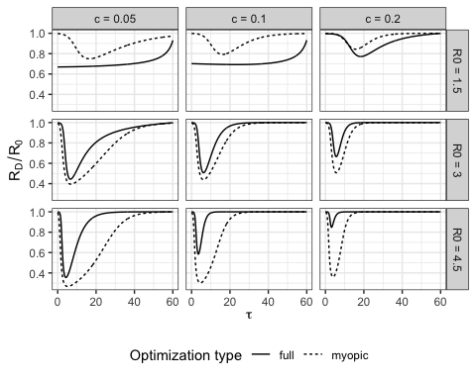

Slide 10
theme_set(theme_bw()) d$Rrel <- d$R_tau/d$R0 g <- ggplot(d[d$R02 %in% c("R0 = 1.5","R0 = 3","R0 = 4.5")&d$i0==1e-04&d$c2%in% c("c = 0.05","c = 0.1","c = 0.2")&d$tFinal %in% c(60),], aes(x = tau,y = Rrel,linetype=as.factor(optimization)))+geom_line()+facet_grid(R02~c2,space="free")+theme(legend.position = "bottom")+xlab(TeX(r'($\tau$)'))+ylab(TeX(r'($R_D/R_0$)')) g

Slide 11
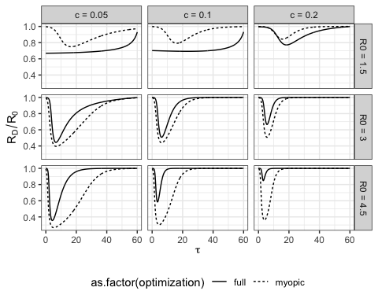

Slide 12
theme_set(theme_bw()) d$Rrel <- d$R_tau/d$R0 g <- ggplot(d[d$R02 %in% c("R0 = 3")&d$i0==1e-04&d$c2%in% c("c = 0.05")&d$tFinal %in% c(60),], aes(x = tau,y = Rrel,linetype=as.factor(optimization)))+geom_line()+facet_grid(R02~c2,space="free")+theme(legend.position = "bottom")+xlab(TeX(r'($\tau$)'))+ylab(TeX(r'($R_D/R_0$)')) g

Slide 13
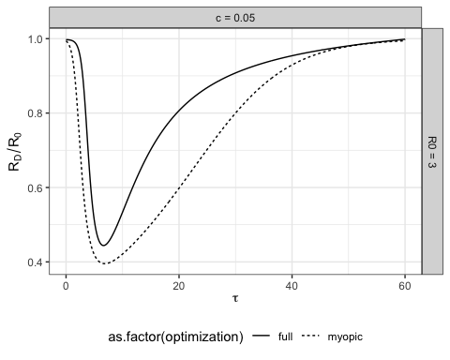

Slide 14
theme_set(theme_bw()) gm1 <- ggplot(d[d$R02 %in% c("R0 = 1.5","R0 = 3","R0 = 4.5")&d$i0==1e-04&d$c2%in% c("c = 0.05","c = 0.1","c = 0.2")&d$tFinal %in% c(60),], aes(x = tau,y = Rrel,linetype=as.factor(optimization)))+geom_line()+facet_grid(R02~c2,space="free")+theme(legend.position = "bottom")+xlab(TeX(r'($\tau$)'))+ylab(TeX(r'($R_D/R_0$)'))+labs(linetype="Optimization\ntype")+guides(linetype=FALSE)
## Warning: The `<scale>` argument of `guides()` cannot be `FALSE`. Use "none" instead as ## of ggplot2 3.3.4. ## This warning is displayed once every 8 hours. ## Call `lifecycle::last_lifecycle_warnings()` to see where this warning was ## generated.
gm1

Slide 15
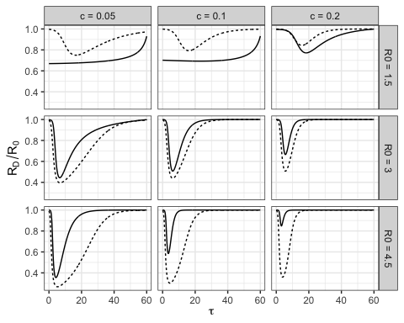

Slide 16
theme_set(theme_bw()) gm1 <- ggplot(d[d$R02 %in% c("R0 = 3")&d$i0==1e-04&d$c2%in% c("c = 0.05")&d$tFinal %in% c(60),], aes(x = tau,y = Rrel,linetype=as.factor(optimization)))+geom_line()+theme(legend.position = "bottom")+xlab(TeX(r'($\tau$)'))+ylab(TeX(r'($R_D/R_0$)'))+labs(linetype="Optimization\ntype")+guides(linetype=FALSE) gm1

Slide 17
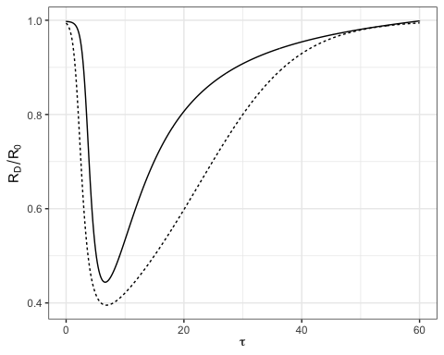

Slide 18
theme_set(theme_bw()) d$min.hi <- 1/d$R0 gm2 <- ggplot(d[d$R0 %in% c(1.5,3,4.5)&d$i0==1e-04&d$c%in% c(0.05,.1,.2)&d$tFinal %in% c(60),], aes(x = tau,y = s,linetype=as.factor(optimization)))+geom_line(show.legend = FALSE)+facet_grid(R02~c2,space="free")+theme(legend.position = "bottom")+xlab(TeX(r'($\tau$)'))+ylab(TeX(r'($s$)'))+ geom_abline(aes(intercept=min.hi,slope=0),show.legend=TRUE,name="Max s\nfor herd\nimmunity",linetype=4,color="red")+labs(linetype="Max s\nfor herd\nimmunity")+guides(linetype=FALSE,color=TRUE)
## Warning in geom_abline(aes(intercept = min.hi, slope = 0), show.legend = TRUE, ## : Ignoring unknown parameters: `name`
gm2

Slide 19
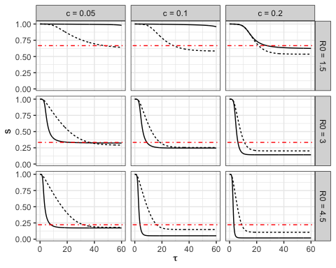

Slide 20
theme_set(theme_bw()) d$min.hi <- 1/d$R0 gm2 <- ggplot(d[d$R0 %in% c(3)&d$i0==1e-04&d$c%in% c(0.05)&d$tFinal %in% c(60),], aes(x = tau,y = s,linetype=as.factor(optimization)))+geom_line(show.legend = FALSE)+theme(legend.position = "bottom")+xlab(TeX(r'($\tau$)'))+ylab(TeX(r'($s$)'))+ geom_abline(aes(intercept=min.hi,slope=0),show.legend=TRUE,name="Max s\nfor herd\nimmunity",linetype=4,color="red")+labs(linetype="Max s\nfor herd\nimmunity")+guides(linetype=FALSE,color=TRUE)
## Warning in geom_abline(aes(intercept = min.hi, slope = 0), show.legend = TRUE, ## : Ignoring unknown parameters: `name`
gm2

Slide 21
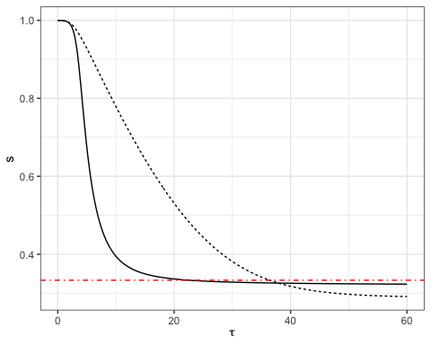

Slide 22
theme_set(theme_bw()) gm3 <- ggplot(d[d$R02 %in% c("R0 = 1.5","R0 = 3","R0 = 4.5")&d$i0==1e-04&d$c2%in% c("c = 0.05","c = 0.1","c = 0.2")&d$tFinal %in% c(60),], aes(x = tau,y = i,linetype=as.factor(optimization)))+geom_line()+facet_grid(R02~c2,space="free")+theme(legend.position = "bottom")+xlab(TeX(r'($\tau$)'))+ylab(TeX(r'($i$)'))+labs(linetype="Optimization\ntype") # Print the plot gm3

Slide 23
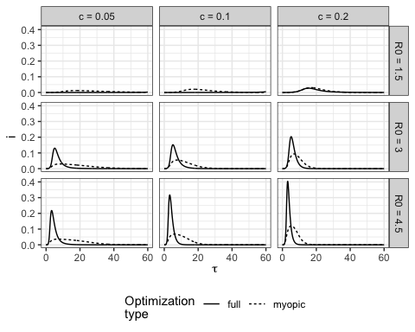

Slide 24
theme_set(theme_bw()) gm3 <- ggplot(d[d$R02 %in% c("R0 = 3")&d$i0==1e-04&d$c2%in% c("c = 0.05")&d$tFinal %in% c(60),], aes(x = tau,y = i,linetype=as.factor(optimization)))+geom_line()+theme(legend.position = "bottom")+xlab(TeX(r'($\tau$)'))+ylab(TeX(r'($i$)'))+labs(linetype="Optimization\ntype")+guides(linetype=FALSE,color=TRUE) # Print the plot gm3

Slide 25
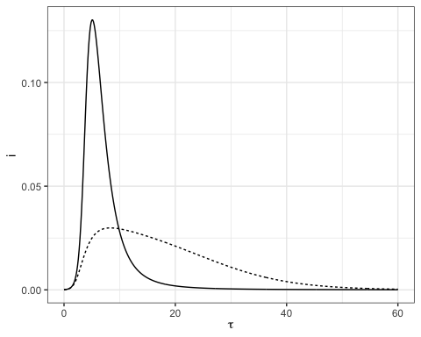

Slide 26
plot_grid(gm1,gm2,gm3,ncol=3,vp.widths = unit(c(2.5, 2.5,3.5), "in"))
## Warning in as_grob.default(plot): Cannot convert object of class ## simpleUnitunitunit_v2 into a grob.

Slide 27
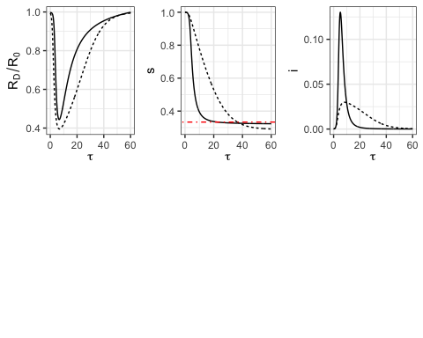

Slide 28
d.weird <- d[d$R02 %in% c("R0 = 3")&d$i0==1e-04&d$c2%in% c("c = 0.05")&d$tFinal %in% c(60),] d.weird$prob.infect <- d.weird$i*d.weird$s*d.weird$R_tau d.weird$r <- 1-d.weird$s-d.weird$i
theme_set(theme_bw()) gmA1 <- ggplot(d.weird, aes(x = tau,y = prob.infect,linetype=as.factor(optimization)))+geom_line()+facet_grid(R02~c2,space="free")+theme(legend.position = "bottom")+xlab(TeX(r'($\tau$)'))+ylab("Rate of new infections")+labs(linetype="Optimization\ntype")+guides(linetype=FALSE) gmA1

Slide 29
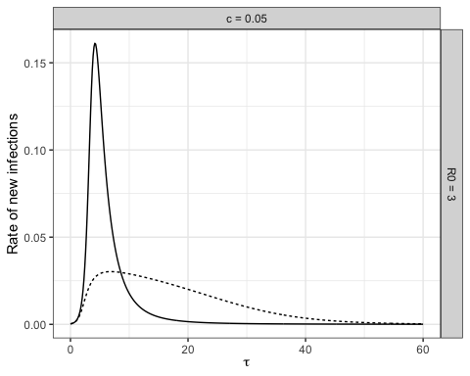

Slide 30
theme_set(theme_bw()) gmA2 <- ggplot(d.weird, aes(x = tau,y = r,linetype=as.factor(optimization)))+geom_line()+facet_grid(R02~c2,space="free")+theme(legend.position = "bottom")+xlab(TeX(r'($\tau$)'))+ylab(TeX(r'($r$)'))+labs(linetype="Optimization\ntype")+guides(linetype=FALSE)+geom_abline(slope=0,intercept=.666666,color="red") gmA2

Slide 31
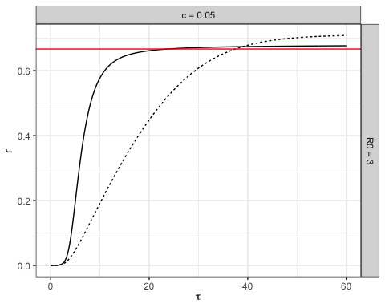

Slide 32
theme_set(theme_bw()) gmA3 <- ggplot(d.weird, aes(x = tau,y = Rt,linetype=as.factor(optimization)))+geom_line()+facet_grid(R02~c2,space="free")+theme(legend.position = "bottom")+xlab(TeX(r'($\tau$)'))+ylab(TeX(r'($sR_D$)'))+labs(linetype="Optimization\ntype")+guides(linetype=FALSE)+geom_abline(slope=0,intercept=1,color="red") gmA3

Slide 33
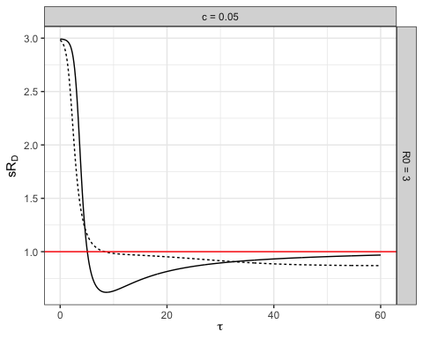

Slide 34
theme_set(theme_bw()) g <- ggplot(d[d$R0 %in% c(1.5,3,4.5)&d$i0==1e-04&d$c%in% c(0.05,.4)&d$tFinal %in% c(4,8,16,32,64),], aes(x = tau,y = s,color=as.factor(c),linetype=as.factor(optimization)))+geom_line()+facet_grid(R0~tFinal,scales="free",space="free")+theme(legend.position = "bottom")+xlab(TeX(r'($\tau$)'))+ylab(TeX(r'($R_D$)'))+scale_x_continuous(breaks = c(8,16,32,64))+scale_fill_manual(values=viridis(6)[c(5,1)],aesthetics = "color",name="c") g

Slide 35
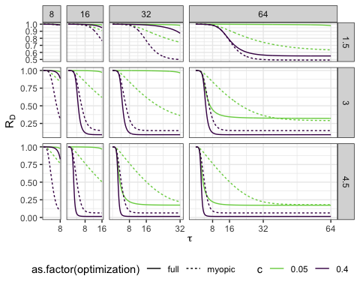

Slide 36
theme_set(theme_bw()) g <- ggplot(d[d$R0 %in% c(1.5,3,4.5)&d$i0==1e-04&d$c%in% c(0.05,.4)&d$tFinal %in% c(4,8,16,32,64),], aes(x = tau,y = s,color=as.factor(c),linetype=as.factor(optimization)))+geom_line()+facet_grid(R0~tFinal,scales="free",space="free")+theme(legend.position = "bottom")+xlab(TeX(r'($\tau$)'))+ylab(TeX(r'($R_D$)'))+scale_x_continuous(breaks = c(8,16,32,64))+scale_fill_manual(values=viridis(6)[c(5,1)],aesthetics = "color",name="c") g

Slide 38
theme_set(theme_bw()) g <- ggplot(d[d$R0 == 4.5&d$i0==1e-04&d$c%in% c(0.025,0.05,.1,.2,.4)&d$tFinal %in% c(4,8,16,32,64),], aes(x = tau,y = s,group = c,color=as.factor(c)))+geom_line()+facet_grid(optimization~tFinal,scales="free_x",space="free")+theme(legend.position = "bottom")+xlab(TeX(r'($\tau$)'))+ylab(TeX(r'($R_D$)'))+scale_y_continuous(limits = c(0,1))+scale_fill_manual(values=viridis(6)[c(5,4,3,2,1)],aesthetics = "color",name="c")+scale_x_continuous(breaks = c(8,16,32,64)) g

Slide 39
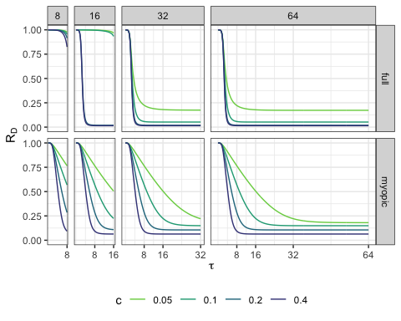

Slide 40
theme_set(theme_bw()) g <- ggplot(d[d$R0 == 4.5&d$i0==1e-04&d$c%in% c(0.025,0.05,.1,.2,.4)&d$tFinal %in% c(4,8,16,32,64),], aes(x = tau,y = R_tau,group = c,color=as.factor(c)))+geom_line()+facet_grid(optimization~tFinal,scales="free_x",space="free")+theme(legend.position = "bottom")+xlab(TeX(r'($\tau$)'))+ylab(TeX(r'($R_D$)'))+scale_y_continuous(limits = c(0,4.5))+scale_fill_manual(values=viridis(6)[c(5,4,3,2,1)],aesthetics = "color",name="c")+scale_x_continuous(breaks = c(8,16,32,64)) g

Slide 41
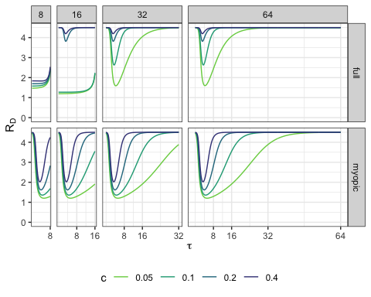

Slide 42
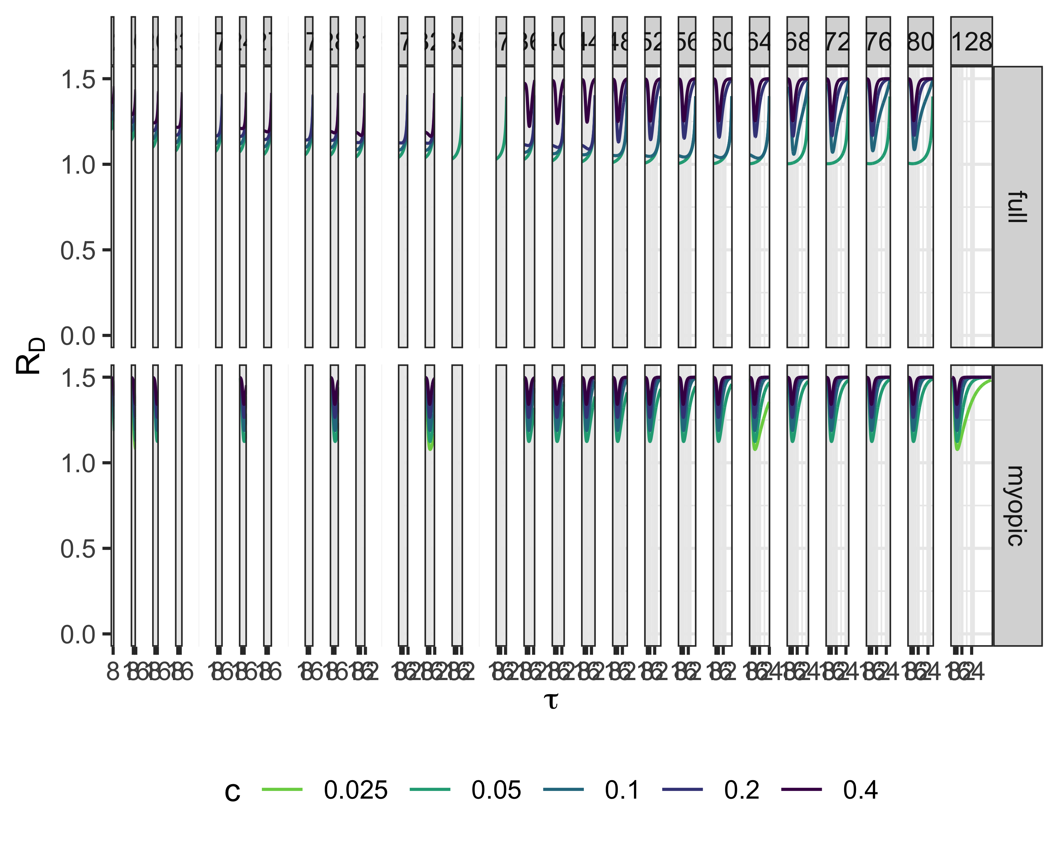

Slide 43
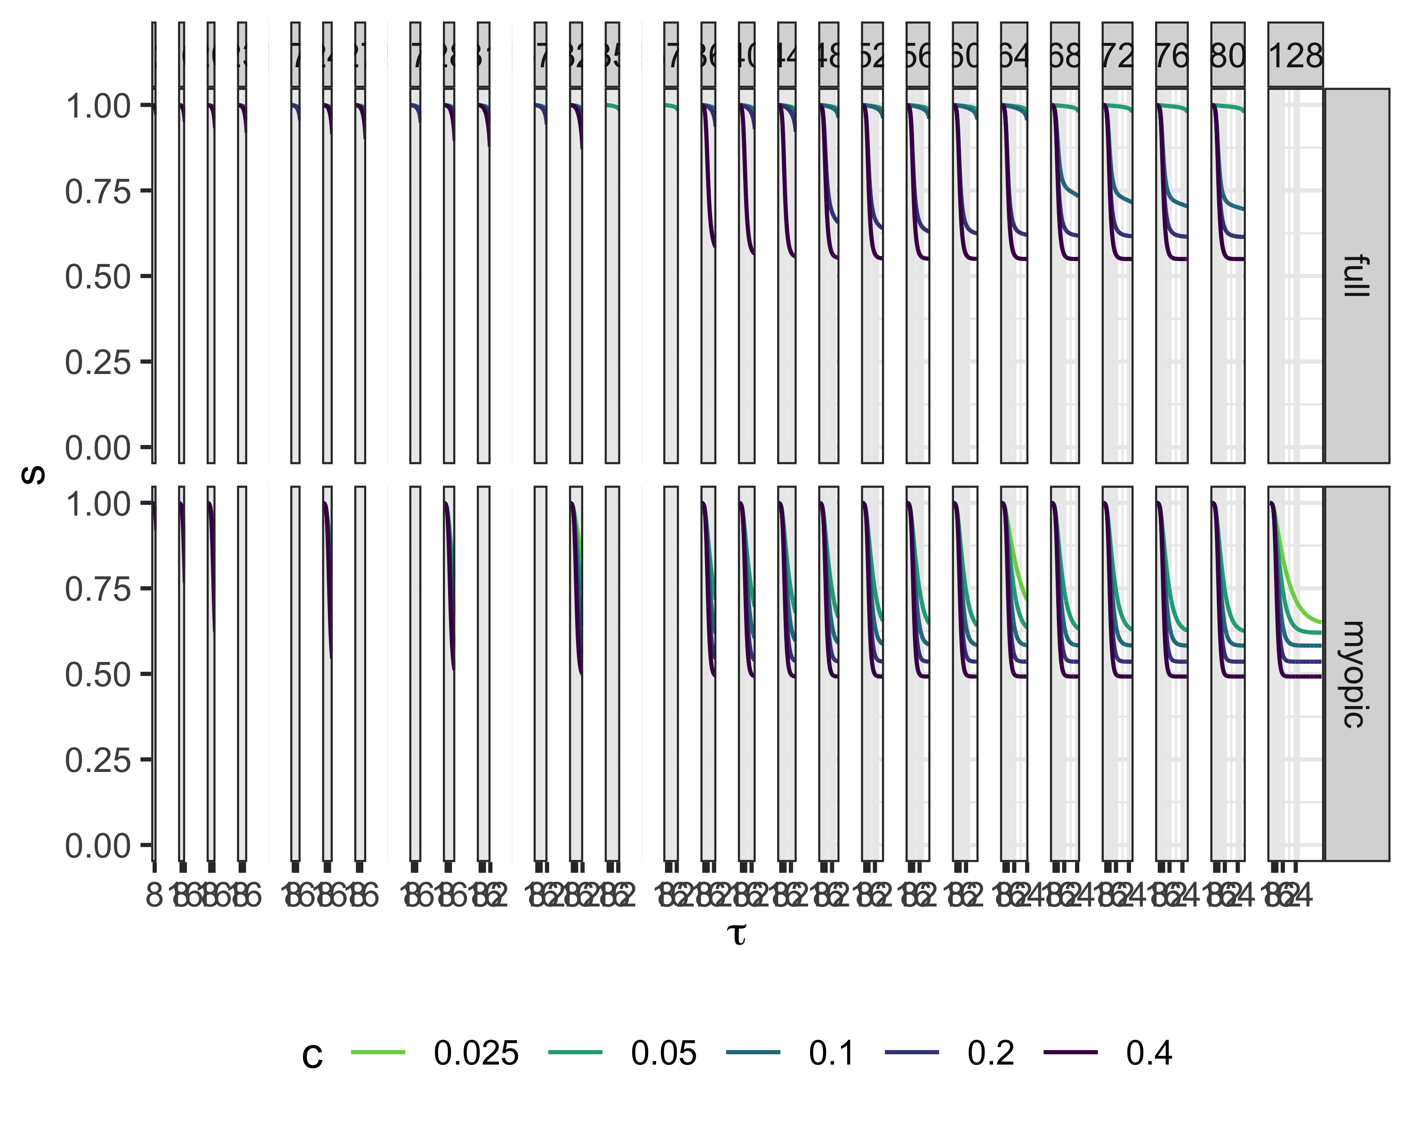

Slide 44
plot_grid(g.1a,g.1b,labels=c(“(a)”,“(b)”),rel_widths = c(1,1.5))
g <- myopic_final_data %>% ggplot(data = ., mapping = aes(x = tFinal, y = c, fill = EpiSize)) + geom_tile() + facet_wrap(R0~.)+scale_fill_viridis_c(name="Final Epidemic Size")+xlab(TeX(r'($T_{final}$)'))+theme(legend.position = "bottom") g

Slide 45
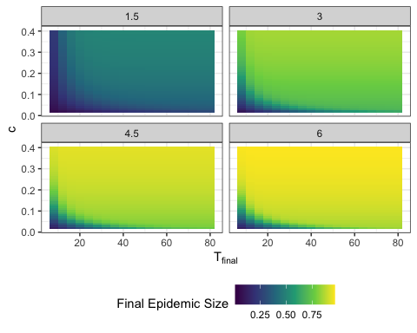

Slide 46
g2 <- all_cases4 %>% dplyr::filter(tFinal == tau, case.id > 417,i0==0.0001,R0==1.5) %>% mutate(EpiSize = 1-s) %>% ggplot(data = ., mapping = aes(x = tFinal, y = c, fill = EpiSize)) + geom_tile() +geom_blank(data=myopic_final_data)+ scale_fill_viridis_c(name="Final Epidemic Size")+xlab(TeX(r'($T_{final}$)'))+theme(legend.position = "bottom") g2

Slide 47
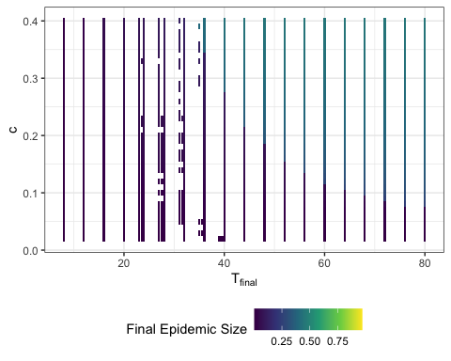

Slide 48
#Total Cost
myopic_data1.5 = myopic_data %>% dplyr::filter(case.id>417&R0==1.5&i0==0.0001) %>% mutate(EpiSize = 1-s)
myopic_cost1.5 <- CalculateCost(myopic_data1.5)
myopic_cost <- CalculateCost(myopic_data)
## Warning in regularize.values(x, y, ties, missing(ties), na.rm = na.rm): ## collapsing to unique 'x' values ## Warning in regularize.values(x, y, ties, missing(ties), na.rm = na.rm): ## collapsing to unique 'x' values ## Warning in regularize.values(x, y, ties, missing(ties), na.rm = na.rm): ## collapsing to unique 'x' values ## Warning in regularize.values(x, y, ties, missing(ties), na.rm = na.rm): ## collapsing to unique 'x' values ## Warning in regularize.values(x, y, ties, missing(ties), na.rm = na.rm): ## collapsing to unique 'x' values ## Warning in regularize.values(x, y, ties, missing(ties), na.rm = na.rm): ## collapsing to unique 'x' values ## Warning in regularize.values(x, y, ties, missing(ties), na.rm = na.rm): ## collapsing to unique 'x' values ## Warning in regularize.values(x, y, ties, missing(ties), na.rm = na.rm): ## collapsing to unique 'x' values ## Warning in regularize.values(x, y, ties, missing(ties), na.rm = na.rm): ## collapsing to unique 'x' values ## Warning in regularize.values(x, y, ties, missing(ties), na.rm = na.rm): ## collapsing to unique 'x' values ## Warning in regularize.values(x, y, ties, missing(ties), na.rm = na.rm): ## collapsing to unique 'x' values ## Warning in regularize.values(x, y, ties, missing(ties), na.rm = na.rm): ## collapsing to unique 'x' values ## Warning in regularize.values(x, y, ties, missing(ties), na.rm = na.rm): ## collapsing to unique 'x' values ## Warning in regularize.values(x, y, ties, missing(ties), na.rm = na.rm): ## collapsing to unique 'x' values ## Warning in regularize.values(x, y, ties, missing(ties), na.rm = na.rm): ## collapsing to unique 'x' values ## Warning in regularize.values(x, y, ties, missing(ties), na.rm = na.rm): ## collapsing to unique 'x' values ## Warning in regularize.values(x, y, ties, missing(ties), na.rm = na.rm): ## collapsing to unique 'x' values ## Warning in regularize.values(x, y, ties, missing(ties), na.rm = na.rm): ## collapsing to unique 'x' values ## Warning in regularize.values(x, y, ties, missing(ties), na.rm = na.rm): ## collapsing to unique 'x' values ## Warning in regularize.values(x, y, ties, missing(ties), na.rm = na.rm): ## collapsing to unique 'x' values ## Warning in regularize.values(x, y, ties, missing(ties), na.rm = na.rm): ## collapsing to unique 'x' values ## Warning in regularize.values(x, y, ties, missing(ties), na.rm = na.rm): ## collapsing to unique 'x' values ## Warning in regularize.values(x, y, ties, missing(ties), na.rm = na.rm): ## collapsing to unique 'x' values ## Warning in regularize.values(x, y, ties, missing(ties), na.rm = na.rm): ## collapsing to unique 'x' values ## Warning in regularize.values(x, y, ties, missing(ties), na.rm = na.rm): ## collapsing to unique 'x' values ## Warning in regularize.values(x, y, ties, missing(ties), na.rm = na.rm): ## collapsing to unique 'x' values ## Warning in regularize.values(x, y, ties, missing(ties), na.rm = na.rm): ## collapsing to unique 'x' values ## Warning in regularize.values(x, y, ties, missing(ties), na.rm = na.rm): ## collapsing to unique 'x' values ## Warning in regularize.values(x, y, ties, missing(ties), na.rm = na.rm): ## collapsing to unique 'x' values ## Warning in regularize.values(x, y, ties, missing(ties), na.rm = na.rm): ## collapsing to unique 'x' values ## Warning in regularize.values(x, y, ties, missing(ties), na.rm = na.rm): ## collapsing to unique 'x' values ## Warning in regularize.values(x, y, ties, missing(ties), na.rm = na.rm): ## collapsing to unique 'x' values
myopic_cost <- myopic_cost[myopic_cost$case.id>417&myopic_cost$i0==0.0001,]
write.csv(myopic_cost,file="INTERMEDIATE/myopic_with_cost.csv")
g <- ggplot(myopic_cost[myopic_cost$tFinal<100&myopic_cost$case.id>417&myopic_cost$i0==0.0001,], mapping = aes(x = tFinal, y = c, fill = cost)) + geom_tile() + scale_fill_viridis_c(name="Cost")+xlab(TeX(r'($T_{final}$)'))+theme(legend.position = "bottom")+facet_wrap(.~R0) g

Slide 49
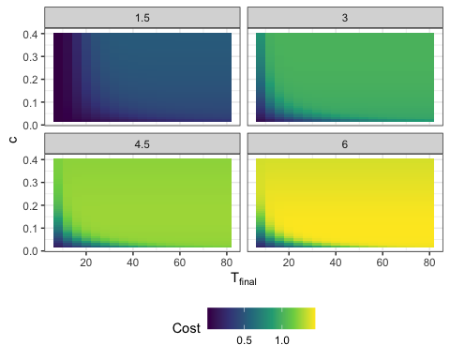

Slide 50
full_opt1.5 <- all_cases4 %>% dplyr::filter(case.id > 417,i0==0.0001,R0==1.5)

