Slide 1
Calculus of Variations Approach to Social Distancing

Slide 2
## Loading required package: ggplot2
## Loading required package: viridis
## Loading required package: viridisLite
## Loading required package: ggthemes
## Loading required package: rootSolve
## Loading required package: latex2exp
## ## Attaching package: 'dplyr'
## The following objects are masked from 'package:stats': ## ## filter, lag
## The following objects are masked from 'package:base': ## ## intersect, setdiff, setequal, union
## Loading required package: spam
## Loading required package: dotCall64
## Loading required package: grid
## Spam version 2.7-0 (2021-06-25) is loaded. ## Type 'help( Spam)' or 'demo( spam)' for a short introduction ## and overview of this package. ## Help for individual functions is also obtained by adding the ## suffix '.spam' to the function name, e.g. 'help( chol.spam)'.
## ## Attaching package: 'spam'
## The following objects are masked from 'package:base': ## ## backsolve, forwardsolve
## See https://github.com/NCAR/Fields for ## an extensive vignette, other supplements and source code
## ## Attaching package: 'Bolstad2'
## The following object is masked from 'package:fields': ## ## describe
f1.5 <- function(x,R0){exp(-1.5*(1-x))-x} f2.5 <- function(x,R0){exp(-2.5*(1-x))-x} f5 <- function(x,R0){exp(-5*(1-x))-x}
Sinf1.5 <- multiroot.1D(f=f1.5,start = .5,nspec= 1)[["root"]] Sinf2.5 <- multiroot.1D(f=f2.5,start = .5,nspec= 1)[["root"]] Sinf5 <- multiroot.1D(f=f5,start = .5,nspec= 1)[["root"]] S1.5max <- 1/1.5 S2.5max <- 2.5 S5max <- 5 d$months <- d$tau/2 d$tFinal <- factor(d$tFinal,levels = c(8,16, 32, 64, 128))
aux$c[aux$c == 0.025] <- "Suppression" aux$c[aux$c == 0.4] <- "Mitigation (Herd Immunity)" require(tidyr)
## Loading required package: tidyr
## ## Attaching package: 'tidyr'
## The following object is masked from 'package:reshape2': ## ## smiths
aux$c[aux$c == 0.025] <- "Suppression" aux$c[aux$c == 0.4] <- "Mitigation (Herd Immunity)" x <- seq(0.01,1,.01) y <- -log(x)+x-1 p <- as.data.frame(cbind(x,y)) g <- ggplot(p,aes(x=x,y=y))+geom_line()+theme_bw()+scale_x_continuous(breaks = c(0,.2,.4,.6,.8,1),labels = c(0, "0.2","0.4","0.6","0.8","1"))+xlab("RD")+ylab("g(x)")+xlab("x")+scale_y_continuous(breaks= c(0,1,2,3),labels = c(0, "1", "2","3")) g

Slide 3
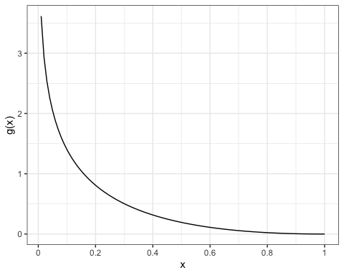

Slide 4
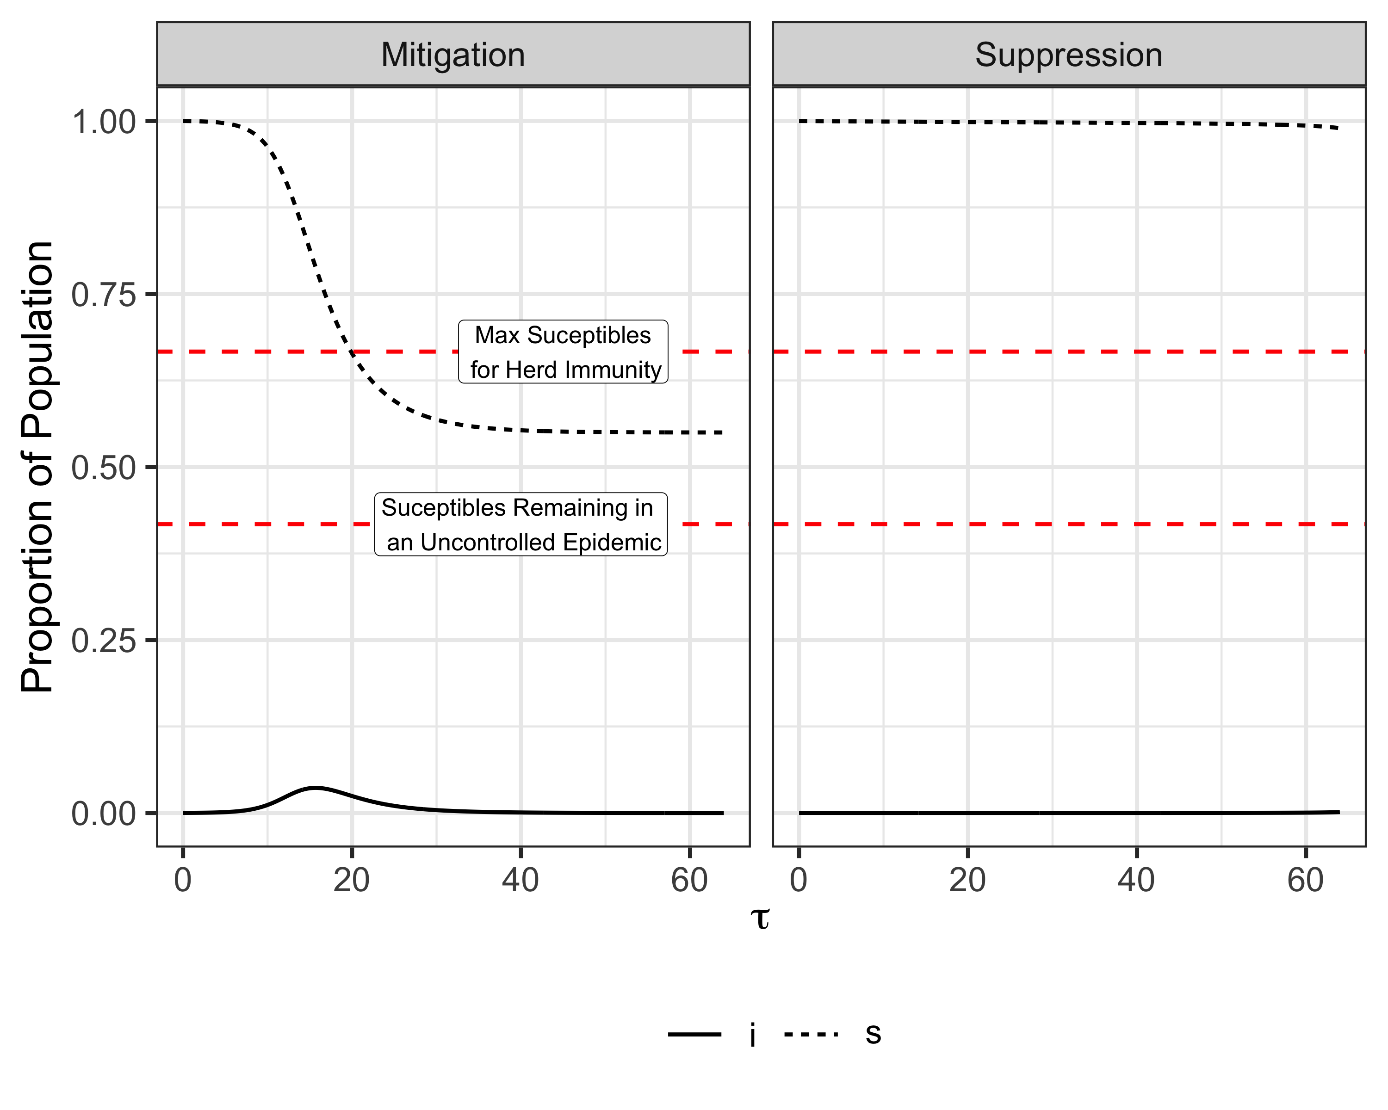

Slide 5
## quartz_off_screen ## 2

Slide 6
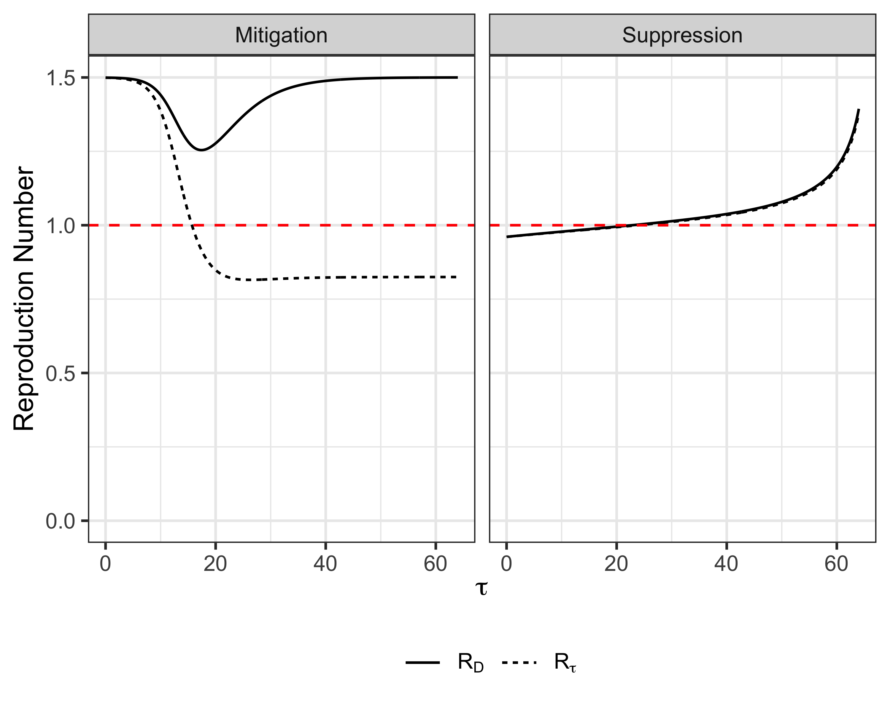

Slide 7
## quartz_off_screen ## 2

Slide 8
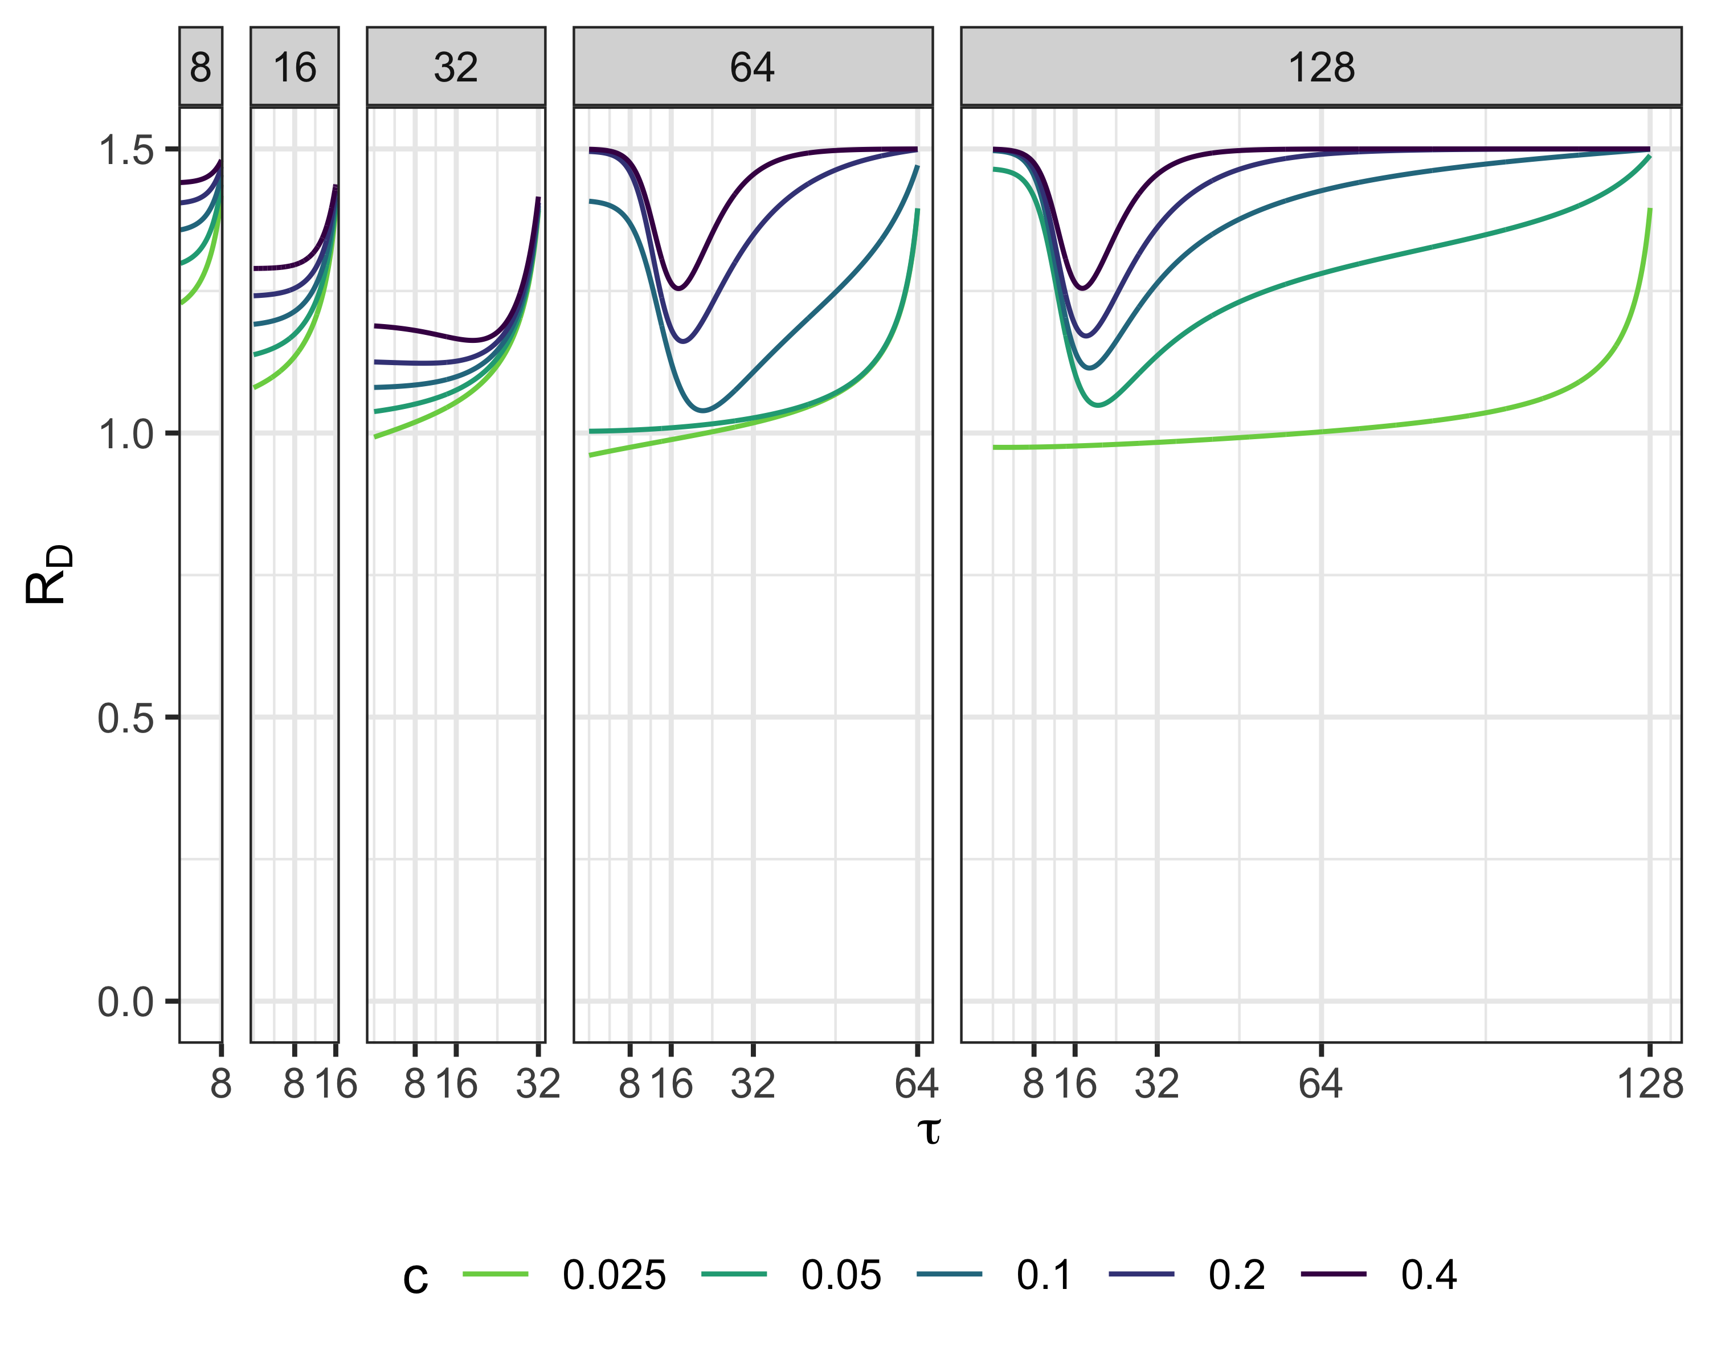
RD, R0 = 1.5

Slide 9
## quartz_off_screen ## 2

Slide 10
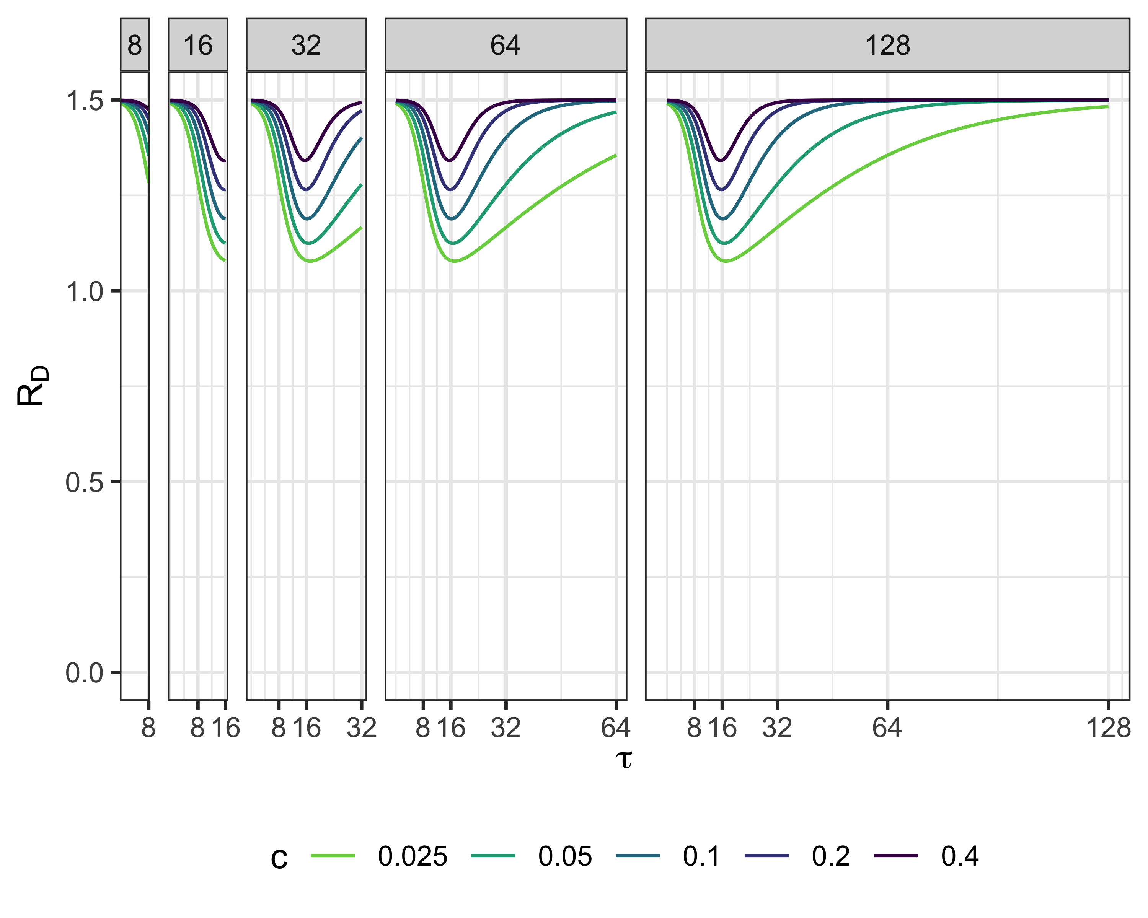

Slide 11
## quartz_off_screen ## 2
Sinf1.5 <- multiroot.1D(f=f1.5,start = .5,nspec= 1)[["root"]] Sinf2.5 <- multiroot.1D(f=f2.5,start = .5,nspec= 1)[["root"]] Sinf5 <- multiroot.1D(f=f5,start = .5,nspec= 1)[["root"]] S1.5max <- 1/1.5 S2.5max <- 1/2.5 S5max <- 1/5
fR0 <- function(x,R0){exp(-R0*(1-x))-x} Sinf1.5 <- multiroot.1D(f=fR0,R0=1.5,start = .5,nspec= 1)[["root"]] Sinf3 <- multiroot.1D(f=fR0,R0=3,start = .5,nspec= 1)[["root"]] Sinf4.5 <- multiroot.1D(f=fR0,R0=4.5,start = .5,nspec= 1)[["root"]] Sinf6 <- multiroot.1D(f=fR0,R0=6,start = .5,nspec= 1)[["root"]] S1.5max <- 1/1.5 S3max <- 1/3 S4.5max <- 1/4.5 S6max <- 1/6 epi.size <- cbind(R0 = c(1.5,3,4.5,6),EpiInf = c(1-Sinf1.5,1-Sinf3,1-Sinf4.5,1-Sinf6),EpiMin = c(1-S1.5max,1-S3max,1-S4.5max,1-S6max)) all_cases = read.csv("INTERMEDIATE/sol.explore.all.csv") all_cases2 <- read.csv("INTERMEDIATE/parallel.output2.csv") all_cases3 <- read.csv("INTERMEDIATE/parallel.output3.csv") all_casesR03 <- read.csv("INTERMEDIATE/output-R03.csv") all_casesR045 <- read.csv("INTERMEDIATE/output-R045.csv") all_cases4 <- rbind(all_cases,all_cases2,all_cases3) all_cases4 <- subset(all_cases4,solved==TRUE&R0!=3&R0!=4.5) all_cases4 <- rbind(all_cases4,all_casesR03[,1:dim(all_cases4)[2]],all_casesR045[,1:dim(all_cases4)[2]]) myopic_data = read.csv("INTERMEDIATE/sol.explore-myopic20210730.csv") %>% dplyr::select(tau, s, i, R_tau, Rt, case.id) myopic_exp_design = read.csv("INTERMEDIATE/exper.design-round13.csv") %>% dplyr::select(case.id, c, R0, i0, tFinal) myopic_data <- left_join(myopic_data,myopic_exp_design)
## Joining, by = "case.id"
myopic_final_data = myopic_data %>% dplyr::filter(tFinal == tau&case.id>417&R0==1.5) %>% mutate(EpiSize = 1-s)
g <- myopic_final_data %>% ggplot(data = ., mapping = aes(x = tFinal, y = c, fill = EpiSize)) + geom_tile() + scale_fill_viridis_c(name="Final Epidemic Size")+xlab(TeX(r'($T_{final}$)'))+theme(legend.position = "bottom") g

Slide 12
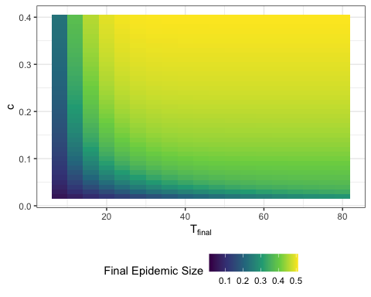

Slide 13
## quartz_off_screen ## 2
g2 <- all_cases4 %>% dplyr::filter(tFinal == tau, case.id > 417,i0==0.0001,R0==1.5) %>% mutate(EpiSize = 1-s) %>% ggplot(data = ., mapping = aes(x = tFinal, y = c, fill = EpiSize)) + geom_tile() +geom_blank(data=myopic_final_data)+ scale_fill_viridis_c(name="Final Epidemic Size")+xlab(TeX(r'($T_{final}$)'))+theme(legend.position = "bottom") g2

Slide 14
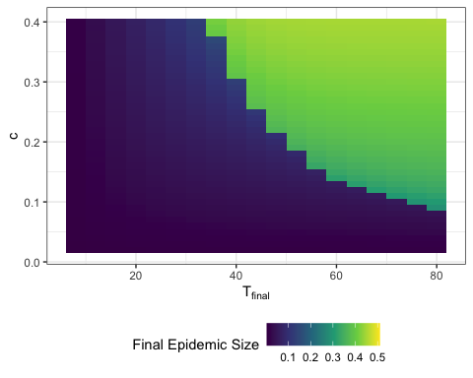

Slide 15
## quartz_off_screen ## 2
#Total Cost
myopic_data1.5 = myopic_data %>% dplyr::filter(case.id>417&R0==1.5&i0==0.0001) %>% mutate(EpiSize = 1-s)
myopic_cost <- CalculateCost(myopic_data1.5)
g <- ggplot(myopic_cost, mapping = aes(x = tFinal, y = c, fill = cost)) + geom_tile() + scale_fill_viridis_c(name="Cost")+xlab(TeX(r'($T_{final}$)'))+theme(legend.position = "bottom") g

Slide 16
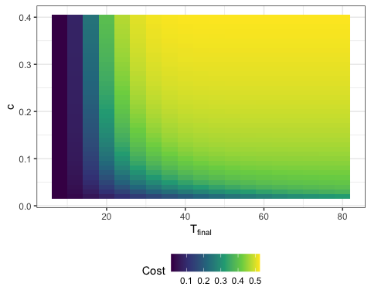

Slide 17
full_opt1.5 <- all_cases4 %>% dplyr::filter(case.id > 417,i0==0.0001,R0==1.5)
opt_cost <- CalculateCost(full_opt1.5)
opt_cost$cost3 <- opt_cost$cost2 opt_cost <- as.data.frame(opt_cost)
g <- ggplot(opt_cost, aes(x = tFinal, y = c,fill=cost)) + geom_tile() + scale_fill_viridis_c(name="Cost")+xlab(TeX(r'($T_{final}$)'))+theme(legend.position = "bottom") g

Slide 18
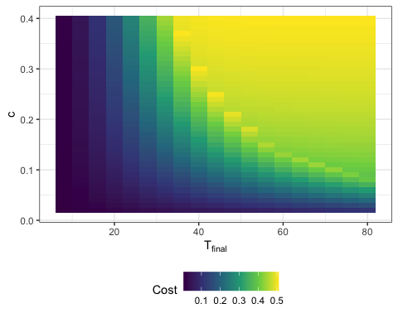

Slide 19
opt_cost$my_cost <- myopic_cost[row.names(opt_cost),"cost"]
opt_cost$ratio <- opt_cost$my_cost/opt_cost$cost
g <- ggplot(opt_cost, aes(x = tFinal, y = c,fill=ratio)) + geom_tile() + scale_fill_viridis_c(name="Cost Ratio")+xlab(TeX(r'($T_{final}$)'))+theme(legend.position = "bottom") g

Slide 20
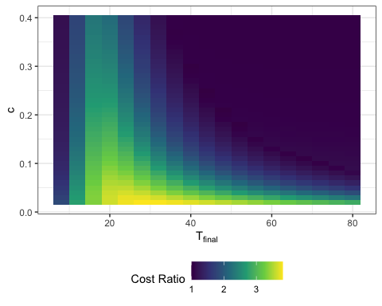

Slide 21
## quartz_off_screen ## 2

