Slide 1
Visualizing Data with OpenMORDM
This work was supported by the National Science Foundation through the Network for Sustainable Climate Risk Management (SCRiM) under NSF cooperative agreement GEO-1240507.

Slide 2
What is OpenMORDM?
A free and open source visualization framework written in R
Supports 3D and 2D visualization of datasets
Analytics: sensitivity analysis, PRIM, CART, etc.
Accessible via your web browser!

Slide 3
Demo
Open your web browser to:
http://openmordm.shinyapps.io/VisDemo/
Login with the username / password provided by SCRiM
Best to use latest version of Firefox or Chrome
This is a beta version. If the application stops responding, refresh the page in your browser.

Slide 4
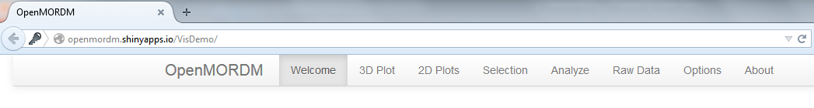
Navigation
Click the tabs at the top of the page to access the different views.

Slide 5
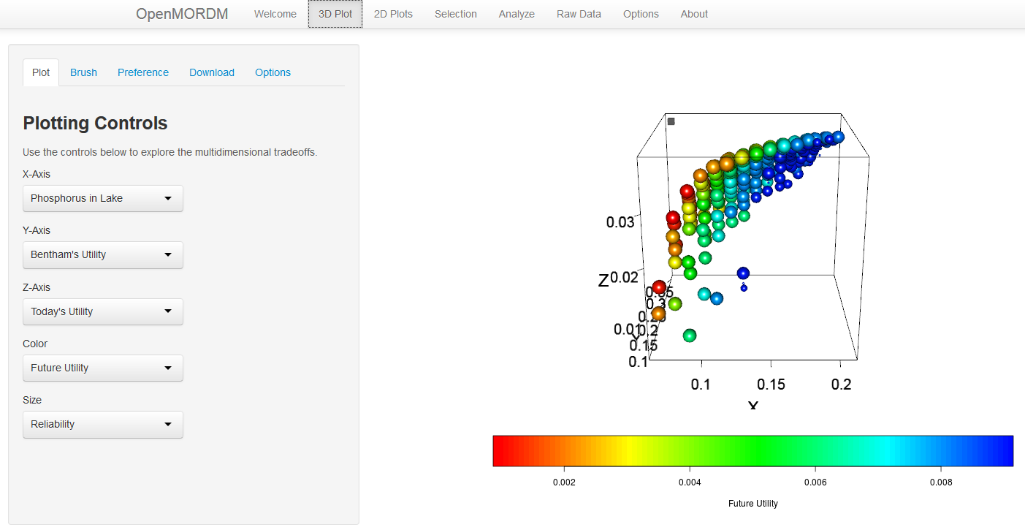
3D View
Adjust plotting options
Click and drag with mouse to rotate, use mouse wheel to zoom

Slide 6
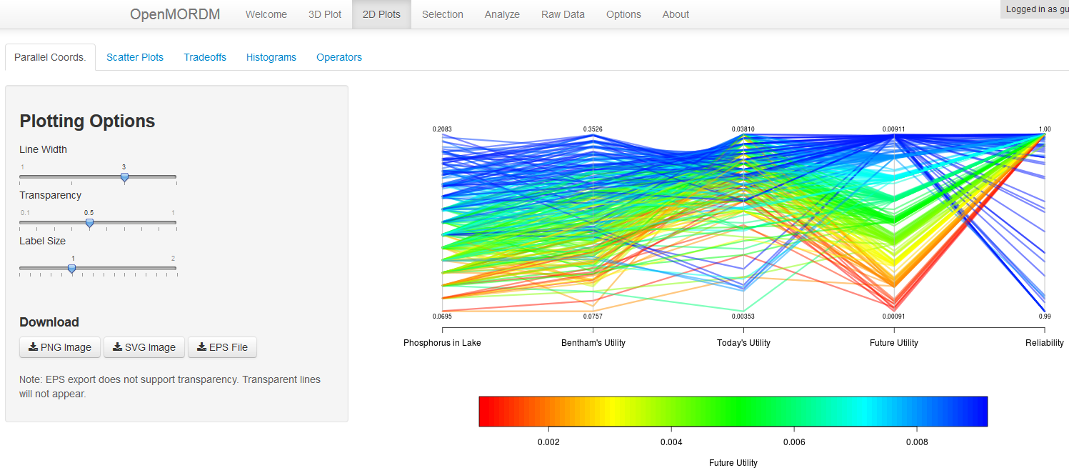
2D Views
Click tabs to access all 2D views
Download high-def image

Slide 7
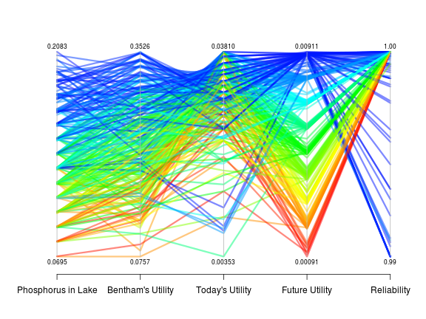
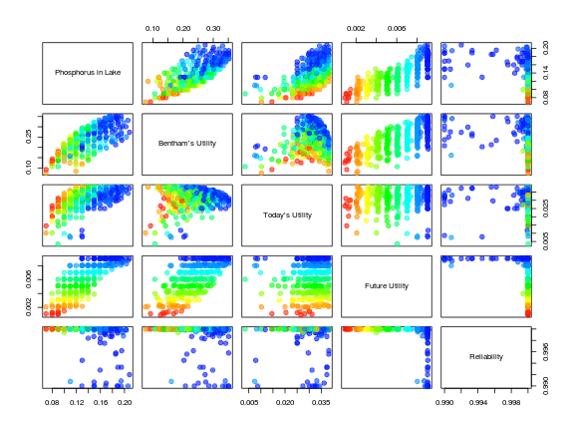
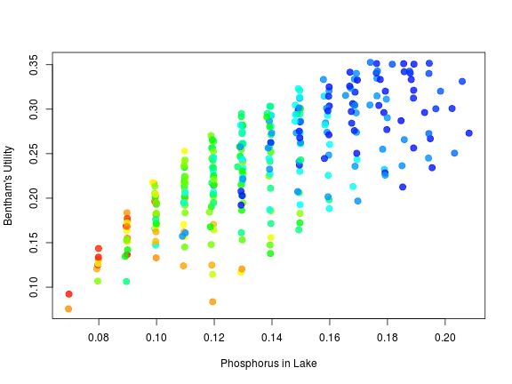
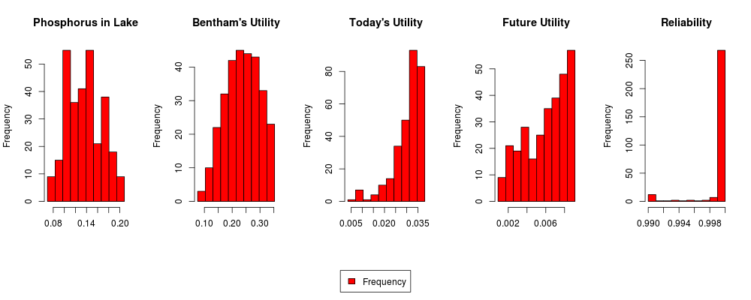
2D Views (Continued)
Parallel Coordinates
Scatter (Multiattribute) Plot
Different ways to view and understand high-dimensional data
Tradeoff Between Two Objectives
Histogram

Slide 8
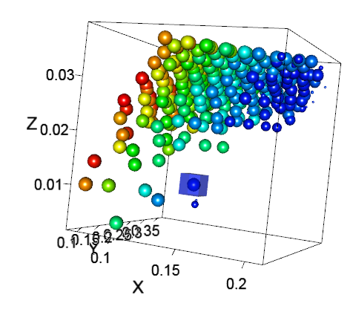
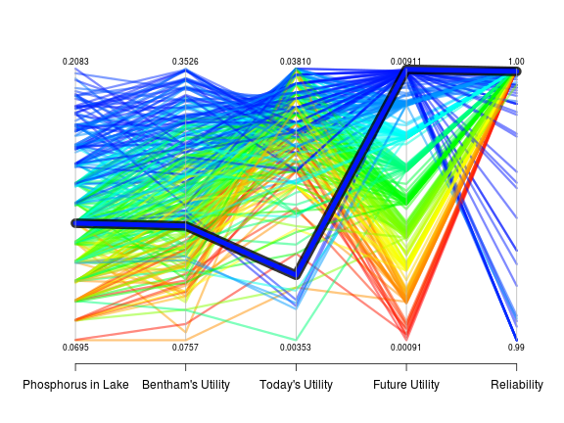

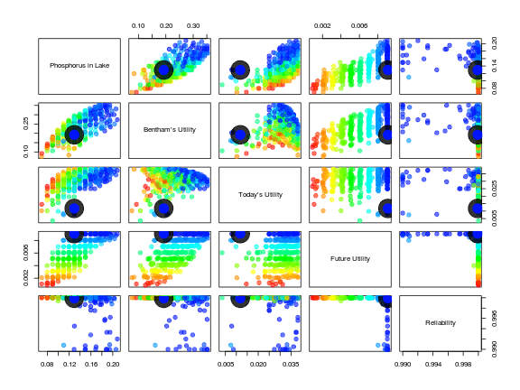
Selecting Points
Click a point in the 3D view to highlight the point in all plots

Slide 9
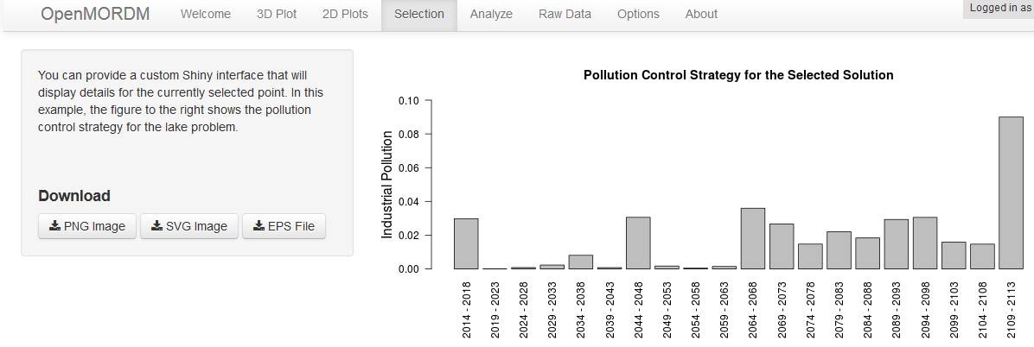
Viewing Details
When a point is selected, switch to the Selection tab to view details of that point. In this example, we are looking at the pollution control strategy for the lake problem.

Slide 10
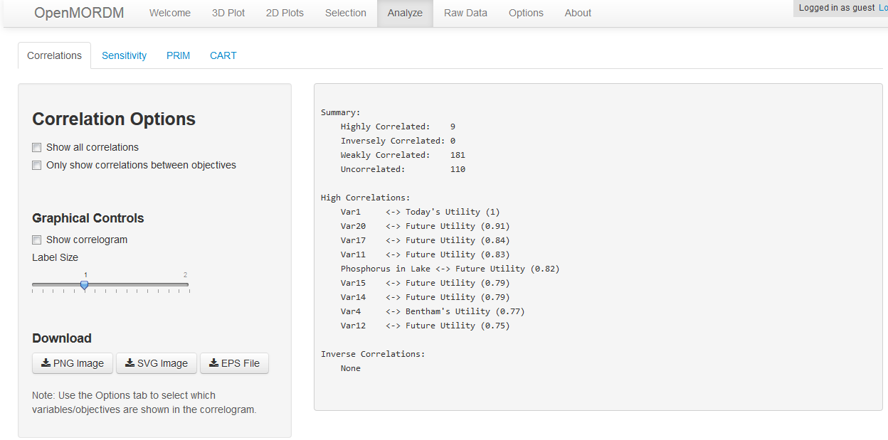
Analysis
The Analyze tab provides a number of routines to analyze multivariate data
Click these tabs to access each method

Slide 11
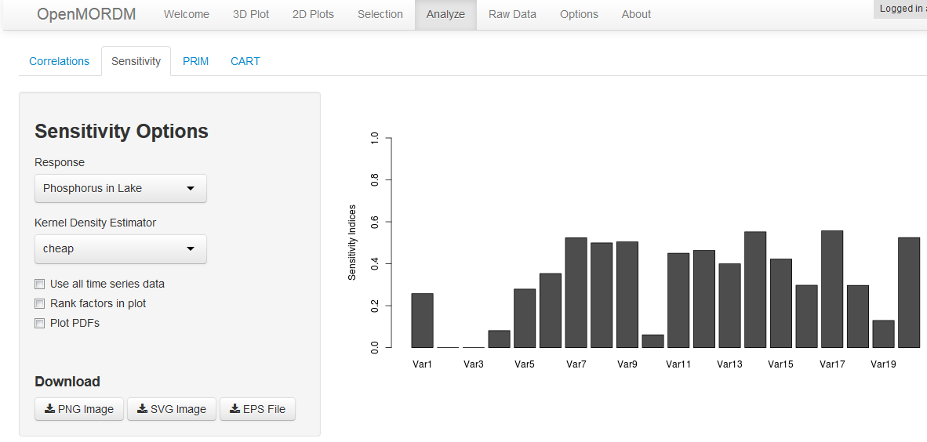
Sensitivity Analysis
Select the response (the objective) of interest…
Plischke, Borgonovo, and Smith (2013). "Global sensitivity measures from given data", European Journal of Operational Research 226(3):536-550.
…to view the sensitivity of that response to each input variable

Slide 12
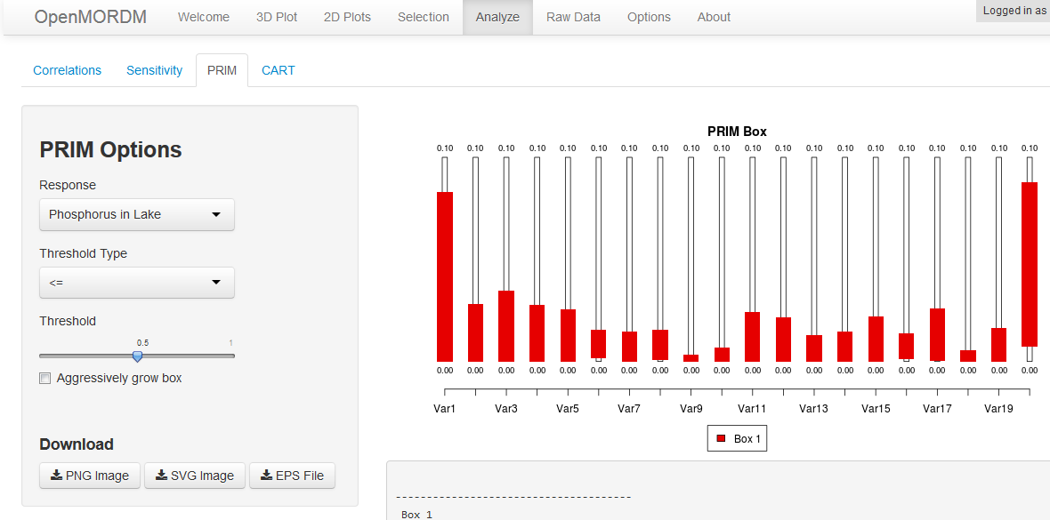
PRIM
Use the Patient Rule Induction Method (PRIM) to discover the ranges of inputs that cause a response to be less than or greater than a given threshold.
Friedman, J.H. and Fisher, N.I. (1999). “Bump-hunting for high dimensional data”, Statistics and Computing,
9, 123–143.
Inputs contained within these red boxes have a high likelihood of satisfying our conditions.

Slide 13
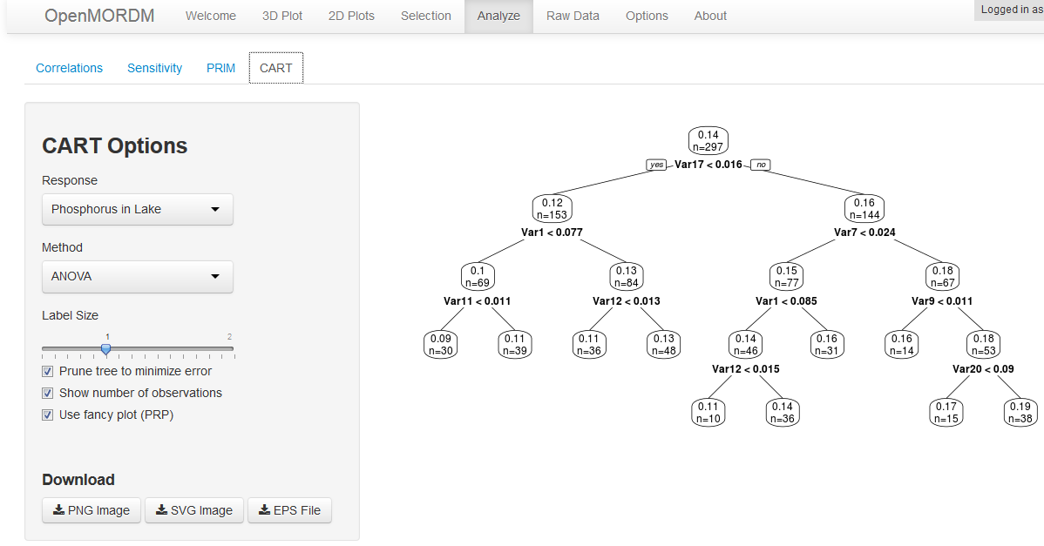
CART
Similar in use to PRIM, Classification and Regression Trees (CART) determine how to partition the data into similar subsets, identifying the key input variables.
Breiman, Leo; Friedman, J. H.; Olshen, R. A.; Stone, C. J. (1984). Classification and regression trees. Monterey, CA: Wadsworth & Brooks/Cole Advanced Books & Software. ISBN 978-0-412-04841-8.

Slide 14
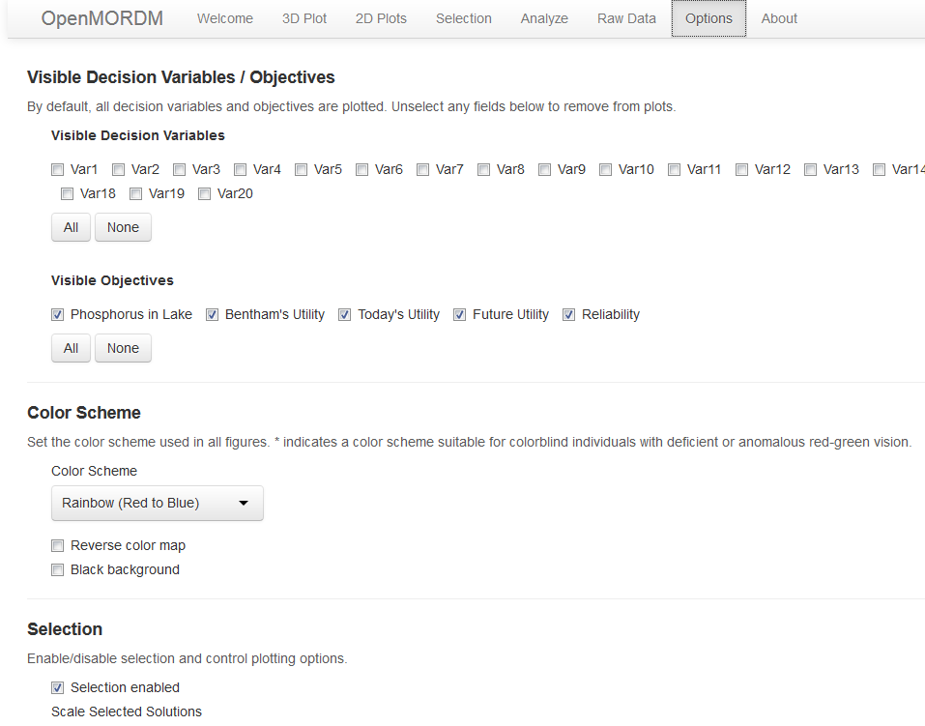
Customization
Customize the tool (which fields are plotted, color schemes, etc.) using the Options tab

Slide 15
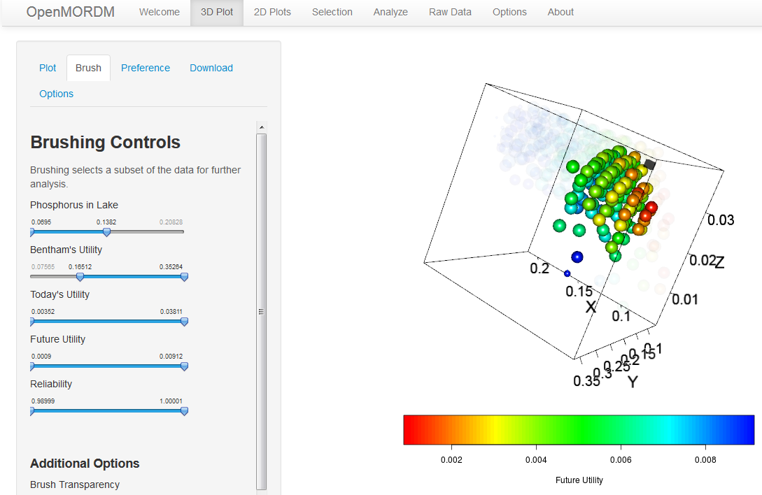
Advanced: Brushing
Brushing lets you identify a subset of the data for analysis.
Use these sliders to specify the lower/upper bounds…
…and see which points remain.

Slide 16
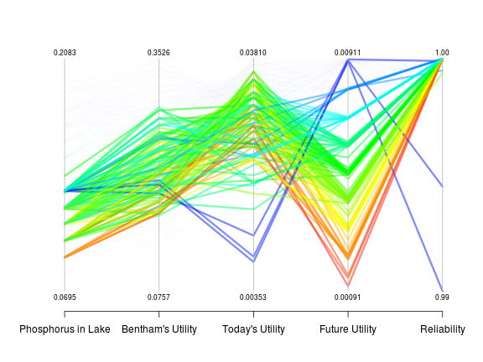
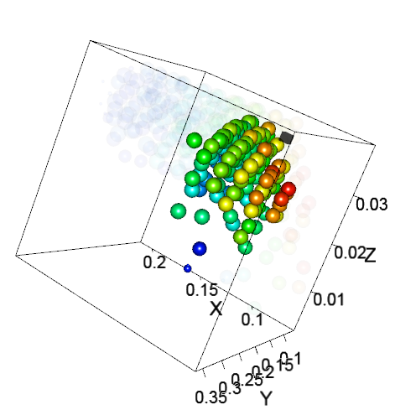
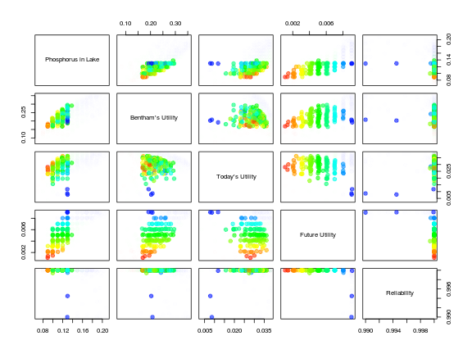
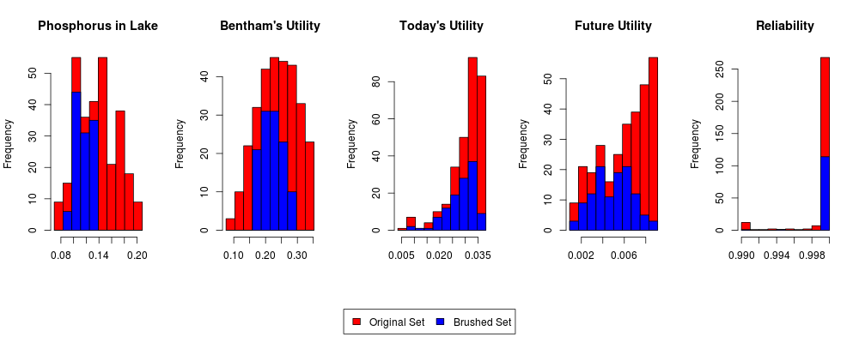
Advanced: Brushing
The 2D plots update automatically to show the brushed set

Slide 17
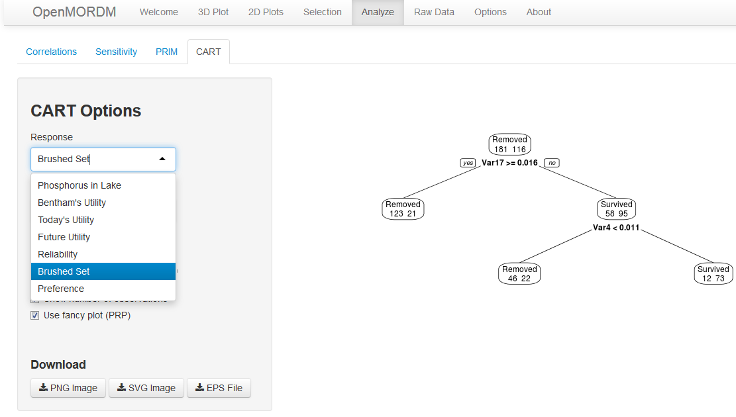
Advanced: Brushing
Additionally, the analysis methods include a “Brushed Set” response to analyze the difference between the solutions in the brushed set and those removed.
In this example, CART shows that only two inputs are needed to classify our brushed set!

Slide 18
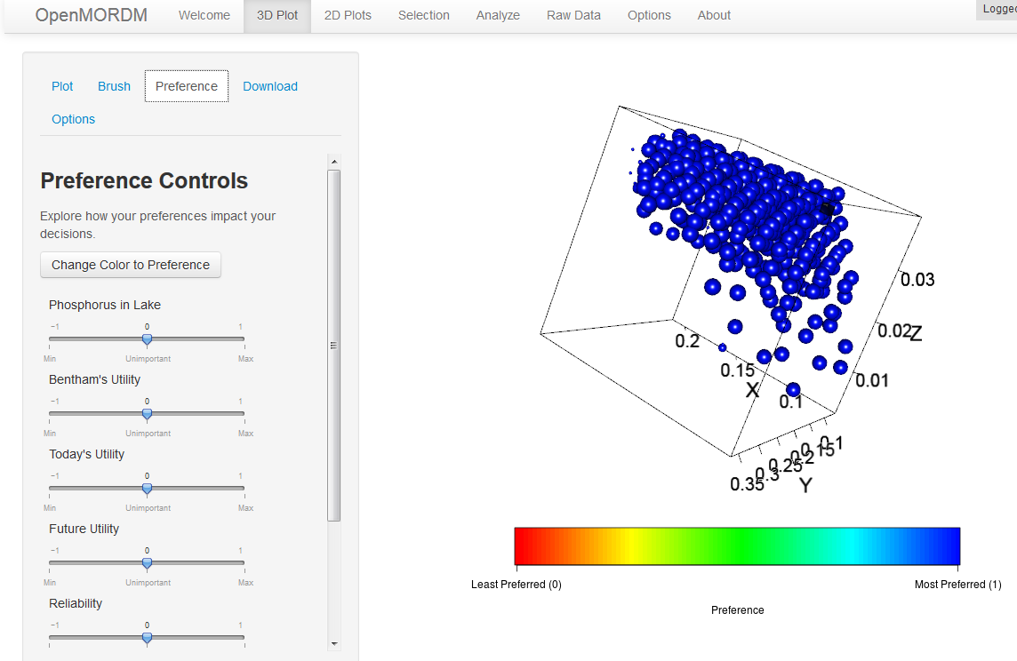
Advanced: Preferences
Specify preferences to color points by their relative importance
Click to color by preference
Initially, all points are blue (equally preferred) since we haven’t set any preferences!

Slide 19
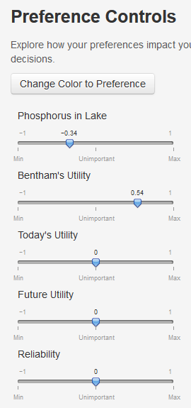
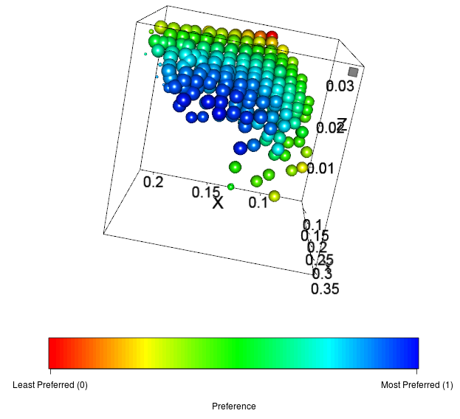
Advanced: Preferences
Adjust these sliders to set your preferences. Slide left to minimize, right to maximize. The further to the left/right increases the importance of that objective.
Your preferred points (blue is most preferred).

Slide 20
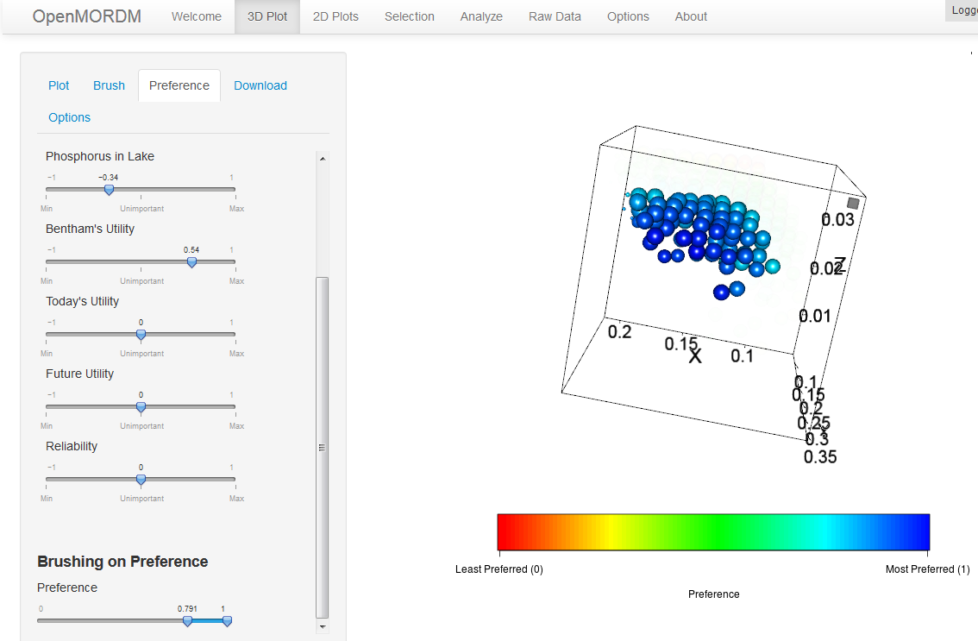
Advanced: Preferences
Finally, you can brush on your preferences and run the analyses on your brushed set.

Slide 21
Conclusion
OpenMORDM aims to be a free and accessible visualization toolkit
Please send comments and suggestions to:
Dr. Klaus Keller (SCRiM PI) - kzk10@ems.psu.edu
Dr. David Hadka (OpenMORDM developer) – dmh309@psu.edu
This work was supported by the National Science Foundation through the Network for Sustainable Climate Risk Management (SCRiM) under NSF cooperative agreement GEO-1240507.

