Slide 1
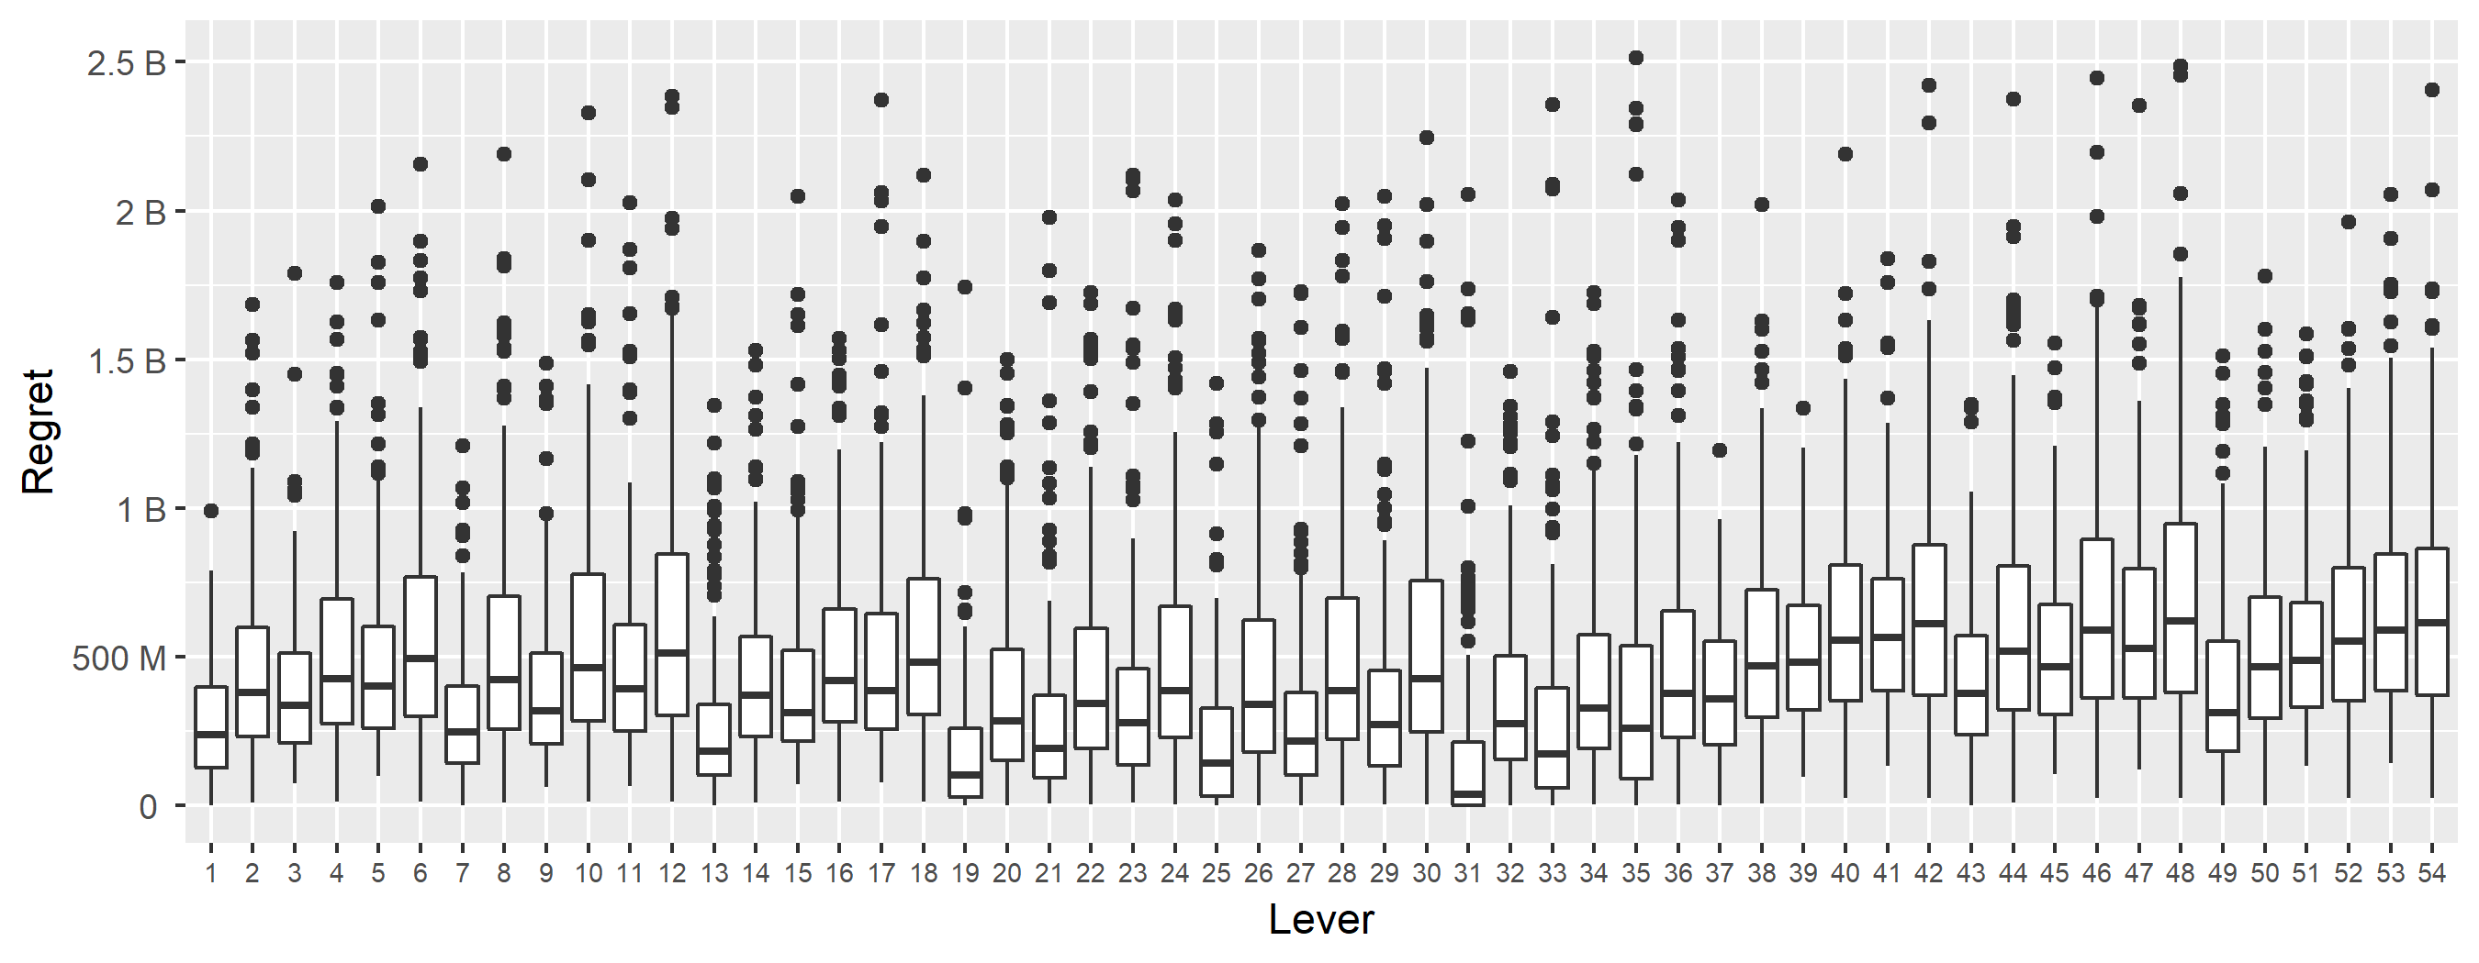
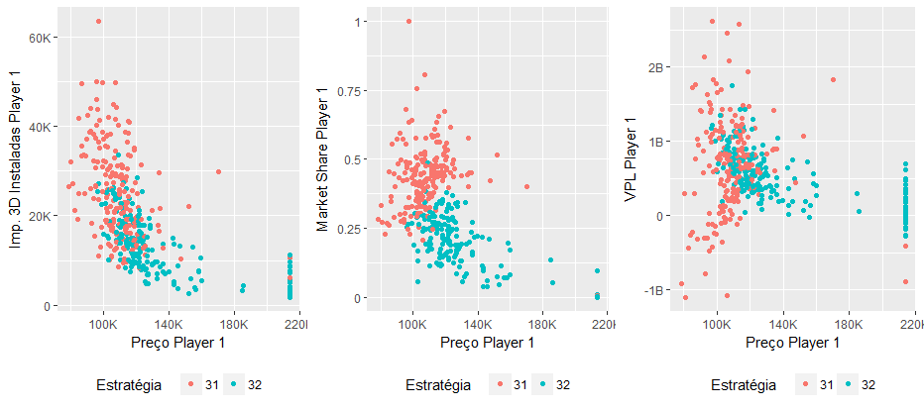
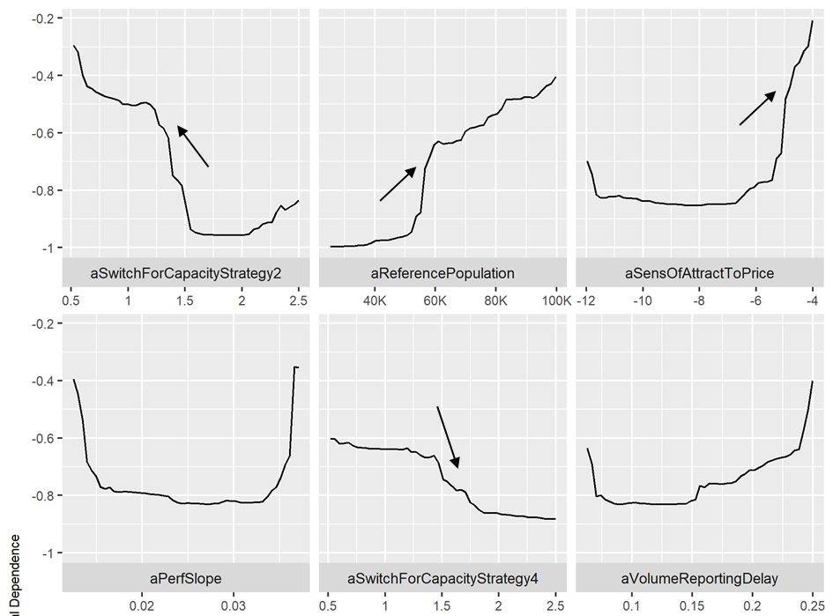
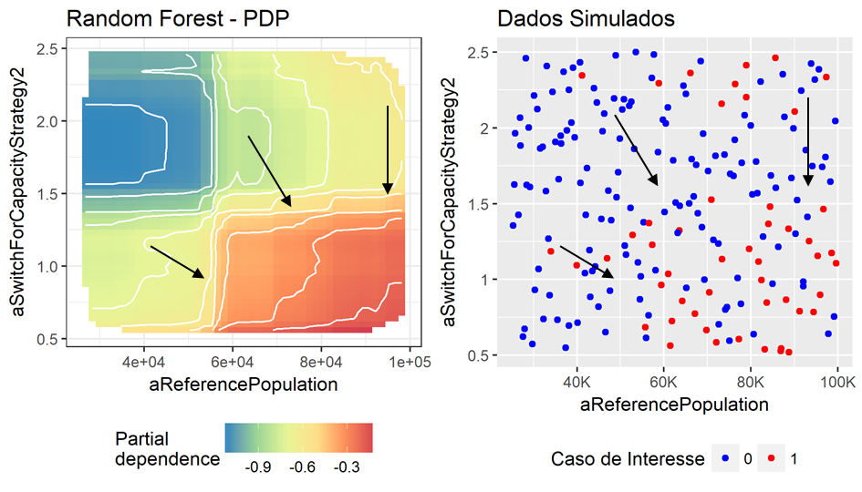
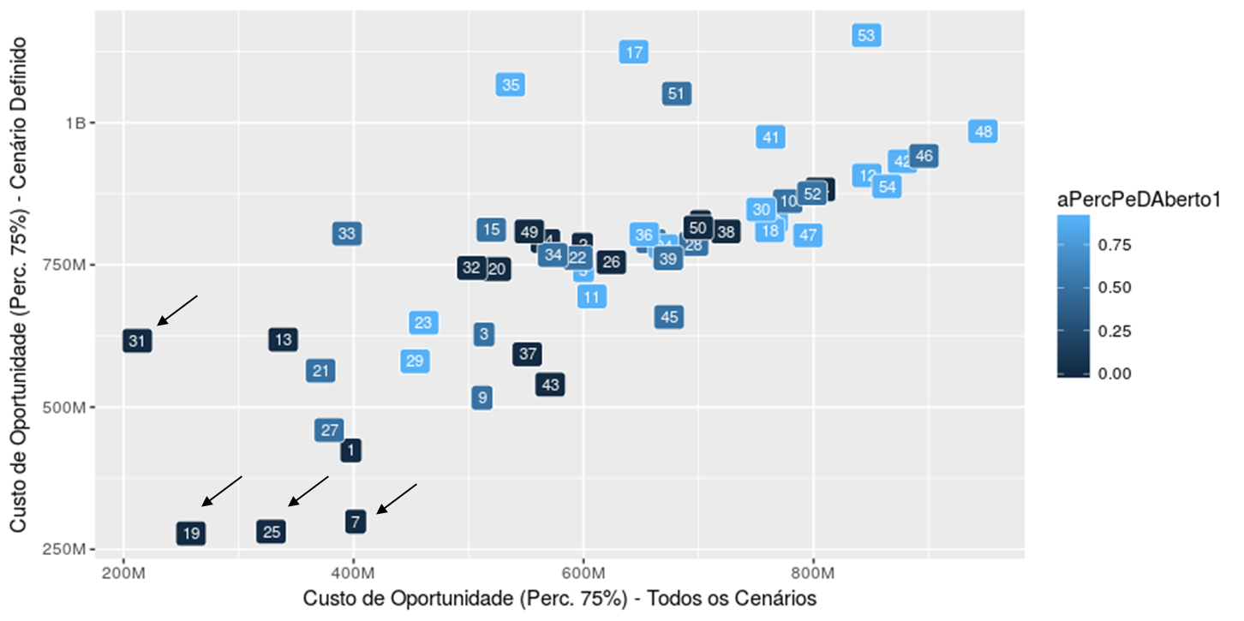
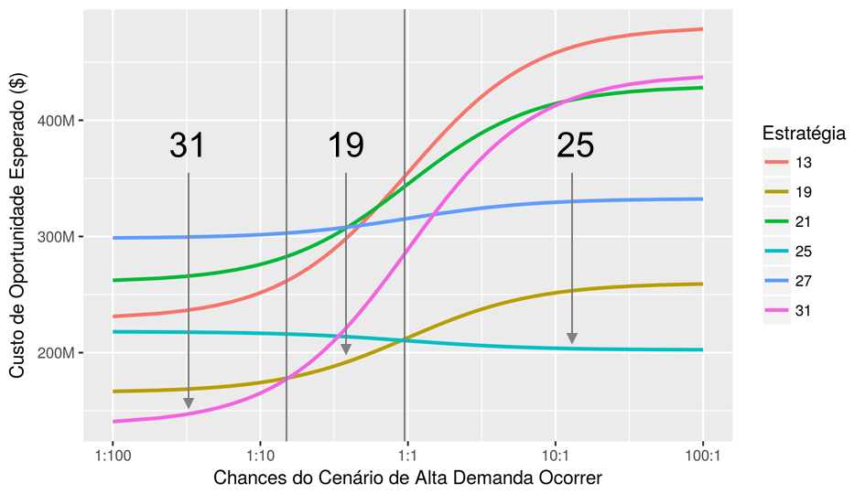
Strategic Decision Making in the 3D Printing Industry A Robust Decision Making Analysis Pedro Nascimento de Lima, Daniel Pacheco Lacerda, Maria I. W. M. Morandi UNISINOS University, GMAP Research Group – www.gmap.unisinos.br 2018 DMDU Society Annual Meeting
Introduction - The 3D Printing Industry
Case Generation
3D printing, the manufacturing of parts by adding layers of material is gaining traction for finished parts production in many segments (most notably in the healthcare and aerospace industries).
Key Factors driving 3D Printing Growth:
R & D and Technology Improvement: There are more than XX different printing
Patent Dynamics and Expiration: The expiration of key patents open up space for new entrants (ex.: The FDM patent expiration in 2007 and RepRap);
Competition and new Entrants:
Open Source Players: The most popular 3D printer, according to 3D Hubs, is open source.
54 strategies were obtained through a full factorial design of selected levers and their levels.
The simulation results database contains 10.800 simulations results, from testing all strategies across 200 scenarios obtained from Latin Hypercube Sampling of the 32 uncertain parameters.
XLRM – Problem Structuring
X – Uncertainties
This study analyzed parametric uncertainty, grouped into these categories:
Diffusion Dynamics parameters: how fast and to what extent the industrial grade 3d printing market might grow.
Opponent's Strategy: The strategy of the opponents players are also defined as uncertain.
L – Levers
Pricing and Capacity Strategies: Aggressive vs Conservative
R & D Strategy:
M – Metrics
We use the Net Present Value Regret as the metric to compare different alternatives.
R – Relationships
We extended Sterman et. al (2007) competitive dynamics model, explicitly allowing players to compete by printer performance, through R & D investments. This figure illustrates the model’s modules.
Scenario Discovery – Vulnerability Analysis
54 strategies were obtained through a full factorial design of selected levers and their levels.
The simulation results database contains 10.800 simulations results, from testing all strategies across 200 scenarios obtained from Latin Hypercube Sampling of the 32 uncertain parameters.
Price
f(Costs, Capacity Utilization, Market Share Strategy,…)
Cost
f(Learning Curve, Minimum Efficient Scale).
Market Share
f(Price, Delivery Time, Printer Performance, …)
Global Demand
f(Price, Market Size, ...)
Target Market Share; Market Share Strategy
Net Present Value
f(Production, Costs)
Production & Shipment
f(Mkt Share, Capacity)
Product Diffusion
f(Diffusion Velocity, Global Demand)
R&D
f(Revenue, R&D Budget, R&D Strategy)
Conclusions
Demand Forecast
f(Production)
Capacity
f(Capacity Strategy, Sales Forecast)

