Slide 1
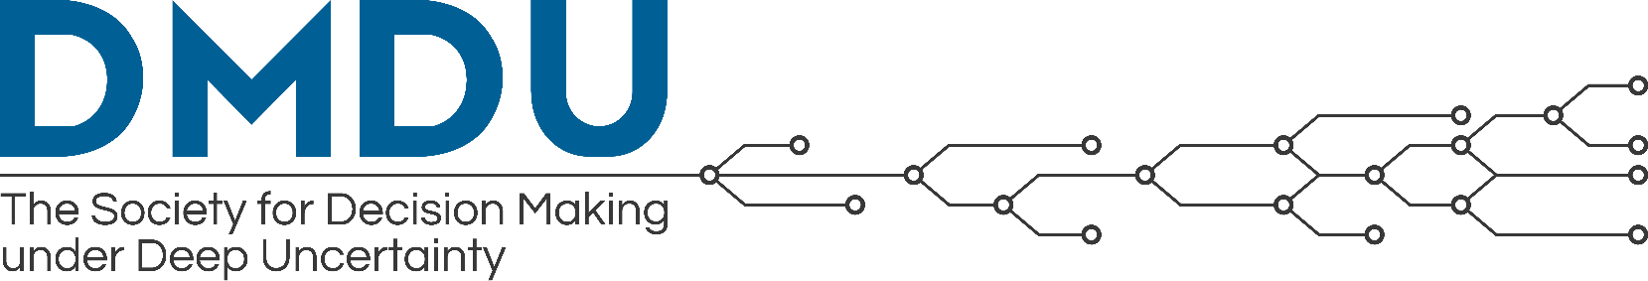
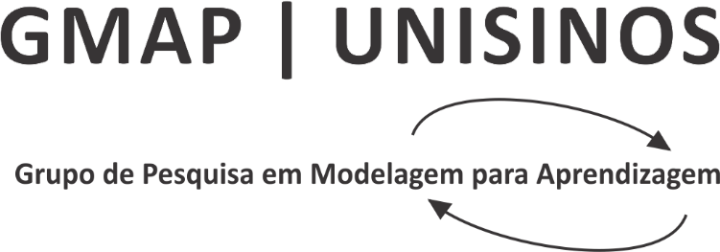
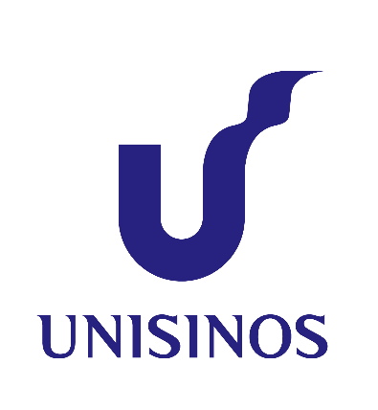

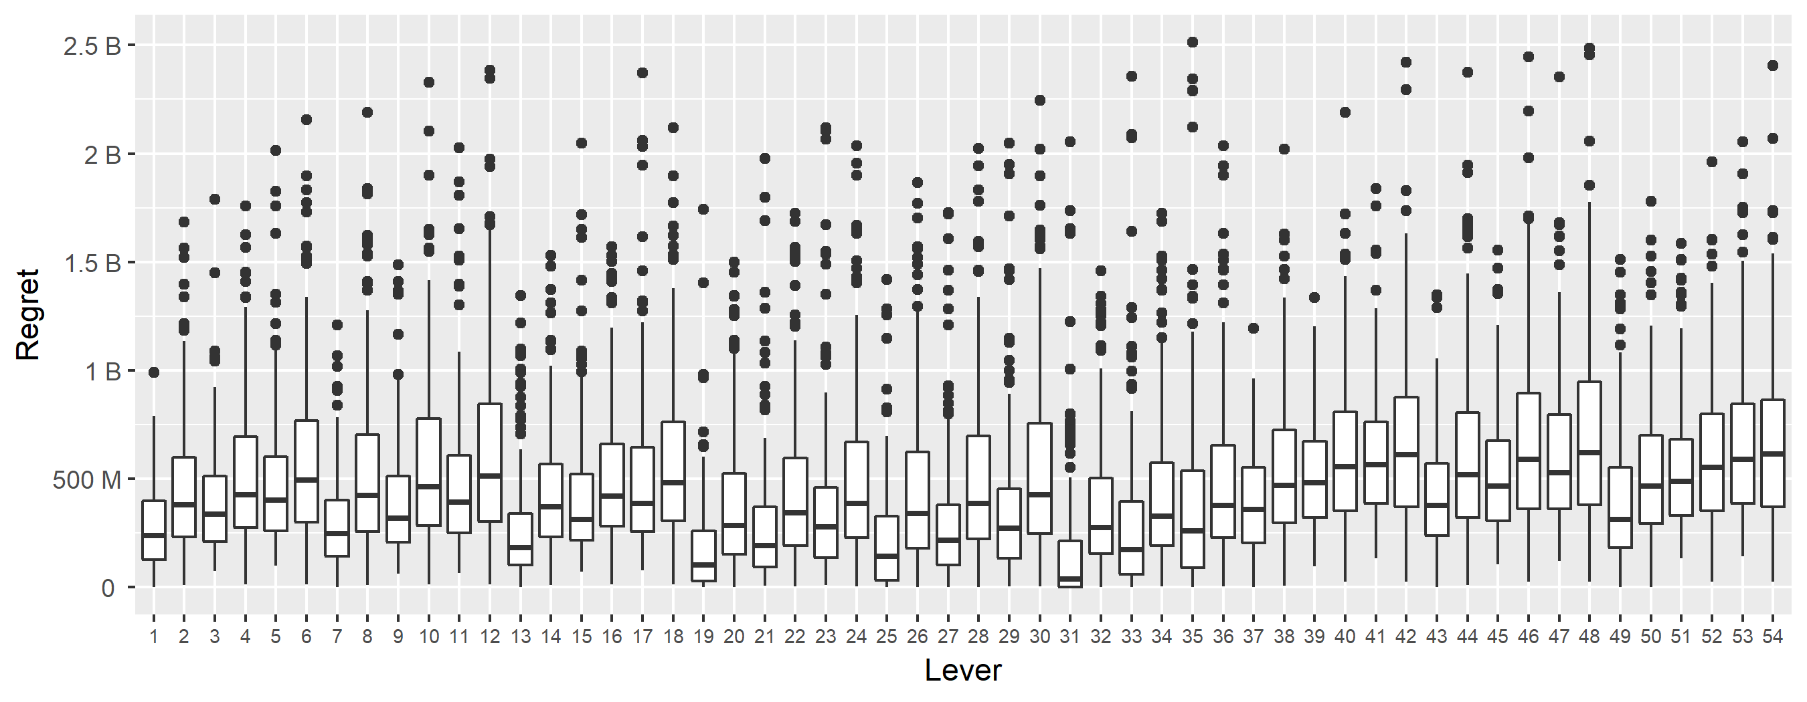
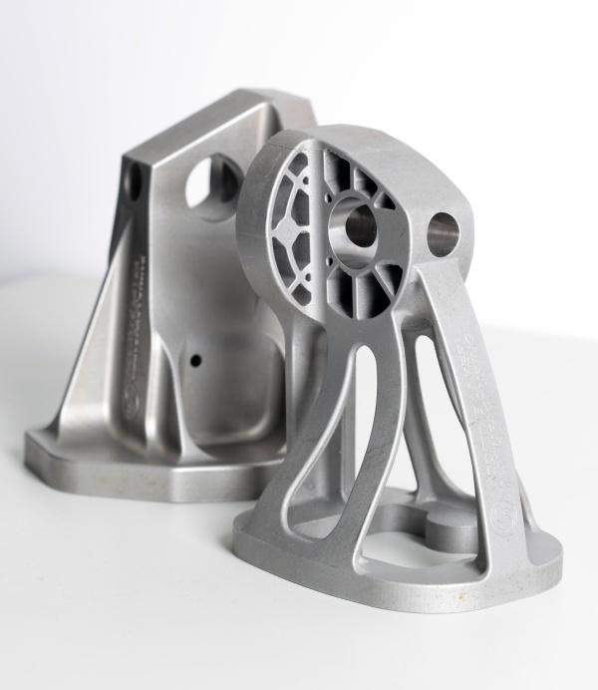
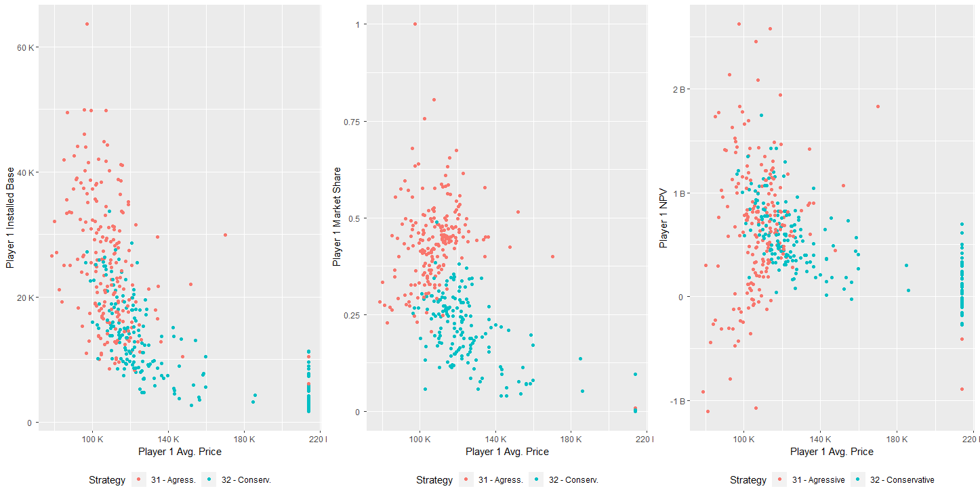
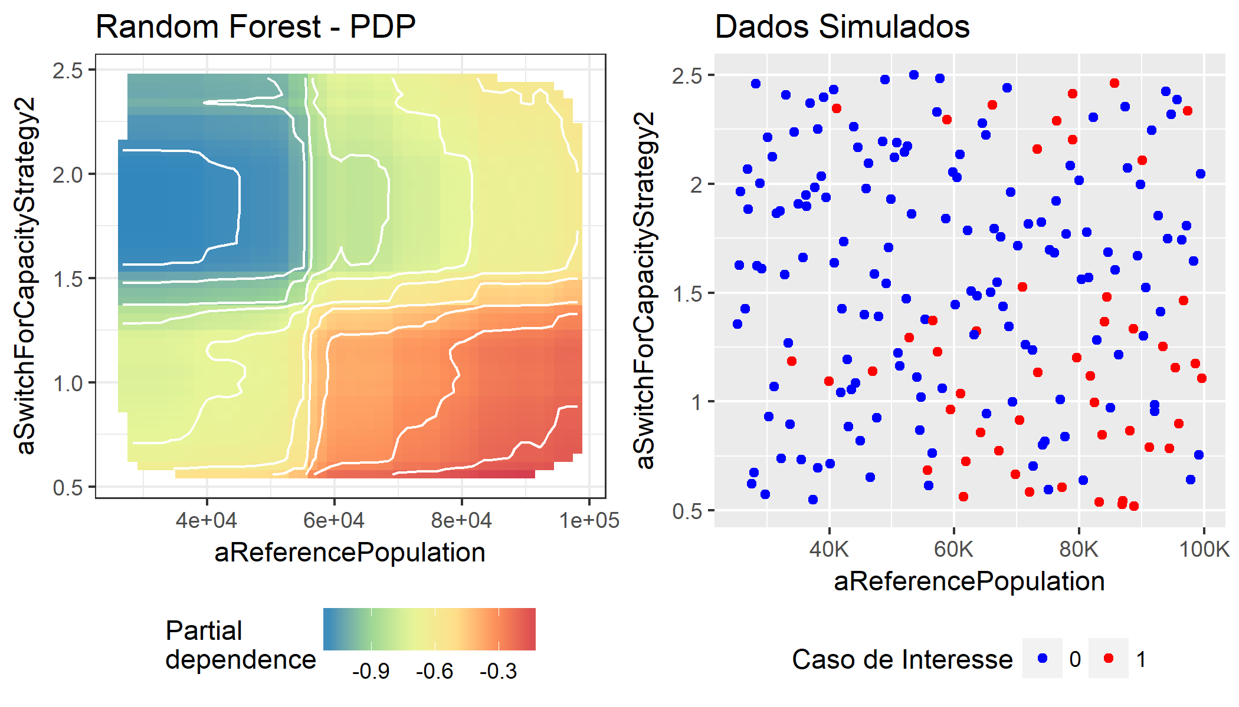
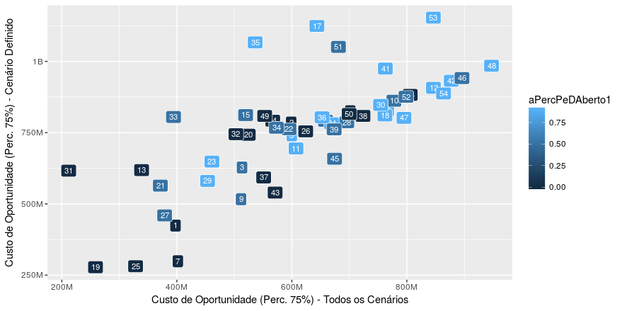
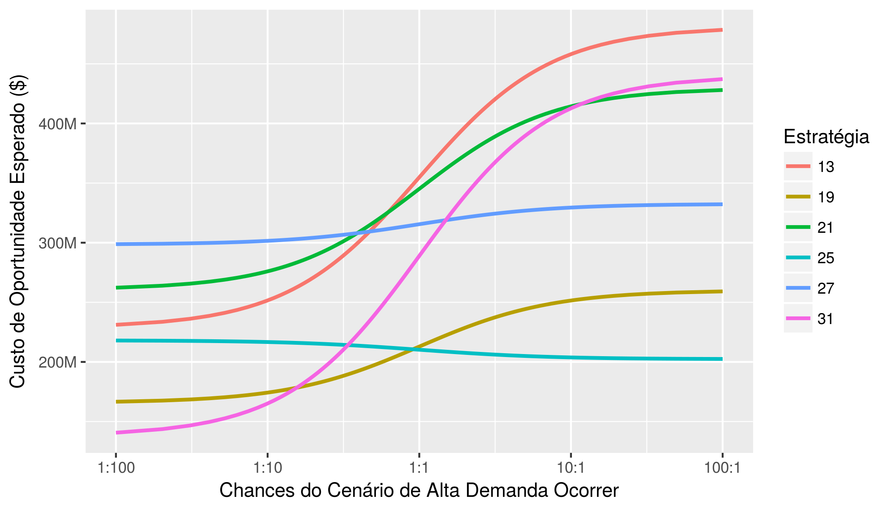

Strategic Decision Making in the 3D Printing Industry A Robust Decision Making Analysis Pedro N. de Lima, Maria I. W. M. Morandi, Daniel P. Lacerda, UNISINOS University, GMAP Research Group – www.gmap.unisinos.br 2018 DMDU Society Annual Meeting, California, US
Introduction - The 3D Printing Industry
Case Generation
3D printing, the manufacturing of parts by adding layers of material, is gaining importance not only for prototyping but also for finished parts production. Additive Manufacturing (AM) holds the potential to impact production systems by streamlining supply chains, enabling economic manufacturing of customized parts, and allowing the production of more efficient technical parts with highly complex geometry (e.g.: GE’s fuel nozzles).
54 strategies were obtained through a full-factorial design of the levers and their levels.
The simulation results database contains 10.800 runs (54 strategies X 200 scenarios obtained from LHS of the 35 uncertain parameters).
Aggressive, Closed Source Strategies dominated their counterparts.
The strategy with the least 75 percentile Regret was selected for vulnerability analysis.
Under this strategy, the player chooses to price aggressively with a high target market share (40 %), invest less in R & D (5%) with a closed source strategy.
Key Factors challenging Professional AM Systems Manufacturers’ Strategy:
Pace of R & D and Tech. Improvement;
Patent Dynamics and Expiration (e.g.: FDM in 2009);
Open Source Players;
Competition and new Entrants.
Conventional vs 3D printed part
XLRM – Problem Structuring
X – Uncertainties
This study analyzed parametric uncertainty present in the professional AM market, represented by 35 model parameters, including: Diffusion Dynamics parameters (how fast and to what extent the industrial-grade 3D printing market might grow), (ii) Opponent's Strategies (The strategy of the opponents manufacturers are also defined as uncertain), (iii) Market Share (to what extent the market will prioritize 3D printer performance rather than its cost), etc.
L – Levers
The AM Systems Manufacturer is allowed to use four levers: (i) Pricing and Capacity Strategy (Aggressive vs Conservative); (ii) Target Market Share (20%, 30% or 40%), (iii) R & D Budget (5%, 10%, 15%), and (iv) % of Open Source R & D (0%, 50%, 90%).
R – Relationships
We extended Sterman et. al (2007) competitive dynamics model, explicitly allowing players to compete by printer performance, through R & D investments. This figure illustrates the model’s modules and main relationships.
Scenario Discovery and Tradeoff Analysis
Scenario Discovery:
We trained a Random Forest, and employed the Boruta Algorithm to identify the most influential uncertainties that define de circumstances under which strategy 32 might fail ( Regret > 211.9 K USD).
PRIM also found a high-regret region where the strategy failed on 82,1 % of the futures simulated.
Tradeoff Analysis:
Tradeoff analysis lends no support for Open R & D or Conservative Strategies, as the tradeoff frontier is dominated by closed-source, less-aggressive strategies.
Strategies 25 and 19 still use an aggressive heuristic but have less ambitious target market share.
Random Forest - PDP
Simulation Results (strat. 31)
P2 – Agressive P2 - Conservative
Reference Market Size
Reference Market Size
Partial Dependence
Strat. Fails
PRIM Results – Conditions under Which Strategy 31 fails
Uncertainty | Vulnerability Range
Reference Market Size | 25K 100K
 | 58K 100K
Capacity Utilization % | 0,6 1
 | 0,626 0,864
Player 2 Desired Market Share | 0,29 0,58
 | 0,325 0,528
Player 4 Capacity Strategy | 0,5 2,5
 | 0,611 2,14
Market Share Sensitivity to Price | -12 -4
 | -11,3 -4,01
Coverage: 46%, Density: 82,6%, Mass: 14 %
75th percentile Regret over high-regret scenario
Open R&D %
75th percentile Regret over all futures
Price
f(Costs, Capacity Utilization, Market Share Strategy,…)
Global Demand
f(Price, Market Size, ...)
Modules Disaggregated by Player
S 31
TM: 40%
S 25
TM: 30%
S 19
TM: 20%
Strategy
Modules not Disaggregated by Player
Expected Regret
Costs
f(Learning Curve, Minimum Efficient Scale, R&D Spending).
Market Share
f(Price, Delivery Time, Printer Performance, …)
Odds of High Regret Scenario
Odds of High Regret Scenario
Target Market Share; Market Share Strategy
Net Present Value
f(Production, Costs)
Production & Shipment
f(Mkt Share, Capacity)
Product Diffusion
f(Diffusion Velocity, Global Demand)
R&D
f(Revenue, R&D Budget, R&D Strategy)
Conclusions
Demand Forecast
f(Production)
Capacity
f(Target Market Share, Sales Forecast)
This analysis provides an exploration of model-based Business Strategic Decision aiding under the DMDU framework. Future work might either relax some of the structural assumptions of the model employed on this analysis or turn to new deeply uncertain business problems.
Slides and full master’s thesis at:
M – Metrics
We use the Absolute Regret of the Player’s 1 Net Present Value as the metric to compare different alternatives.
www.pedronl.com/post

