Slide 1

JavaScript Promises
by Pedro Liska

Slide 2
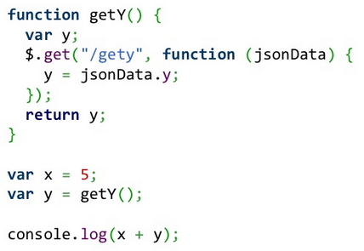
Common Beginner Issue

Slide 3
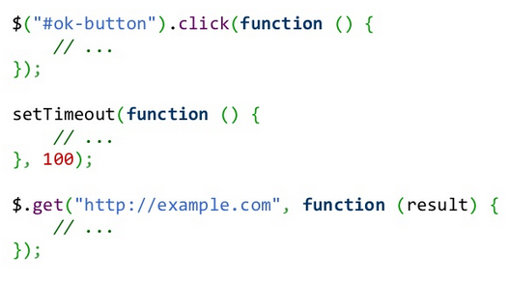
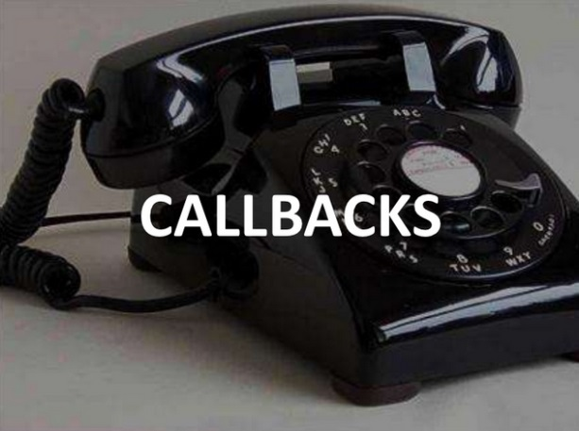
Why are promises such a big deal in JavaScript?
The callback pattern is everywhere and it can get messy (callback hell)

Slide 4
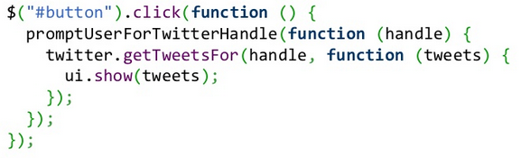
Doing things in sequence is hard

Slide 5
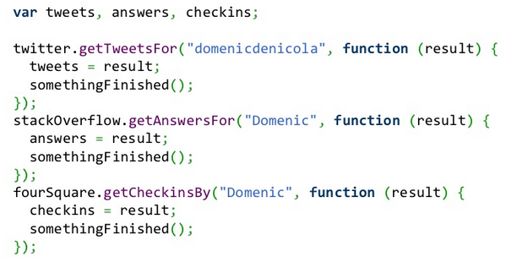
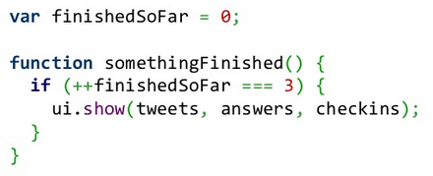
Doing things in parallel is harder

Slide 6
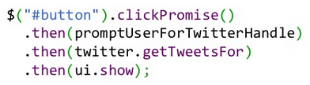
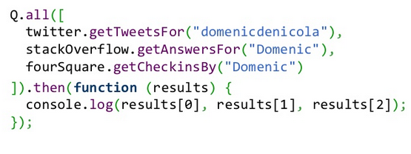
Promises are cleaner

Slide 7
Promises look clean, but how would you define them?
A promise is an object that represents an action that can only be executed ONE time.
Promises can be in the following states:
Fullfilled
Rejected
Pending
Settled (fullfilled or rejected)

Slide 8
Promise Standards
The latest is the Promises/A+
Promises/A
Promises/B

Slide 9
Native Browser Support
OK on latest Chrome, Opera, and Firefox Nightly
There is a pollyifll
github.com/jakearchibald/es6-promise
Based on rsvp.js
A+ guys are actively updating the ECMAScript6 draft

Slide 10
Promise Libraries
Q
Promises/A+
Can wrap jQuery promises making them A+
rsvp.js (A+)
Bluebird (A+)
Fast and lightweight
jQuery (Deferred)
Not A+
And tons more

Slide 11
Let’s be more specific, why are promises so popular?
Cleaner method signatures
Easy composition
sequential/parallel join
Standard return semantics*
Standard error handling*
* great benefits when chaining promises

Slide 12
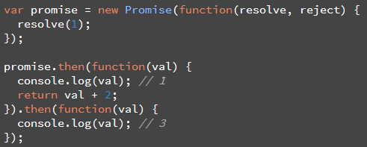
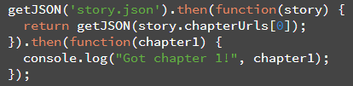
Return semantics
Returning a value
Returning a promise

Slide 13
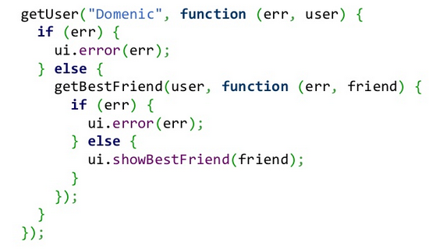
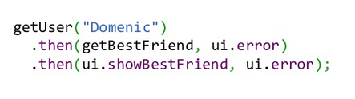

Error handling

Slide 14
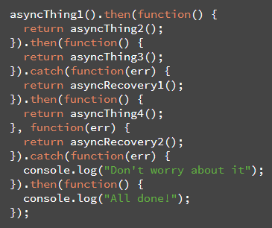
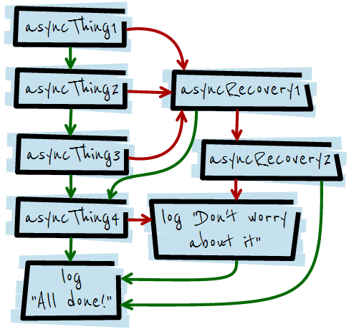
Cool chaining feature: “catch”

Slide 15
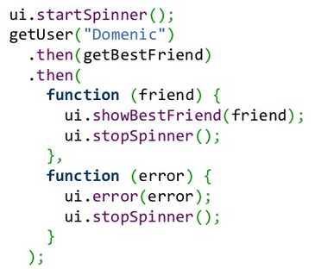
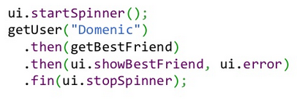
Cool chaining feature: “finally”

Slide 16
Code Demo time!
... almost … references first:
Callbacks, Promises, and Coroutines by Domenic Denicola
http://www.slideshare.net/domenicdenicola/callbacks-promises-and-coroutines-oh-my-the-evolution-of-asynchronicity-in-javascript
JavaScript Promises by Jake Archibald
http://www.html5rocks.com/en/tutorials/es6/promises/

Slide 17
Code Demo

