Slide 1
How do incumbents respond when a low-cost rival enters?
An agent-based model of DIGI’s entry into the Portuguese bundled-services market
30 October 2026 | Project 1 · Agentic AI
Notes:
Introduce the group (10 s). We took the Consumer Choice model, rebuilt it in Mesa, fitted it to DIGI's entry into the Portuguese market and let the incumbents learn their prices.

Slide 2
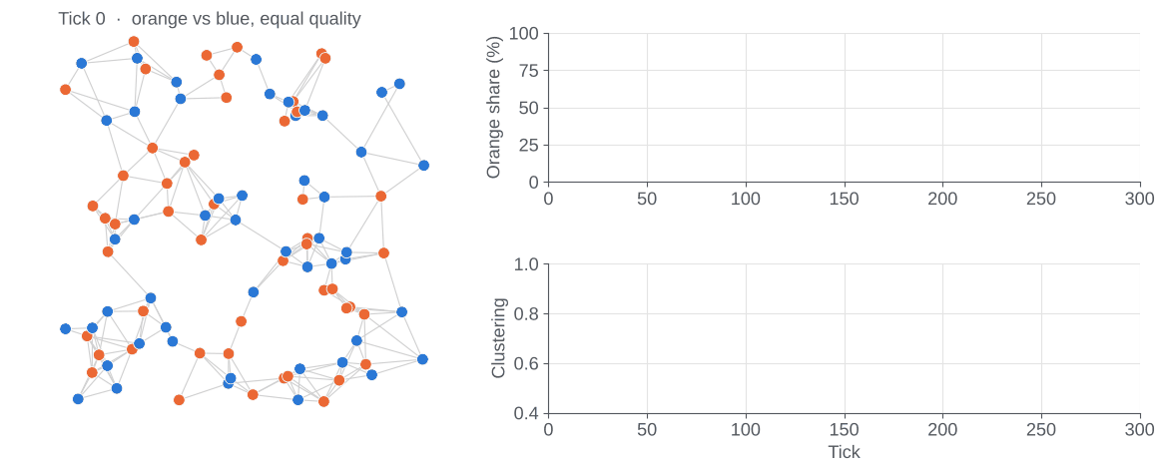
Consumer Choice: habit, exploration, utility
| Tasks 1-2 · Baseline model
Habit
keep the product with probability equal to satisfaction, log₁₀(1 + 9q)
1
Exploration
otherwise, try another product with a small probability ε
2
Utility
otherwise, choose the highest mix of friends’ norm and known quality
3
One run, rebuilt in Python and Mesa: 100 consumers in a friendship network. Friends end up with the same product.
Notes:
About 45 s. Model by Jager and Wang (NetLogo library), rebuilt in Python with Mesa; with the same seeds our version reproduces the decision rule step by step. Consumers sit in a friendship network. Each tick: (1) habit, they keep the product with probability equal to satisfaction; (2) otherwise, with small probability they explore another product; (3) otherwise they pick the highest utility, which mixes the social norm (share of friends using it) and the quality they know from experience and from friends. Outputs: market shares and clustering.

Slide 3
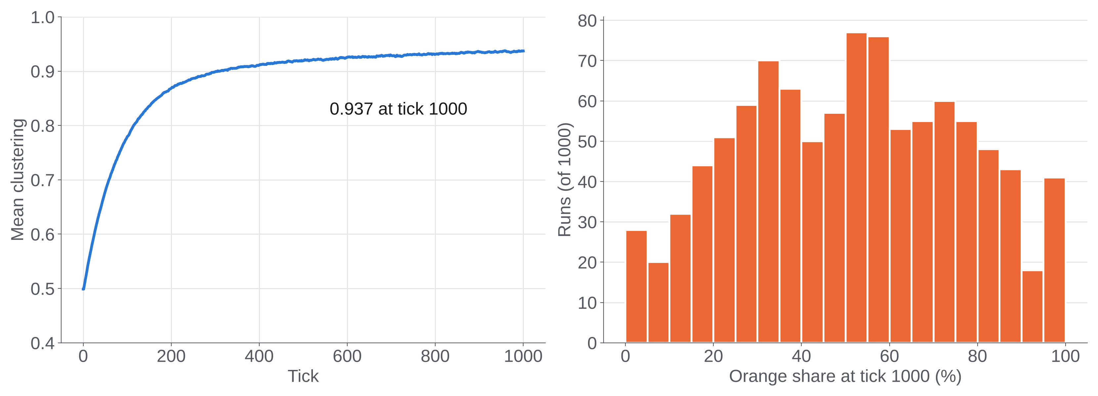
Baseline: strong clusters, unpredictable winner
| Tasks 1-2 · 1000 runs, two equal products
0.937
clustering at tick 1000: friends end up with the same product
0.11 – 0.92
orange share, middle 90% of runs: same settings, different markets
Sensitivity: any norm creates clusters (0.54 → 0.94) · a 0.05 quality gap decides the winner (0.95 vs 0.07) · exploration breaks clusters (0.67 at ε = 0.2)
Notes:
About 45 s. 1000 runs, results at tick 1000. Friends end up using the same product: clustering 0.937 (95% CI 0.935-0.939). The mean orange share is one half, as expected with equal products, but no run looks like the mean: SD 0.25, the middle 90% of runs lie between 0.11 and 0.92. Same settings, very different markets, driven by social influence and chance. One-at-a-time sensitivity, 100 runs per value: any norm creates clusters (0.54 at norm 0, about 0.94 from 0.1 up); a small quality gap decides the winner (orange 0.95 when blue is 0.45, 0.07 when blue is 0.55); exploration breaks clusters (0.67 at 0.2).

Slide 4
Adapting the model to a real market
| Tasks 3-4 · From two products to four operators
Kept from the baseline
Added for the telecom market
Social network of friends
Three-step decision: habit → exploration → utility
Utility from the social norm and the known quality
Information and memory: consumers know only what they tried or heard
Real operators and prices: MEO, NOS €42.49 · Vodafone €40.50 · DIGI €22
Quality from ANACOM complaints, DIGI improving over time
Contracts and legal penalties (Lei 16/2022): 24 months vs DIGI’s 3
Market entry: NOWO becomes DIGI (Nov 2024)
Dynamic demography: households enter and leave
Prices learned by reinforcement learning (ε-greedy bandit)
Notes:
Ze, about 50 s. Left: what we kept from the baseline, so tasks 1-2 still hold: the social network, the three-step decision (habit, exploration, utility), utility from the norm and the known quality, and limited information and memory: consumers know only what they tried or heard from friends. Right: what we added for the telecom market: real operators with empirical prices; quality from ANACOM complaints; contracts and legal early-exit penalties (Lei 16/2022); the market entry of DIGI, which bought NOWO; a dynamic population; and strategic pricing learned with reinforcement learning, a multi-armed epsilon-greedy bandit.

Slide 5
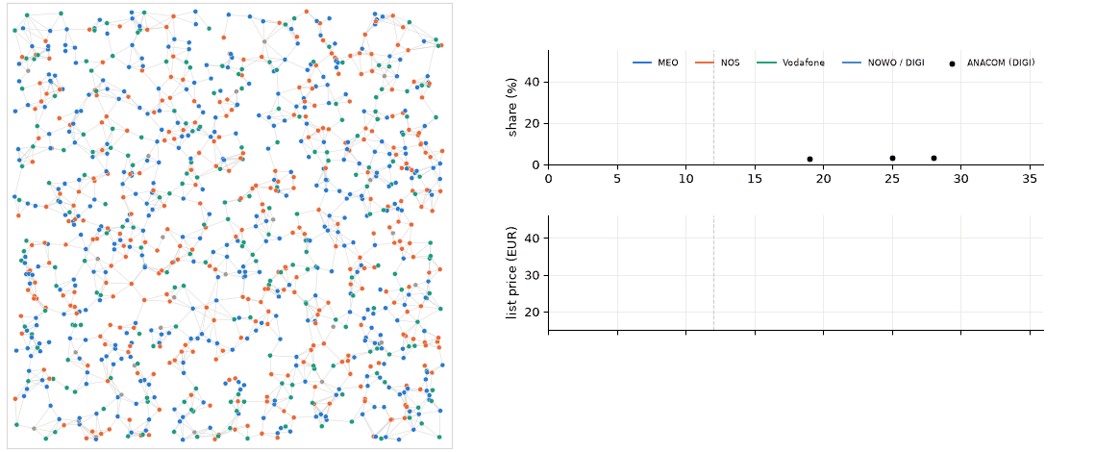
Half the price, slow growth: the model reproduces it
| Tasks 3-4 · The adapted model, calibrated to ANACOM data
€22 vs €42.49
DIGI fibre + TV vs MEO and NOS
+0.6 pp
DIGI/NOWO share in 18 months: 2.6% → 3.2%
3.2% = 3.2%
model vs ANACOM at month 28 (error 0.22 pp)
One run, 48 months: households coloured by operator (DIGI in purple from month 12); right, shares and list prices.
Notes:
Ze, about 40 s. The puzzle: DIGI sells fibre plus TV at 22 euros against 42.49 at MEO and NOS, with 3-month instead of 24-month contracts, yet its share (with NOWO) rose only 0.6 points in about 18 months, from 2.6% to 3.2%. We fitted two behavioural parameters (norm weight 0.10, exploration 0.02) and brand constants to DIGI's path. The model reaches 3.2% at month 28 but grows later than the data (2.4% vs 2.8% at month 19). Error 0.22 points, 30 runs. Month 0 is November 2023; DIGI enters in month 12, November 2024. Sources: ANACOM bundled services; CNN Portugal/DECO barometer Oct 2025.

Slide 6
Incumbents learn their price by trial and error
| Task 5 · Reinforcement learning: ε-greedy multi-armed bandit
Choose a price
list × 1.00 · 0.95 · 0.90 · 0.85 · 0.80
90% best so far, 10% random
Consumers react
3 months of habit, friends, prices and contracts
Agents MEO, NOS and Vodafone, from DIGI’s entry; DIGI stays at €22
Start each price is tried once, in random order
Information own profit only: no firm sees or talks to the others
Test vs fixed-price scenarios, same random numbers, 30 runs × 10 years
Update the value
Q ← Q + 0.2 · (reward − Q)
Reward
profit of the quarter (margin 40%)
Notes:
About 50 s. The learning agents are the three incumbents; DIGI keeps 22 euros. From DIGI's entry, every three months, each incumbent picks one of five prices, from the list price to 20% below; 90% of the time the price with the best value so far, 10% a random one. It observes the profit of the quarter, the margin and not revenue, and updates that price's value with step 0.2, which weights recent quarters because the market keeps changing. Each price is tried once first, in random order. No firm sees the others' prices or talks to them. We compare with fixed-price scenarios using the same random numbers: 30 runs, 10 years after the entry. Method: Sutton and Barto (2018), ch. 2.

Slide 7
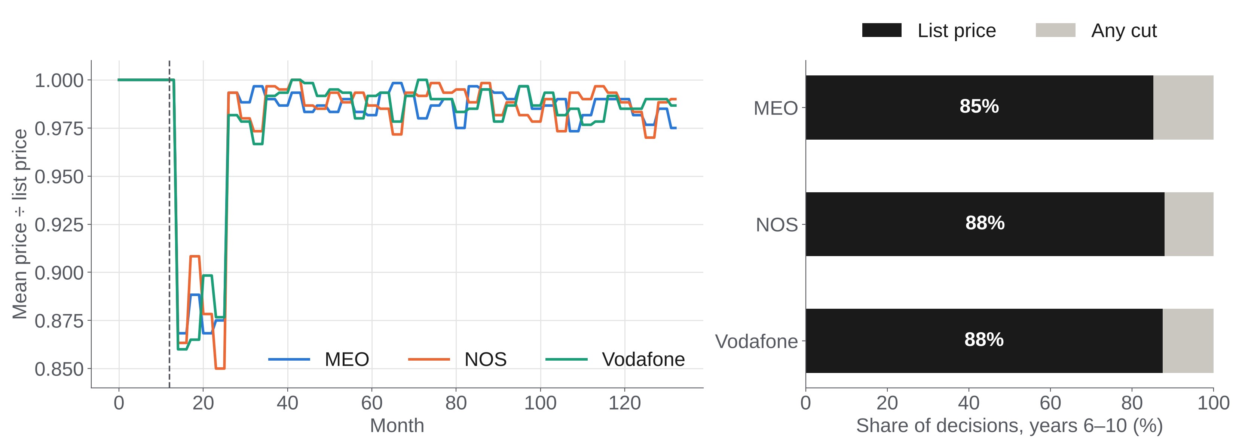
Learned prices return to the list price
| Task 5 · List price chosen in 85-88% of decisions in years 6-10
Notes:
About 40 s. Left: mean price relative to the list price, 30 runs. After the entry the incumbents try every price once (the dip), then settle close to the list price: mean multiplier 0.98. Right: in years 6-10 the list price is chosen in 85% (MEO) and 88% (NOS, Vodafone) of the decisions; most of the rest is the 10% random exploration. This is not learned collusion: the bandit cannot see its rivals. A cut lowers the margin at once, while the customers it wins arrive slowly, over 24-month contracts, so a 3-month reward favours keeping the margin.

Slide 8
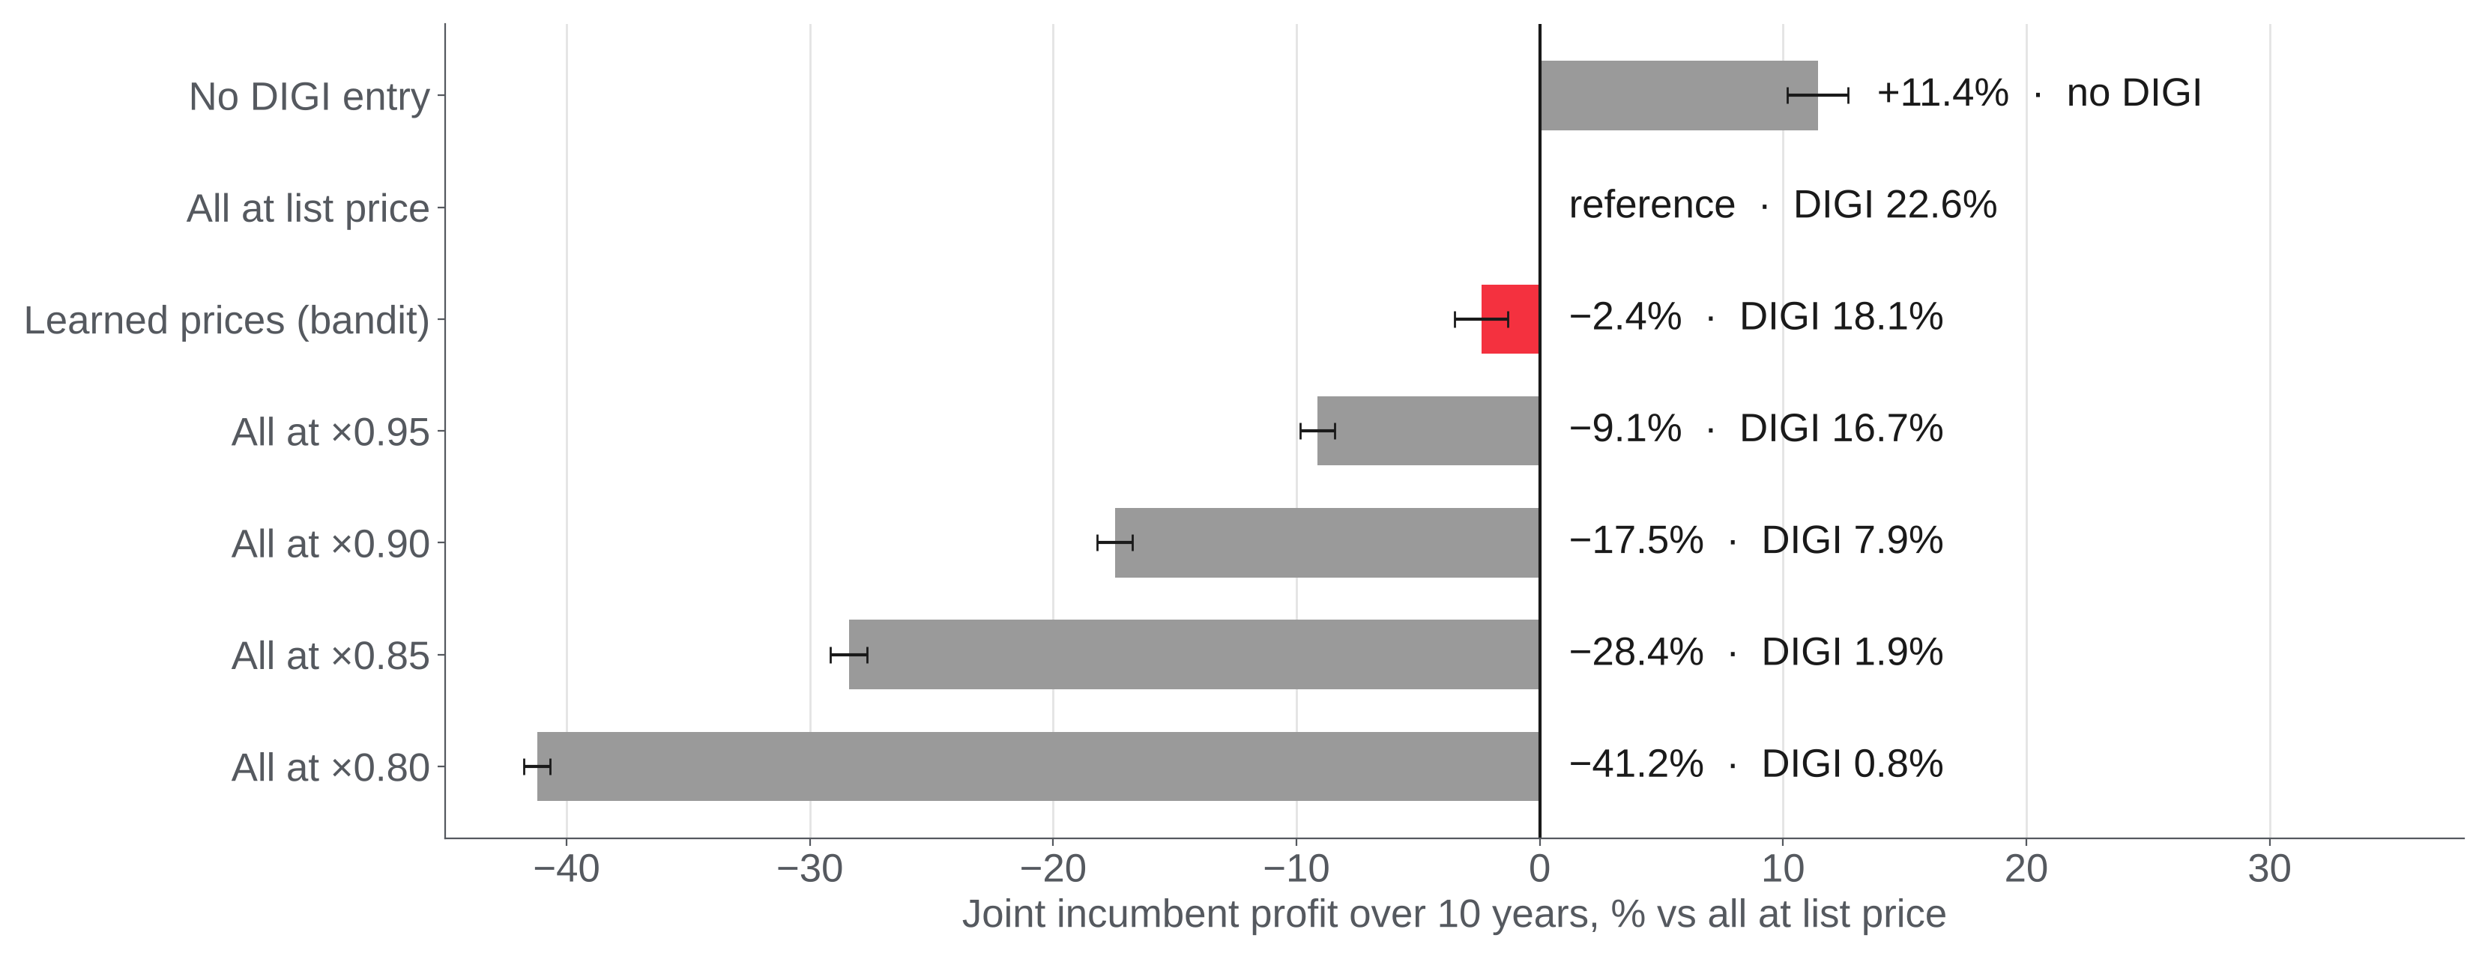
Cutting prices together costs far more than it saves
| Task 6 · Joint incumbent profit over 10 years vs all at list price
Notes:
About 40 s. Paired by seed, 95% confidence intervals, 30 runs per scenario. DIGI costs the incumbents about a tenth of their profit: without the entry they would earn 11.4% more. Learned prices cost only 2.4% (CI -3.5 to -1.3). Matching DIGI on price stops much of its growth (DIGI at 7.9% instead of 22.6% with all at 0.90) but costs 17.5% of joint profit. The 10-year values compare scenarios; they are not forecasts: our data cover 30 months.

Slide 9
Each gains alone, all lose together
| Task 6 · Results, robustness and conclusions
Own profit vs list | Cuts alone to ×0.90 | All cut to ×0.90
MEO | +14.9% | −18.3%
NOS | +19.3% | −8.7%
Vodafone | +36.2% | −30.5%
Conclusions
1
Contracts and habit slow a cheap rival
DIGI reaches 3.2% only after 16 months
2
List price is not an equilibrium
each incumbent gains by cutting alone
Robust to 9 changes (quality spread, exits, initial contracts, renewal discount, lock-in, margin): a solo cut pays for NOS and Vodafone in all; learned prices stay at 0.97–0.98 × list.
3
Simple learners stay near list price
no communication; as observed, main brands kept prices
Notes:
About 50 s. Own profit against all at list price. Each incumbent gains by cutting alone to 0.90 (MEO +14.9%, NOS +19.3%, Vodafone +36.2%), but loses when all cut: a prisoner's dilemma, so the list price is not an equilibrium. Robustness: 9 one-at-a-time changes (quality spread, exits, initial contracts, renewal discount 17.8%, full lock-in, margin 60%), 20 runs each: a solo cut pays for NOS and Vodafone in all of them; learned prices stay at 0.97-0.98 of the list price. Conclusions, then limitations if asked: low mobility at contract end (under 1% vs 13.6% in Confraria et al.), long horizon, bandit without view of rivals.

