Slide 1
Optimisation in Pattern Recognition: Principal Component Analysis (PCA)
Tae-Kyun Kim
Senior Lecturer
https://labicvl.github.io/
Backgrounds:
Linear algebra
Optimisation
- Lagrange multipliers
- Gradient method
Matrix and vector derivatives
Further reading:
Chapter 12, C.M.Bishop, Pattern Recognition and Machine Learning, Springer, 2006.

Slide 2
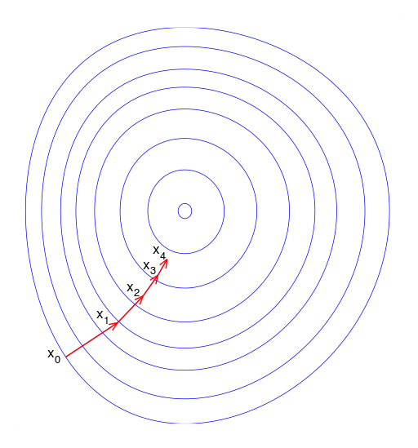
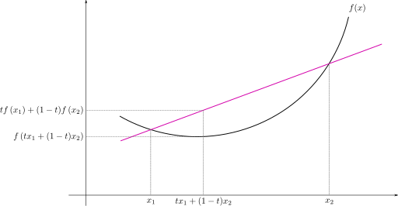



Gradient-based optimisation
In optimization, gradient method is an algorithm to solve problems of the form
with the search directions defined by the gradient of the function at the current point.
Examples of gradient method are PCA, LDA, Kernel Machines, Neural Networks.
Gradient descent (or ascent) is an iterative optimization algorithm for finding a local minimum (or maximum) of a function, taking steps proportional to the gradient at the current point.
$$\min_{\text{x}\text{∈}\text{R}\text{n}}{f(x)}$$
$$x_{i+1}=x_{i}−γ_{i}∇f\left(x_{i}\right), i≥0$$
$$f(x)$$
When the function f is convex, all local minima are also global minima.
A function is convex, if the line segment between any two points on the graph of the function lies above or on the graph.
Appendix A: Mathematical Foundations, R.Duda, P.Hart, D.Stork, Pattern Classifcation (Second Edition), JOHN WILEY & SONS, Inc. 2001.

Slide 3
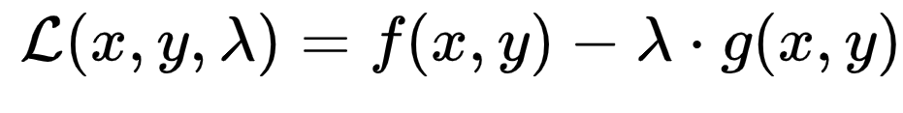
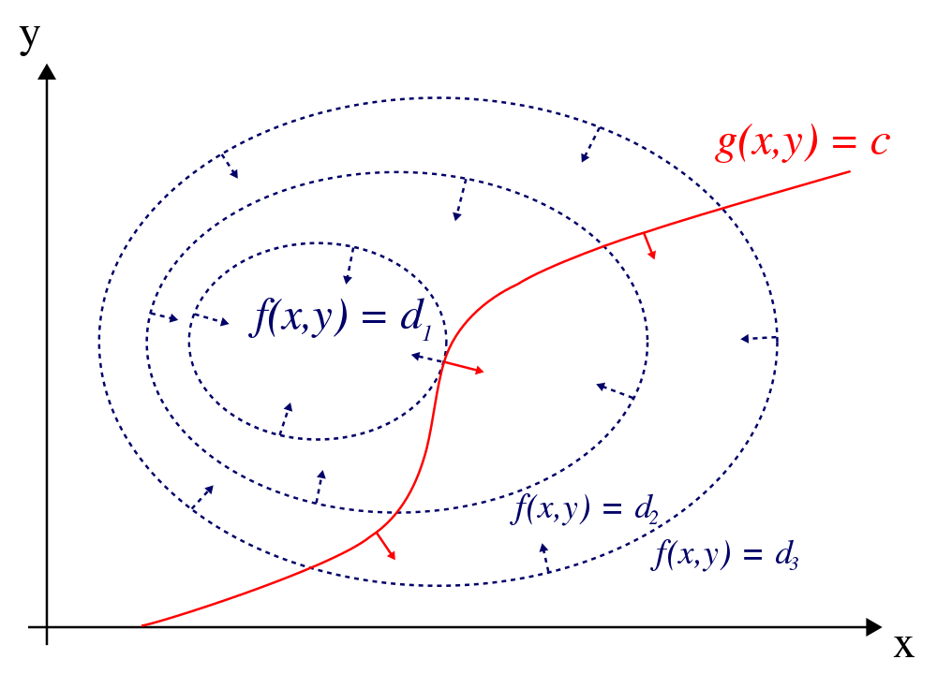
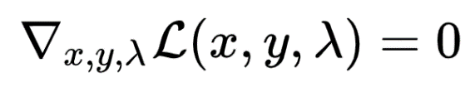
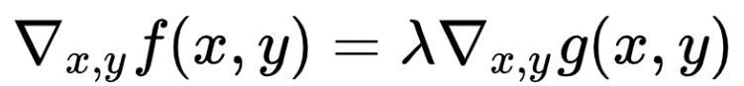


Lagrange multipliers for constrained optimisation problems
The method of Lagrange multipliers is a strategy for finding the local maxima/minima of a function subject to equality constraints.
The Lagrange function is
where λ is a constant.
We solve
maximize f(x, y)
subject to g(x, y) = 0, or g(x, y) = c
Appendix A: Mathematical Foundations, R.Duda, P.Hart, D.Stork, Pattern Classifcation (Second Edition), JOHN WILEY & SONS, Inc. 2001.

Slide 4
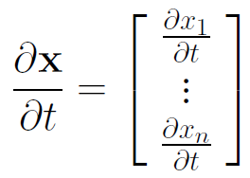
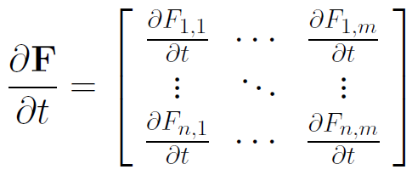
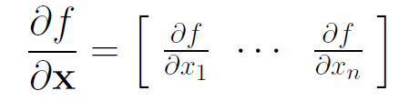
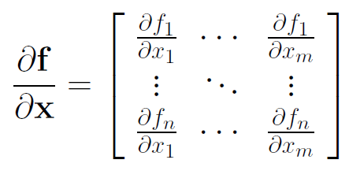
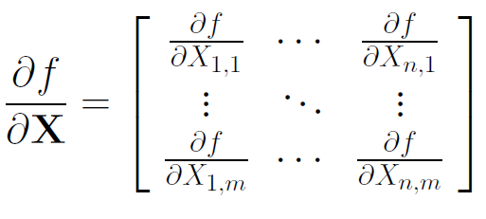
Matrix and vector derivatives
Matrix and vector derivatives are obtained first by element-wise derivatives and then reforming them into matrices and vectors.

Slide 5
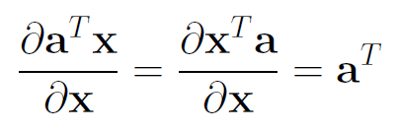
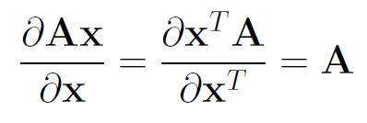
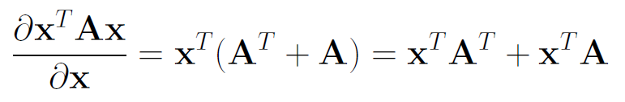
Matrix and vector derivatives
Useful formula for linear and quadratic functions:

Slide 6
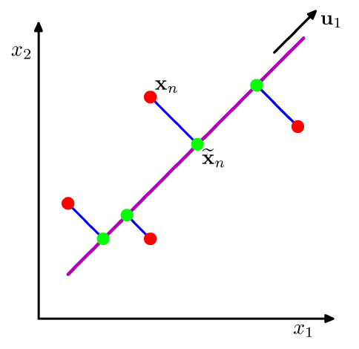
Maximum variance formulation of PCA
PCA (also known as Karhunen-Loeve (KL) transform) is a technique for: dimensionality reduction, lossy data compression, feature extraction, and data visualisation.
PCA is defined as the orthogonal projection of the data onto a lower dimensional linear space such that the variance of the projected data is maximised.

Slide 7
Maximum variance formulation of PCA
Given a data set {x_{n}}, n = 1,...,N and x_{n} ∈ R^{D}, our goal is to project the data onto a space of dimension M << D while maximising the projected data variance.
For simplicity, M = 1. The direction of this space is defined by a vector u₁ ∈ R^{D} s.t. u₁^{T}u₁ = 1.
Each data point x_{n} is then projected onto a scalar value u₁^{T}x_{n}.

Slide 8

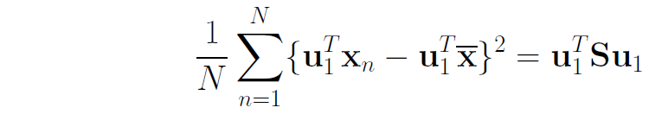
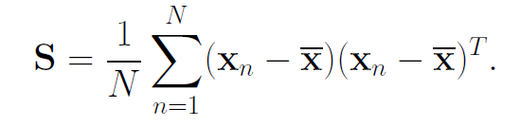
Maximum variance formulation of PCA
The mean is ,
where
The variance is given by
where S is the data covariance matrix defined as

Slide 9




Maximum variance formulation of PCA
We maximise the projected variance
J = u₁^{T}Su₁
with respect to u₁ with the normalisation condition u₁^{T}u₁ = 1.
The Lagrange multiplier formulation is
By setting the derivative with respect to u₁ to zero, we obtain
u₁ is an eigenvector of S.
By multiplying u₁^{T} to both sides and using the condition u₁^{T}u₁ = 1, the variance is obtained by
$$L=$$

Slide 10

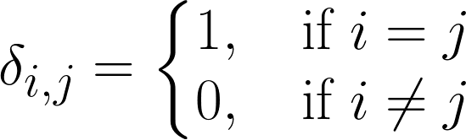

Maximum variance formulation of PCA
We obtain the maximum variance, when u₁ is the eigenvector with the largest eigenvalue λ₁.
The eigenvector is also called the principal component.
For the general case of an M dimensional subspace, we obtain the M eigenvectors u₁, u₂, … , u_{M} of the data covariance matrix S corresponding to the M largest eigenvalues λ₁, λ₂ …, λ_{M}.
$$u_{2}$$

Slide 11
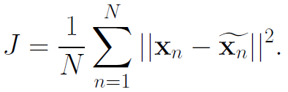
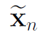

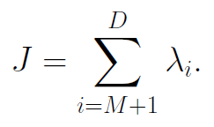
Minimum error formulation of PCA
Alternative (equivalent) formulation of PCA is to minimise the reconstruction error.
We minimise the distortion measure (or reconstruction error)
where is the reconstruction of n-th data point x_{n} ∈ R^{D}.
The solution is to choose the eigenvectors of the covariance matrix with M largest eigenvalues:
where i = 1, ... ,M.
The distortion measure (or reconstruction error) becomes
*More examples of gradient method are in LDA, Kernel Machines, Neural Networks.

Slide 12




(Recap) PCA
Principal components are the vectors in the direction of the maximum variance of the projection data.
For given 2D data points, u1 and u2 are found as PCs.
For dimension reduction,
Each 2D data point is transformed to a single variable z1 representing the projection of the data point onto the eigenvector u1.
The data points projected onto u1 has the max variance.
PCA infers the inherent structure of high dimensional data.
The intrinsic dimensionality of data is much smaller.
$$x_{2}$$
$$u_{1}$$
$$u_{2}$$
$$x_{1}$$

Slide 13
(Recap) PCA
PCA (also known as Karhunen-Loeve transform) is a useful technique for:
feature extraction,
lossy data compression,
dimensionality reduction,
and data visualisation.
Original face
M=50

Slide 14
Low-dimensional computation of Eigenspace, when D>>N
Given a data set {x_{n}}, n = 1,...,N and x_{n} ∈ R^{D}, our goal is to project the data onto a space of dimension M << D.
We compute the eigenvectors u_{i} of the matrix AA^{T} (for simplicity, instead of S=(1/N)AA^{T}).
The matrix AA^{T} (DxD matrix) is typically very large (not practical).
We consider the matrix A^{T}A (NxN matrix) instead.
Compute the eigenvectors v_{i} of A^{T}A:
A^{T}Av_{i} = λ_{i}v_{i}
What is the relationship between u_{i} and v_{i}?
A^{T}Av_{i} = λ_{i}v_{i} → AA^{T}Av_{i} = λ_{i}Av_{i} → SAv_{i} = λ_{i}Av_{i}
→ Su_{i} = λ_{i}u_{i ,} where u_{i}=Av_{i}
Thus, AA^{T} and A^{T}A have the same eigenvalues and their eigenvectors are related s.t. u_{i}=Av_{i}

Slide 15
Low-dimensional computation of Eigenspace, when D>>N
Note:
1: AA^{T} can have up to D eigenvalues and eigenvectors.
2: A^{T}A can have up to N (or N-1) eigenvalues and eigenvectors.
3: The M eigenvalues of A^{T}A (along with their corresponding eigenvectors) correspond to the M largest eigenvalues of AA^{T} (along with their corresponding eigenvectors).
Compute the M best eigenvectors of AA^{T} : u_{i}=Av_{i}
(important: normalize u_{i} such that ||u_{i}|| = 1)

Slide 16
Limitations of PCA

Slide 17
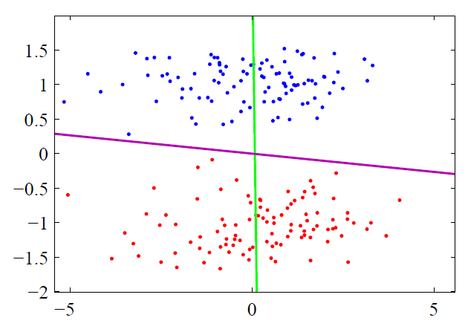
Unsupervised learning
PCA finds the direction for maximum variance of data (unsupervised), while LDA (Linear Discriminant Analysis) finds the direction that optimally separates data of different classes (discriminative or supervised).
LDA
PCA
PCA vs LDA

Slide 18
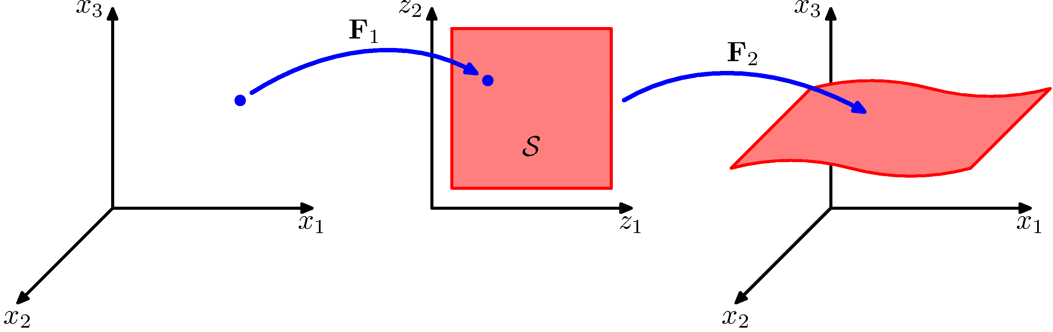

Linear model
PCA is a linear projection method.
When data lies in a nonlinear manifold, PCA is extended to Kernel PCA by the kernel trick.
$$φ(x)$$
Linear Manifold = Subspace
Nonlinear Manifold
PCA vs Kernel PCA

Slide 19
Gaussian assumption
PCA (Principal Component Analysis) models data as Gaussian distributions (2nd order statistics), whereas ICA (Independent Component Analysis) captures higher-order statistics.
PC2
IC1
ICA
PCA
IC2
PC1
PCA vs ICA

Slide 20
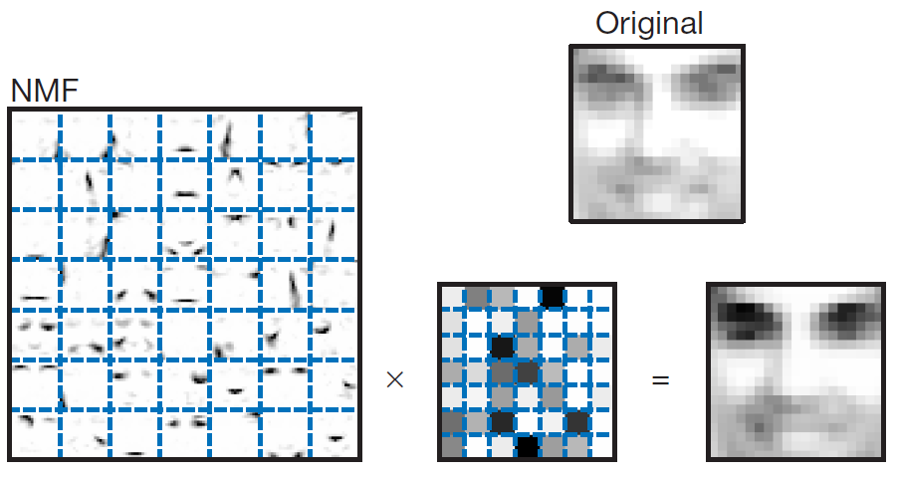
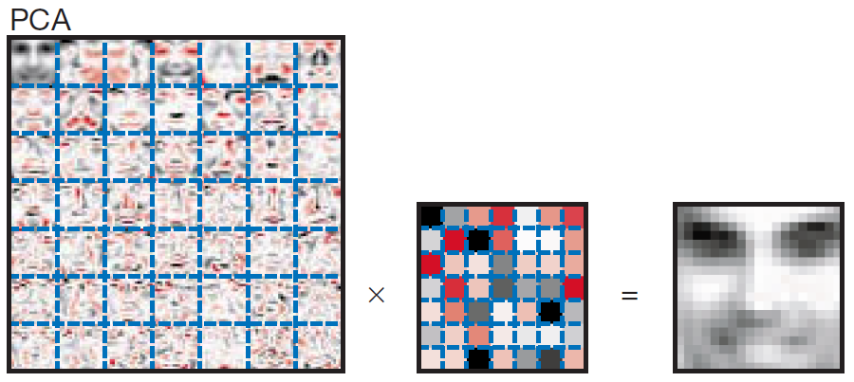
Holistic bases
PCA bases are holistic (cf. part-based) and less intuitive.
NMF (Non-negative Matrix Factorisation) yields bases, which capture local facial components.
D.Lee and S.Seung (1999). "Learning the parts of objects by non-negative matrix factorization". Nature 401 (6755): 788–791.
PCA vs NMF

Slide 21
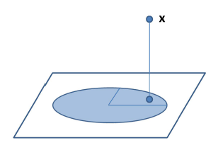

Uniform prior on the subspace
A subspace is spanned by the orthonormal bases i.e. eigenvectors computed from the covariance matrix.
It interprets each observation with the uniform prior on the subspace.
PPCA (Probabilistic PCA): It estimates the probability of generating each observation with Gaussian distribution,
PCA: uniform prior on the subspace
PPCA: Gaussian distribution on the subspace
PCA vs PPCA

Slide 22
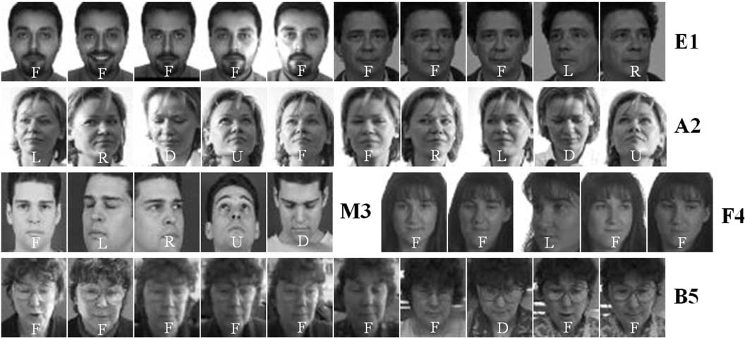
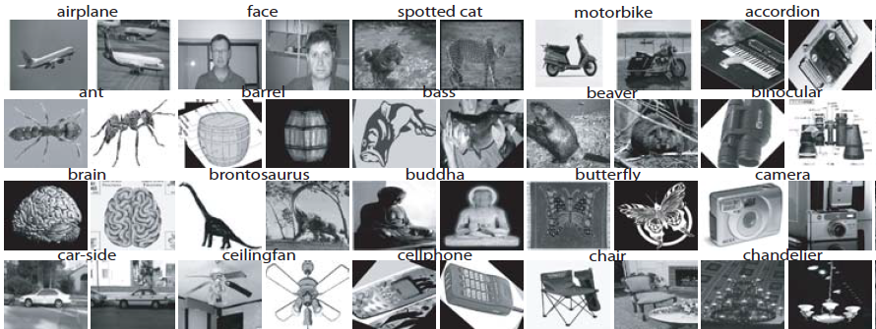
Face Recognition vs Object Categorisation
Both are as multi-class classification problems.
Classes are different object categories in object categorisation, while classes are different person identities in face recognition.
Face dataset
Object category dataset
Class 1
Class 2
Class 1
Class 2
Class 3 …
Class 3

Slide 23
Face Recognition vs Object Categorisation
Intraclass and Interclass variations in object categorisation are wider, compared to face recognition.
We extract representations/features that minimise intraclass variations and maximise interclass variations for a classification problem.
Bag of Words (BoW) is one of dominating-arts for feature extraction for generic object categorisation, while subspace/manifolds are standard techniques for face image analysis.
Using more advanced classifiers (Support Vector Machine/Randomised Forests/Convolutional Neural Network, cf. NN (Nearest Neighbour) classifier) often improves recognition performance.

