Slide 1
Online and Incremental Learning:
Merging and Splitting Eigenspace Models
Tae-Kyun Kim
Senior Lecturer
https://labicvl.github.io/
Further reading:
T-K. Kim, B. Stenger, J. Kittler and R. Cipolla, Incremental Linear Discriminant Analysis Using Sufficient Spanning Sets and Its Applications, International Journal of Computer Vision, 91(2):216-232, 2011.
P Hall, D Marshall, R Martin, Merging and splitting eigenspace models, IEEE Trans. on PAMI, 22 (9), 1042-1049, 2000.

Slide 2
Why Learning Online?
  Non-stationarity of real data
    ⇒ Update of models is needed when new data is available
    ⇒ Evaluation of relevance of past data
  Learning on a tight budget
    ⇒ Some data may be irrelevant
    ⇒ Cost-sensitive learning

Slide 3
Applications of Online Learning
Time series analysis
Anomaly and change point detection
Security event monitoring
Object tracking

Slide 4
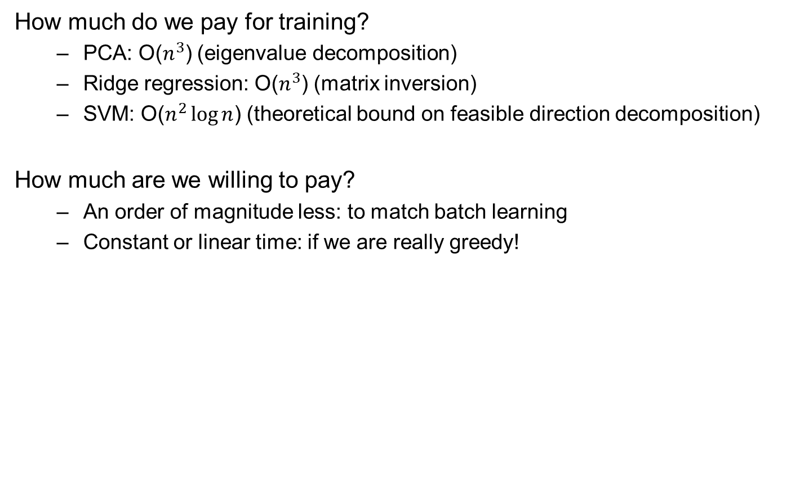
Computational Considerations
How much do we pay for training?
  PCA: O($n^{3}$) (eigenvalue decomposition)
  Ridge regression: O($n^{3}$) (matrix inversion)
  SVM: O($n^{2}\log{n}$) (theoretical bound on feasible direction decomposition)
How much are we willing to pay?
  An order of magnitude less: to match batch learning
  Constant or linear time: if we are really greedy!

Slide 5
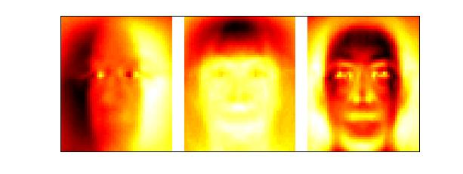
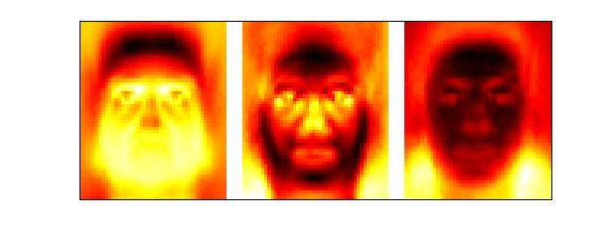
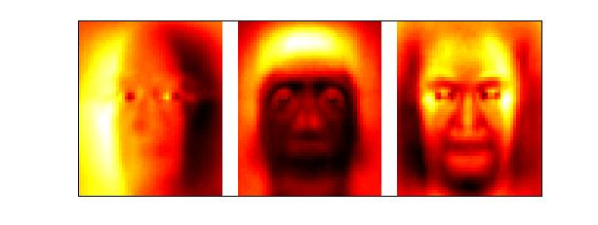
Dynamically updating eigenspace
  Eigenspace models have a wide variety of applications, such as classification for recognition systems.
  In practice, we need to build the engenspace models for numerous images: those images may not be given all initially, but incrementally.
  Our goal is to dynamically update the eigenspace models, when new data entries are given or existing data points are removed.
  The mean also needs to be updated.
1
2
3
P1
P2
P3

Slide 6
Incremental PCA
Batch vs Incremental
  In batch computation: all observations are used simultaneously to compute the eigenspace model.
  In incremental computation: an existing eigenspace model is updated using new observations.
Requirements: methods need to
  handle a change in the mean.
  add multiple new observations than exactly one observation at a time.
Pros and Cons
  Benefits: an incremental method
    does not need all observations at once - thus, reducing storage requirements and making large problems feasible.
    Even if all observations are available, is usually faster to compute a new eigenspace model by incrementally than by batch computation.
  Disadvantage: is their accuracy compared to batch methods. When only a few incremental updates are made, the inaccuracy is small.

Slide 7
Merging and splitting eigenspace models
  We learn a deterministic method that given two eigenspace models - each representing a set of D-dimensional observations - will:
  Merge the models to yield a representation of the union of the sets,
  Split one model from another to represent the difference between the sets.

Slide 8
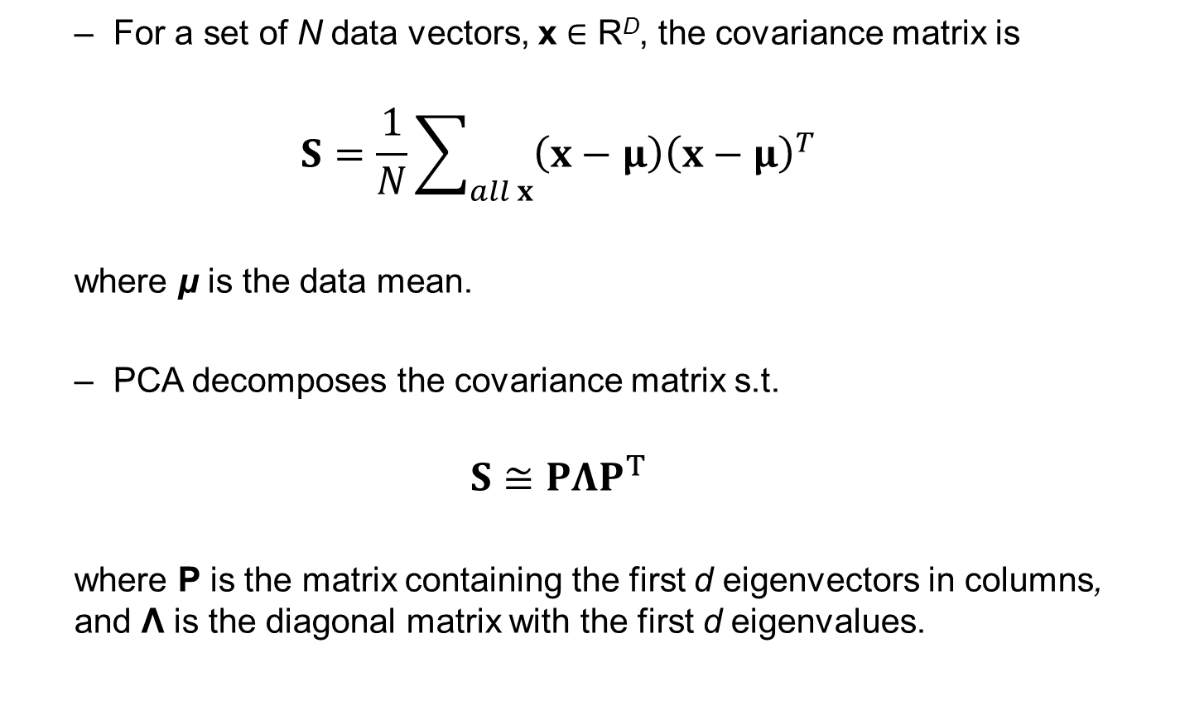
Eigenspace models and notations
  For a set of N data vectors, x ∈ R^{D}, the covariance matrix is
  $$S=\frac{1}{N}\sum_{all x}{\left(x−μ\right){\left(x−μ\right)}^{T}}$$
  where μ is the data mean.
  PCA decomposes the covariance matrix s.t.
  $$S≅PΛP^{T}$$
  where P is the matrix containing the first d eigenvectors in columns, and Λ is the diagonal matrix with the first d eigenvalues.

Slide 9

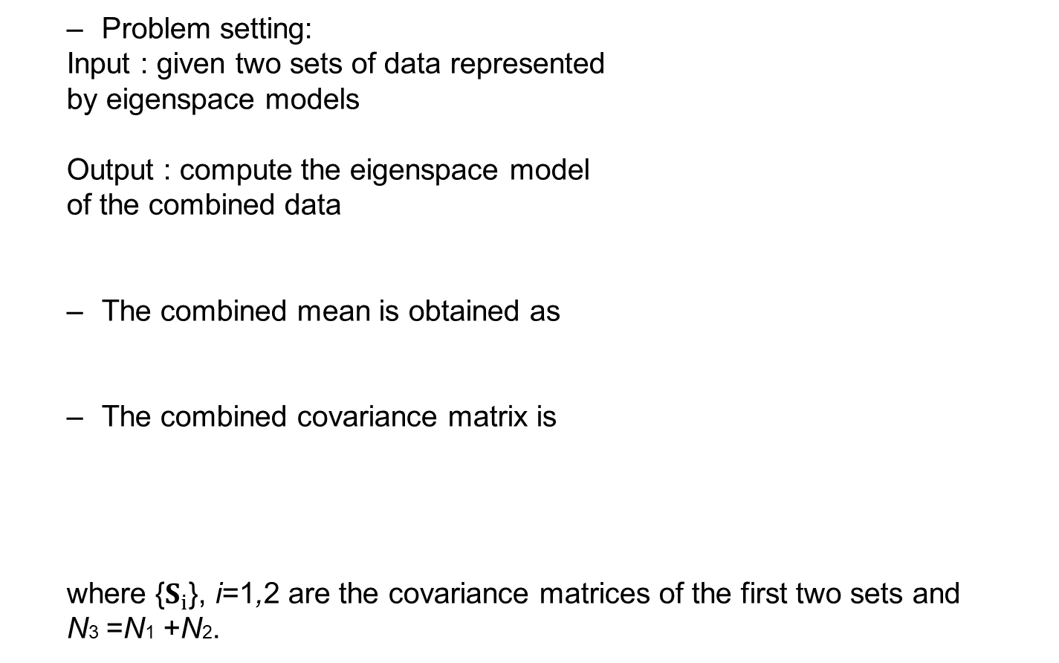
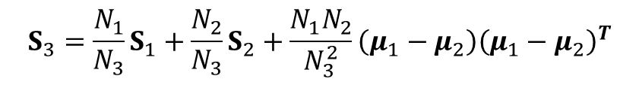


Incremental PCA
  Problem setting:
  Input : given two sets of data represented
  by eigenspace models
  Output : compute the eigenspace model
  of the combined data
  The combined mean is obtained as
  The combined covariance matrix is
  where {$S_{i}$}, i=1,2 are the covariance matrices of the first two sets and
  N3 =N1 +N2.
$${\left\{μ_{i}, N_{i}, P_{i},Λ_{i}\right\}}_{i=1,2}$$
1
2
3
{$μ_{3}, N_{3}, P_{3},Λ_{3}$}
$$μ_{3}=(N_{1}μ_{1}+N_{2}μ_{2})/N_{3}$$
$$S_{3}=\frac{N_{1}}{N_{3}}S_{1}+\frac{N_{2}}{N_{3}}S_{2}+\frac{N_{1}N_{2}}{N_{3}^{2}}\left(μ_{1}−μ_{2}\right){\left(μ_{1}−μ_{2}\right)}^{T}$$

Slide 10
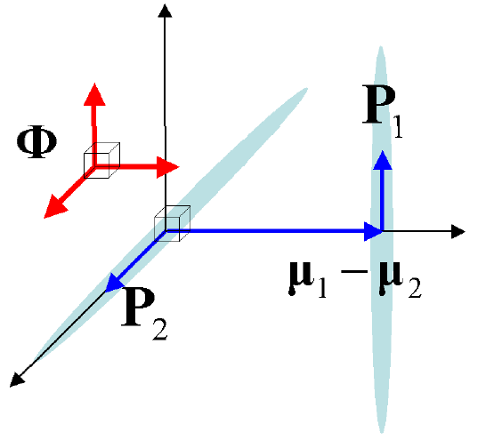
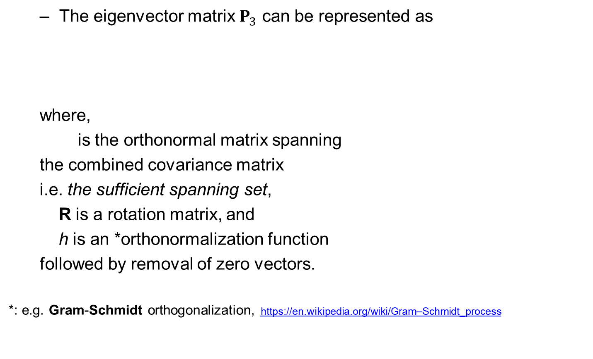
Incremental PCA
  The eigenvector matrix $P_{3}$ can be represented as
  where,
  is the orthonormal matrix spanning
  the combined covariance matrix
  i.e. the sufficient spanning set,
  R is a rotation matrix, and
  h is an *orthonormalization function
  followed by removal of zero vectors.
*: e.g. Gram-Schmidt orthogonalization, https://en.wikipedia.org/wiki/Gram–Schmidt_process
$P_{3}=ΦR=h\left([P_{1},P_{2}, μ_{1}−μ_{2}]\right)R$

Slide 11

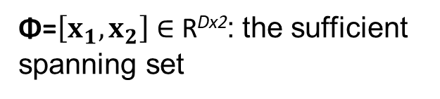






PCA by the sufficient spanning set
$$x_{2}$$
P =[$p_{1}, p_{2}$] $\text{∈ }\text{R}\text{D}\text{x}\text{2}$= ΦR
$$p_{2}$$
Φ=$\left[x_{1}, x_{2}\right] \text{∈ }\text{R}\text{Dx}\text{2}$: the sufficient
spanning set
$$p_{1}$$
  R $\text{∈ }\text{R}\text{2}\text{x}\text{2}$ : a rotation matrix
R
$$x_{1}$$
We can reduce the dimension by removing eigenvectors with non-significant eigenvalues: P =[$p_{1}$] $\text{∈ }\text{R}\text{D}\text{x}1$

Slide 12
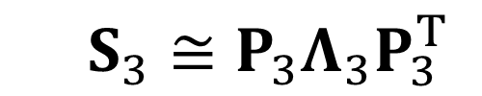




Incremental PCA
  Using this representation $P_{3}=ΦR$, the eigenproblem is converted into a smaller eigenproblem as
  By computing the eigendecomposition on the r.h.s. Λ3 and R are obtained as the respective eigenvalue and eigenvector matrices.
  $$S_{3}≅P_{3}Λ_{3}P_{3}^{T}$$
  $$Φ^{T}S_{3}Φ≅RΛ_{3}R^{T}$$
$$min(D,N_{3})$$
d1+d2+1
d1+d2+1
$$min(D,N_{3})$$

Slide 13

Incremental PCA
  The eigenvector matrix to seek is given as
  Note the eigenanalysis on the r.h.s. only takes computations
  Where d1, d2 are the number of the eigenvectors stored in P1 and P2.
  The eigenanalysis in a batch mode on the l.h.s. requires
$$O(min{\left(D,N_{3}\right)}^{3})$$

Slide 14

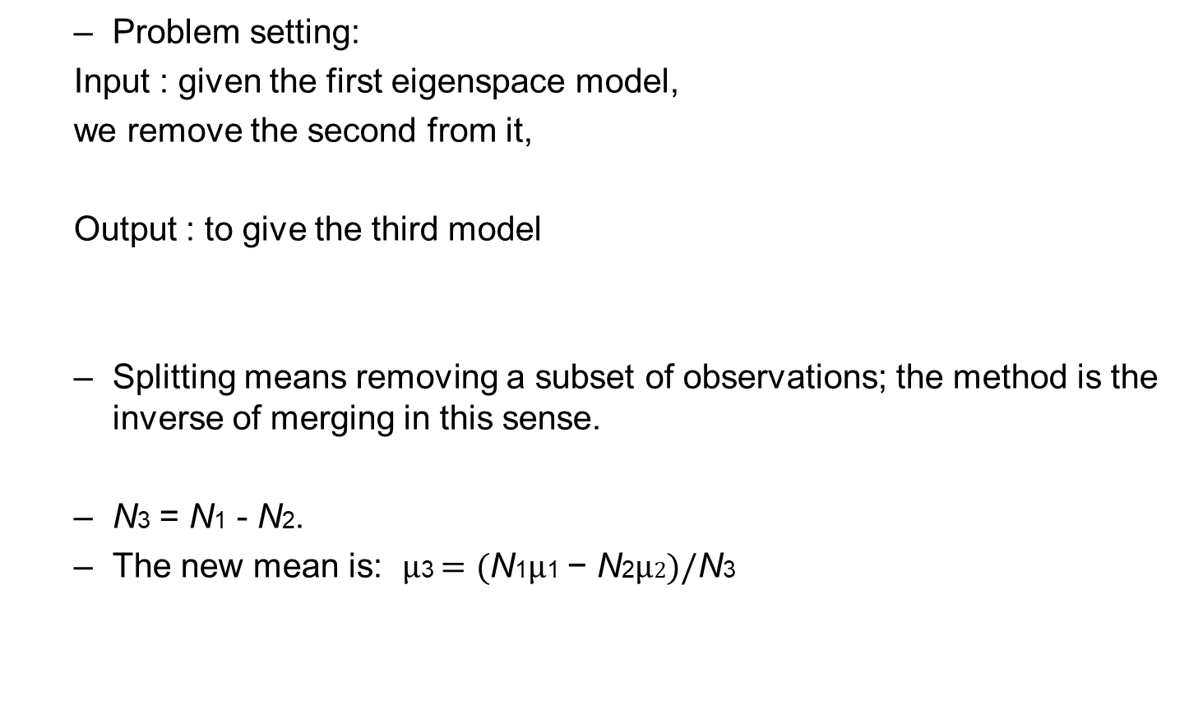

Splitting eigenspace models
  Problem setting:
  Input : given the first eigenspace model,
  we remove the second from it,
  Output : to give the third model
  Splitting means removing a subset of observations; the method is the inverse of merging in this sense.
  $\text{N}\text{3}$ = $\text{N}\text{1}$ - $\text{N}\text{2}$.
  The new mean is: $µ\text{3}=(\text{N}\text{1}µ\text{1 }\text{−} \text{N}\text{2}µ2)/\text{N}\text{3}$
$${\left\{μ_{i}, N_{i}, P_{i},Λ_{i}\right\}}_{i=1,2}$$
1
2
3
{$μ_{3}, N_{3}, P_{3},Λ_{3}$}

Slide 15
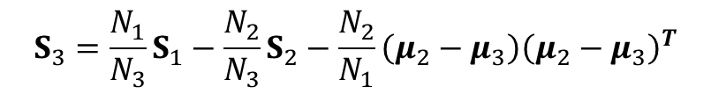
Splitting eigenspace models
  The new covariance matrix is
  The eigenvector matrix P3 can be represented as P3 = ΦR = P1R
  where
  Φ is the orthonormal matrix spanning the new covariance matrix
  i.e. the sufficient spanning set, and
  R is a rotation matrix.
  It is impossible to regenerate information which was discarded when the overall model was created. Thus, if we split one eigenspace model from a larger one, the eigenvectors of the remnant must still form some subspace of the larger.
$$S_{3}=\frac{N_{1}}{N_{3}}S_{1}−\frac{N_{2}}{N_{3}}S_{2}−\frac{N_{2}}{N_{1}}\left(μ_{2}−μ_{3}\right){\left(μ_{2}−μ_{3}\right)}^{T}$$

Slide 16




Splitting Eigenspace Models
  Using this representation, the eigenproblem is converted into a smaller eigenproblem as
  By computing the eigendecomposition on the r.h.s. Λ3 and R are obtained as the respective eigenvalue and eigenvector matrices.
  The eigenvector matrix to seek is given as P3 = ΦR = P1R
  $$S_{3}≅P_{3}Λ_{3}P_{3}^{T}$$
  $$Φ^{T}S_{3}Φ≅RΛ_{3}R^{T}$$
$$min(D,N_{3})$$
d1
d1
$$min(D,N_{3})$$

Slide 17
Results
- We examine the efficiency and accuracy of the incremental method, compared to the batch method.
- We used a database of 300 face images (each of 112x92=10,304 pixels).
- The gray levels in the images were scaled into the range [0, 1] by division only, but no other preprocessing was done.
- 300 images were partitioned into two data sets, each containing a multiple of 50 images.
- The number of eigenvectors retained in any model, including a merged model, was set to be 100 as a maximum, for ease of comparing results.
- The incremental time is the time needed to compute and then merge one eigenspace model to an existing one.
- The joint time is the time to compute both eigenmodels and then merge them.

Slide 18
Results
  First compared the means of the models produced by each method using Euclidean distance.
  Next compared the directions of the eigenvectors produced by each method, the error measured by the mean angular deviation of corresponding eigenvectors.
  The sizes of eigenvalues from both methods were compared, more precisely the mean relative absolute error was measured: |a – b|/a for eigenvalues a and b.

Slide 19
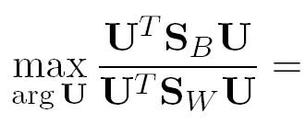
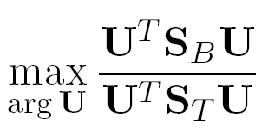


Experiments
  Similarly, we can compute LDA (Linear Discriminant Anlaysis) incrementally.
  We apply the sufficient spanning set approximation in each update step, i.e. for the between-class scatter matrix, the total scatter matrix and the projected data matrix:
By sufficient spanning sets

Slide 20
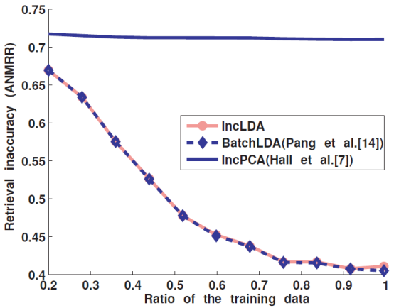
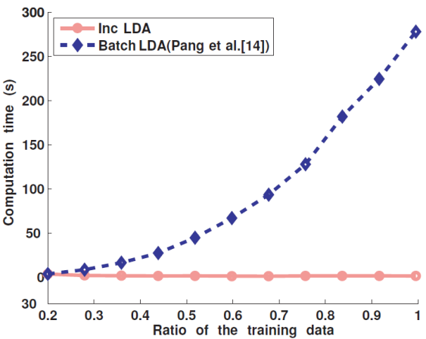
Experiments
MPEG7 face image datasets of 6370 images

Slide 21
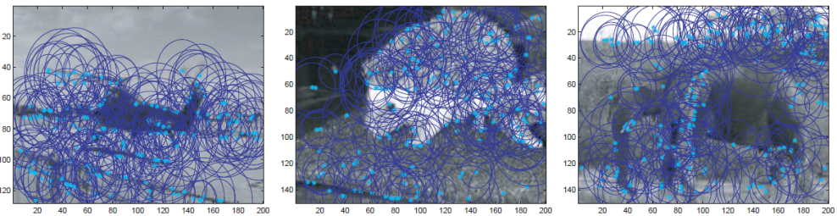
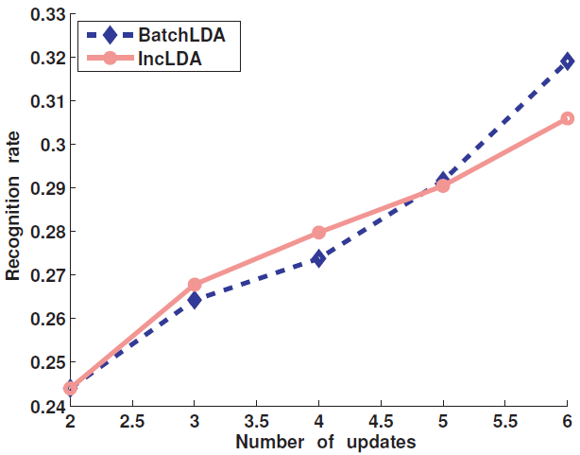
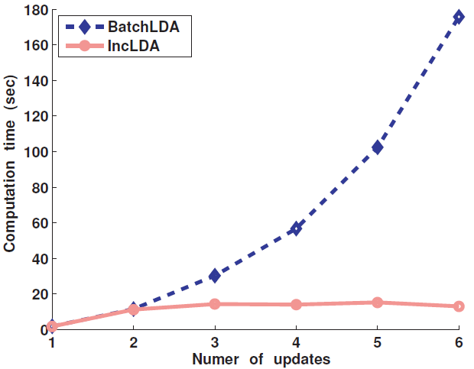
Experiments
Caltech101 datasets (using BoW representations), up to 800 images per category

