Slide 1
Algorithm-independent learning
Unsupervised learning
Supervised learning
Ensemble learning
Generative model
Discriminative model
Randomisation
PCA
FLD/LDA
Committee machine
Maximum margin classifier
Online learning
Regression
Probabilistic model
Feature extraction
Classification
PCA
NN classification
FLD/LDA
Discriminant functions
Maximum margin classifier

Slide 2
Subspace learning
Optimisation
Randomisation
PCA
Projection/pooling
Gradient-based
FLD/LDA
Orthonormal basis vectors
Lagrange multipliers
Dimension reduction
Eigenvalue problem
Data visualisation
Generalized eigenvalue problem
Reconstruction
Gaussian distributions
Underfitting
Generalization
Overfitting
Linear model
Nonlinear model
Training loss
Eigenface
Kernel trick
Testing (real) loss
Fisherface
Feature space
Bayes decision theory

Slide 3
Committee Machine, Ensemble Learning
Random Sampling LDA for Face Recognition
Tae-Kyun Kim
Senior Lecturer
https://labicvl.github.io/

Slide 4
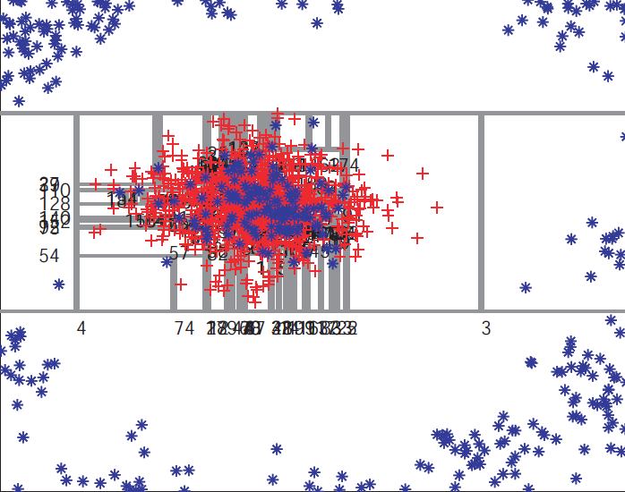
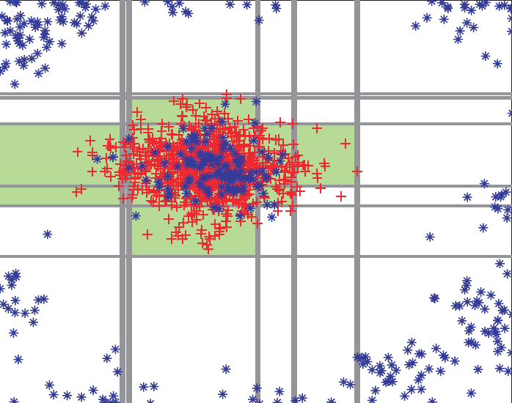
Overfitting
x
Combined model
x
Single model
t=1
t=2
t=T
……
y
y
vs
Overfit (axis-aligned weaklearners, 2 class problem)
Generalised, smooth decision regions (axis-aligned weaklearners, 2 class problem)

Slide 5
Ensemble of models
The key aspect of the ensemble model is the fact that its component models are all randomly different from one another.
This leads to decorrelation between the individual model predictions and, in turn, results in improved generalization and robustness.
The combined model is characterized by the same components as the individual models.
The amount of randomness influence the prediction/estimation properties of the models.
* Dropout in deep neural networks ≈ randomisation

Slide 6




Randomness model
Randomness is injected into the models during the two phases. Two techniques used together are:
random training set sampling (i.e. bagging), and
randomized model parameters.
The full training set:
The randomly sampled subset of training data made available for t-th model:
1. Bagging, randomisation on data
……
t=1
2. Randomised model parameters
t=T
……
Efficient (parallel) training

Slide 7
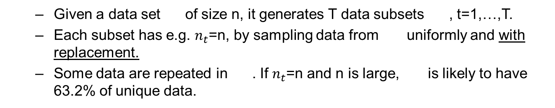
Bagging (Bootstrap AGGregatING) - randomizing the training set
Given a data set of size n, it generates T data subsets , t=1,…,T.
Each subset has e.g. $n_{t}$=n, by sampling data from uniformly and with replacement.
Some data are repeated in . If $n_{t}$=n and n is large, is likely to have 63.2% of unique data.
……

Slide 8
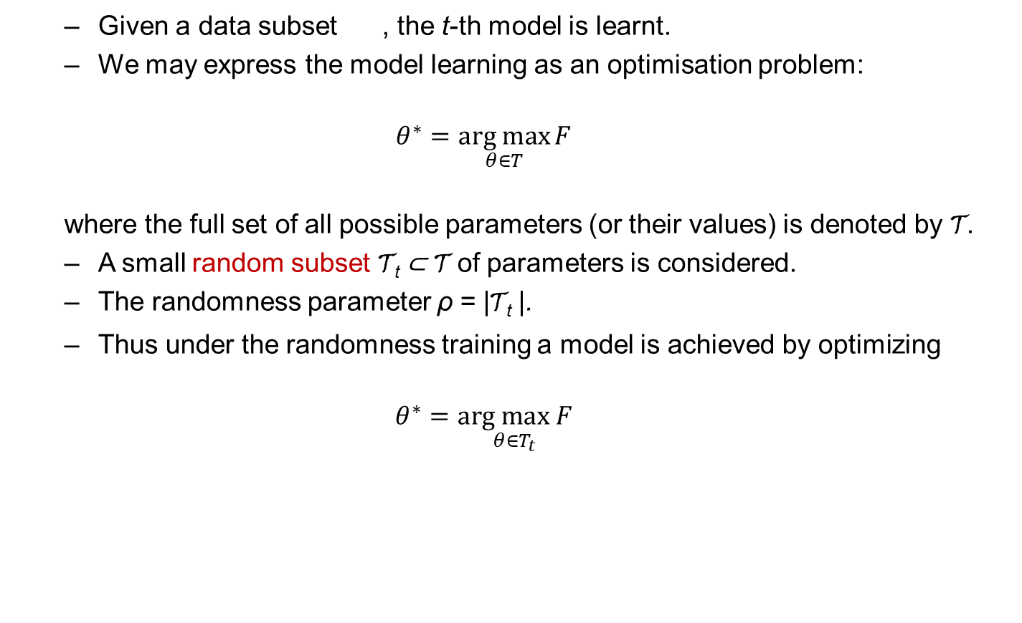
Randomizing model parameters
Given a data subset , the t-th model is learnt.
We may express the model learning as an optimisation problem:
$$θ^{∗}=\underset{θ∈T}{arg max}{F}$$
where the full set of all possible parameters (or their values) is denoted by T.
A small random subset T_{t} ⊂ T of parameters is considered.
The randomness parameter ρ = |T_{t} |.
Thus under the randomness training a model is achieved by optimizing
$$θ^{∗}=\underset{θ∈T_{t}}{arg max F}$$

Slide 9

Randomizing model parameters
The randomness parameter ρ = |T_{t} | controls not only the amount of randomness within each model but also the amount of correlation between different models in the ensemble.
As illustrated, when ρ = | T | all the models will be identical (if no bagging) and as ρ decreases the models become more decorrelated.
The effect of
ρ = | T |
ρ = 1
t=1
t=2
t=T
t=1
t=2
…
t=T
…
Low randomness, high model correlation
High randomness, low model correlation

Slide 10
Model correlation vs strength
Randomisation on data and model parameters increases diversity among component models.
For the fixed data, the randomised model parameters decreases strength of each model.
This compromising issue is further explained in the perspective of a generic committee machine.

Slide 11


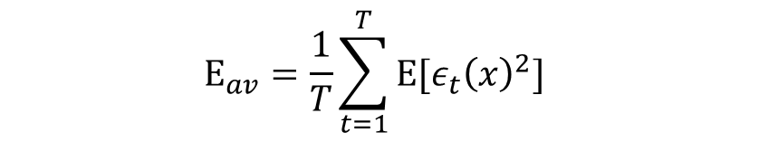

Committee machine
We consider multiple models or experts, $y_{t}\left(x\right), t=1,…,T$.
Output of each model is
where are the true value and error of each model.
The average sum-of-squares error is
The average error by acting individually is
$$y_{t}\left(x\right)=h\left(x\right)+ε_{t}(x)$$
$h\left(x\right),ε_{t}(x)$
$$E[{\left\{y_{t}\left(x\right)−h\left(x\right)\right\}}^{2}]=E[ε_{t}{\left(x\right)}^{2}]$$
$$E_{av}=\frac{1}{T}\sum_{t=1}^{T}{E[ε_{t}{\left(x\right)}^{2}] }$$

Slide 12
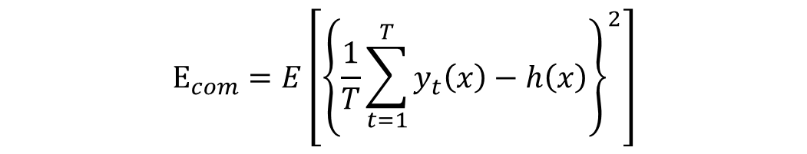
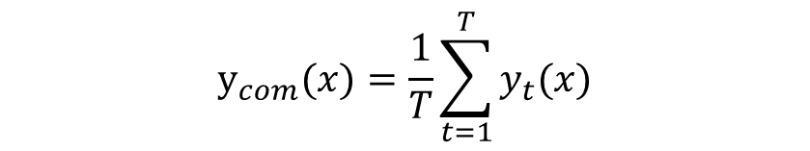
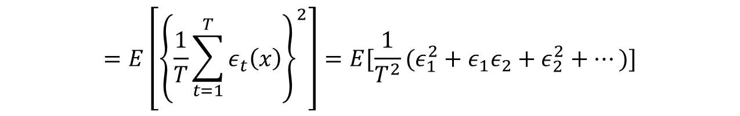
Committee machine
The committee machine is
The expected error of the committee machine is
$$y_{com}(x)=\frac{1}{T}\sum_{t=1}^{T}{y_{t}(x)}$$
$$E_{com}=E\left[{\left\{\frac{1}{T}\sum_{t=1}^{T}{y_{t}\left(x\right)−h\left(x\right)}\right\}}^{2}\right]$$
$$=E\left[{\left\{\frac{1}{T}\sum_{t=1}^{T}{ε_{t}\left(x\right)}\right\}}^{2}\right]=E[\frac{1}{T^{2}}(ε_{1}^{2}+ε_{1}ε_{2}+ε_{2}^{2}+…)]$$

Slide 13
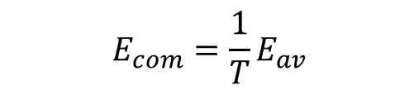
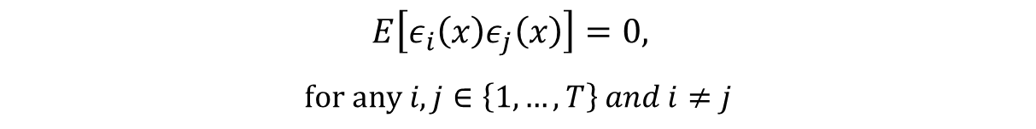

Committee machine
If we assume
then we obtain
In practice, the errors are typically highly correlated, but we can still expect that
$$E\left[ε_{i}\left(x\right)ε_{j}\left(x\right)\right]=0,$$
$$for any i,j∈\left\{1,…,T\right\} and i≠j$$
$$E_{com}=\frac{1}{T}E_{av}$$
$$E_{com}≤E_{av}$$

Slide 14
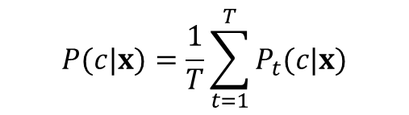
Prediction models and testing
In an ensemble with T models we use the variable t ∈ {1, . . . , T } to index each component model.
All models are trained independently (and possibly in parallel).
During testing, each test point x is simultaneously pushed through all models.
Testing can also often be done in parallel, thus achieving high computational efficiency on modern parallel CPU or GPU hardware.
Combining all model predictions into a single prediction is done by a simple averaging operation. E.g. in classification
where P_{t}(c|x) denotes the class posterior distribution obtained by the t-th model.
$$P(c|x)=\frac{1}{T}\sum_{t=1}^{T}{P_{t}(c|x)}$$

Slide 15
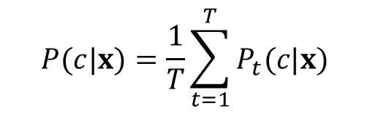


Ensemble of models: evaluation
A data point is passed down all models, and the respective posterior distributions are collected.
Classification is done by
x
x
t=1
……
t=T
$$P_{1}(c|x)$$
$$P_{T}(c|x)$$
category c
category c
$$P(c|x)=\frac{1}{T}\sum_{t=1}^{T}{P_{t}(c|x)}$$

Slide 16
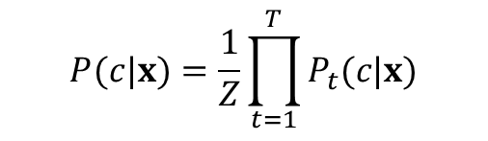
Prediction models and testing
Alternatively one could also multiply the model outputs together (though the models are not statistically independent)
with Z ensuring probabilistic normalization.
$$P(c|x)=\frac{1}{Z}\prod_{t=1}^{T}{P_{t}(c|x)}$$

Slide 17




Prediction models and testing
Model output fusion is illustrated in the next slide, for a simple example where the attribute we want to predict is a continuous variable y.
Imagine that we have trained an ensemble with T = 4 models.
For a test data point x, we get the corresponding posteriors p_{t}(y|x), with t = {1, . . . ,4}.
t=1
t=2
t=3
t=4
$$P_{t=1}(y|x)$$
$$P_{t=2}(y|x)$$
$$P_{t=3}(y|x)$$
$$P_{t=4}(y|x)$$

Slide 18
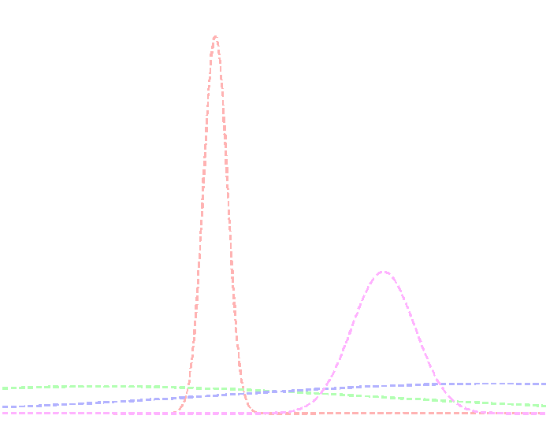
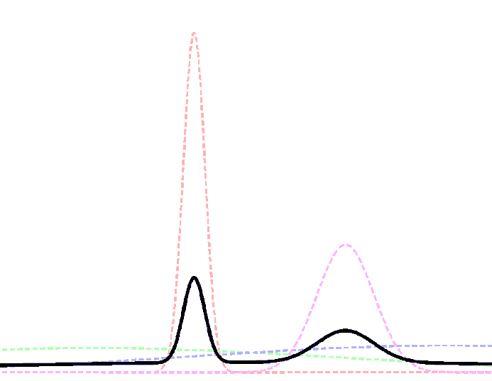
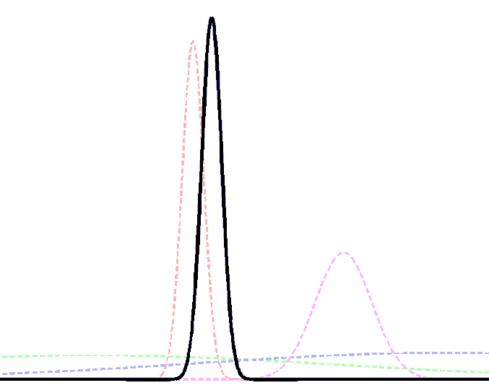







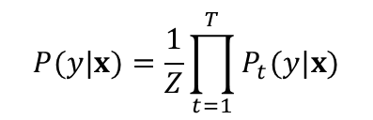

Prediction models and testing
Some models produce peakier (more confident) predictions than others.
Both the averaging and the product operations produce combined distributions (shown in black) which are heavily influenced by the most confident i.e. most informative models.
Therefore, such simple operations have the effect of selecting (softly) the more confident models out of the ensemble.
Averaging many posteriors also has the advantage of reducing the effect of possibly noisy model contributions.
In general, the product based ensemble model may be less robust to noise.
$$P(y|x)=\frac{1}{T}\sum_{t=1}^{T}{P_{t}(y|x)}$$
$$P(y|x)=\frac{1}{Z}\prod_{t=1}^{T}{P_{t}(y|x)}$$
$$P_{2}(y|x)$$
$$P_{3}(y|x)$$
$$P(y|x)$$
$$P_{1}(y|x)$$
$$P_{4}(y|x)$$
$$P(y|x)$$

Slide 19


Prediction models and testing
Alternative ensemble models are possible, where for instance one may choose to select individual models in a hard way, or may do majority voting.
Min:
Max:
Majority voting (in classification):
each learned model votes for a class to assign to a query image.
Classification of the query image is by assigning the class has the highest number of 'votes'.
$$P(y|x)=\min_{t}{P_{t}(y|x)}$$
$$P(y|x)=\max_{t}{P_{t}(y|x)}$$

Slide 20

In our case, each single model can be
x
x
x
x
x
x
PCA
LDA
PCA
SVM
PCA
LDA
LDA
NN
NN
SVM
SVM
NN
y
y
y
y
y
y
More discriminative than PCA
When $S_{W}^{−1}$ is not attainable
SVM is a global optimiser?
PCA helps the computational complexity of SVM, but accuracy?
Two discriminative parts in a sequence?

