Slide 1
Dicas
Geral
Para a construção dos slides:
Fonte: Utilizar sempre Arial.
Tamanho da fonte nos textos: Geral tamanho 11. Pode variar depois entre 10 e 9 para listas se sentirem necessidade.
Cor dos Títulos e Texto: Tanto em títulos como no corpo do texto a cor é Cinzento escuro (#5C5457).
Cor dos Subtítulos: Cinzento claro (#958B8E).
Para as listas: usar “círculo” ou “check” em azul (#00A2AA) tamanho 120%.

Slide 2


Slide 3
NestJS and Databases
Nest is database agnostic.
Integrates with any SQL or NoSQL database
Database support is added by loading an appropriate Node.js driver for the database, just as we would with Express or Fastify.

Slide 4
What’s an ORM
ORM stands for Object-Relational Mapping.
simplify database programming by allowing developers to work with objects rather than tables
map classes and their properties to database tables and their columns
It can also help with data validation and constraints enforcement
can improve application performance by reducing the number of database queries and optimizing the SQL generated by the framework
However, ORM can also add some overhead and complexity to the application, and it's important to choose the right tool and approach for the specific project

Slide 5
Libraries and ORM’s
MikroORM
Sequelize (out of the box)
Knex.js
TypeORM (out of the box)
Prisma

Slide 6
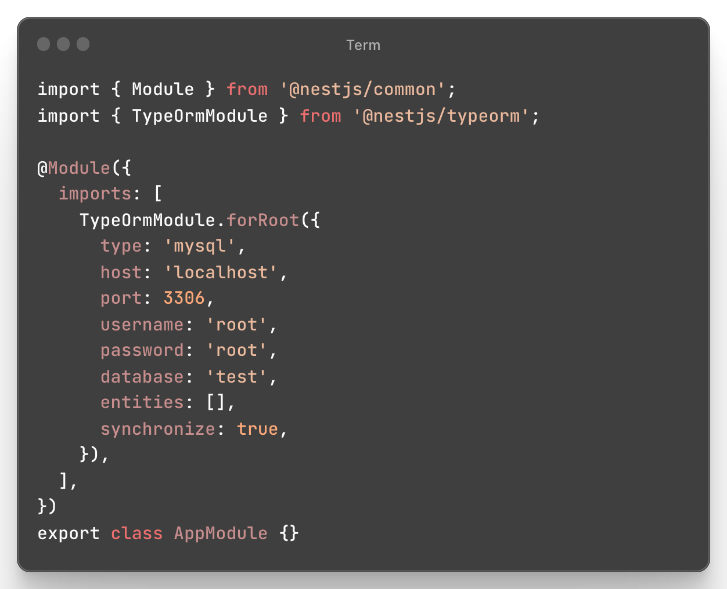
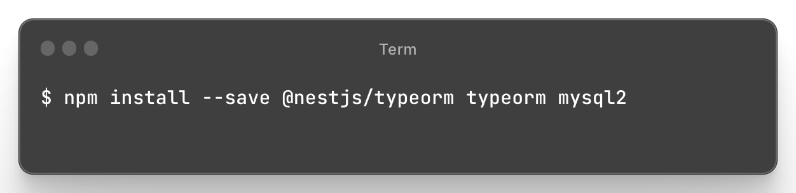
TypeORM

Slide 7
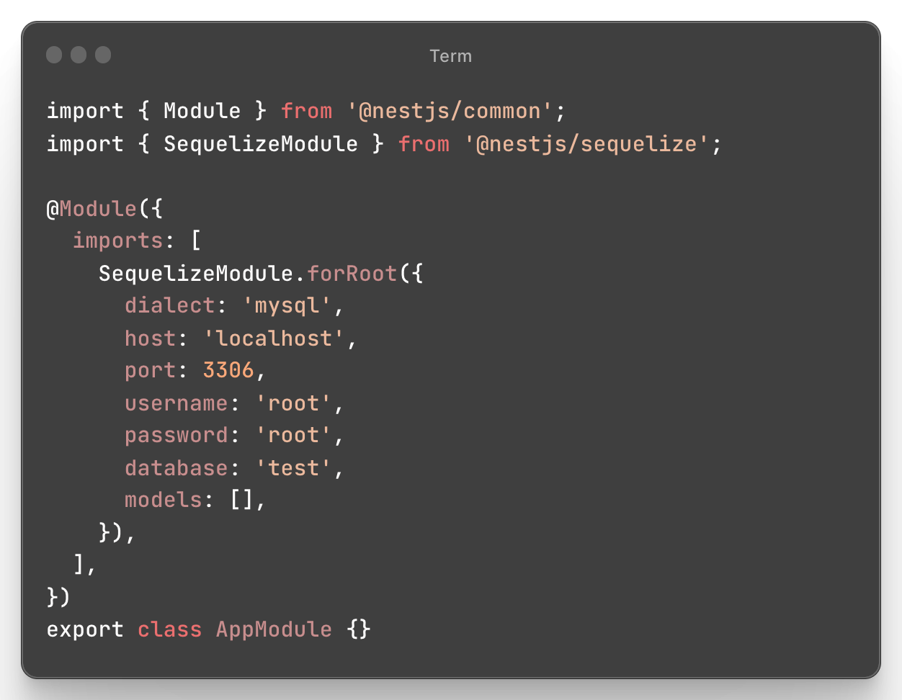
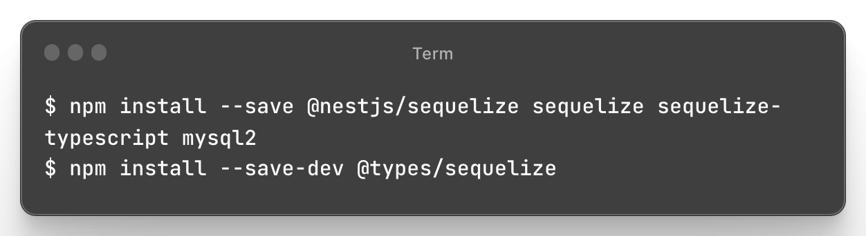
Sequelize

Slide 8
Prisma
TypeScript ORM
Prisma Client: Auto-generated and type-safe query builder for Node.js & TypeScript
Prisma Migrate: Migration system
Prisma Studio: GUI to view and edit data in your database.
Prisma Client can be used in any Node.js (supported versions) or TypeScript backend application.
Focused on providing a DX (developer experience)

Slide 9
Prisma cli
Prisma Migrate
migrate dev
migrate reset
migrate deploy
migrate resolve
migrate status
migrate diff
db
db pull
db push
db seed
db execute

Slide 10
Prisma cli
Commands
version (-v)
init
generate
validate
format
https://www.prisma.io/docs/reference/api-reference/command-reference#migrate-diff

Slide 11
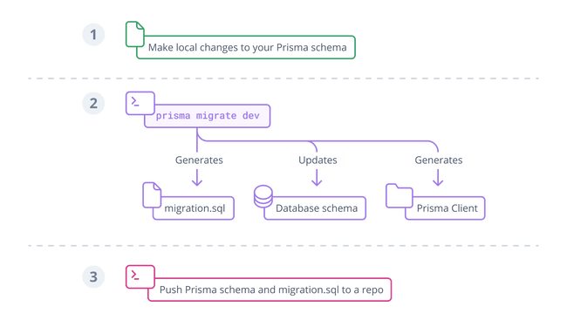
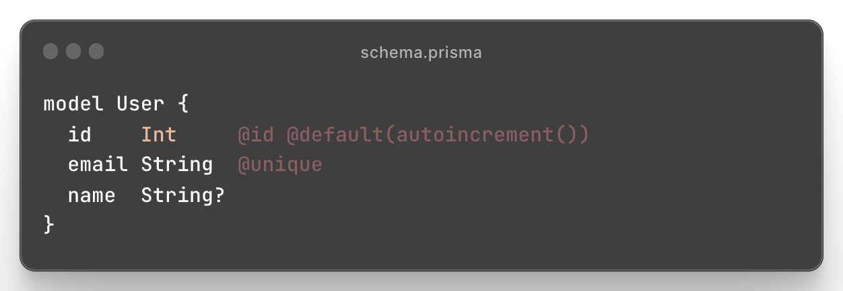
Prisma Schema
Every project starts with a Prisma schema file.
Data source: Specifies your database connection (via an environment variable)
Generator: Indicates that you want to generate Prisma Client
Data model: Defines your application models
Manually writing the data model and mapping it to the database with Prisma Migrate
Generating the data model by introspecting a database

Slide 12
Types
model field scalar types
String
Boolean
Int
BigInt
Float
Decimal
DateTime
Json
Bytes
Unsupported
https://www.prisma.io/docs/reference/api-reference/prisma-schema-reference

Slide 13
Attributes
@id
@@id
@default
@unique
@@unique
@@index
@relation
@map
@@map
@updatedAt
@ignore
@@ignore
https://www.prisma.io/docs/reference/api-reference/prisma-schema-reference

Slide 14
Attribute functions
auto()
autoincrement()
sequence()
cuid()
uuid()
now()
dbgenerated()

Slide 15
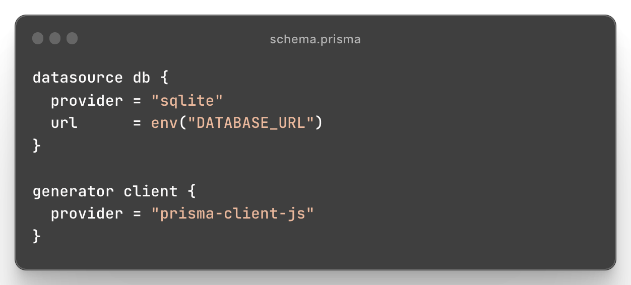
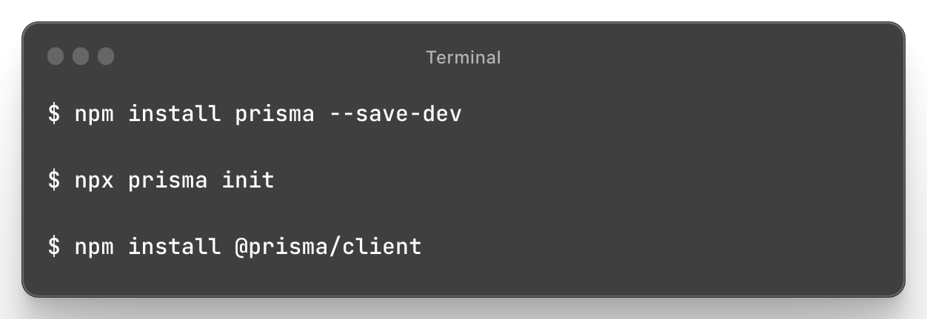
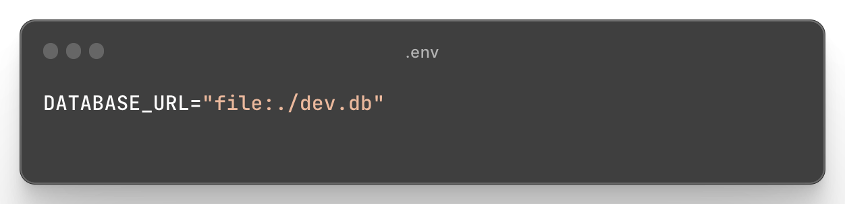
Setup

Slide 16
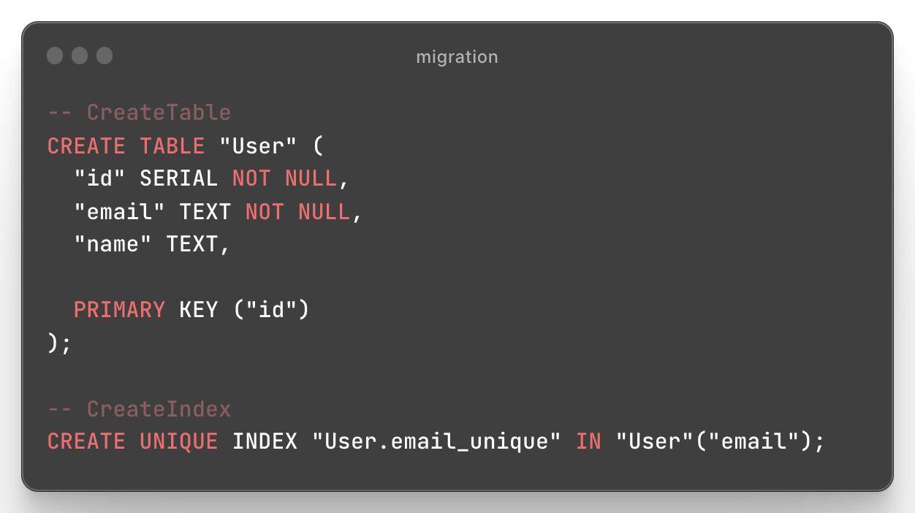
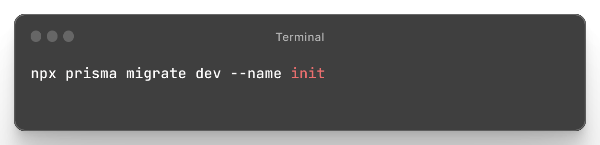
Migrations
Prisma Migrate uses Prisma schema changes to automatically generate fully customizable database schema migrations

Slide 17
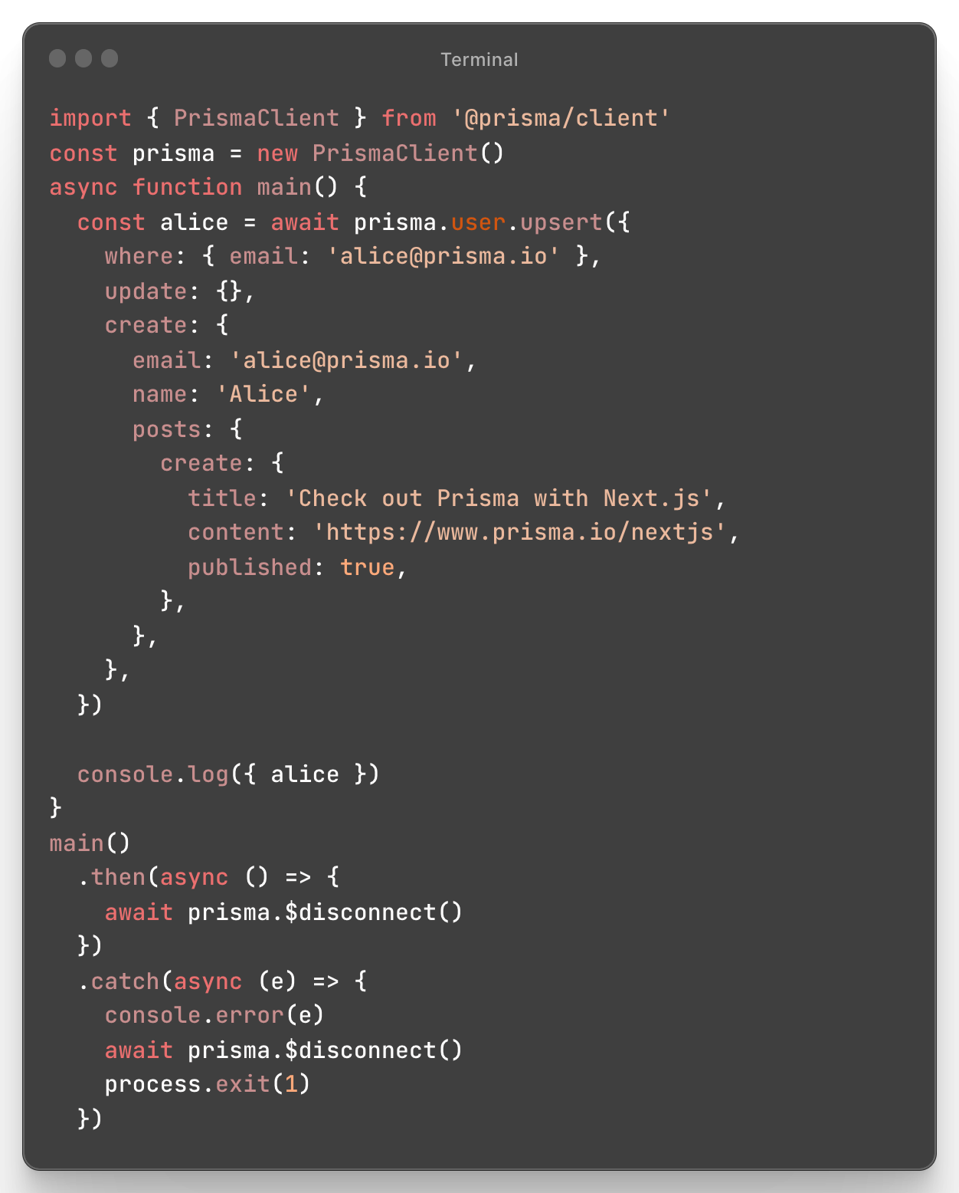
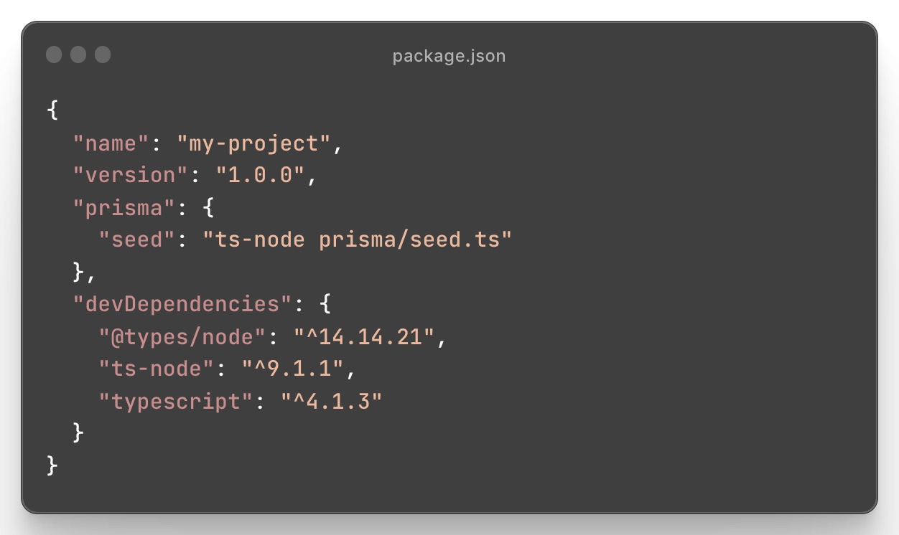
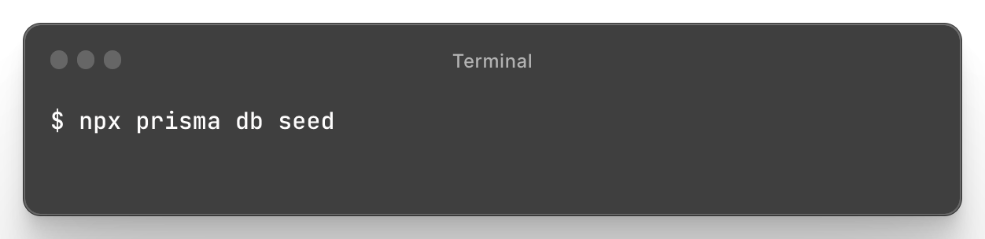
Seeding
Populate your database with data that is required for your application to start
Provide basic data for validating and using your application in a development environment.

Slide 18
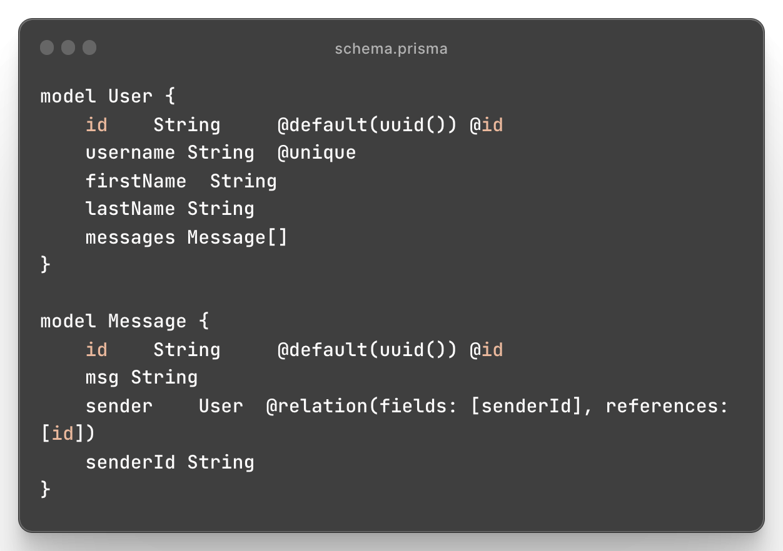
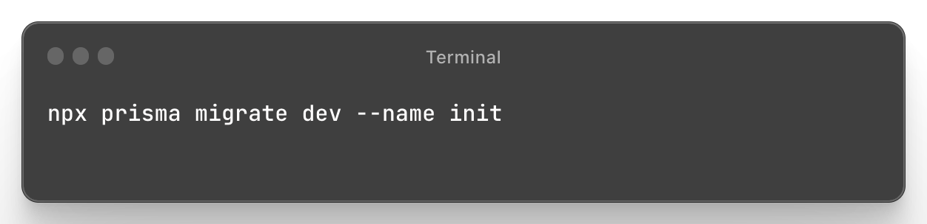
Create db

Slide 19
Back to NestJS!
We will:
Add prisma to the project;
Create the database;
Create a prisma service in the global core module;
Inject the service in the UserService and use it to query a sqlite db;
Handle prisma exceptions by implementing a global exception filter;
Add validation to the UserDto and use the ValidationPipe created in the last session;

