Slide 1
Dicas
Geral
Para a construção dos slides:
Fonte: Utilizar sempre Arial.
Tamanho da fonte nos textos: Geral tamanho 11. Pode variar depois entre 10 e 9 para listas se sentirem necessidade.
Cor dos Títulos e Texto: Tanto em títulos como no corpo do texto a cor é Cinzento escuro (#5C5457).
Cor dos Subtítulos: Cinzento claro (#958B8E).
Para as listas: usar “círculo” ou “check” em azul (#00A2AA) tamanho 120%.

Slide 2


Slide 3

4 - NestJS Data Persistence

Slide 4
NestJS and Databases
Nest is database agnostic.
Integrates with any SQL or NoSQL database
Database support is added by loading an appropriate Node.js driver for the database and optionally using an ORM or query builder.

Slide 5
What’s an ORM
Stands for Object-Relational Mapping;
Simplifies database programming by allowing developers to work with objects rather than tables;
Maps classes and their properties to database tables and their columns;
Helps with data validation and constraints enforcement;
Can improve application performance by reducing the number of database queries and optimizing the SQL generated;
Can add some overhead and complexity to the application.

Slide 6




Libraries and ORM’s
MikroORM
Sequelize (out of the box)
Knex.js
TypeORM (out of the box)
Prisma

Slide 7
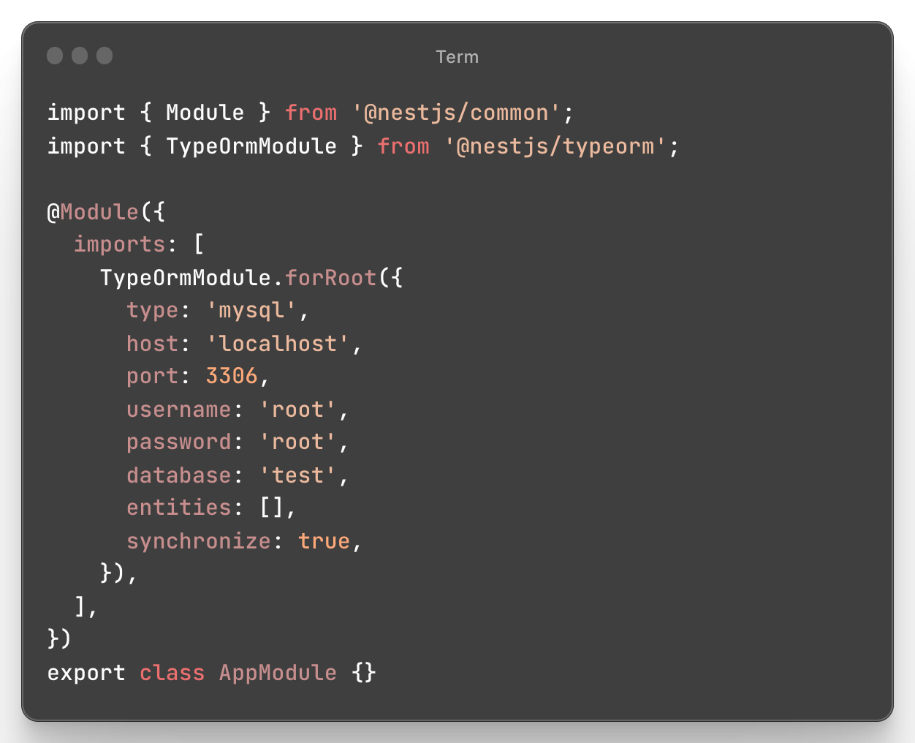
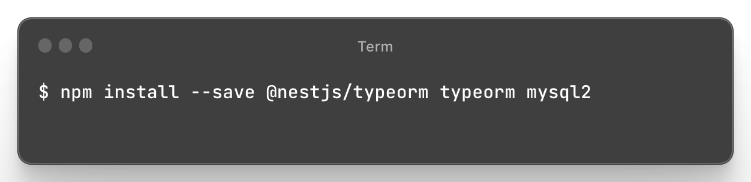
TypeORM

Slide 8
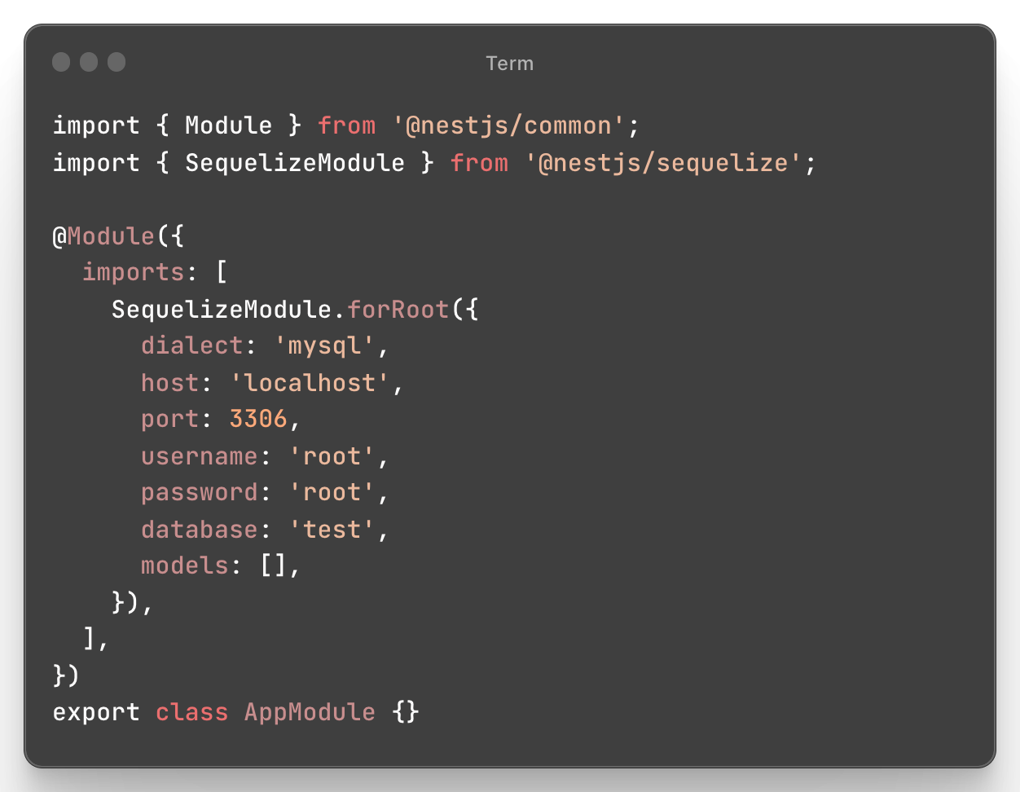
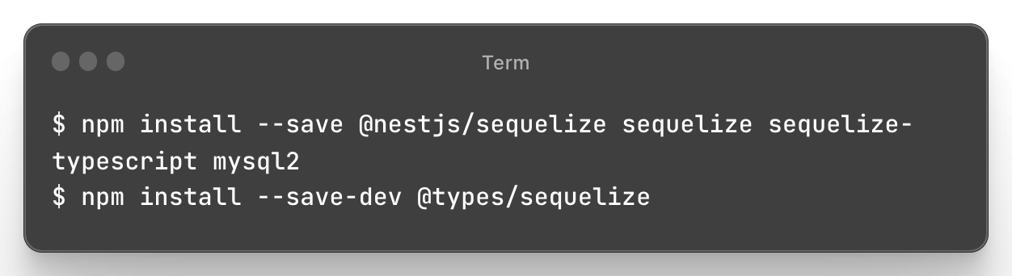
Sequelize

Slide 9
Prisma
TypeScript ORM
Prisma Client: Auto-generated and type-safe query builder for Node.js & TypeScript
Prisma Migrate: Migration system
Prisma Studio: GUI to view and edit data in your database.
Prisma Client can be used in any Node.js (supported versions) or TypeScript backend application.

Slide 10
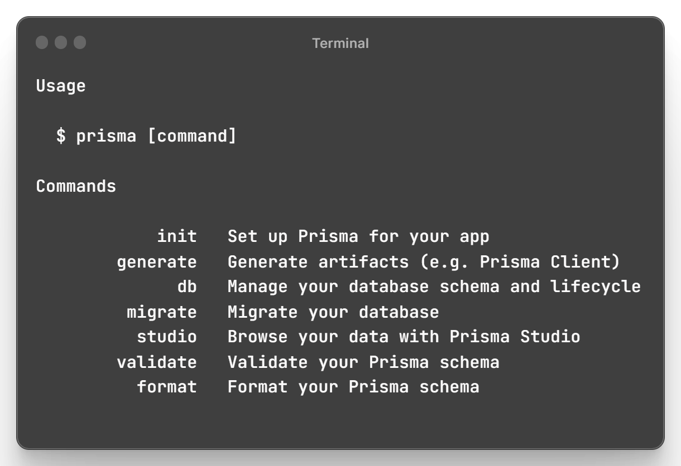
Prisma cli
Commands

Slide 11
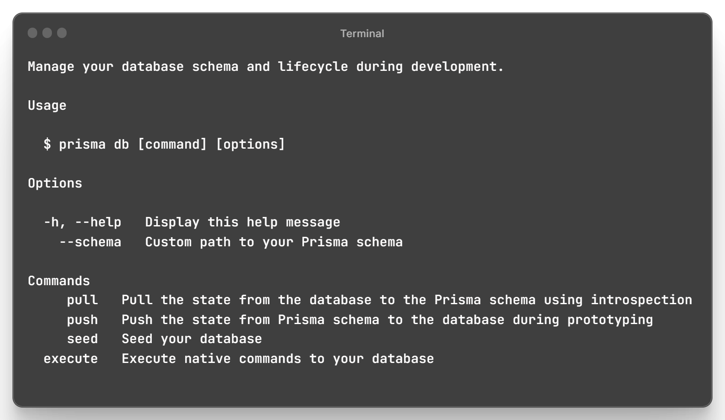
Prisma cli
Commands - db

Slide 12
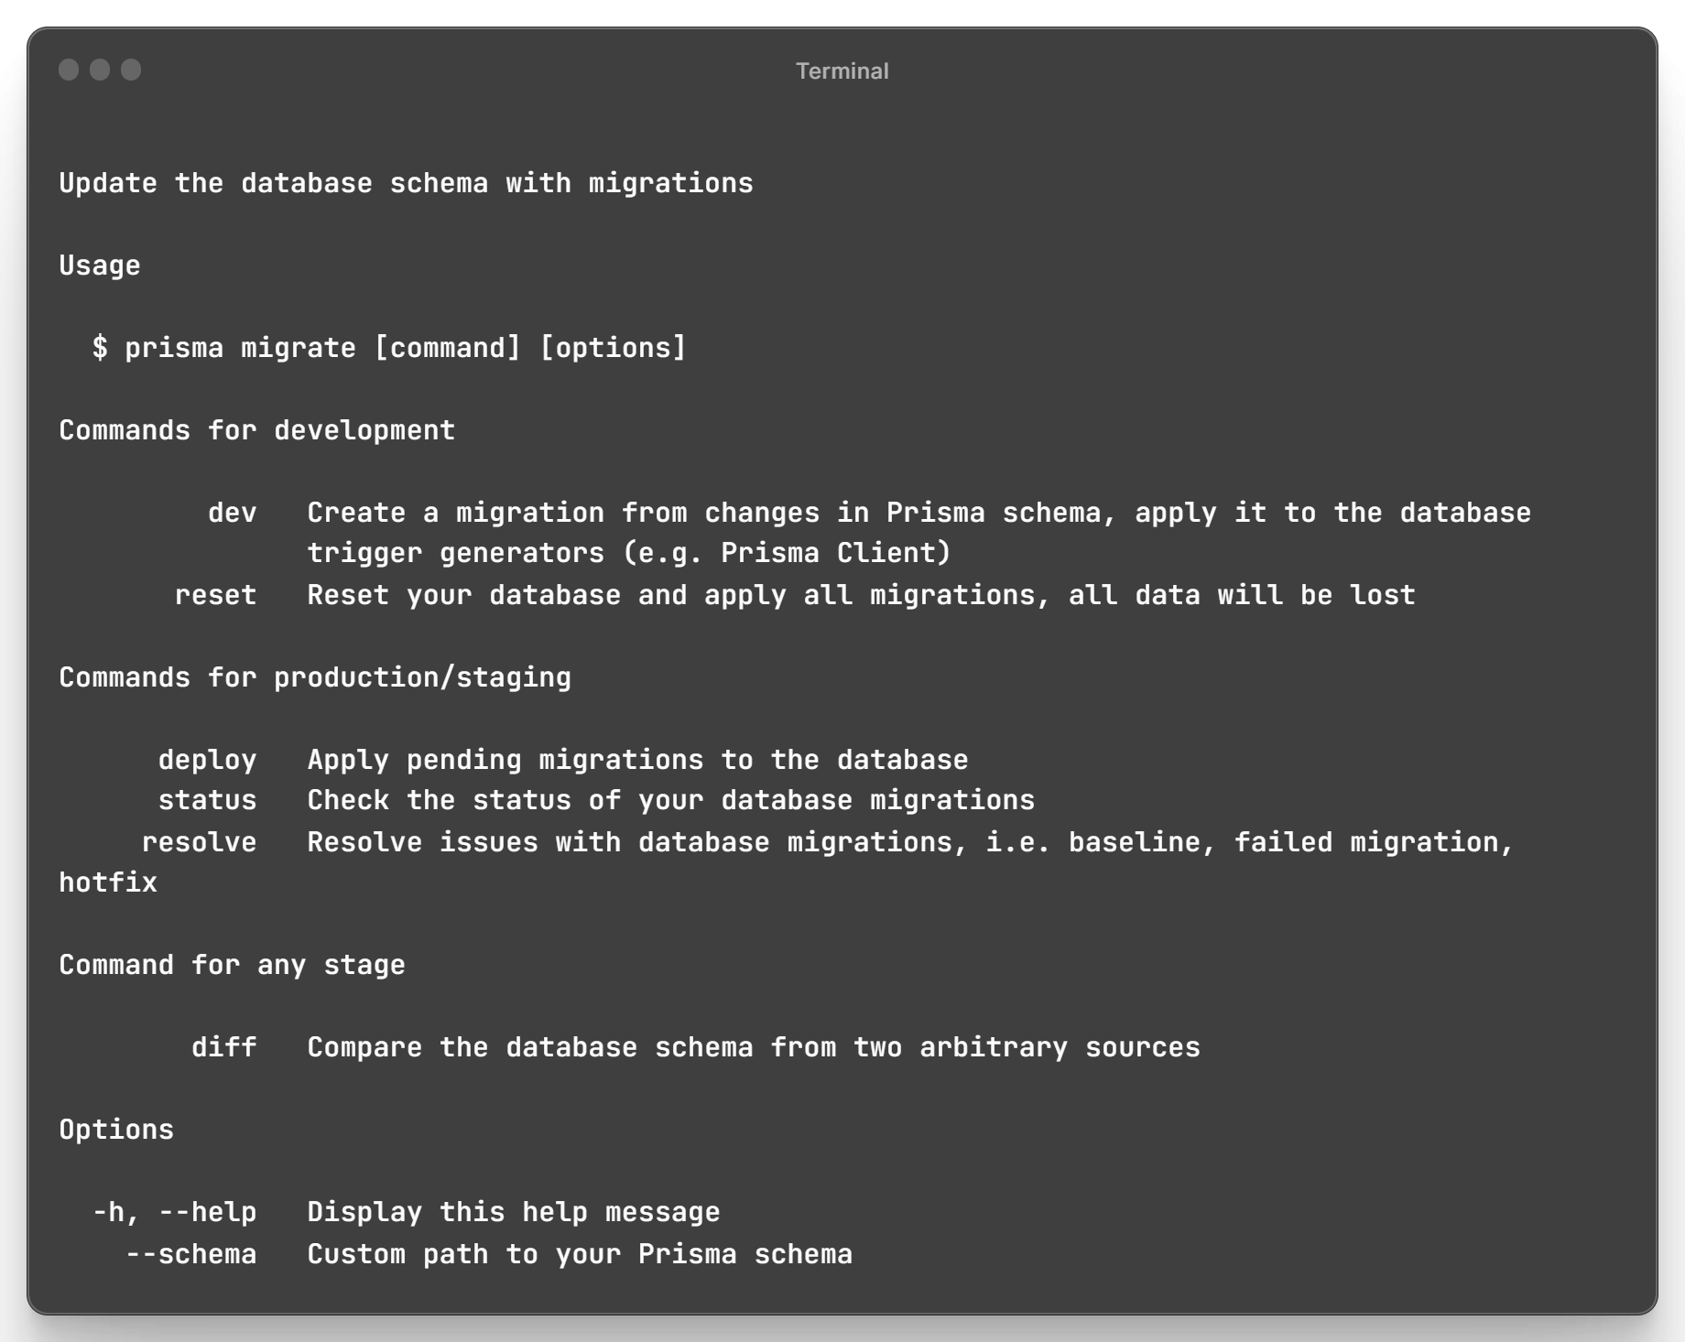
Prisma cli
Commands - migrate

Slide 13
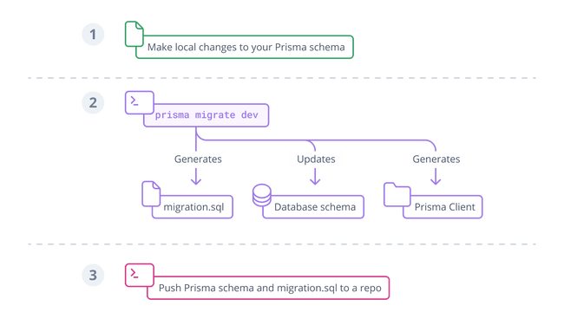
Prisma Schema
Every project starts with a Prisma schema file.
Data source: Specifies database connection (via an environment variable)
Generator: Indicates that we want to generate Prisma Client
Data model: Defines application models
A Data model can be created by:
Manually writing the data model and mapping it to the database with Prisma Migrate
Generating the data model by introspecting a database

Slide 14
Prisma Schema
Types
String
Boolean
Int
BigInt
Float
Decimal
DateTime
Json
Bytes
Unsupported

Slide 15
Prisma Schema
Attributes
@id - Defines a single-field ID
@@id - Defines a multi-field ID (composite ID) on the model
@default - Defines a default value for a field
@unique - Defines a unique constraint for this field
@@unique - Defines a compound unique constraint
@@index - Defines an index in the database
@relation - Defines meta information about the relation (name, fields, references, map, onUpdate, onDelete)
@map - Maps a field name or enum value from the Prisma schema to a column or document field with a different name in the database
@@map - Maps the Prisma schema model name to a table (relational databases) or collection (MongoDB) with a different name
@updatedAt - Automatically stores the time when a record was last updated
@ignore - exclude a field from the Prisma Client
@@ignore - exclude a model from Prisma Client

Slide 16
Prisma Schema
Attribute functions
autoincrement() - Create a sequence of integers in the underlying database and assign the incremented values to the ID values of the created records.
cuid() - Generate a globally unique identifier based on the cuid spec
uuid() - Generate a globally unique identifier based on the UUID spec, version 4 (random)
now() - Set a timestamp of the time when a record is created
dbgenerated() - Represents default values that cannot be expressed in the Prisma schema (such as random())

Slide 17
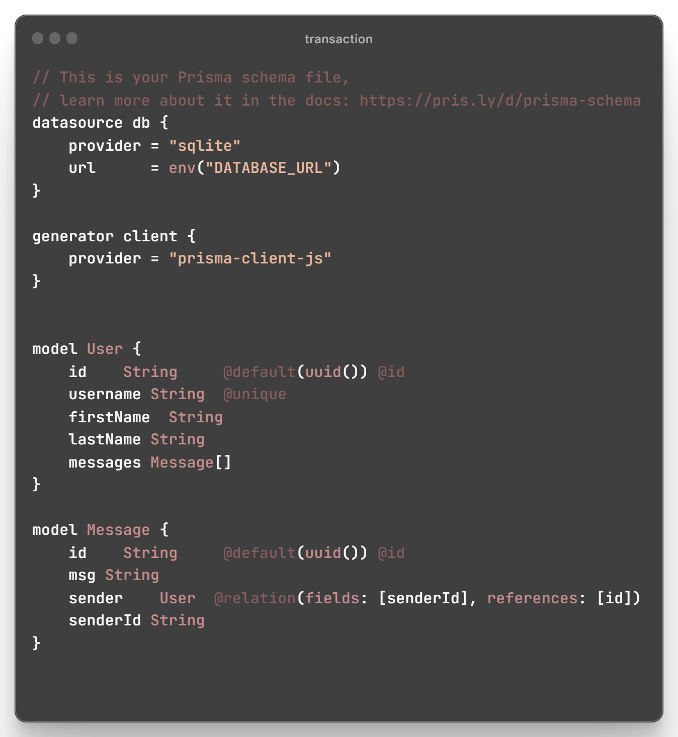
Prisma Schema

Slide 18
Queries
findUnique - retrieve a single database record
findUniqueOrThrow - if the query does not find a record, it throws NotFoundError
findFirst - returns the first record in a list that matches your criteria
findFirstOrThrow - if the query does not find a record, it throws NotFoundError
findMany - returns a list of records.

Slide 19
Queries
create - Creates a new database record.
update - Updates an existing database record.
upsert - If an existing database record satisfies the where condition, it updates that record else create the record
Delete - Deletes an existing database record
createMany - Creates multiple records in a transaction.
updateMany - Updates a batch of existing database records in bulk and returns the number of updated records.
deleteMany - Deletes multiple records in a transaction.

Slide 20
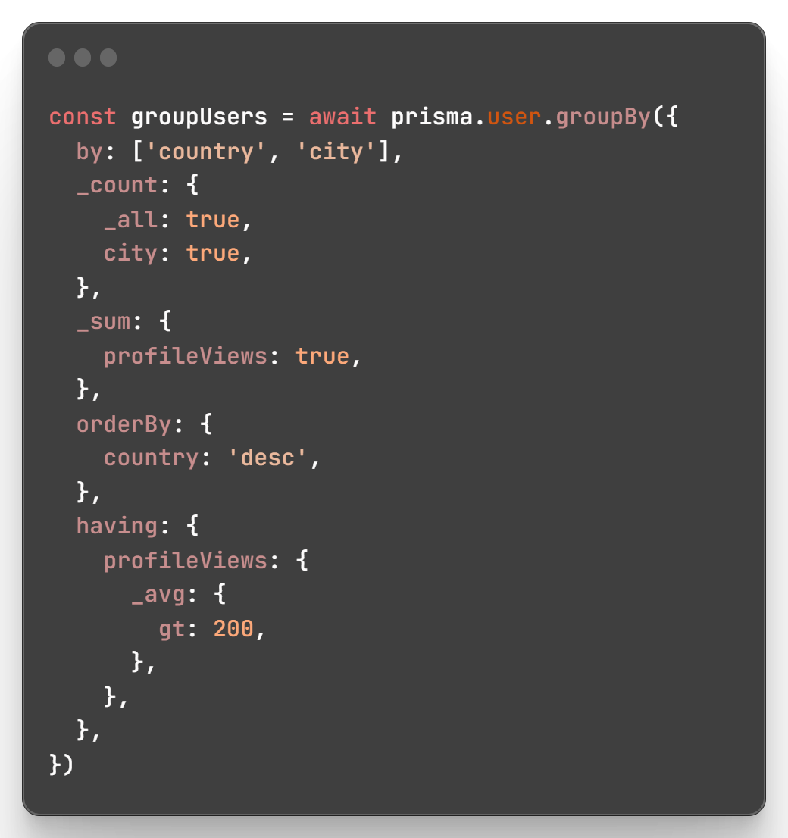
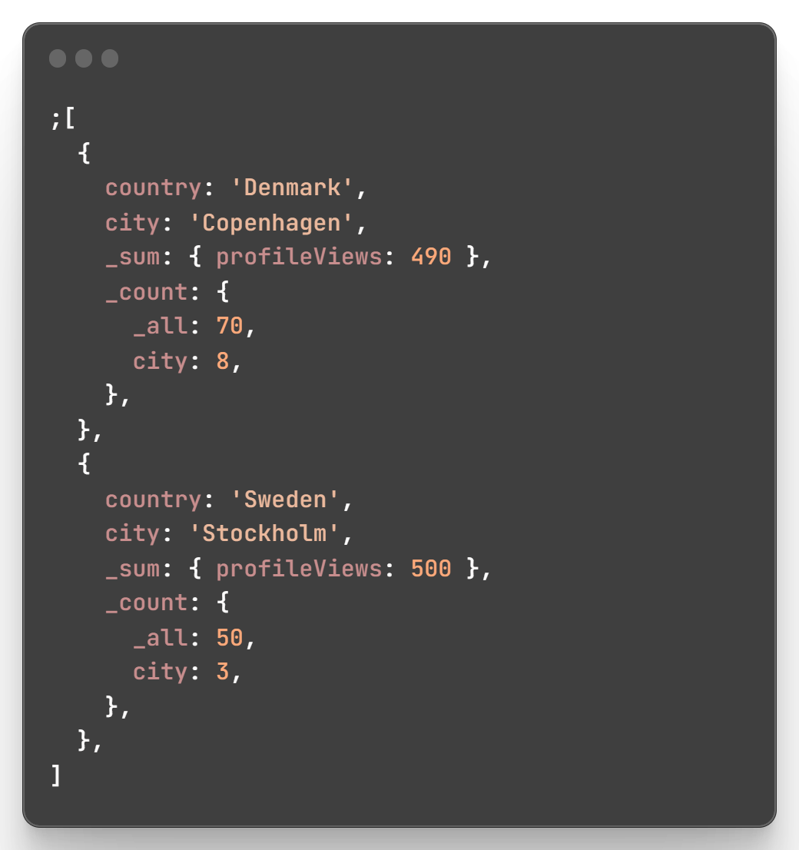
Queries
count
aggregate
groupBy

Slide 21
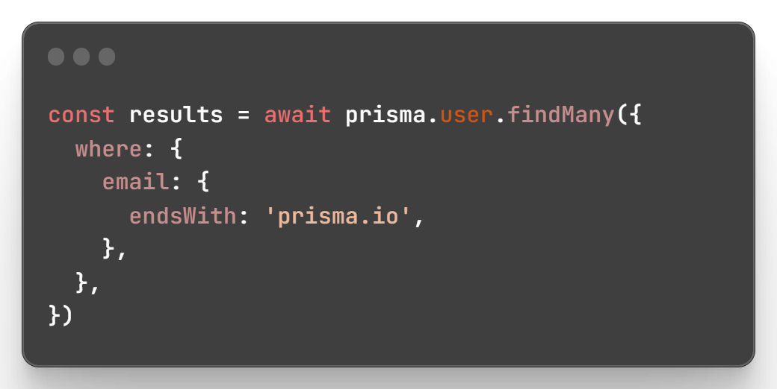
Query options
Where - Wraps all model fields in a type so that the list can be filtered by any property.
Select - Specifies which properties to include on the returned object.
Include - Specifies which relations should be eagerly loaded on the returned object.
orderBy - Lets you order the returned list by any property.
Distinct - Lets you filter out duplicate rows by a specific field - for example, return only distinct Post titles.
skip - Specifies how many of the returned objects in the list should be skipped.
take - Specifies how many objects should be returned in the list.
data - Wraps all the model fields in a type so that they can be provided when creating new records.
_avg, _sum, _min, _max…

Slide 22
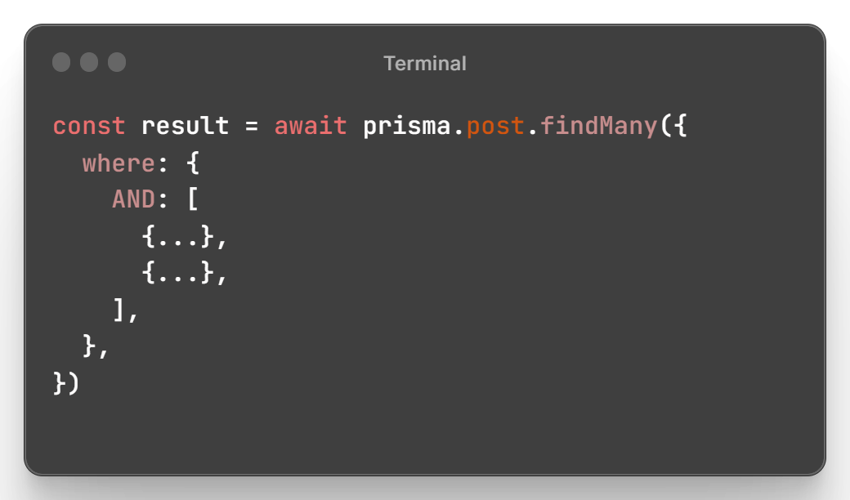
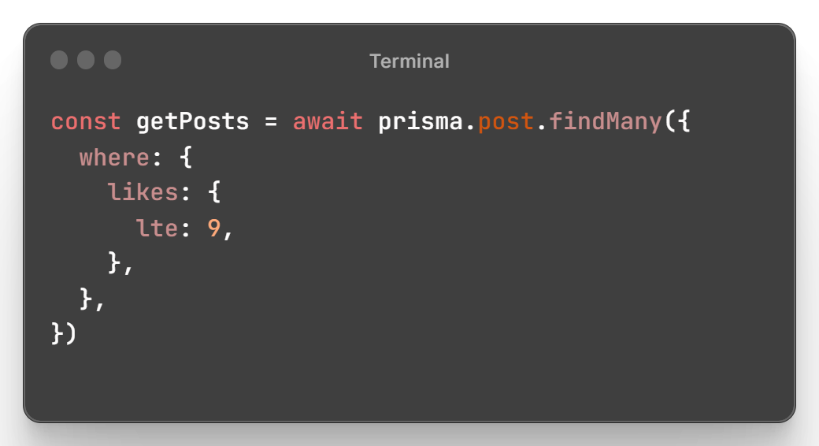
Filters
equals
not
in
notIn
lt
lte
gt
gte
AND
OR
NOT

Slide 23
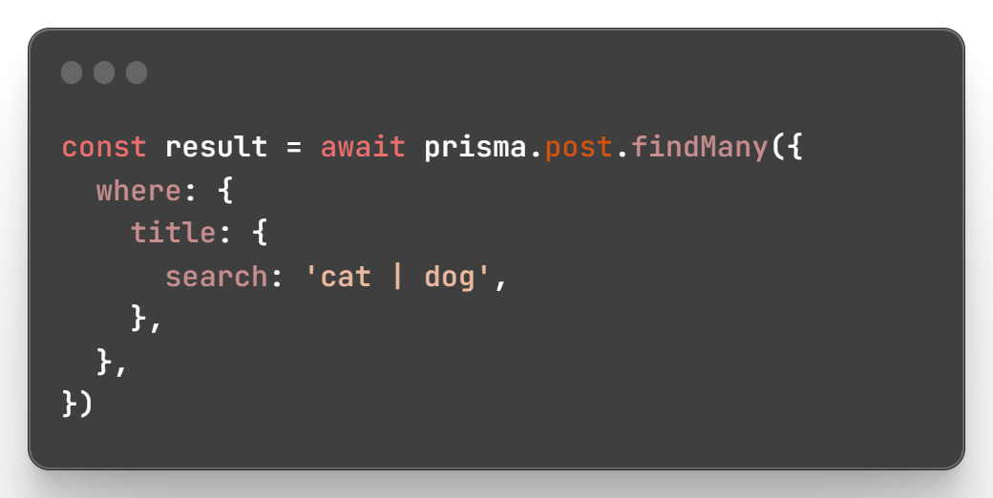
Filters
contains
search
mode
startsWith
endsWith

Slide 24
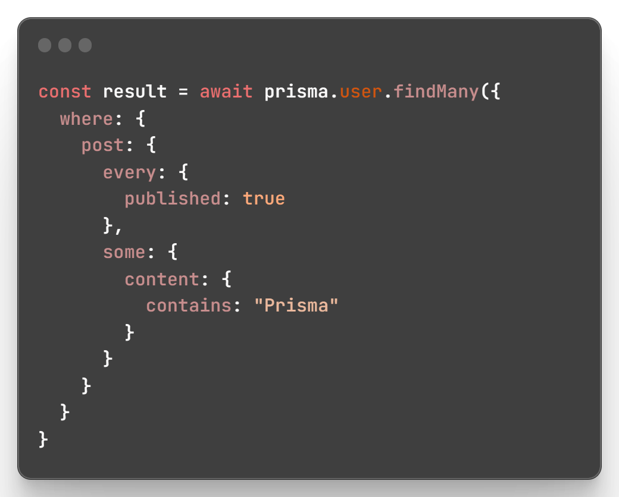
Relation Filters
some
every
none
is
isNot

Slide 25
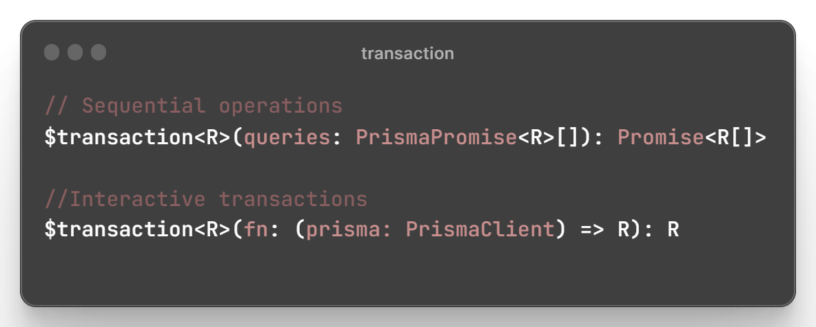
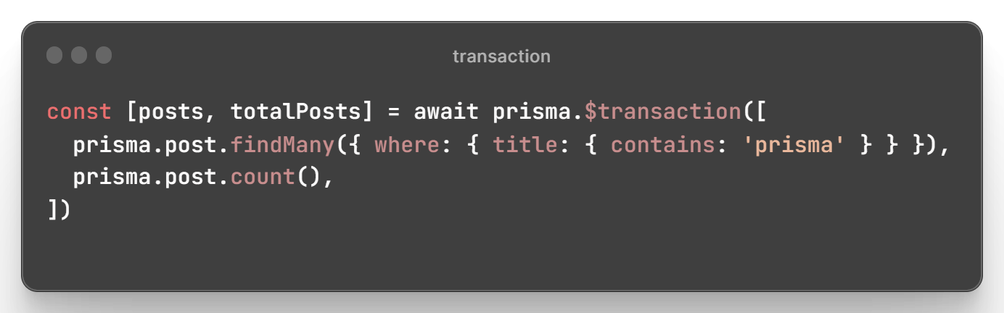
Transactions
sequence of read/write operations that are guaranteed to either succeed or fail as a whole.

Slide 26
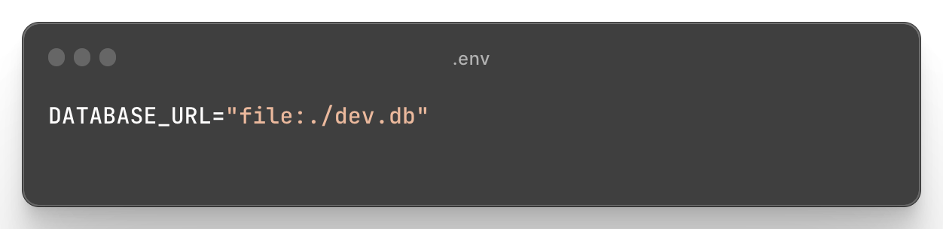
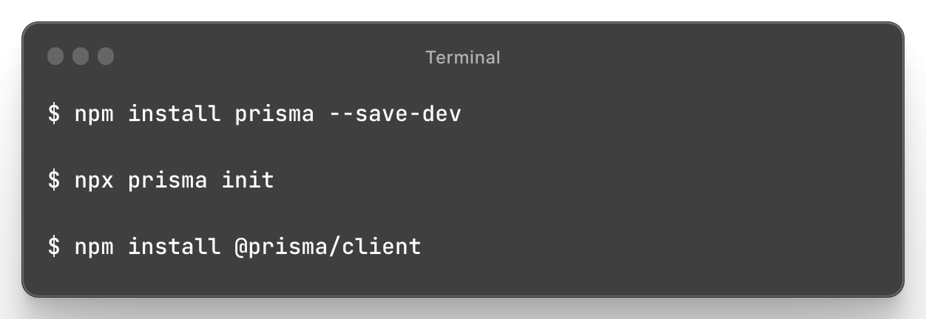
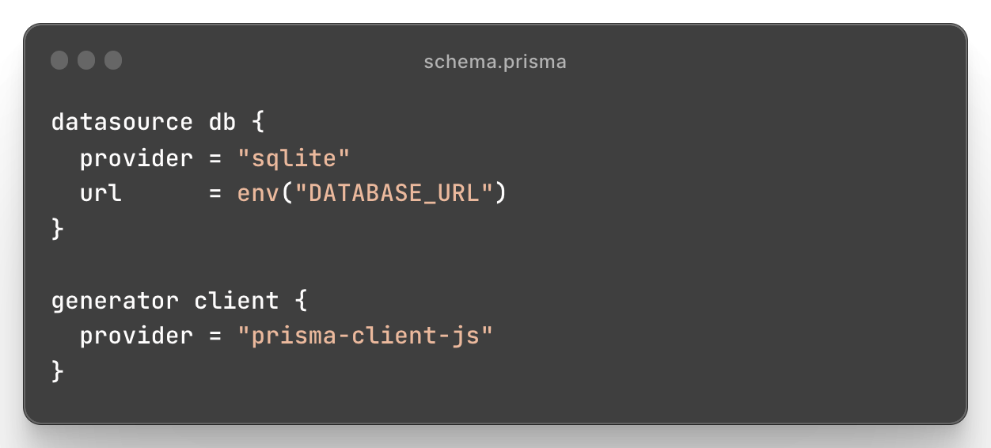
Setup

Slide 27
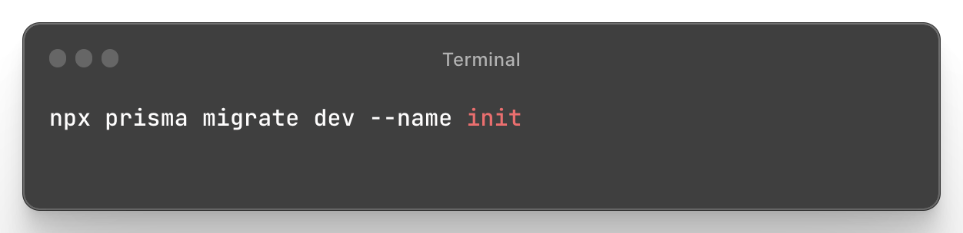
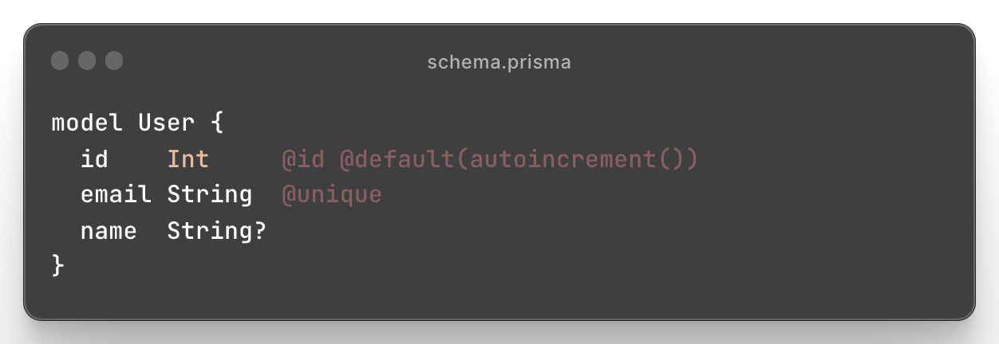
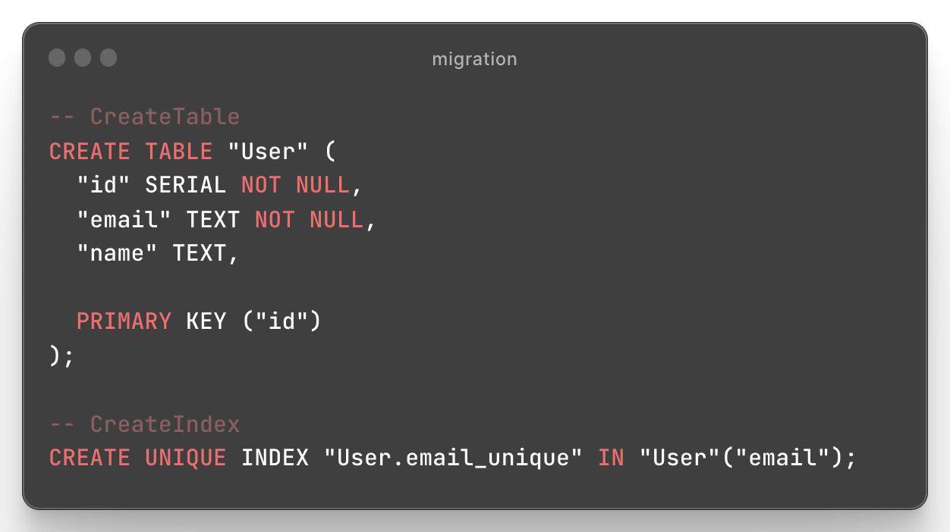
Migrations
Prisma Migrate uses Prisma schema changes to automatically generate fully customizable database schema migrations

Slide 28
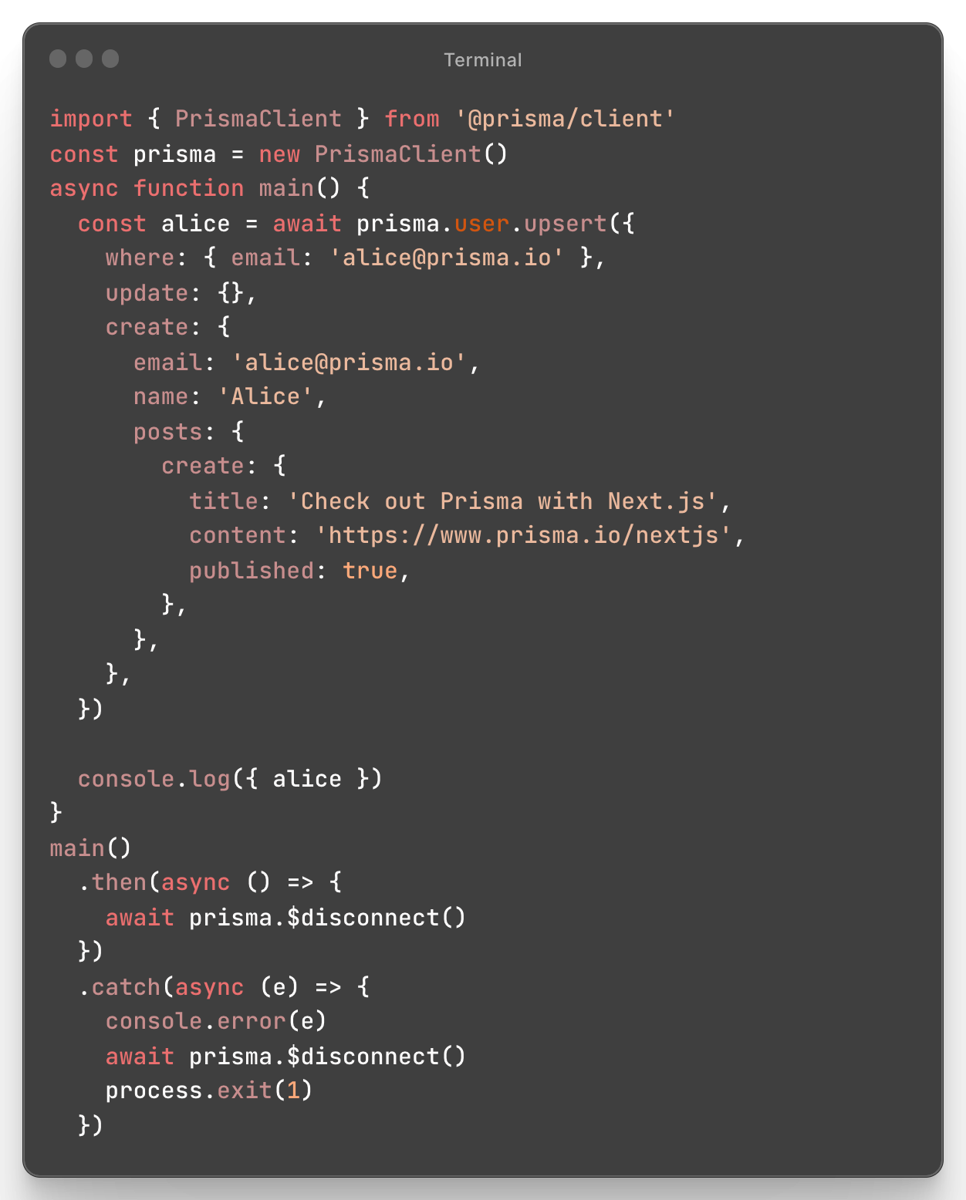
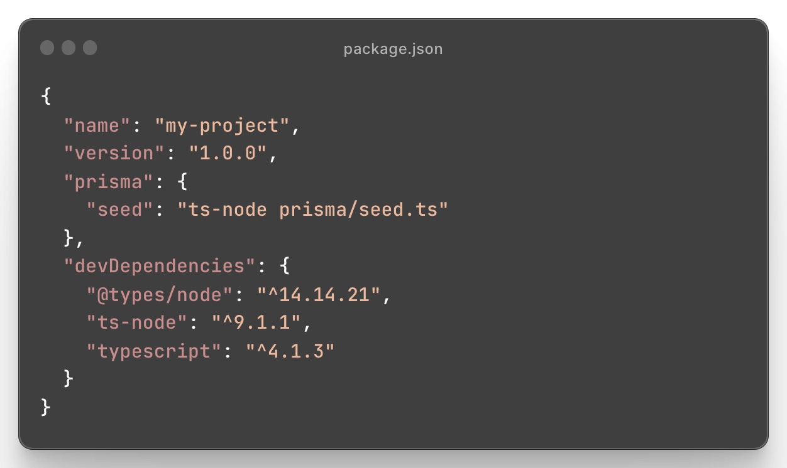
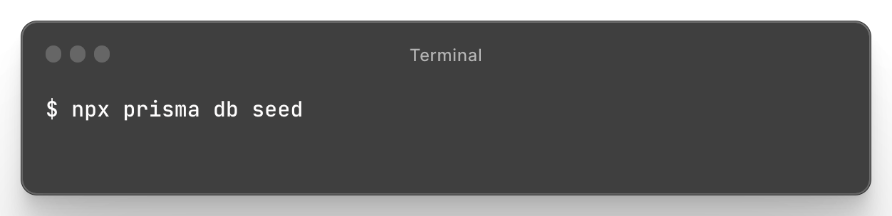
Seeding
Populate database with data that is required for the application to start
Provide basic data for validating and using the application in a development environment.

Slide 29
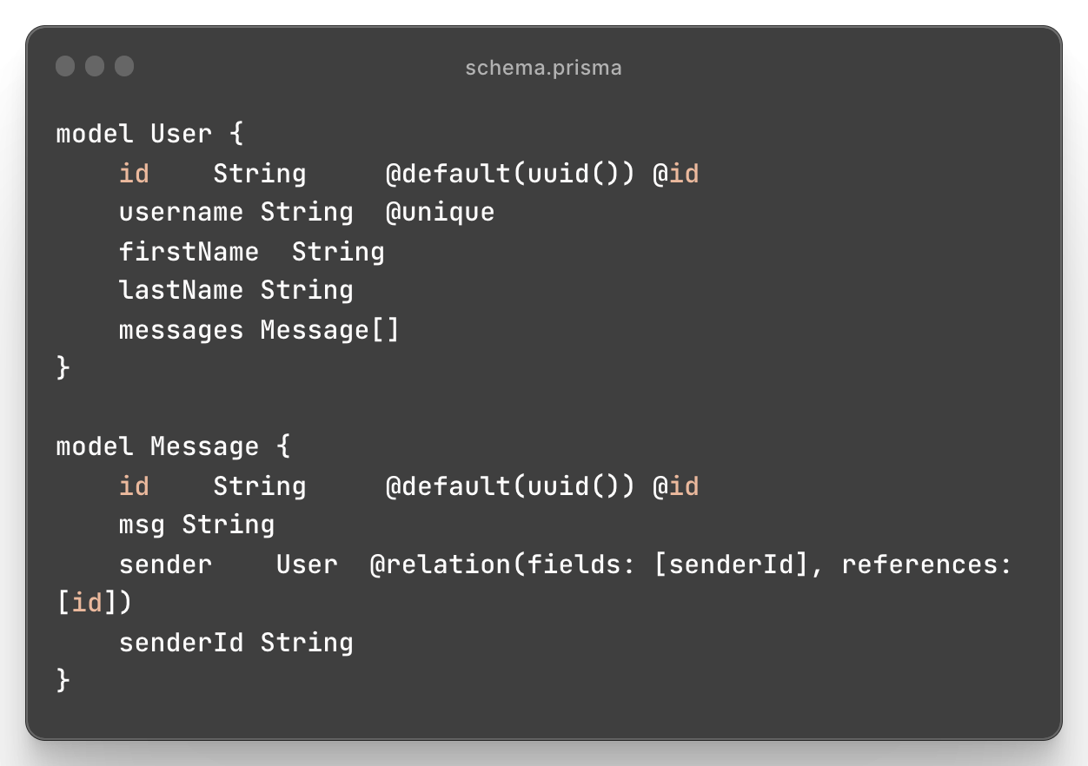
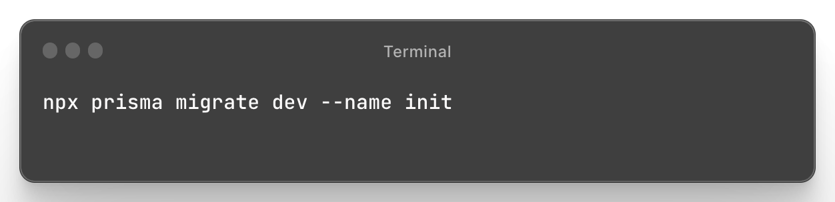
Create db

Slide 30
Back to NestJS!
Next steps:
Add prisma to the project;
Create the database;
Create a prisma service in the global core module;
Inject the service in the UserService and use it to query a sqlite db;
Handle prisma exceptions by implementing a global exception filter;
Add validation to the UserDto and use the ValidationPipe created in the last session;

Slide 31
Q&A

