Slide 1
Analysis of Wind Energy Generation in Brazil Using a SARIMA-MLP Hybrid Model with Weight Optimization
Pedro Natanael Firmino da Silva, Morgan Oliveira Melo de Siquiera
Graduate Program in Computer Engineering, University of Pernambuco (UPE)

Slide 2
Introduction
Context: Increasing electricity demand in Brazil and reliance on non-renewable sources.
Problem: Need for more accurate forecasts for wind energy generation.
Objective: Improve forecast accuracy by combining SARIMA and MLP models with weight optimization.

Slide 3
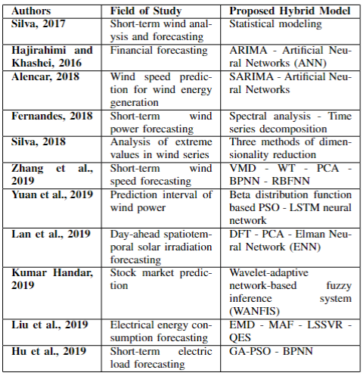
Literature Review
Related Studies: Use of statistical and hybrid models in wind energy forecasting.
Limitations of Traditional Models: ARIMA captures linear patterns but fails with nonlinear ones; MLP models complex nonlinear relationships but may miss seasonality and trends.

Slide 4
Methodology
Study Steps:
1. Data collection and preprocessing
2. Determination of model type (additive or multiplicative)
3. Trend and seasonality tests (Cox-Stuart and Kruskal-Wallis)
4. Fitting SARIMA and MLP models
5. Weight optimization

Slide 5
SARIMA Model
(p, d, q)x(P, D, Q)s
Description: Captures seasonal components and trends in time series.
Parameters: Autoregressive (AR), Moving Average (MA), Integrated (I).
Process: Model identification, parameter estimation, diagnostic checking, and forecasting.

Slide 6
MLP Model
Description: Neural network that models complex nonlinear relationships.
Components: Input layer, hidden layers, output layer.
Activation Functions: Sigmoid, Hyperbolic Tangent, ReLU.

Slide 7
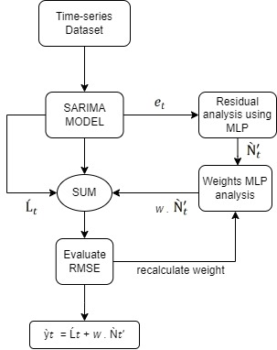
SARIMA-MLP Hybrid Model
Structure: SARIMA captures linear components; MLP models nonlinear residuals.
Formulation: Combination of SARIMA and MLP predictions with optimized weight.

Slide 8
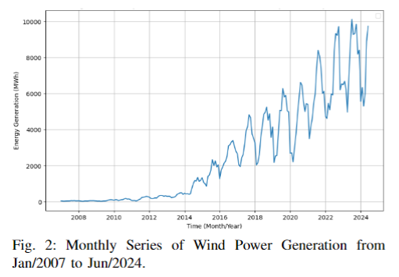
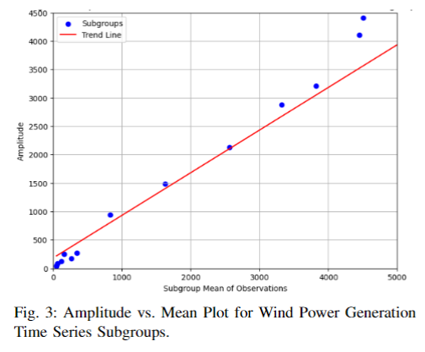
Experimental Results
Data: Wind energy generation in Brazil (2007-2024).
BOX-COX

Slide 9
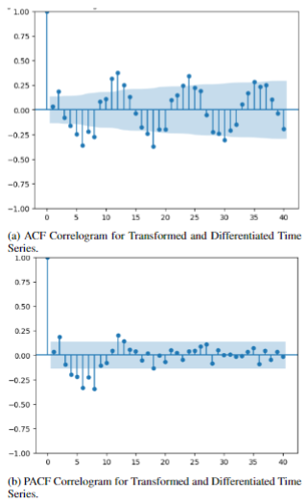
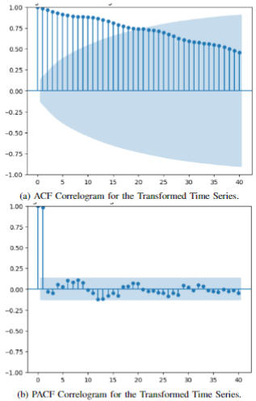

Experimental Results
SARIMA MODEL
BOX-COX
(p, d, q)x(P, D, Q)s
s
Q
q
Differentiation
d
P
p
D

Slide 10
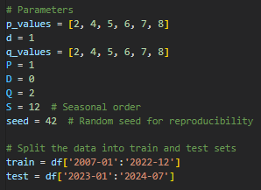
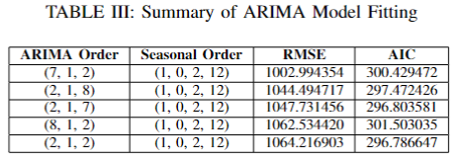
Experimental Results
SARIMA MODEL
(p, d, q)x(P, D, Q)s

Slide 11
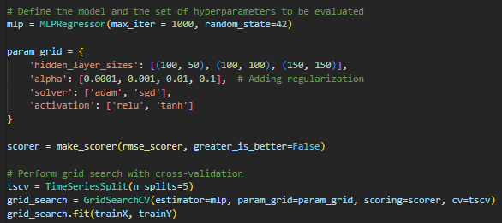
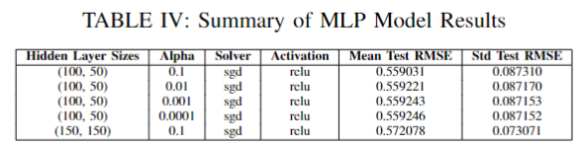
Experimental Results
MLP MODEL

Slide 12
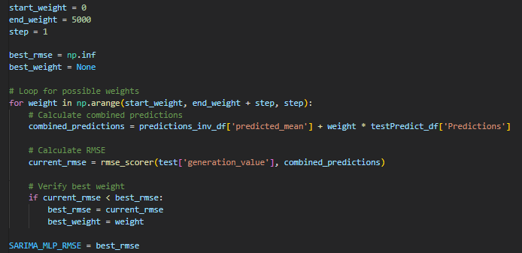
Experimental Results
Weight Optimization

Slide 13
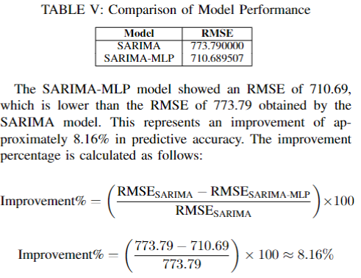
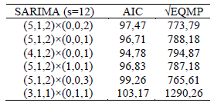
Experimental Results
Comparing Results
Silva, 2022

Slide 14
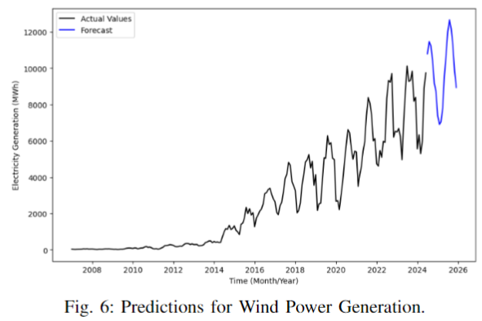
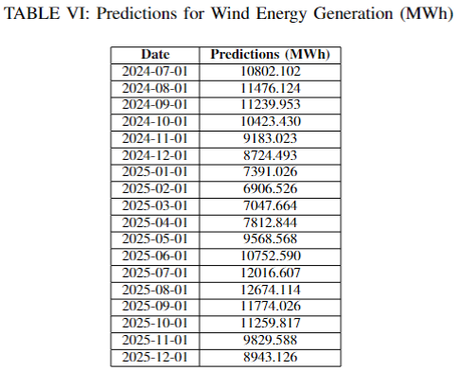
Experimental Results
Future Predictions

Slide 15
Conclusion
Summary: The SARIMA-MLP model with weight optimization provides more accurate forecasts.
Impact: Improved planning and management of wind energy resources in Brazil.
Future Work: Explore other machine learning algorithms and include more variables.

Slide 16
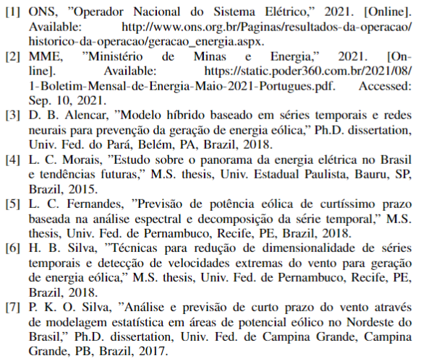
References

Slide 17
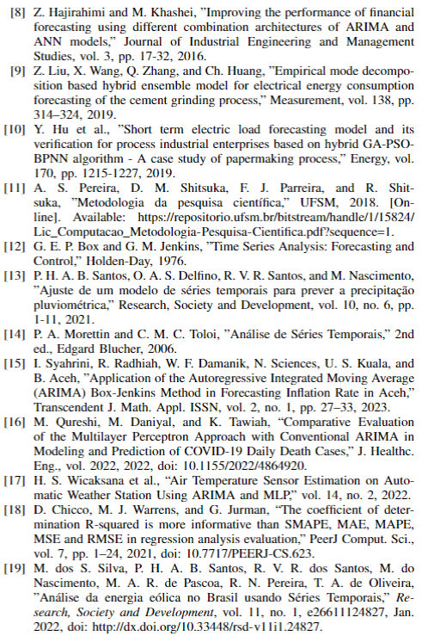
References

