Slide 1









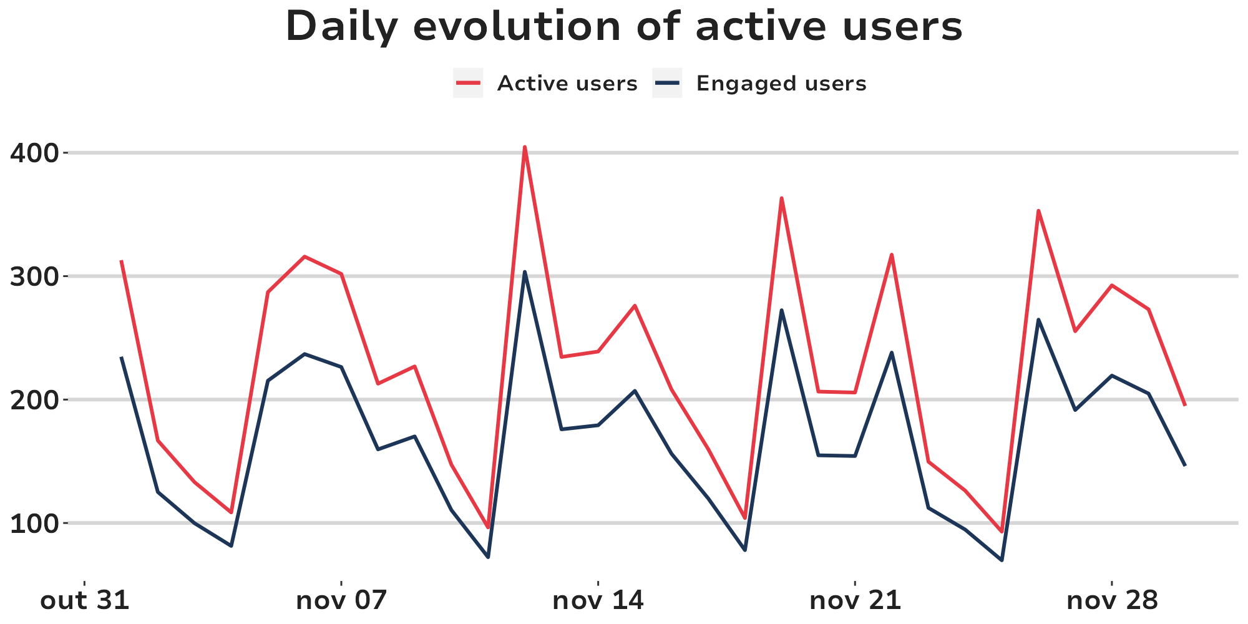
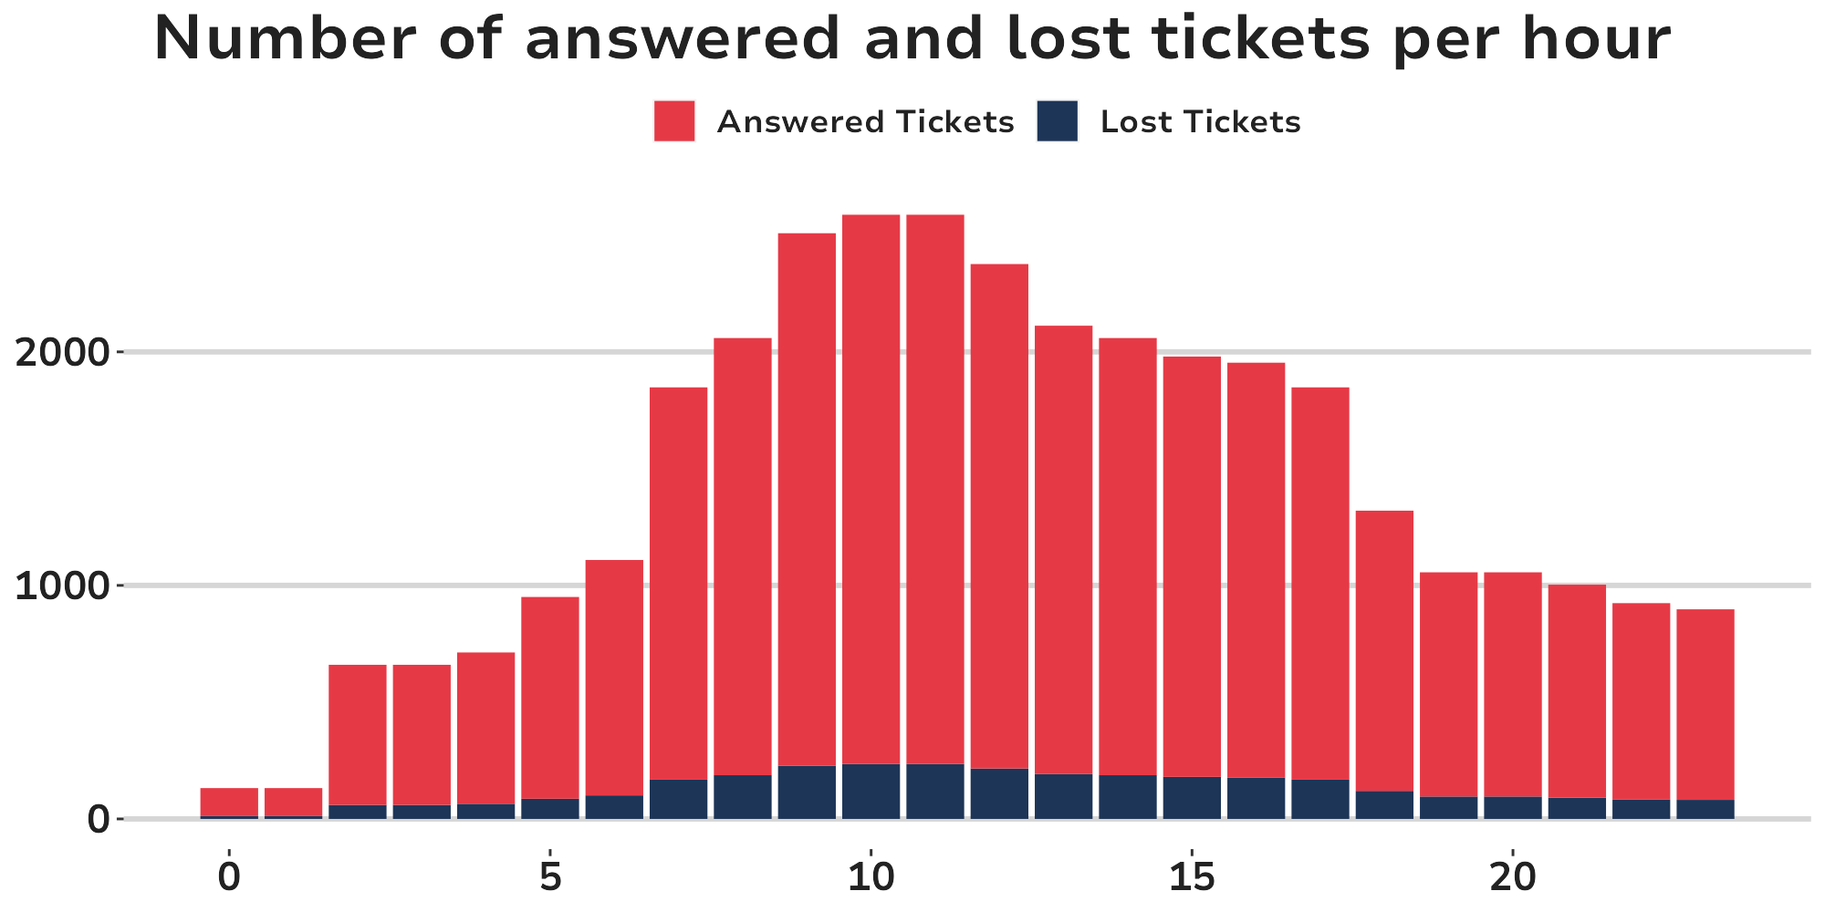
OVERVIEW
Visits
Active users
Engaged users
New users
Total messages
Recurrence
Engagement
rate
Monthly return
30,000
25,670
-4.40%
22,190
-2.20%
1,150
3.50%
100,000
4.00%
60.00%
-8.00%
90.00%
2.70%
80.00%
0.90%
12.00%
Until October, the engaged users database got 200,000 users.
As a result, the number of new users at October reached a database increase of:
0.15%

Slide 2
SALES
Number of proposals sold
Conversion rate
API calls success rate
Total amount sold
1,500
$ 20 K
60%
90%
15%
20%
15 pp.
40 pp.
Secured loan
over vehicles
Payroll loan
$ 8 K
$ 12 K
5%
100%

Slide 3
SALES
Mesmo com as quedas no número de usuários entrando na plataforma, e no valor total vendido para os produtos de consignado, tivemos um grande resultado com o aumento da taxa de conversão, e com a introdução de um novo produto no fluxo (empréstimos com garantia sobre veículos).
Realizamos algumas melhorias na API utilizada no fluxo de vendas. Como resultado, a taxa de sucesso nas chamadas de API teve uma forte melhora. Isso contribuiu muito para o aumento da taxa de conversão geral, e para as vendas como um todo.
Number of proposals sold
Total amount sold
Conversion rate
API calls success rate
1,500
$ 20 K
60%
90%
15%
20%
15 pp.
40 pp.
Secured loan
over vehicles
Payroll loan
$ 8 K
$ 12 K
5%
100%

Slide 4
SALES
Even with the 12% drop in the number of users entering the platform, and 5% in the total amount sold for payroll products, we had a significant increase of 20% over the total amount sold. Because we had an increase of 15 pp. at the conversion rate. In addition to the introduction of a new product (secured loans on vehicles) which obtained $12 thousand in sales in its first month.
Number of proposals sold
Total amount sold
1,500
$ 20 K
15%
20%
Payroll loan
Secured loan
over vehicles
$ 8 K
$ 12 K
5%
100%

Slide 5
REFORMULAÇÃO

Slide 6
SALES
At October, our sales increased by 20%
Number of proposals sold
Total amount sold
1,500
$ 20 K
15%
20%

Slide 7
WHERE DID WE SELL MORE ?
In the first month of the new product, we managed to generate $12 K in sales!
Payroll loan
Secured loan
over vehicles
$ 8 K
$ 12 K
5%
100%

Slide 8
WHY DID WE SELL MORE ?
API calls success rate
Important improvement in the API used at the sales process;
90%
40 pp.
Conversion rate
Significant increase in the conversion rate;
60%
15 pp.

