Slide 1
Factory Method
Joao Pinto - 104384
April 24th, 2024

Slide 2
When should we use this pattern?
Factory Method is a creational design pattern that provides an interface for creating objects in a superclass, but allows subclasses to alter the type of objects that will be created.
In situations like:
When you don’t know beforehand the exact types of the objects.
E.g: To add a new product: create a new creator subclass and override the factory method in it.
When you want to provide users of your library a way to extend its internal components.
E.g: Extend the standard Button class with a RoundButton subclass.

Slide 3
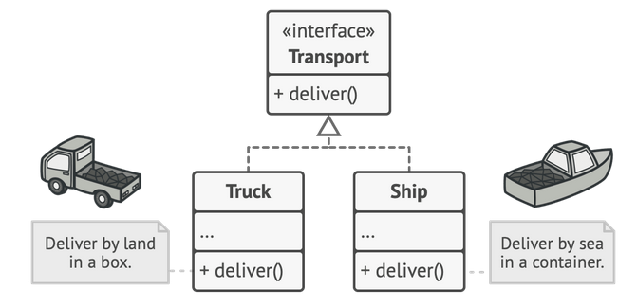
How to implement this pattern?
All products must follow the same interface.
This interface should declare methods that make sense in every product.
Example:
The Truck and Ship classes must implement the Transport interface.

Slide 4
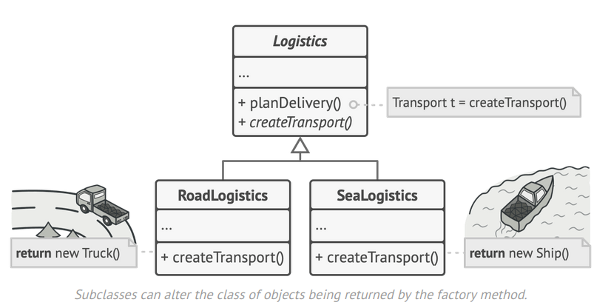
How to implement this pattern?
Idea: Replace direct object construction calls with calls to a special factory method.
Objects returned by a factory method are often referred to as products.
Example:
The factory method in the RoadLogistics class returns truck objects, whereas the factory method in the SeaLogistics class returns ships.
Base factory class
Subclasses can alter the class of objects being returned by the factory method.

Slide 5
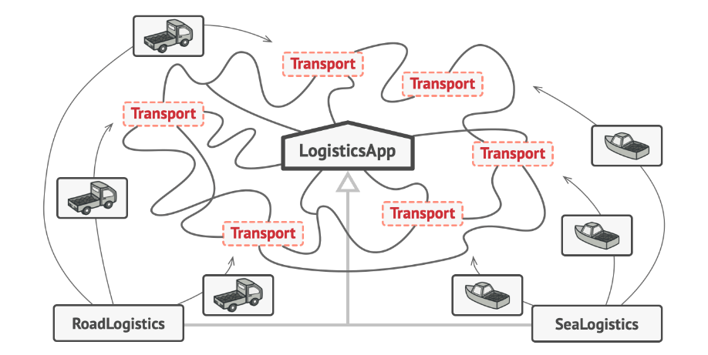
Result
As long as all classes responsible for creating the products implement the same interface, we can pass objects from these classes to the client code without any problem.
This code does not see differences between the different products created by the different subclasses.

Slide 6
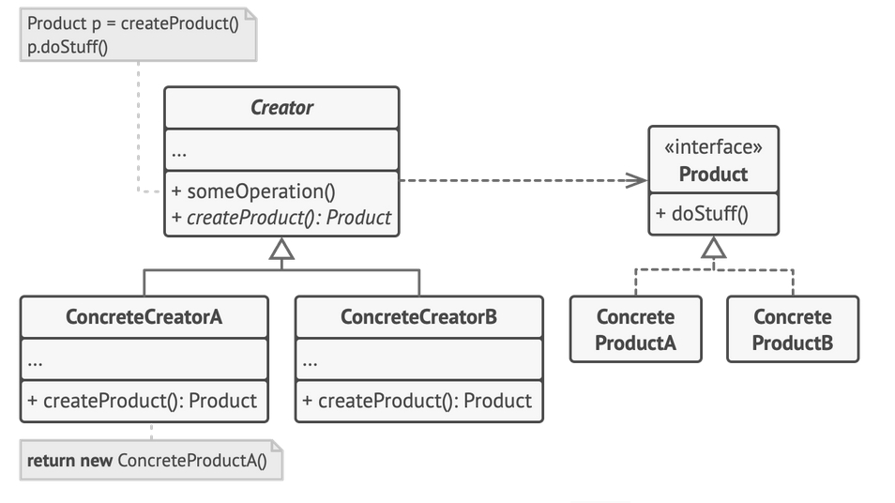
(Base) Class Structure and Example
Exemplo | Função
Transport | Product (Interface)
Truck | ConcreteProductA
Ship | ConcreteProductB
Logistics | Creator (Factory)
RoadLogistics | ConcreteCreatorA
SeaLogistics | ConcreteCreatorB

Slide 7
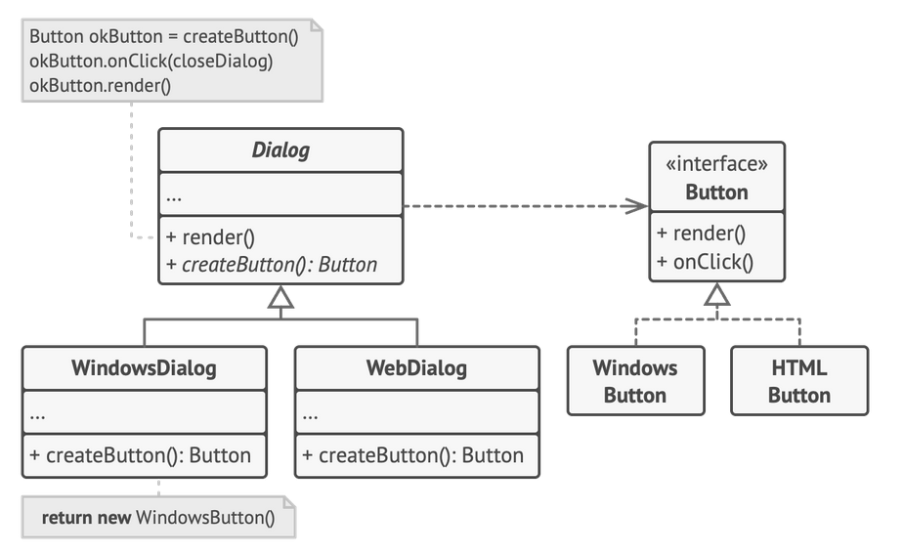

Code Example(s) (Another)
Regardless of the Operating System, all buttons have the same behavior.
Two different implementations of the button.
Subclasses can change the type of button returned by the factory method.

Slide 8
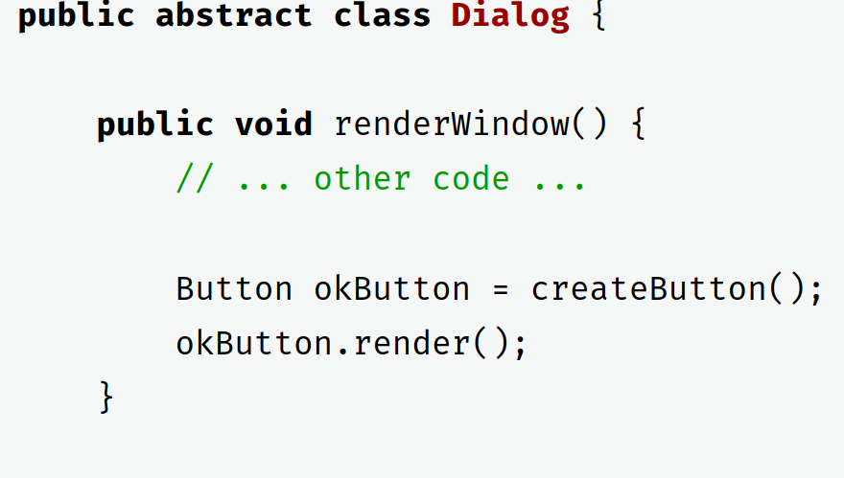
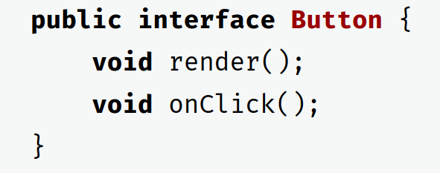
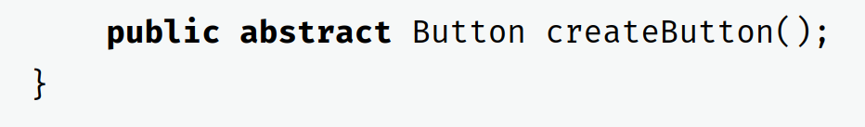
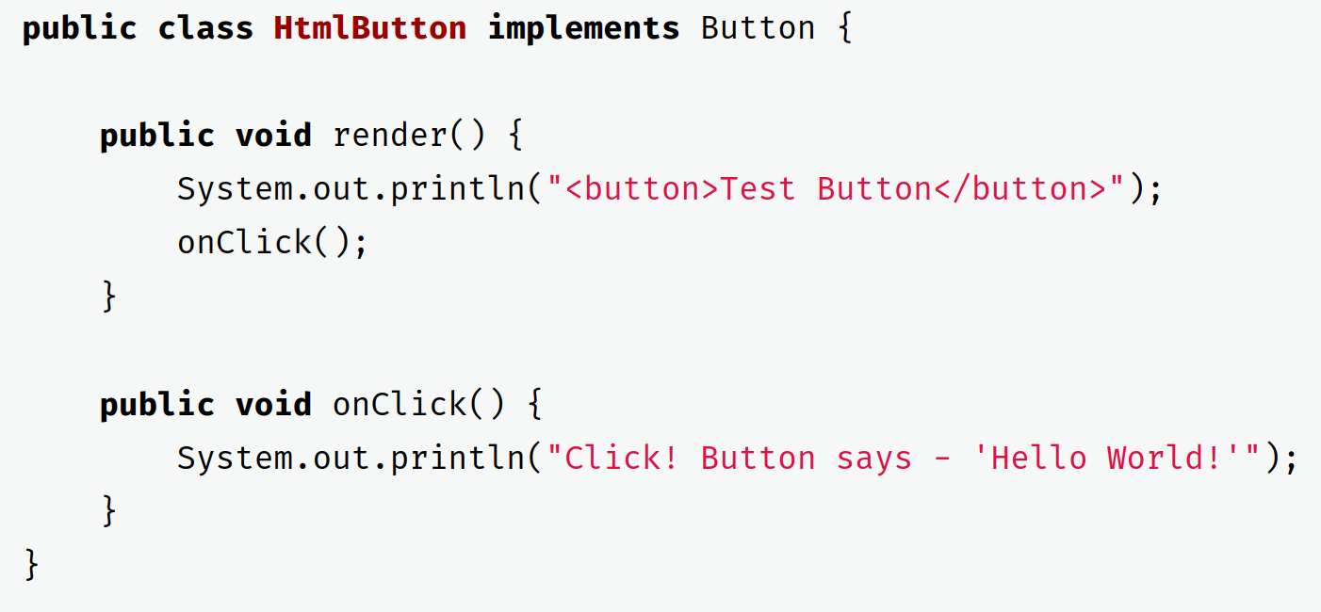
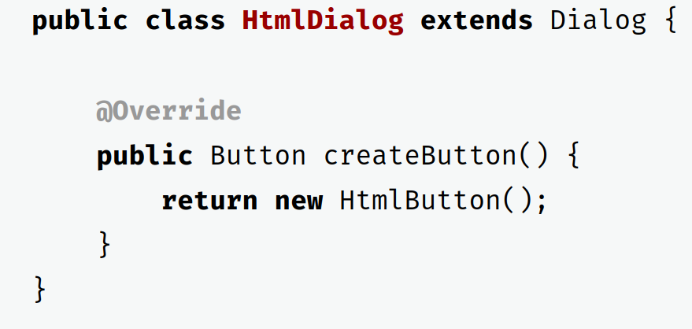
Code Example(s) (Another)
Base factory class
Regardless of the Operating System, all buttons have the same behavior.
ConcreteProductA
ConcreteCreatorA
Note: ConcreteCreatorB (WindowsDialog) is similar
Note: ConcreteProductB (WindowsButton) is similar

Slide 9
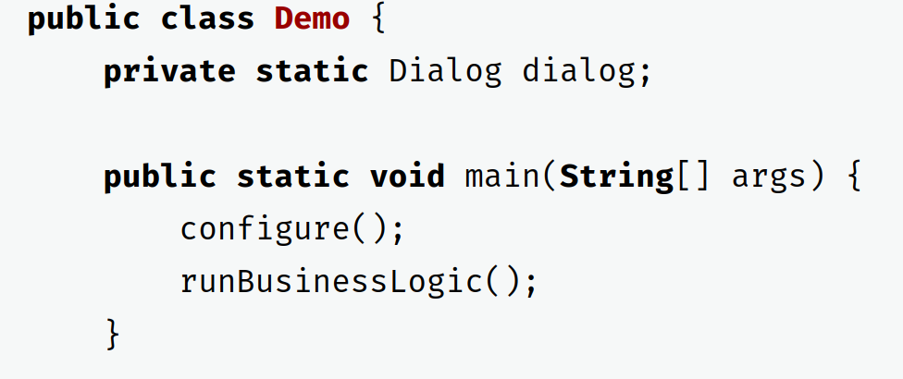
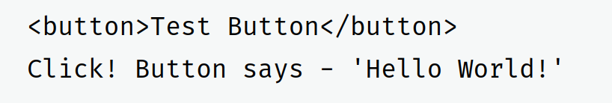
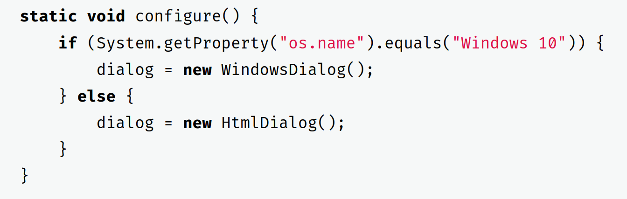
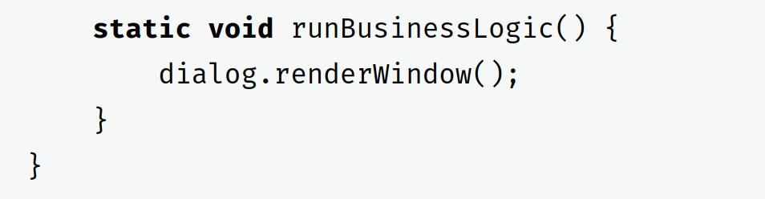
Code Example(s) (Another)
Client Code
Output (HtmlDialog)

Slide 10
Advantages and Disadvantages:
Advantages:
Strong cohesion between the Creator and the different products is avoided.
Single Responsibility Principle: all the code responsible for creating object instances is centralized in one part of the system, reducing coupling and facilitating maintenance.
Open/Closed Principle: allows new types of products to be introduced without the need to change the existing code of clients who use these products.
Disadvantage:
The implementation of the pattern can lead to an increase in code complexity, due to the need to introduce several subclasses to carry out the creation of different types of products.

