Slide 1
Factory Method
Danilo Micael Gregório Silva - 113384
April 24th, 2024

Slide 2
When should we use this pattern?
Use the Factory Method when you don’t know beforehand the exact types and dependencies of the objects your code should work with.
Use the Factory Method when you want to provide users of your library or framework with a way to extend its internal components.
Use the Factory Method when you want to save system resources by reusing existing objects instead of rebuilding them each time.

Slide 3
How to implement this pattern?
Make all products follow the same interface. This interface should declare methods that make sense in every product
1
Add an empty factory method inside the creator class. The return type of the method should match the common product interface
2
In the creator’s code find all references to product constructors. One by one, replace them with calls to the factory method, while extracting the product creation code into the factory method.
3
Create creator subclasses for each product type in the factory, overriding the factory method in each subclass and extracting the relevant construction code from the base method
4
If there are too many product types and it doesn’t make sense to create subclasses for all of them, you can reuse the control parameter from the base class in subclasses.
5
If, after all of the extractions, the base factory method has become empty, you can make it abstract. If there’s something left, you can make it a default behavior of the method
6

Slide 4
(Base) Class Structure
Product p = createProduct()
p.doStuff()
Creator
<<Interface>>
Product
…
+ someOperation()
+ createProduct(): Product
+ doStuff()
Concrete ProductA
Concrete ProductB
ConcreteCreatorA
ConcreteCreatorB
…
…
+ createProduct(): Product
+ createProduct(): Product
Return new ConcreteProductA()

Slide 5
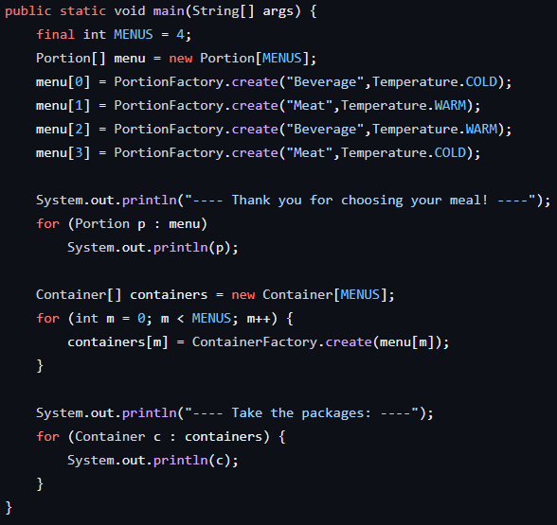
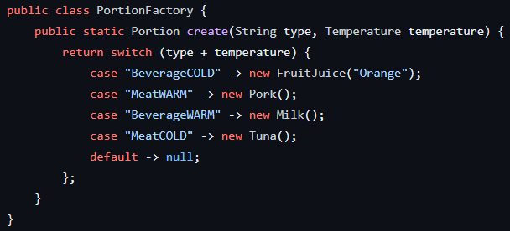
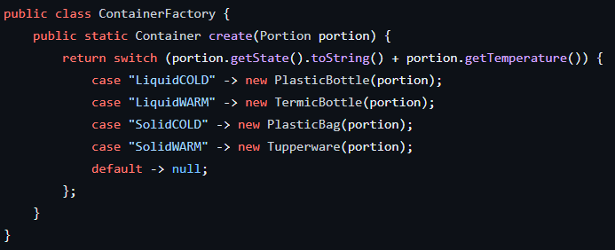
Code Example(s)
Main
PortionFactory
ContainerFactory

