Slide 1
Abstract Factory
André Dora – 113613
April 24th, 2024

Slide 2
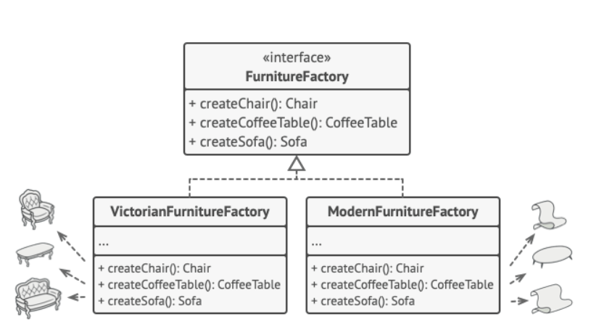
When should we use this pattern?
The Abstract Factory design pattern is a factory for creating different types of related objects.
Instead of specifying exactly which type of object you want to create, you delegate that decision to the factory.
This allows you to switch between different families of objects without changing your code, making your application more flexible and easier to maintain.

Slide 3
How to implement this pattern?
1
Map out a matrix of distinct product types versus variants of these products.
Declare abstract product interfaces for all product types. Then make all concrete product classes implement these interfaces.
Declare the abstract factory interface with a set of creation methods for all abstract products.
Implement a set of concrete factory classes, one for each product variant.
5
Create factory initialization code somewhere in the app. It should instantiate one of the concrete factory classes, depending on the application configuration or the current environment. Pass this factory object to all classes that construct products.
Scan through the code and find all direct calls to product constructors. Replace them with calls to the appropriate creation method on the factory object.
2
3
6
4

Slide 4
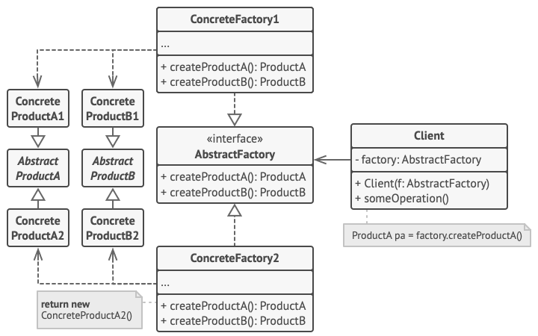
(Base) Class Structure

Slide 5
Code Example(s)
class WindowsLaptop implements Laptop {
@Override
public void bootUp() {
System.out.println("Booting up Windows laptop");
}
}
class MacBook implements Laptop {
@Override
public void bootUp() {
System.out.println("Booting up MacBook");
}
}
Step 3: Declare abstract factory interface
interface ElectronicDeviceFactory {
Phone createPhone();
Laptop createLaptop();
}
Step 1: Define abstract product interfaces
interface Phone {
void makeCall();
}
interface Laptop {
void bootUp();
}
Step 2: Implement concrete product classes
class AndroidPhone implements Phone {
@Override
public void makeCall() {
System.out.println("Making call from Android phone");
}
}
class IPhone implements Phone {
@Override
public void makeCall() {
System.out.println("Making call from iPhone");
}
}

Slide 6
Code Example(s)
@Override
public Laptop createLaptop() {
return new MacBook();
}
}
Step 4: Implement concrete factory classes
class AndroidFactory implements ElectronicDeviceFactory {
@Override
public Phone createPhone() {
return new AndroidPhone();
}
@Override
public Laptop createLaptop() {
// Android doesn't produce laptops, so return null or throw an exception
return null;
}
}
class AppleFactory implements ElectronicDeviceFactory {
@Override
public Phone createPhone() {
return new IPhone();
}

Slide 7
Code Example(s)
Step 5: Factory Initialization
public class Main {
public static void main(String[] args) {
// Initialize factory based on application configuration or environment
ElectronicDeviceFactory factory;
// Example: Choose factory based on user's preferred platform
if (args.length > 0 && args[0].equalsIgnoreCase("android")) {
factory = new AndroidFactory();
} else {
factory = new AppleFactory();
}
// Pass factory object to classes that construct products
Phone phone = factory.createPhone();
Laptop laptop = factory.createLaptop();
// Use the created products
phone.makeCall();
if (laptop != null) {
laptop.bootUp();
}
}
}

