Slide 1
Abstract Factory
Sebastião Teixeira - 114624
April 24th, 2024

Slide 2
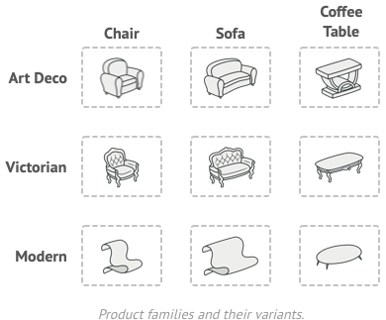
When should we use this pattern?
Abstract Factory is a creational design pattern that lets you produce families of related objects without specifying their concrete classes.
So, it should be used when:
- we have a collection of Objects (Products), that shouldn’t be instanciated directly by client;
- there are several variants of these family of Products;
- these objects can be cataloged by a set of families.

Slide 3
How to implement this pattern?
1. Map out a matrix of distinct product types versus variants of these products.
2. Declare abstract product interfaces for all product types. Then make all concrete product classes implement these interfaces.
3. Declare the abstract factory interface with a set of creation methods for all abstract products.
4. Implement a set of concrete factory classes, one for each product variant.
5. Create factory initialization code somewhere in the app. It should instantiate one of the concrete factory classes, depending on the application configuration or the current environment. Pass this factory object to all classes that construct products.
6. Scan through the code and find all direct calls to product constructors. Replace them with calls to the appropriate creation method on the factory object.

Slide 4
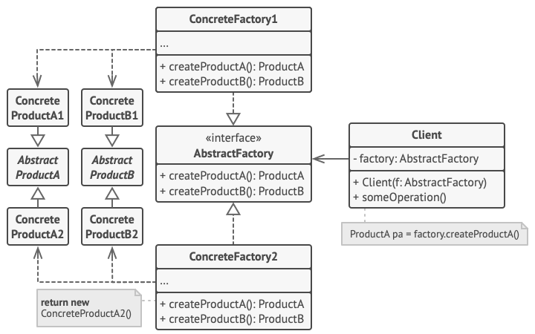
(Base) Class Structure

Slide 5


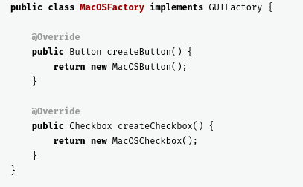
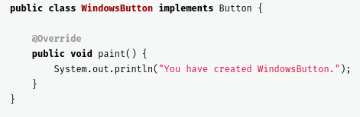
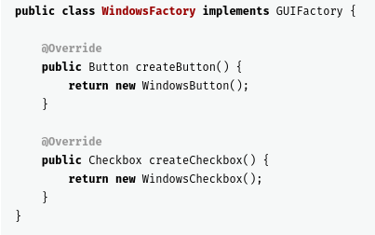
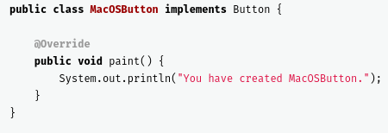
Code Example(s)
Abstract Factory
Concrete Factory
Abstract Product
Concrete Products

Slide 6
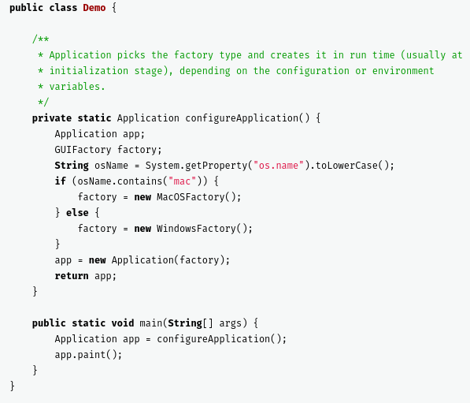
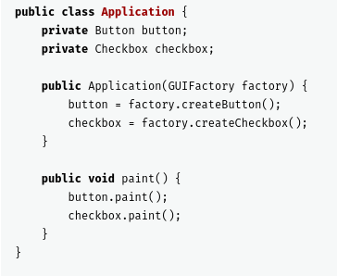
Code Example(s)
Main
Client

