Slide 1
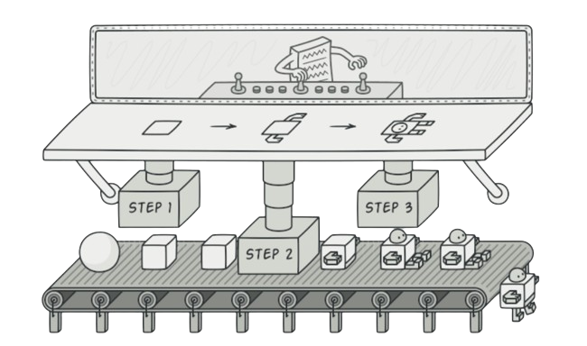
Builder Pattern
Afonso Castanheta - 98584
April 24th, 2024

Slide 2

When should we use this pattern?
When creation of a new object requires setting many parameters, and some of them (or all of them) are optional.
When you need to create complex objects through a step-by-step process, where different configurations or options need to be set.
When the number of parameters in a constructor becomes too large, and using telescoping constructors becomes unwieldy and error-prone.
When you want to create immutable objects, and the builder pattern allows you to construct the object gradually before making it immutable.

Slide 3
How to implement this pattern?
Make sure that you can clearly define the common construction steps for building all available product representations. Otherwise, you won’t be able to proceed with implementing the pattern.
Declare these steps in the base builder interface.
3. Create a concrete builder class for each of the product representations and implement their construction steps.
4. Think about creating a director class. It may encapsulate various ways to construct a product using the same builder object.
5. The client code creates both the builder and the director objects. Before construction starts, the client must pass a builder object to the director. Usually, the client does this only once, via parameters of the director’s class constructor. The director uses the builder object in all further construction.
6. The construction result can be obtained directly from the director only if all products follow the same interface. Otherwise, the client should fetch the result from the builder.

Slide 4
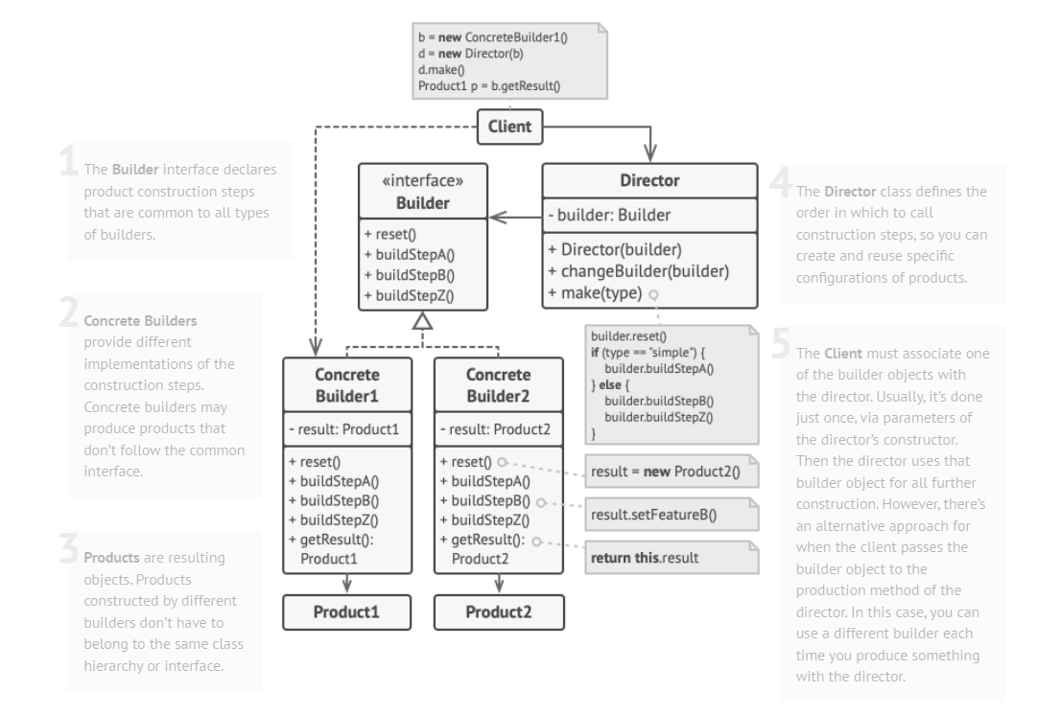
(Base) Class Structure

Slide 5
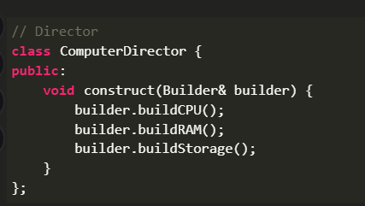
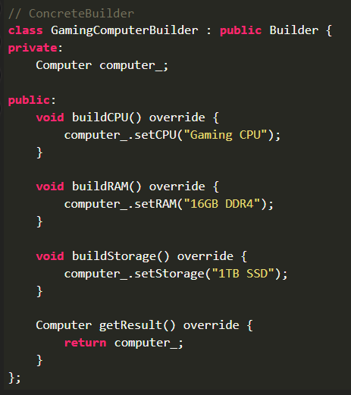
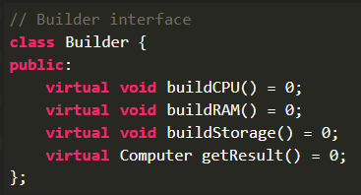
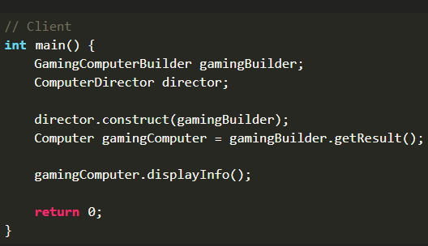
Code Example(s)
Main Class

