Slide 1
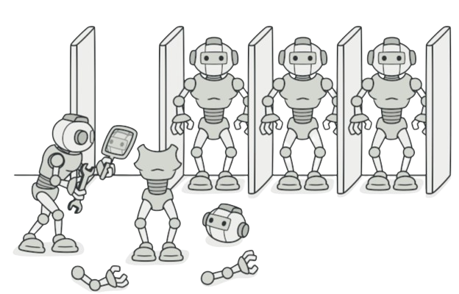
Prototype
Matilde Teixeira- 108193
April 24th, 2024

Slide 2
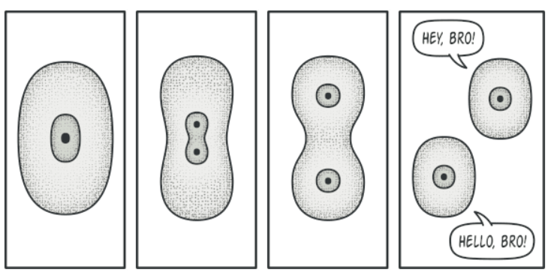
When should we use this pattern?
Difference to Similar Patterns:
Factory-> Subclasses can alter type of objects that will be created
Abstract Factory-> Does not specify specific classes
Builder-> Step-By-Step Construction
Create new objects from existing ones, like prototypes without being dependent on their classes (creation of a new object is more costly than cloning)
Problem:
Copying an object assumes construction with the same parameters and defining the remaining ones (not defined in the constructor) individually. However, there are private attributes that we cannot access “from outside”
RealLife Analogy: Mitosis (from one cell, you create two equal cells)

Slide 3
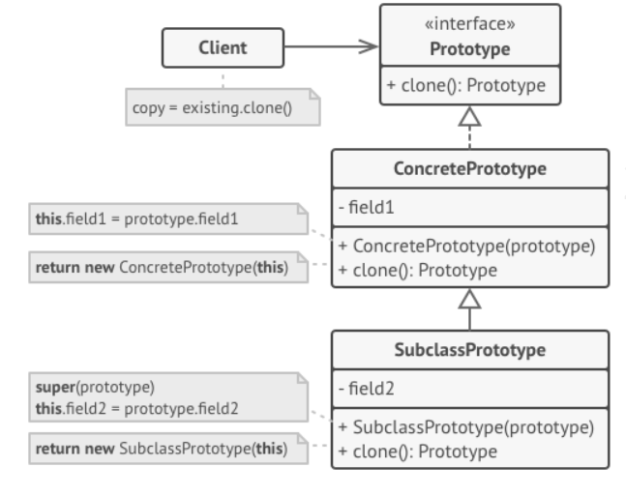
How to implement this pattern?
Delegate the cloning process to the object to be copied, through a method declared in an interface common to all common objects capable of cloning.
Objects that implement interfaces are called Prototypes
Private attributes can be copied without any problems, as it is possible to access a private attribute from another

Slide 4
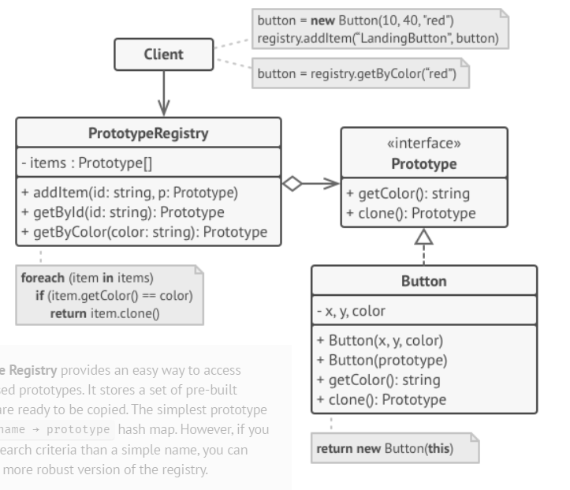
(Base) Class Structure
Basic Implementation
Implementation with Prototype Registration

Slide 5
Code Example(s)
Concrete Prototype
Subclass Prototype
public class PrototypeExample {
public static void main(String[] args) {
// Creating prototype
Animal animalPrototype = new Animal("unknown");
// Cloning Prototype -> new objects
Animal cat = animalPrototype.clone();
cat.setSpecies("cat");
System.out.println(cat.getSpecies());
}
}
class Animal {
private String species;
public Animal(String species) {
this.species = species;
}
public void setSpecies(String species) {
this.species = species;
}
public String getSpecies() {
return species;
}
// Método clone
public Animal clone() {
return new Animal(this.species);
}
}
Interface
interface ClonableAnimal{
// Método clone
ClonableAnimal clone();
}
Implementation Without Registry

Slide 6
Code Example(s)
Concrete Prototype
Subclass Prototype
// Prototype With Registry
public class PrototypeExampleWithRegistry {
private static Map<String, ClonableAnimal> animalRegistry = new HashMap<>();
// Register
public static void registerAnimal(String species, ClonableAnimal prototype) {
animalRegistry.put(species, prototype);
}
}
Equal to previous slide
Interface
Equal to previous slide
Difference
Implementation
With Registry

