Slide 1
Prototype
Francisca Silva- 112841
April 24th, 2024

Slide 2
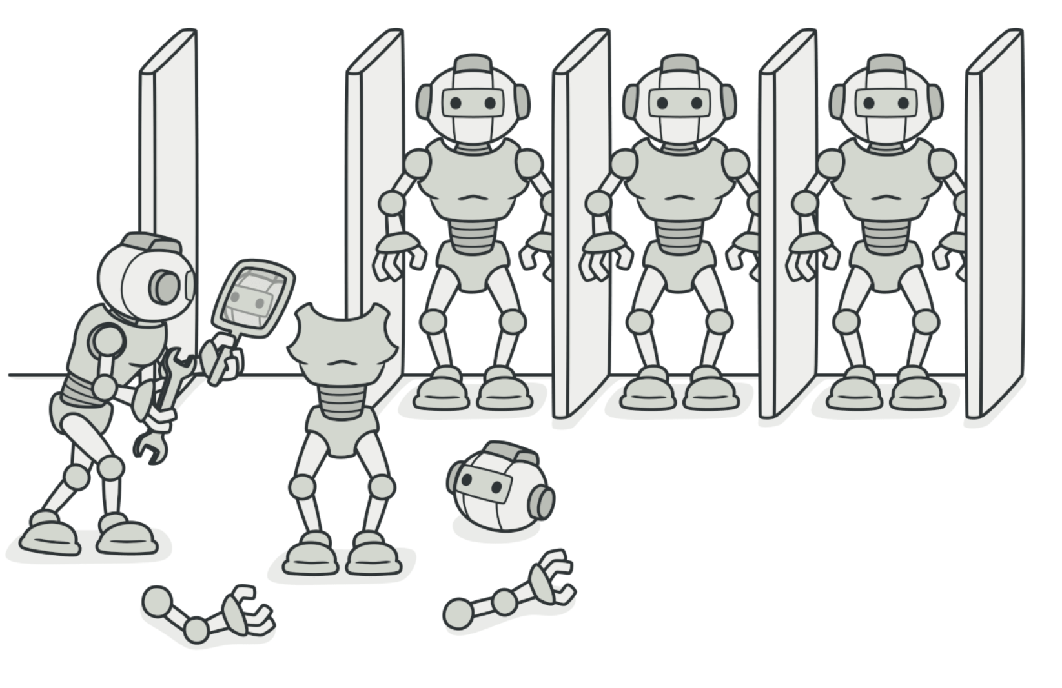
When should we use this pattern?
Use the Prototype pattern when your code shouldn’t depend on the concrete classes of objects that you need to copy.
Use the pattern when you want to reduce the number of subclasses that only differ in the way they initialize their respective objects.

Slide 3
How to implement this pattern?
Create the prototype interface and declare the clone method in it.
A prototype class must define the alternative constructor that accepts an object of that class as an argument. The constructor must copy the values of all fields defined in the class from the passed object into the newly created instance. If you’re changing a subclass, you must call the parent constructor to let the superclass handle the cloning of its private fields.
If your programming language doesn’t support method overloading, you won’t be able to create a separate “prototype” constructor. Thus, copying the object’s data into the newly created clone will have to be performed within the clone method. Still, having this code in a regular constructor is safer because the resulting object is returned fully configured right after you call the new operator.
The cloning method usually consists of just one line: running a new operator with the prototypical version of the constructor.
Note: Every class must explicitly override the cloning method and use its own class name along with the new operator. Otherwise, the cloning method may produce an object of a parent class.

Slide 4
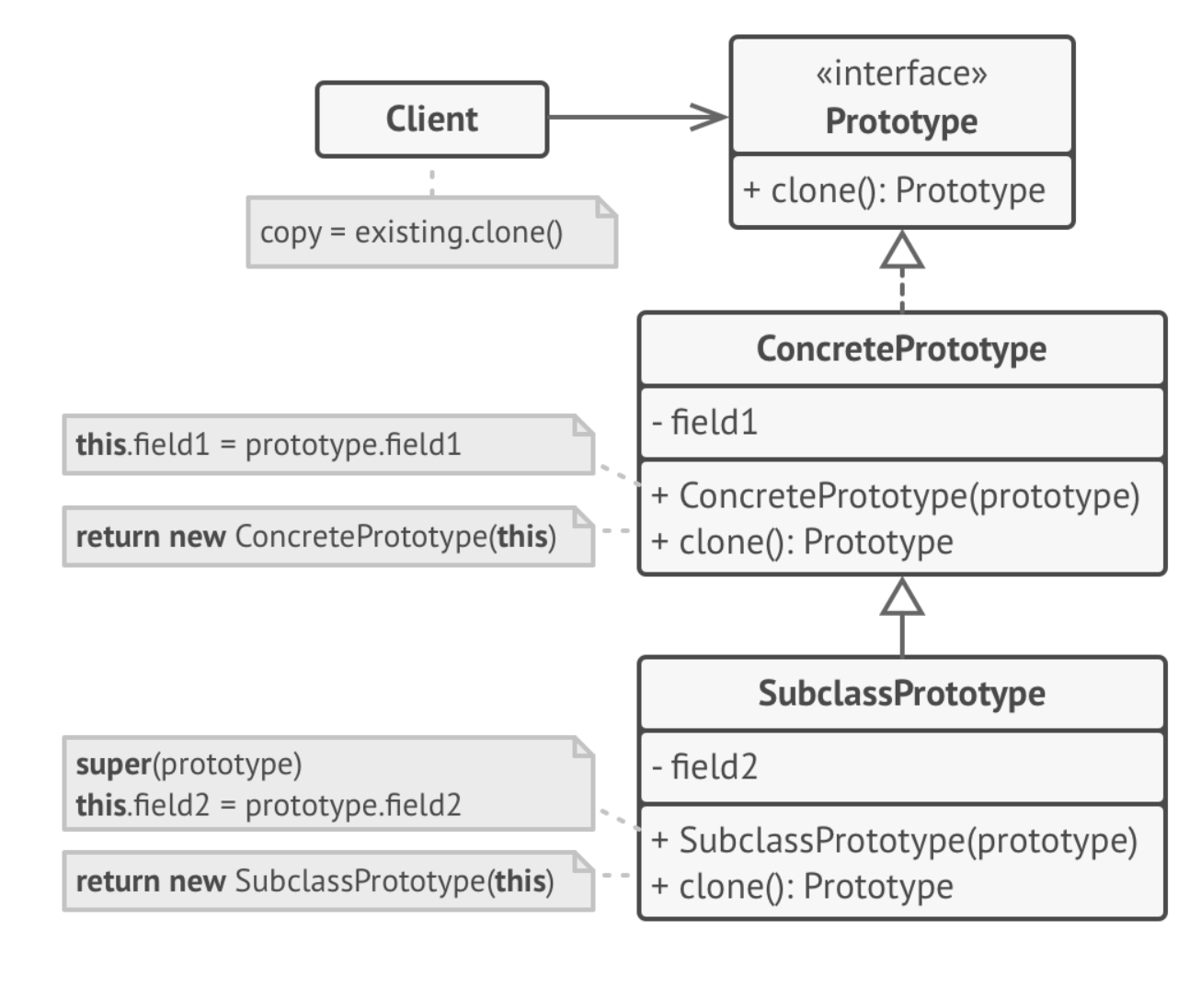
(Base) Class Structure

Slide 5
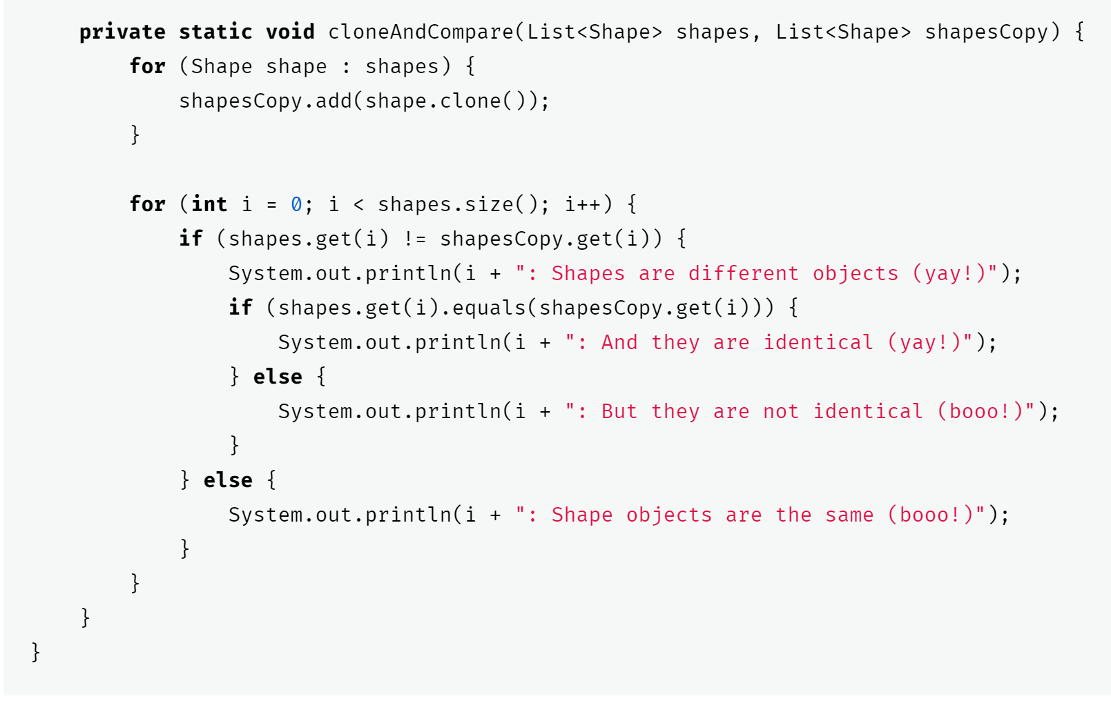
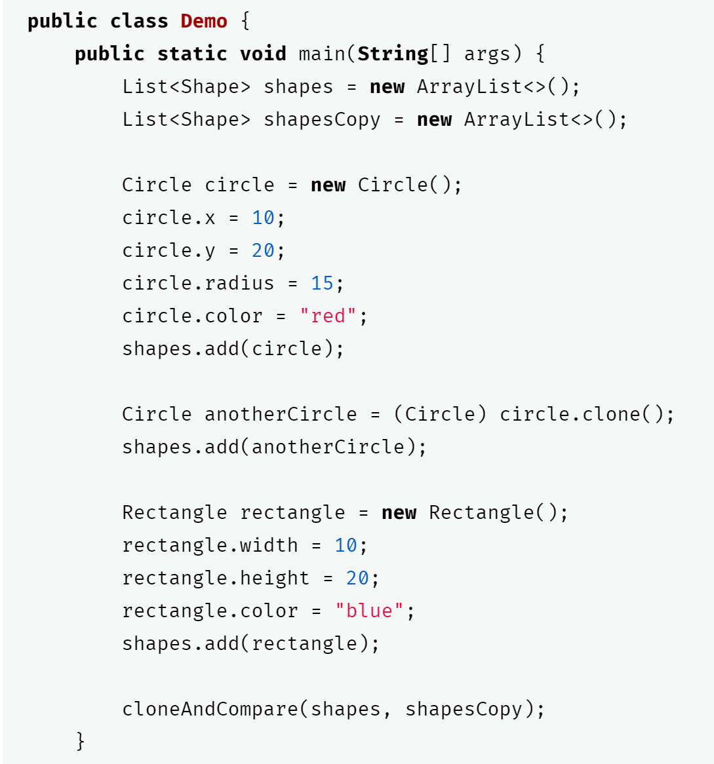
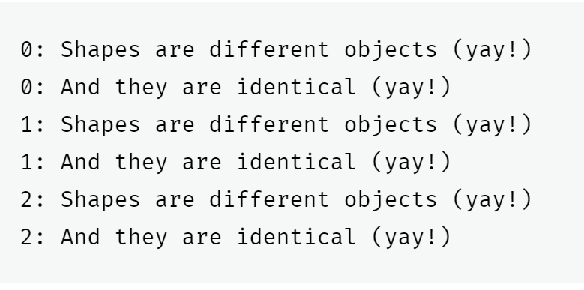
Code Example(s)

