Slide 1
Singleton
João Capucho - 113713
April 24th, 2024

Slide 2
When should we use this pattern?
We want to ensure our class has a single instance
We want to have global access to that instance
Common when dealing with shared resources
Examples: Databases, shared configuration, cache, …
In general we should use it when we have some global state and need to control it in a stricter manner

Slide 3
How to implement this pattern?
Make all constructors private
Create a private static field to save the unique instance
Create a public static method to access the instance field, which creates the instance if it’s null
Profit!
(The method might need to be synchronized for multi threaded application)

Slide 4
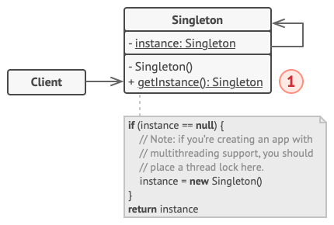
(Base) Class Structure
Very simple just 2 classes
The singleton class
And the client of the singleton (possibly more than one)

Slide 5
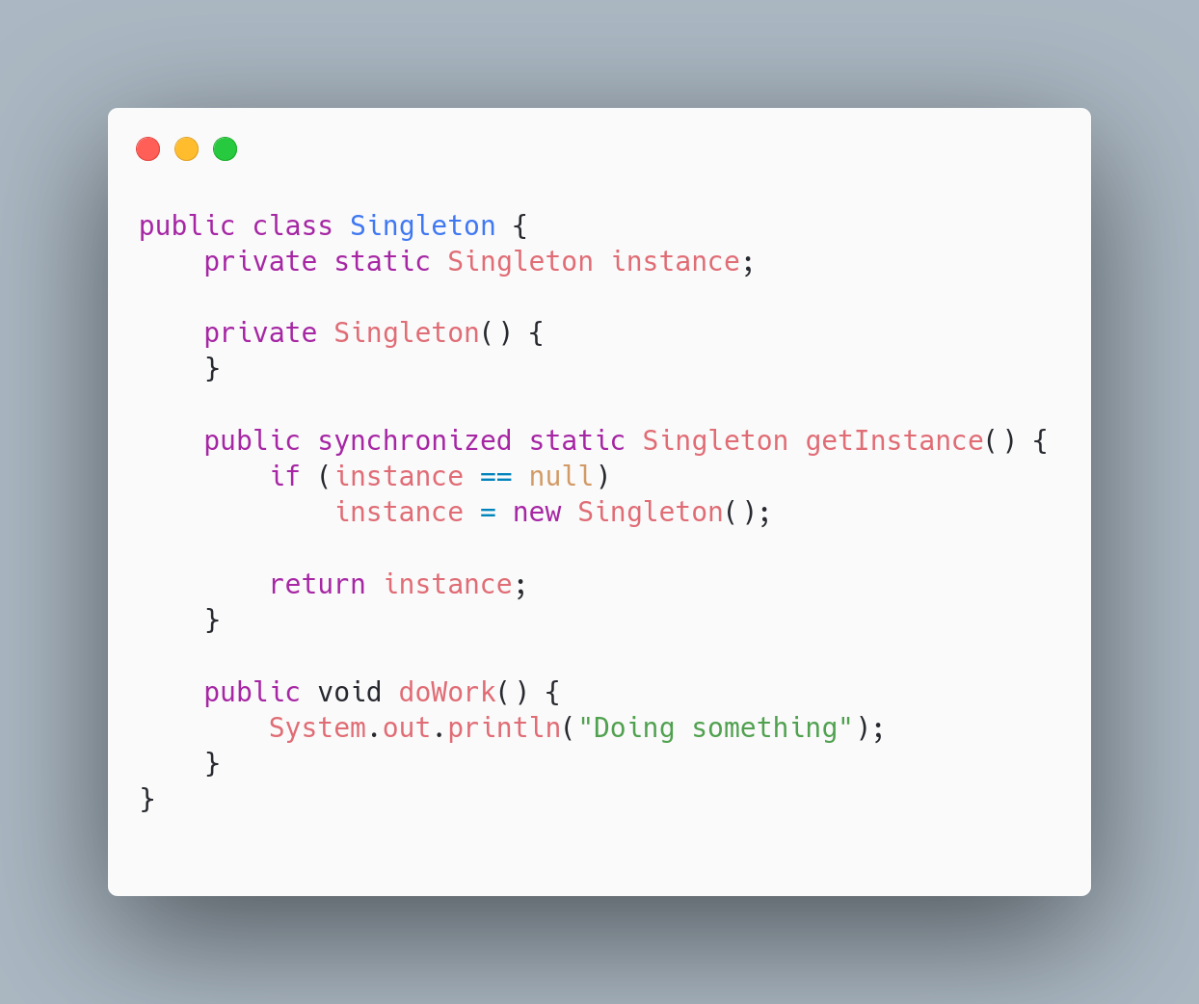
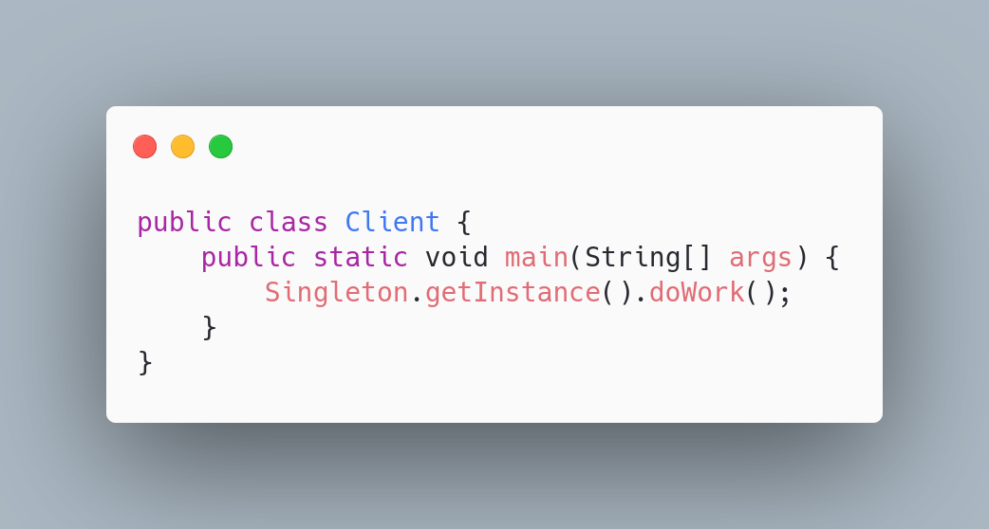
Code Example(s)

