Slide 1

<Adapter Pattern>
<Bruno de Barros Bonilauri Charão> - <111590>
April 24th, 2024

Slide 2
When should we use this pattern?
The Adapter Pattern is a structural design pattern that allows objects with incompatible interfaces to interact with each other.
It's used in software design to resolve issues where a system's components might not work together directly due to mismatched interfaces.
Here are some scenarios where using the Adapter Pattern might be particularly useful:
1 - Integration of Third-Party Libraries: When your application needs to integrate a third-party library that has a different interface from what
your application expects, you can use an adapter to convert the third-party interface into one that your application can work with.
2 - Legacy System Integration: If you're working with legacy systems that cannot be altered, using an adapter can help you wrap the old
system’s interface into a new interface expected by modern components.
3 - System Refactoring: During refactoring, you might find that new components do not fit well with the old systems because of interface
differences. An adapter can bridge this gap without requiring changes to the existing system code.
4 - Providing Alternative Interfaces: If you need to offer multiple interfaces for different parts of your application or for different user groups,
adapters can convert a single underlying implementation into multiple usable forms.
5 - Incremental Migration: When migrating from an old system to a new one incrementally, adapters can be used to slowly phase out old
components without disrupting the functionality of the system.
6 - Testing and Mocking: Adapters are useful in testing scenarios where you might need to replace complex parts of the system with simpler,
controlled implementations (mocks or stubs) to test functionalities independently.

Slide 3
When should we use this pattern?
7- Simplifying Complex Interfaces: If you're dealing with a complex interface that is difficult to use, the Adapter pattern can be used to create a simpler interface that wraps the complex interface, making it easier to use
The Adapter Pattern is especially valuable when maintaining the open/closed principle, allowing systems to remain open for extension but closed
for modification. This approach keeps the system flexible and change-tolerant without requiring extensive changes to existing code.

Slide 4
How to implement this pattern?
Implementing the Adapter pattern involves creating an adapter class that translates the interface of one class into the interface
expected by another class. This allows two incompatible interfaces to work together.
Step 1: Identify the Incompatible Interfaces
First, identify the two interfaces that you need to adapt. One of these interfaces is the "target" interface, which is the interface that the client
expects. The other is the "adaptee" interface, which is the interface that needs to be adapted.
Step 2: Define the Adapter Class
Create an adapter class that implements the target interface. This class will have a reference to an instance of the adaptee class.
Step 3: Implement the Target Interface Methods
In the adapter class, implement the methods of the target interface. These methods will call the corresponding methods of the adaptee class,
translating the interface as necessary.
Step 4: Use the Adapter
Instead of using the adaptee class directly, use the adapter class. This allows the client to interact with the adaptee class through the target
interface.

Slide 5
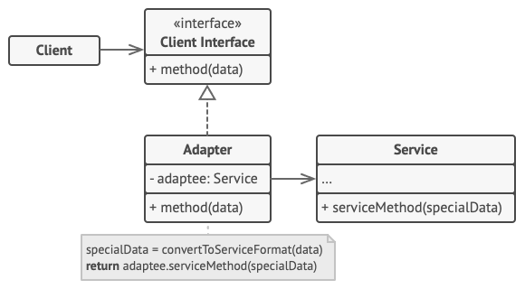
(Base) Class Structure
1 - Target Interface: Defines the methods that the client expects.
2 - Adaptee Class: The class that needs to be adapted. It has a different interface than the target interface.
3 - Adapter Class: Implements the target interface and contains a reference to an instance of the adaptee class.
It translates the interface of the adaptee to the target interface.
4 - Client Code: Uses the adapter to interact with the adaptee through the target interface.

Slide 6
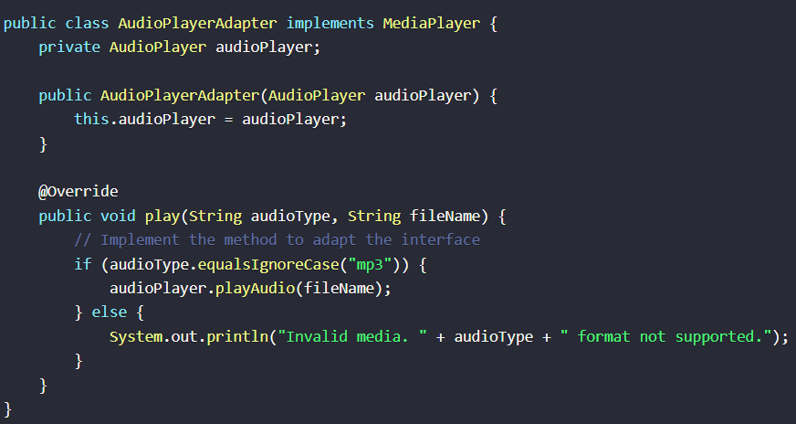
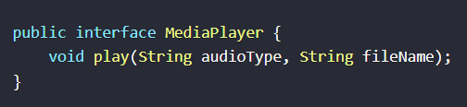
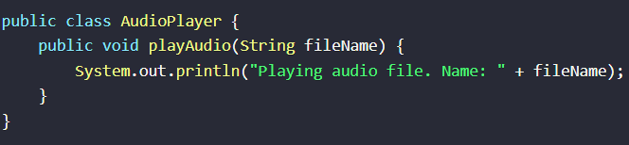
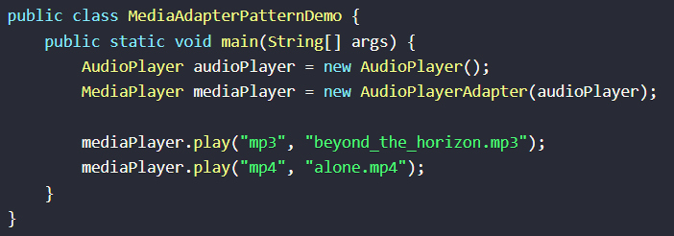
Adpter Class
Code Example(s)
Interface Target
Adptee Class
Client Code

