Slide 1
Adapter
Pedro Ponte - 98059
April 24th, 2024

Slide 2
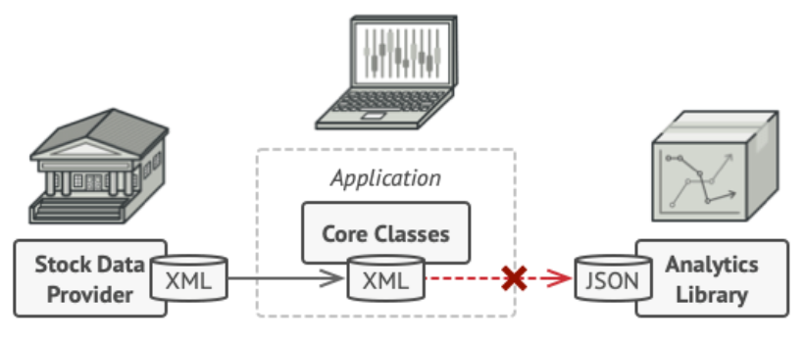
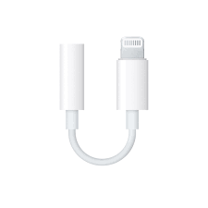
When should we use this pattern?
When we need objects with incompatible interfaces to work together.
For example: headphone adapters, file format adapters, etc.

Slide 3
How to implement this pattern?
1. We need two objects with incompatible interfaces. For example a 3rd party service and a client that would benefit from this service.
2. We declare the client interface and describe how clients communicate with the service.
3. Create the adapter class and make it follow the client interface.
4. Add a field to the adapter class to store a reference to the service object. We usually initialize this field in the constructor.
5. One by one, implement all methods of the client interface in the adapter class. The adapter should delegate most of the real work to the service object, handling only the interface or data format conversion.
6. Clients should use the adapter via the client interface. This will let you change or extend the adapters without affecting the client code.

Slide 4
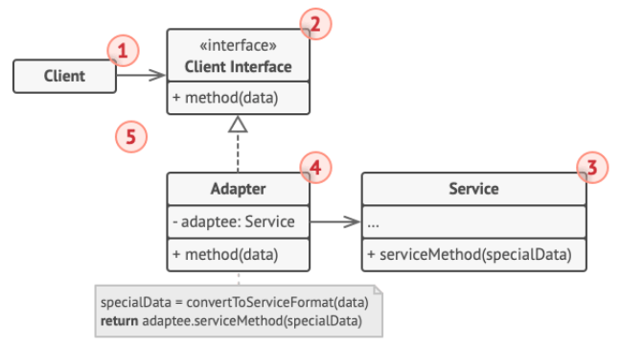
(Base) Class Structure
1. The client is the class that contains the existing logic of the program.
2. The Client interface describes what other classes must follow to be able to collaborate with the client.
3. The Service is the 3rd party service we’re gonna be using.
4. The Adapter, our class that will be able to work with both. It implements the client itnerface, while wrapping the service object. It receives calls from the client and translates them into calls from the wrapped service object that the client can understand.

Slide 5
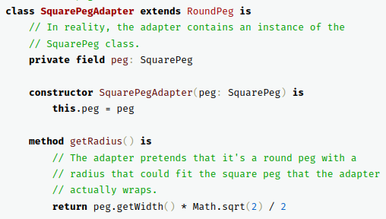
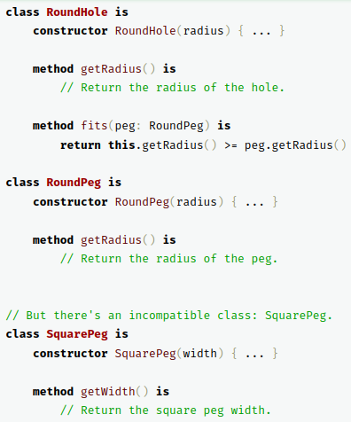
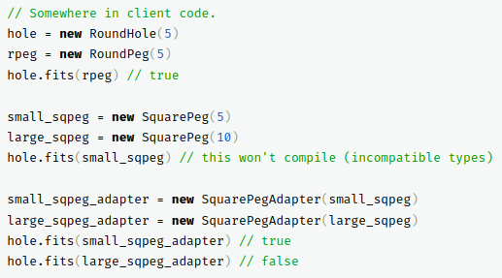
Code Example(s)

