Slide 1
Bridge
Luís Oliveira - 98543
April 24th, 2024

Slide 2
When should we use this pattern?
The Bridge design pattern is useful when you want to decouple an abstraction from its implementation so that both can vary independently. Here are some scenarios:
When you need to separate abstraction from implementation;
When you want to avoid a permanent binding between abstraction and implementation;
When you have a complex class hierarchy;
When you want to hide implementation details from clients:;
When you need to support multiple platforms or systems.
Overall, the Bridge pattern is particularly useful when you anticipate changes in either the abstraction or the implementation, or when you want to achieve a higher degree of flexibility and reusability in your code.

Slide 3
How to implement this pattern?
Identify the orthogonal dimensions in your classes. These independent concepts could be: abstraction/platform, domain/infrastructure, front-end/back-end, or interface/implementation.
See what operations the client needs and define them in the base abstraction class.
Determine the operations available on all platforms. Declare the ones that the abstraction needs in the general implementation interface.
For all platforms in your domain create concrete implementation classes and make sure they follow the implementation interface.
Inside the abstraction class, add a reference field for the implementation type. The abstraction delegates most of the work to the implementation object that’s referenced in that field.
If you have several variants of high-level logic, create refined abstractions for each variant by extending the base abstraction class.
The client code should pass an implementation object to the abstraction’s constructor to associate one with the other. After that, the client can forget about the implementation and work only with the abstraction object.

Slide 4
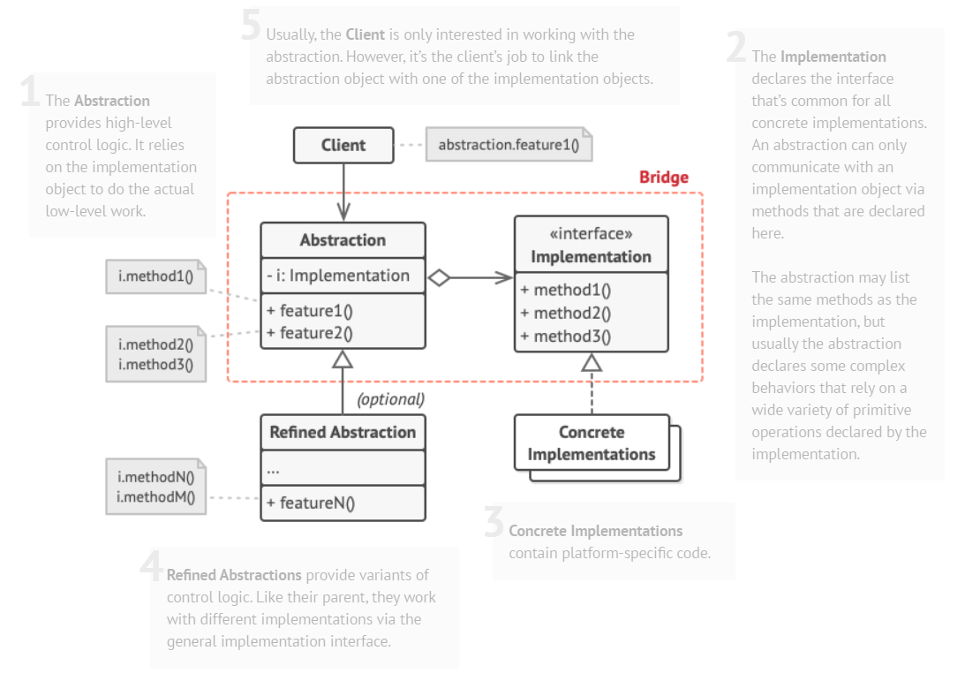
(Base) Class Structure

Slide 5
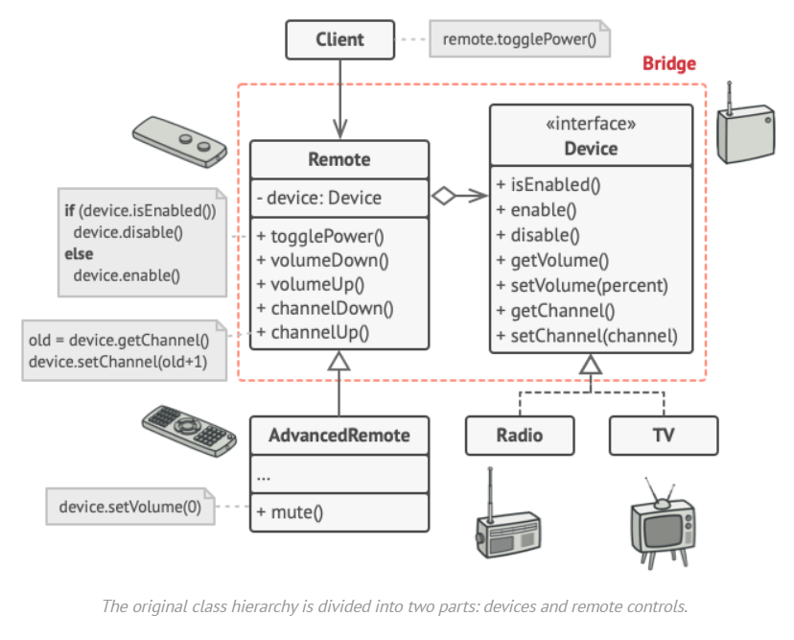
Code Example(s)

