Slide 1
Composite
Pedro Pinto - 115304
April 24th, 2024

Slide 2
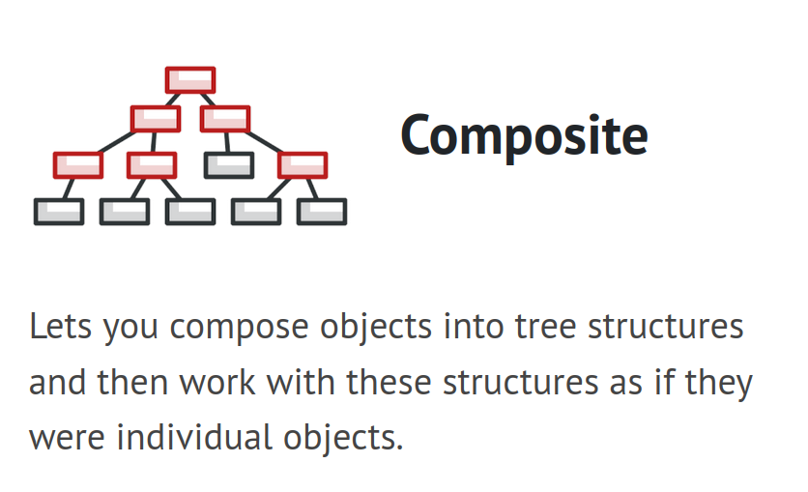
When should we use this pattern?
When you want to:
implement a tree-like object structure.
treat both simple and complex elements uniformly.
apply the same uniform operation in all hierarchical objects

Slide 3
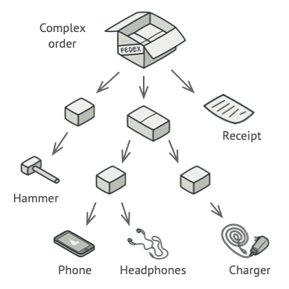
How to implement this pattern?
Break the tree structure into simple elements and containers.
Define a uniform interface. With a list of methods that make sense for both simple and complex components. (e.g., Component )
Container
Note:
With an uniform interface you can now iterate through all hierarchical objects and apply an uniform method in each iteration.
When it applies to simple elements they return the result, otherwise it iterates within all objects in the container
Container
Leaf
Define a leaf class to represent simple elements. (one or more…)
Define a container class to represent complex elements. In this class, provide an array field for storing sub-elements (leaves and containers).

Slide 4
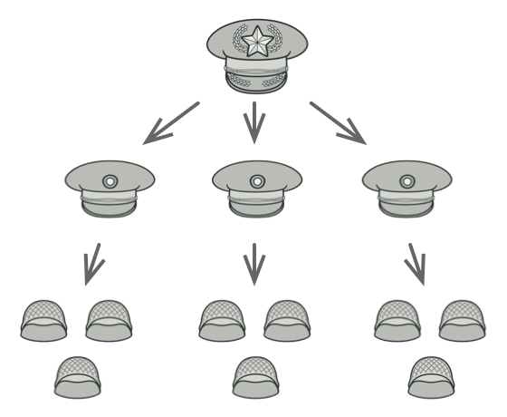
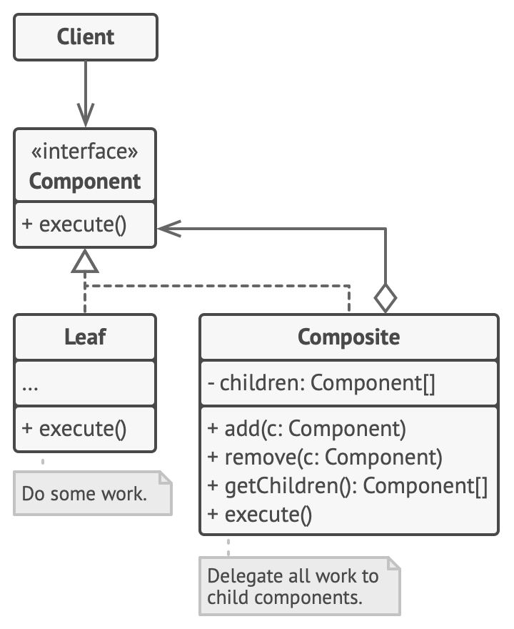
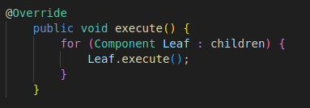
(Base) Class Structure

Slide 5

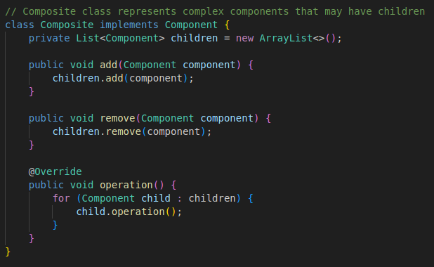
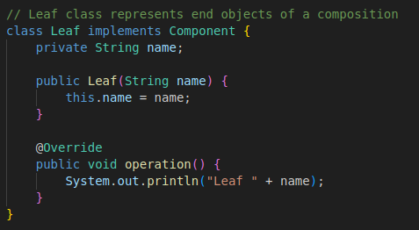
Code Example(s)
Common interface:

Slide 6
Composite
Pedro Pinto - 115304
April 24th, 2024

