Slide 1
Decorator Pattern
Joao Santos - 110555
April 24th, 2024

Slide 2
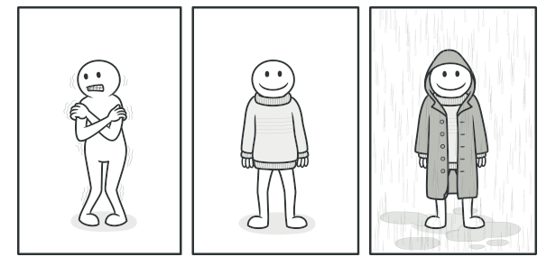
When should we use this pattern?
Is used for adding additional functionalities to an existing object. In this example the object is the person, and the additional functionalities are the various type of clothes that we put on him .
It is easy to add functionality to an entire class of objects by subclassing an object class, but it is impossible to extend a single object this way. With the decorator pattern, you can add functionality to a single object and leave others like it unmodified.

Slide 3
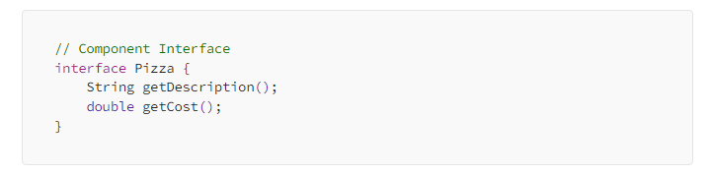
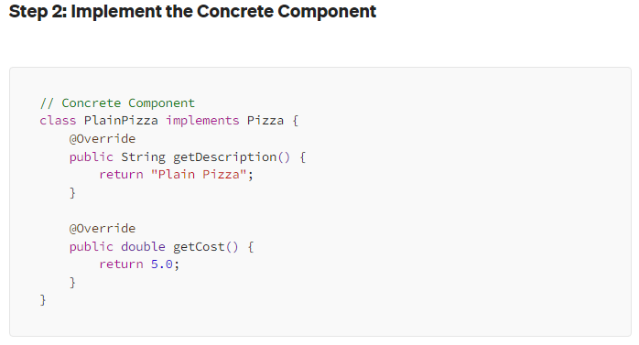
How to implement this pattern?

Slide 4
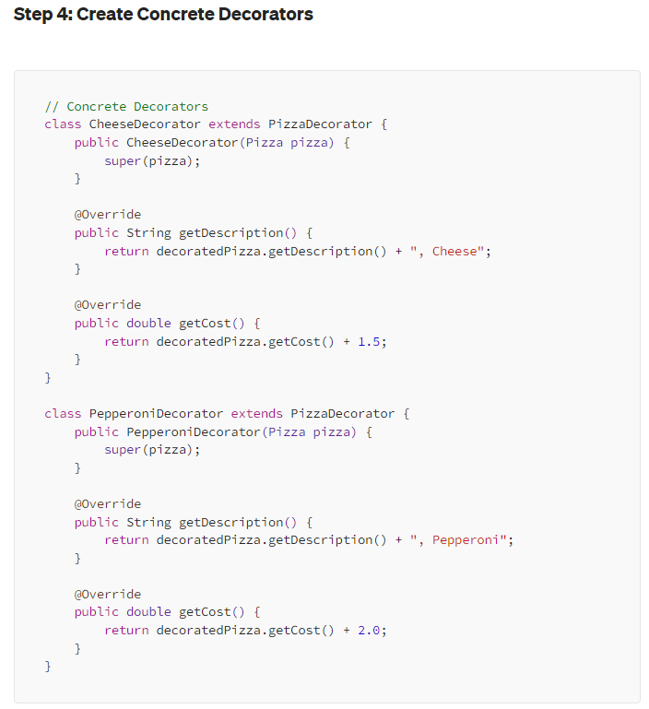
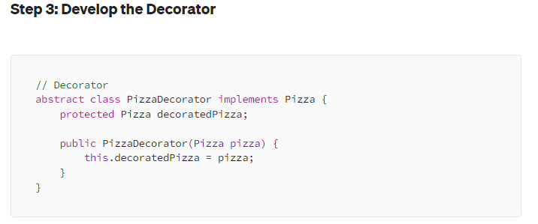
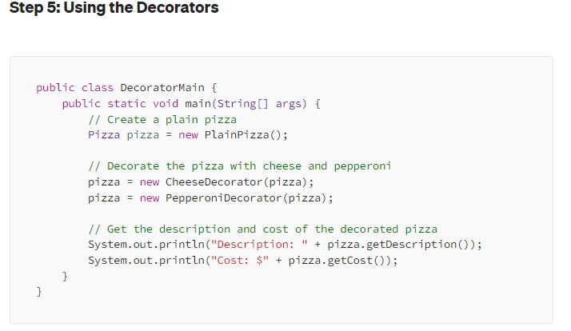
How to implement this pattern?

Slide 5
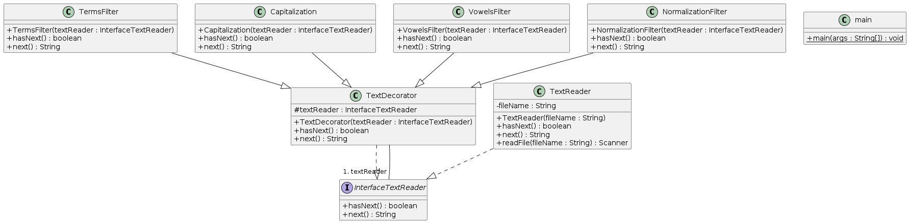
(Base) Class Structure
A common interface that is implemented by the default object and the decorator.
A default class for creating the base object (TextReader)
A default decorator class that is extended by the concrete decorator classes.

Slide 6
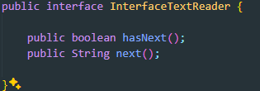
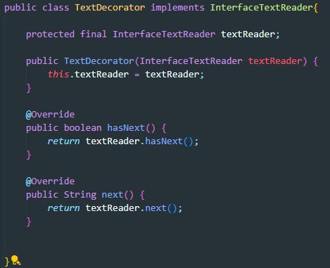
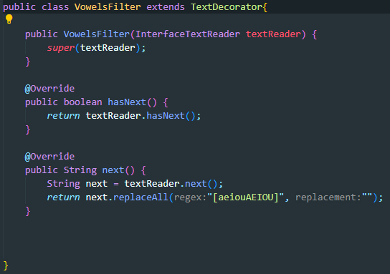
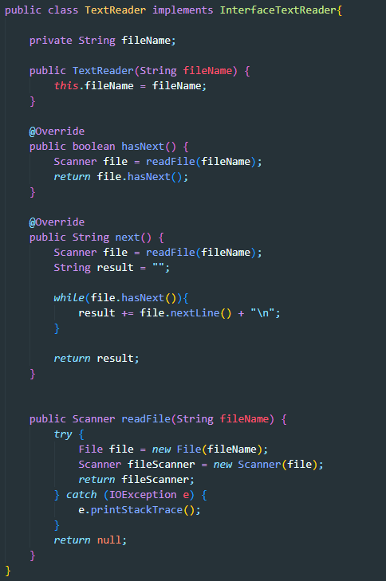
Code Example(s)

