Slide 1
Decorator
João Monteiro - 114547
April 24th, 2024

Slide 2
When should we use this pattern?
This pattern should be used when there’s a need to implement new responsibilities into an object which does not contain them, during runtime, while making sure that other instances of the same class won’t be affected. The Decorator should be seen as an alternative to subclassing, by avoiding excessive and unnecessary class extensions.
This pattern also helps each class to maintain themselves single-focused (Single Responsibility Principle), by adding features to the basic class without changing its structure.

Slide 3
How to implement this pattern?
First step should be the creation of an interface that includes the main methods that are going to be implemented by both the basic component and the additional layers.
The next task is the creation of the concrete class, where the basic behaviours are implemented.
The third step should involve the creation of a base decorator, that should contain a field referencing a wrapped object. This base decorator should delegate the work to the wrapped object, which of the interface type. This characteristic allows linking to concrete components as well as decorators.
Finally, according to the necessities of the problem, we should create the various concrete decorators. These should be implemented by extending the base decorator. Each of this decorators overrides the methods that are implemented from the interface adding their own role in that process.

Slide 4
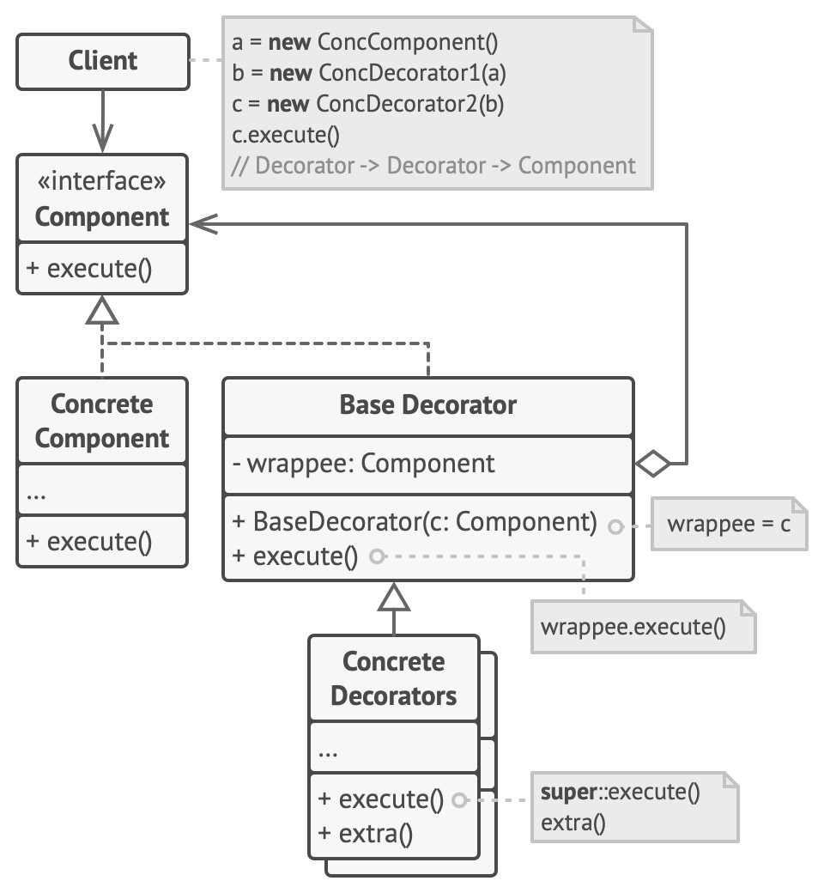
(Base) Class Structure

Slide 5
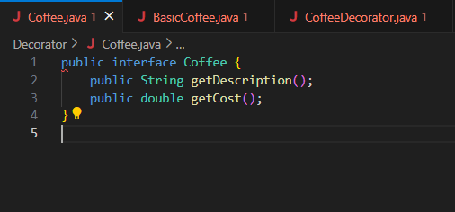
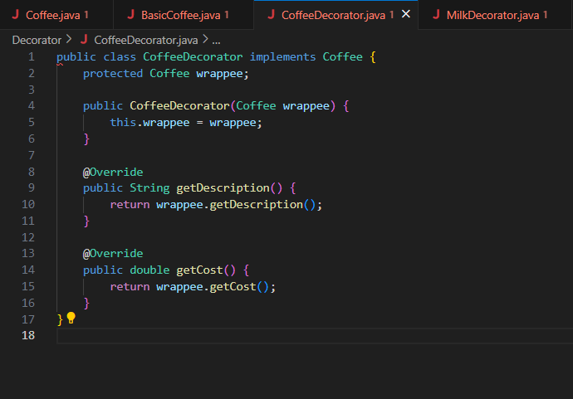
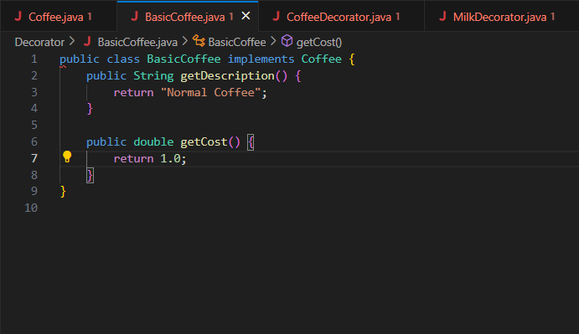
Code Example(s)
Coffee.java
CoffeeDecorator.java
BasicCoffee.java

Slide 6
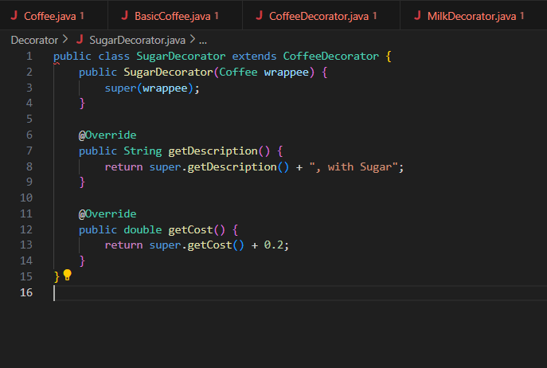
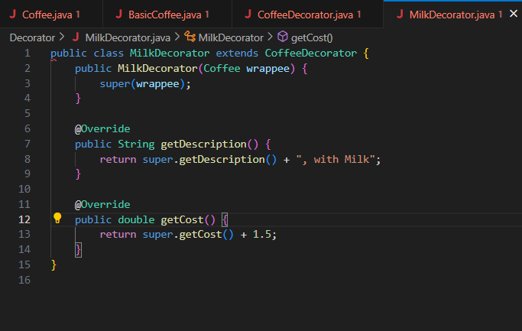
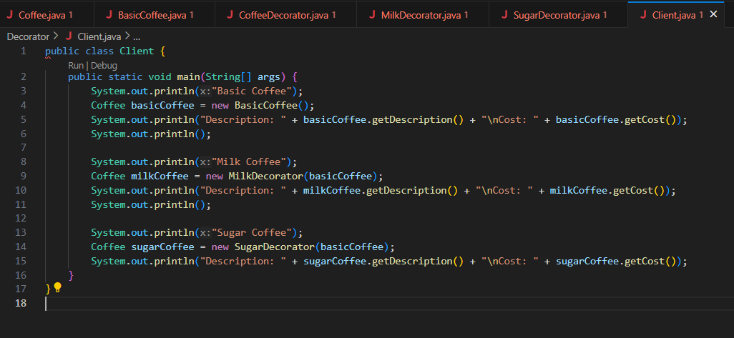
Code Example(s)
SugarDecorator.java
MilkDecorator.java
Client.java

