Slide 1
Facade
Hugo Ribeiro - 113402
April 24th, 2024

Slide 2
When should we use this pattern?
Use the Facade pattern when you need to have a limited but straightforward interface to a complex subsystem.
Use the Facade when you want to structure a subsystem into layers.
In an implementation where you have a lot of different subsystems and they get more complex over time, applying design patterns to these subsystems will have you creating more classes and thus increasing the code complexity.
Using a single subsystem directly may be easier to reuse in various contexts, but it demands a lot of configuration from the client.
The Facade attempts to fix this problem by providing a shortcut to the most-used features of the subsystem which fit most client requirements.
This Design pattern will not only allow the user to use more than one subsystem at once but also, but will also contain all the dependencies associated with the various subsystems, allowing the user a simpler implementation.
By requiring multiple subsystems to communicate only through facades, you can reduce coupling between them.
For example, let’s thinks about a video conversion framework.
It can be broken down into two layers: Video and Audio.
For each layer, you can create a facade and then make the classes of each layer communicate with each other via those facades.
Also notable, is the fact you can have facades of other facades, this allows for example, if we continue with our video conversion framework, a main facade that would have the facades for Video, Audio and Manager. (A class that would be responsible for managing the audio/video.)
This would allow for a simpler and more reusable implementation of this framework.

Slide 3
How to implement this pattern?
1. Check for the possibility to provide a simpler interface than what an existing subsystem already provides. You’re on the right track if this interface increases abstraction and independency from many of the subsystem’s classes.
3. To get the full benefit from the pattern, make all the client code communicate with the subsystem only via the facade. Now the client code is protected from any changes in the subsystem code. For example, when a subsystem gets upgraded to a new version, you will only need to modify the code in the facade.
2. Declare and implement this interface in a new facade class. The facade should redirect the calls from the client code to appropriate objects of the subsystem. The facade should be responsible for initializing the subsystem and managing its further life cycle unless the client code already does this.
4. If the facade becomes too big, consider extracting part of its behavior to a new, refined facade class.
(Facades of Facades referenced in the previous slide.)

Slide 4
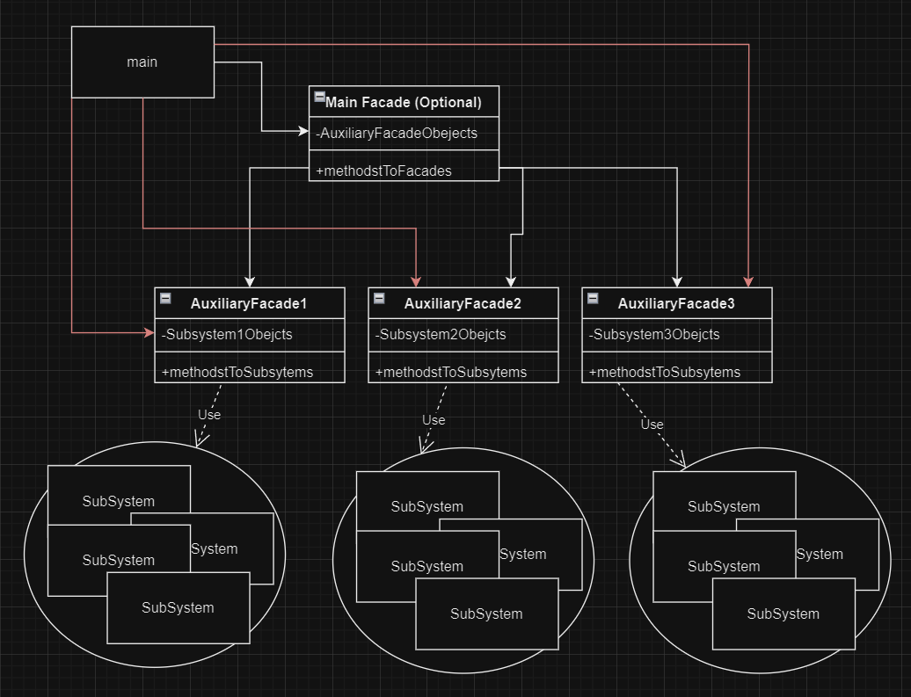
(Base) Class Structure
The red arrows symbolise the diagram if the Main facade didn’t exist.
In this scenario instead of the client assessing the Facade of Facades, he would access each and every Facade Individually.

Slide 5
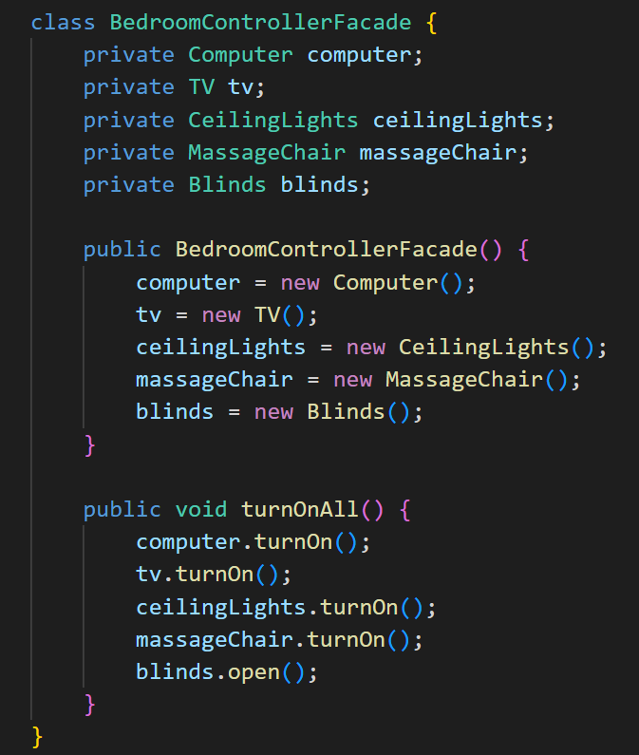
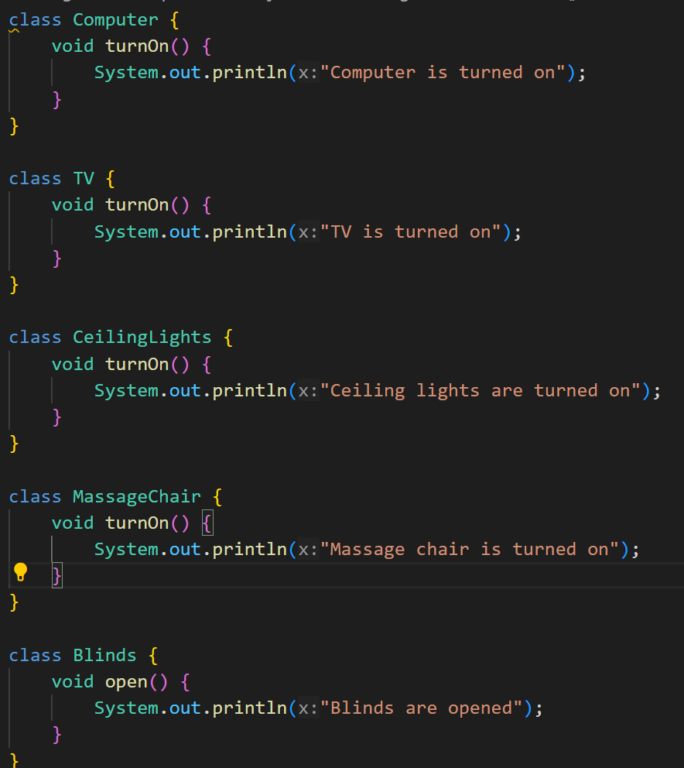
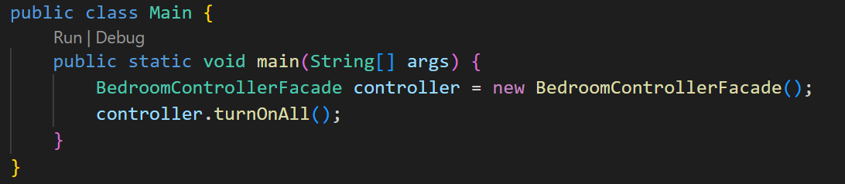
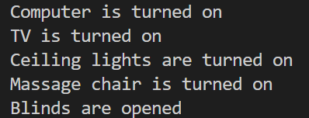
Code Example
Facade:
Subsystems:
Main:
Output:

Slide 6
Code Example Analysis
The example provided tries to simulate the use of the Facade design pattern. In this scenario the Facade is a hand-held controller that has the power to manipulate all the smart devices in the bedroom, these are the subsystems.
Usually you will need the Facade design pattern to assist with the complexity of the methods of the various subsystems, in this example pseudo-methods are used for the sake of simplicity, so you will have to use your imagination :)
Note that the facade Class has one attribute for each subsystem, and instanciates them in the constructor, this will remove the need for the final user to instantiate each and every subsystem and call different objects for specific methods, with the facade design pattern you only have to instantiate it, and then all methods will look like controller.method().

