Slide 1
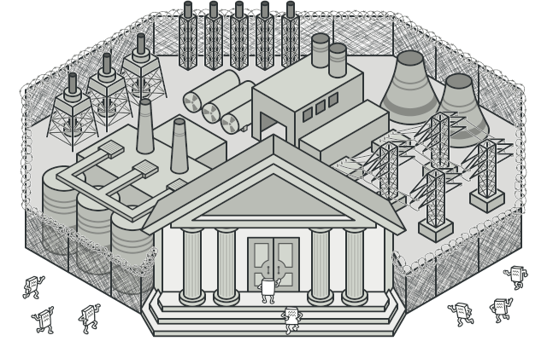
Facade
Diogo Lopes Oliveira - 113664
April 24th, 2024

Slide 2
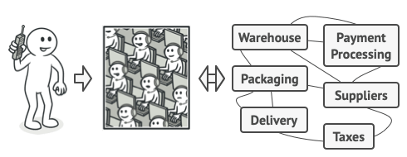
When should we use this pattern?
Use the Facade pattern when you need to have a limited but straightforward interface to a complex subsystem.
The Facade Design Pattern serves as a crucial tool in software engineering, especially when dealing with increasingly complex subsystems that evolve over time.
As subsystems expand and become more flexible, they often demand more configuration and boilerplate code from clients, leading to increased complexity and decreased maintainability. In such scenarios, the Facade pattern comes to the rescue by offering a simplified interface that acts as a shortcut to the most commonly used features of the subsystem.

Slide 3
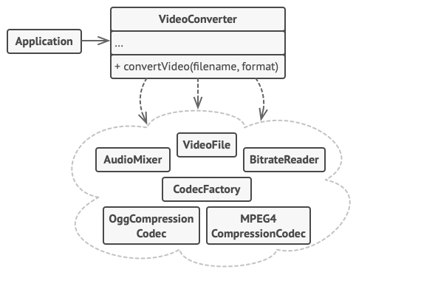
How to implement this pattern?
Assess whether it's possible to simplify the interface provided by an existing subsystem to make client code independent from many of its classes.
Create a new facade class to declare and implement this simplified interface.
Ensure that the facade redirects calls from client code to appropriate objects within the subsystem.
The facade should handle initialization and lifecycle management of the subsystem unless the client code already does this.
Encourage all client code to communicate with the subsystem exclusively through the facade to protect against changes in the subsystem.
Facilitate future upgrades or modifications to the subsystem by modifying only the code within the facade.
If the facade becomes overly complex, consider extracting part of its behavior into a new, refined facade class.

Slide 4
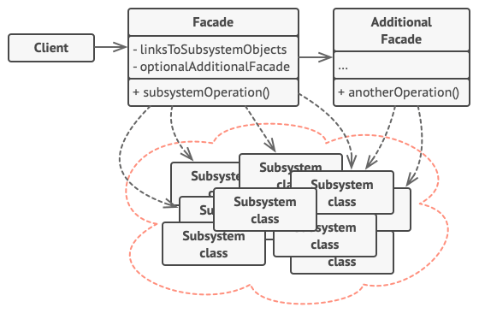
(Base) Class Structure

Slide 5
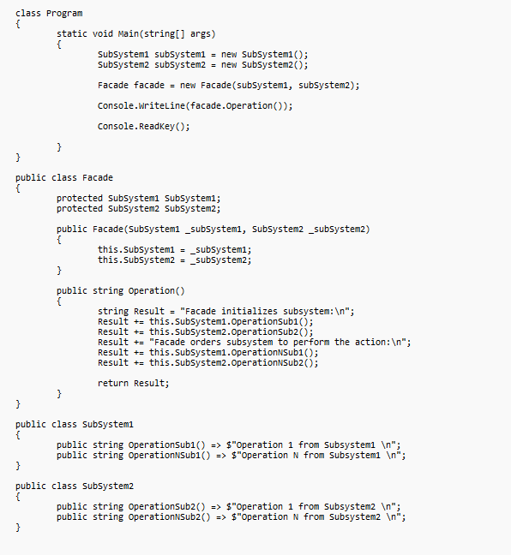
Code Example(s)

