Slide 1
Flyweight
Francisco Albergaria - 114646
April 24th, 2024

Slide 2
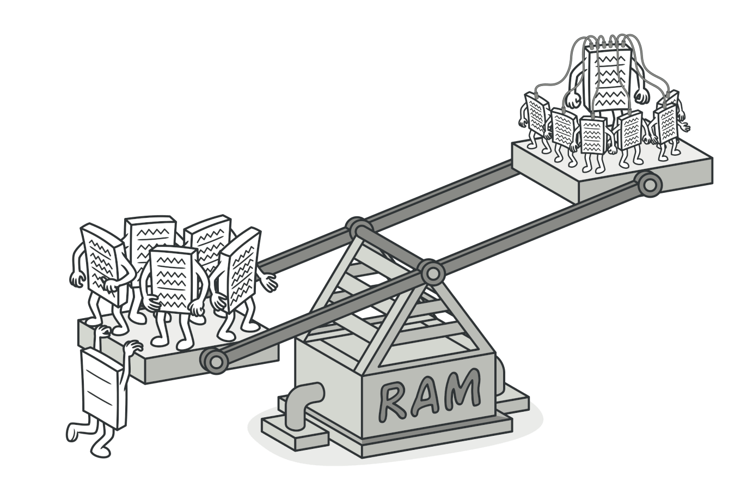
When should we use this pattern?
Flyweight design pattern should be used when there is a need to optimize memory usage by sharing common state among a large number of objects. So, use the Flyweight pattern only when your program must support a huge number of objects which barely fit into available RAM.
It’s most useful when:
an application needs to spawn a huge number of similar objects;
this drains all available RAM on a target device;
the objects contain duplicate states which can be extracted and shared between multiple objects

Slide 3
How to implement this pattern?
Implementing the Flyweight pattern typically involves the following steps:
Identify Intrinsic and Extrinsic State:
Identify the state of the objects that can be shared among multiple instances (intrinsic state) and the state that varies between instances (extrinsic state).
Create a Flyweight Interface:
Define a common interface or abstract class that represents the shared state and provides methods to manipulate the intrinsic state.
Implement Concrete Flyweight Classes:
Create concrete implementations of the flyweight interface to represent different types of shared state. These classes should be immutable and reusable.
Manage Flyweight Objects:
Use a flyweight factory or flyweight manager to create and manage flyweight objects. The factory is responsible for maintaining a pool of flyweight objects and providing access to them.
Use Extrinsic State:
Pass the extrinsic state as arguments to the methods of flyweight objects when their unique state needs to be combined with the shared state.

Slide 4
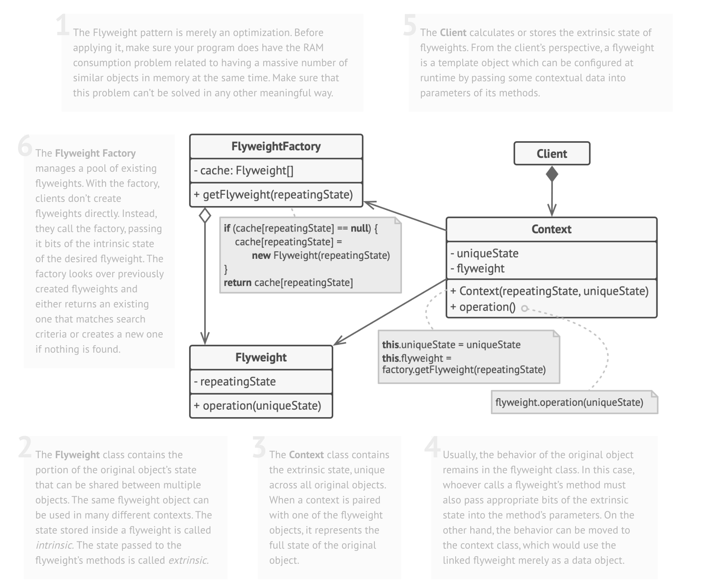
(Base) Class Structure

Slide 5
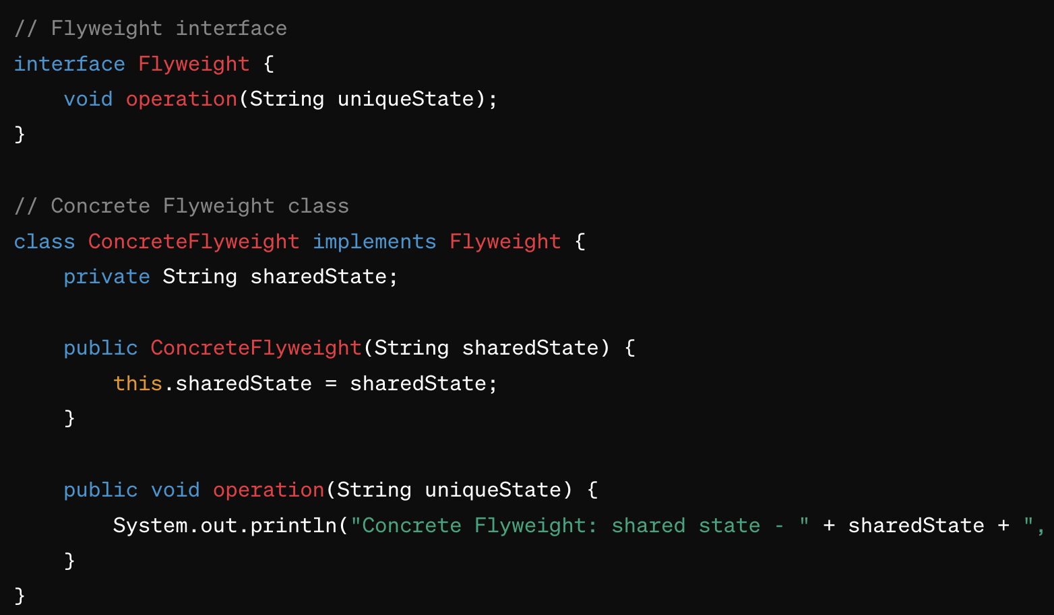
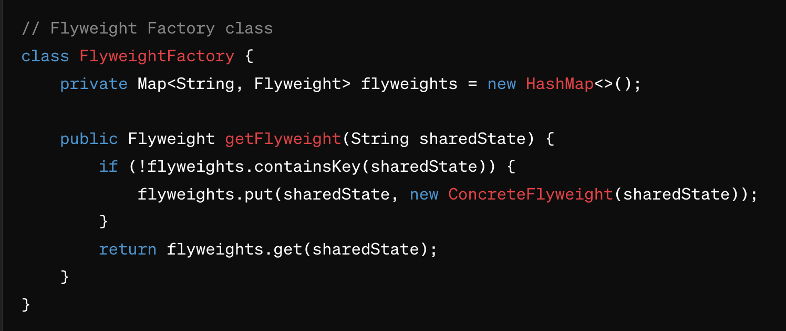
Code Example(s)
Flyweight is the interface that declares the operation method.
ConcreteFlyweight is the concrete implementation of the Flyweight interface, representing the shared state.
FlyweightFactory manages the creation and retrieval of flyweight objects. It ensures that flyweights are reused when possible to avoid unnecessary object creation.

