Slide 1
Proxy
José Maria Mendes – 114429
April 24th, 2024

Slide 2
When should we use this pattern?
The proxy pattern is a structural design pattern used when you want to control access to an object or add additional functionalities to it without directly modifying its code. It acts as a surrogate or placeholder for the actual object and allows you to intercept requests and perform actions such as lazy initialization, caching, logging, or access control.
Common scenarios for using the proxy pattern include managing remote objects in distributed systems, creating virtual placeholders for expensive objects, controlling access rights through protection proxies, adding logging capabilities, implementing caching mechanisms to improve performance, and applying additional actions before or after accessing the original object using smart proxies.
In essence, the proxy pattern enhances modularity, separation of concerns, and performance optimization in various software design contexts.

Slide 3
How to implement this pattern?
1. Define an interface or abstract class: Create a common interface that both the proxy and the real object will implement. This ensures that the proxy can be used interchangeably with the real object by clients.
2. Create a proxy class: Implement the same interface as the real object in the proxy class. This class should internally hold a reference to the real object.
3. Implement proxy methods: Within the proxy class, implement methods to intercept requests and perform additional actions before or after forwarding the request to the real object. These actions can include access control, logging, caching, lazy initialization, or any other functionality you want to add.
4. Instantiate the proxy: Use the proxy class instead of the real object in your client code. Clients will interact with the proxy object as if it were the real object, unaware of the additional functionalities provided by the proxy.
By following these steps, you can effectively implement the proxy pattern in your software design to control access to objects or add extra functionalities without directly modifying their code.

Slide 4
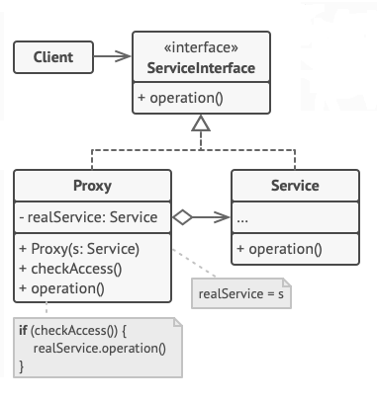
(Base) Class Structure

Slide 5
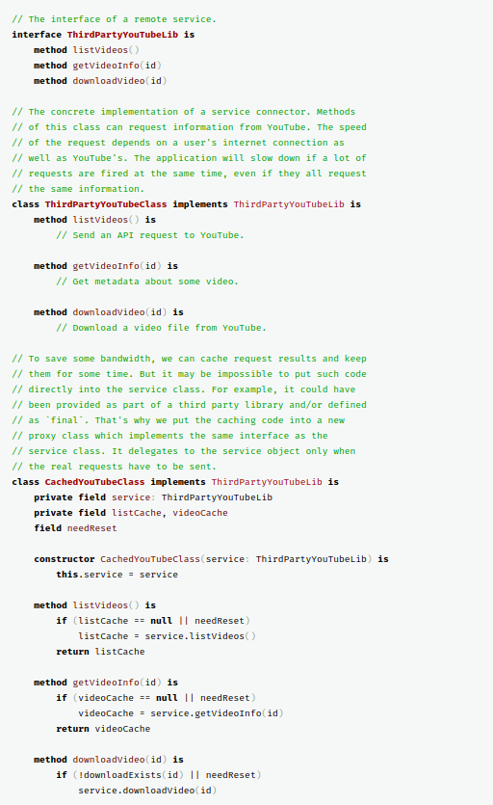
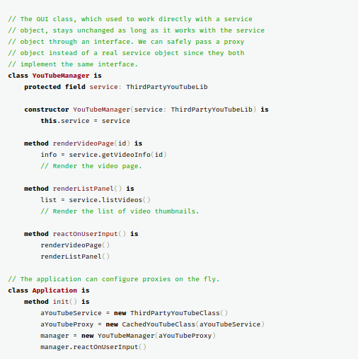
Code Example(s)

