Slide 1
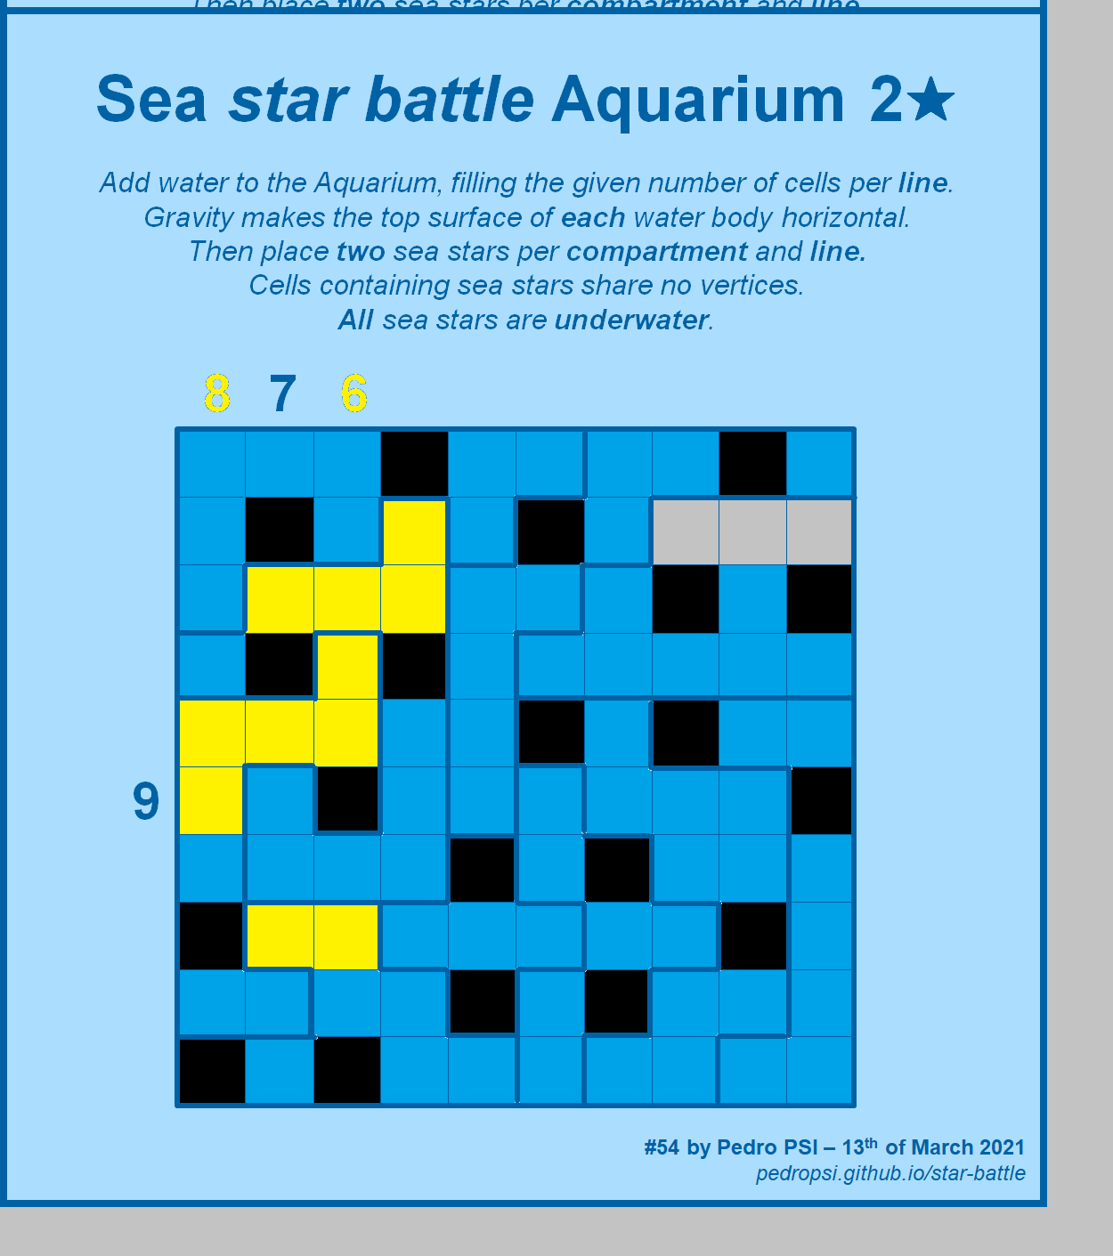
Sea star battle Aquarium 2★
Add water to the Aquarium, filling the given number of cells per line.
Gravity makes the top surface of each water body horizontal.
Also place two sea stars per compartment and line.
Cells containing sea stars share no vertices.
All sea stars are underwater.
8
7
6
9
10
#54 by Pedro PSI – 13th of March 2021
pedropsi.github.io/star-battle

Slide 2
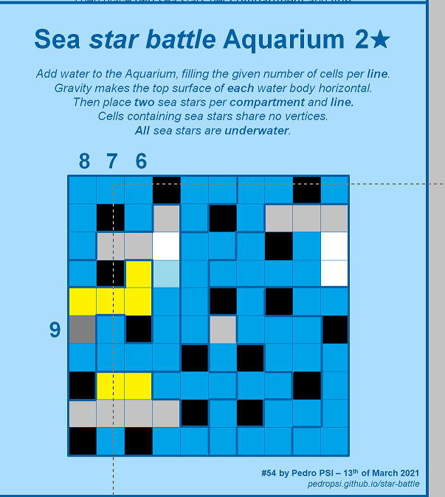
Sea star battle Aquarium 2★
Add water to the Aquarium, filling the given number of cells per line.
Gravity makes the top surface of each water body horizontal.
Then place two sea stars per compartment and line.
Cells containing sea stars share no vertices.
All sea stars are underwater.
8
7
6
9
#54 by Pedro PSI – 13th of March 2021
pedropsi.github.io/star-battle

Slide 3
1
2
4
1
7
6
8
9

