Slide 1
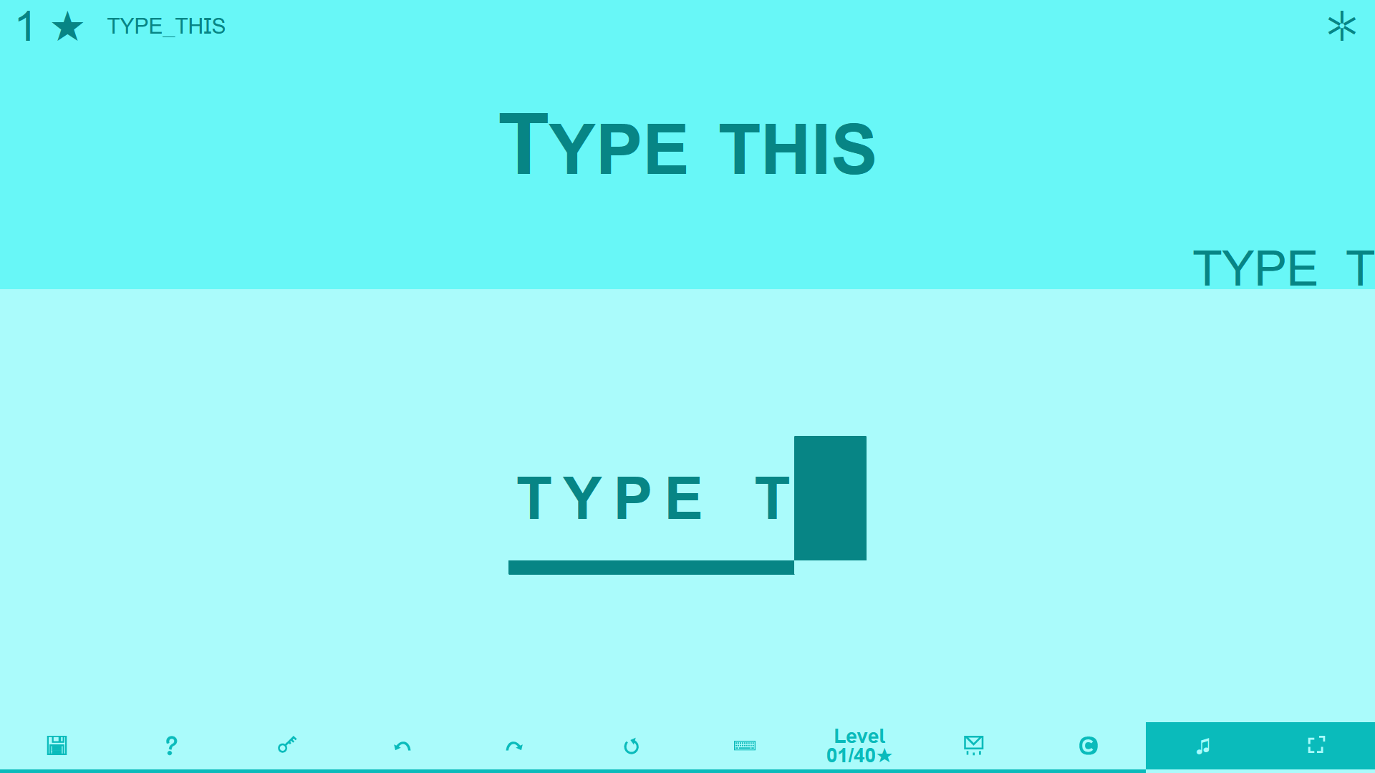
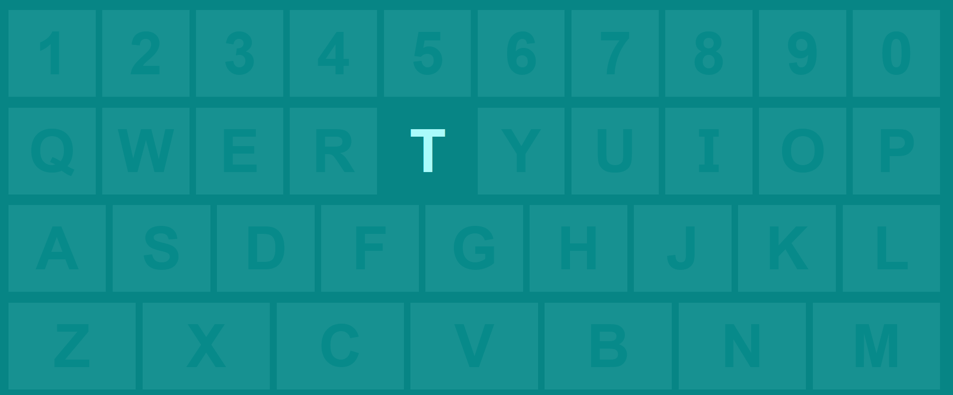
Clue
What you must type
This is level 1
Beat it to earn this star
1-star levels are the easiest
Your best solution is saved here
Result
of your typing
efforts
Keystrokes
typed so far
Use your keyboard!

Slide 2
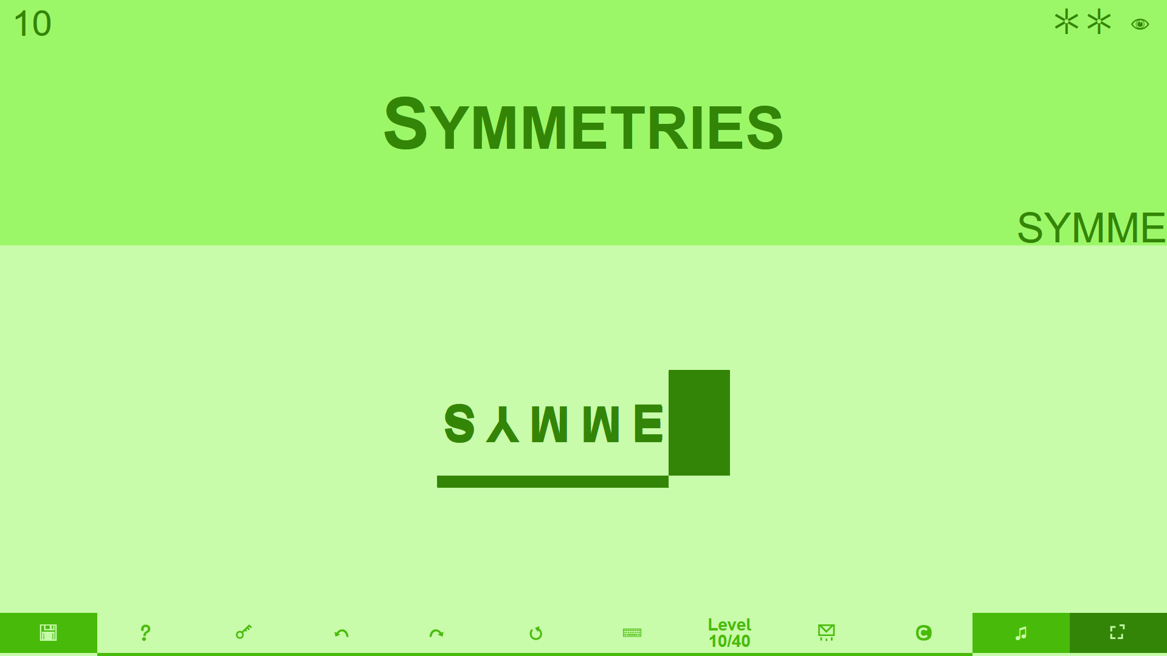
Clue
What you must type
This is level 10
Not beaten yet
2 stars is still easy
Pictograms
An eye means this is a “visual level”
Result
of your typing
efforts
Keystrokes
typed so far
Uh oh…
We’re in fullscreen
music is on
Is it time to undo?
Or shall we restart?

Slide 3
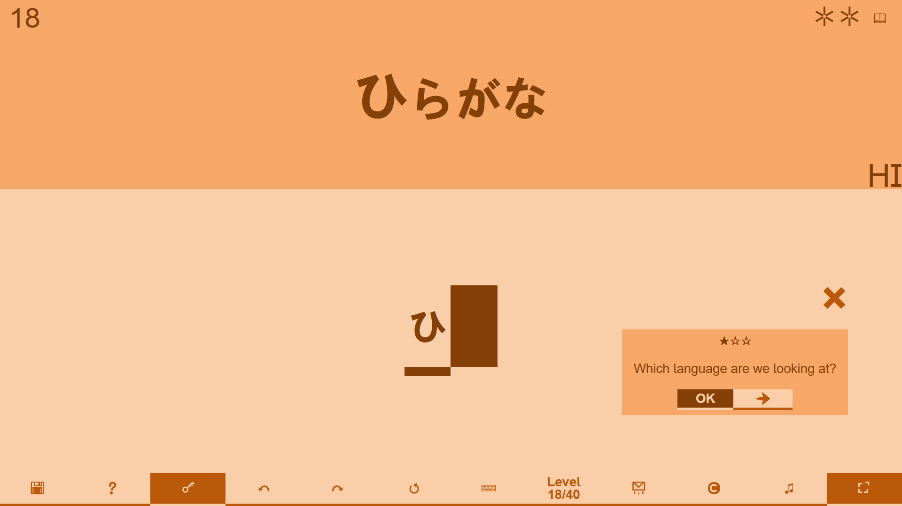
Clue
What you must type
Pictograms
A book means this is a “language level”
Result
Keystrokes
?????
typed so far
Need a hint?
Press this key!
Hints appear here,
press next for more…

Slide 4
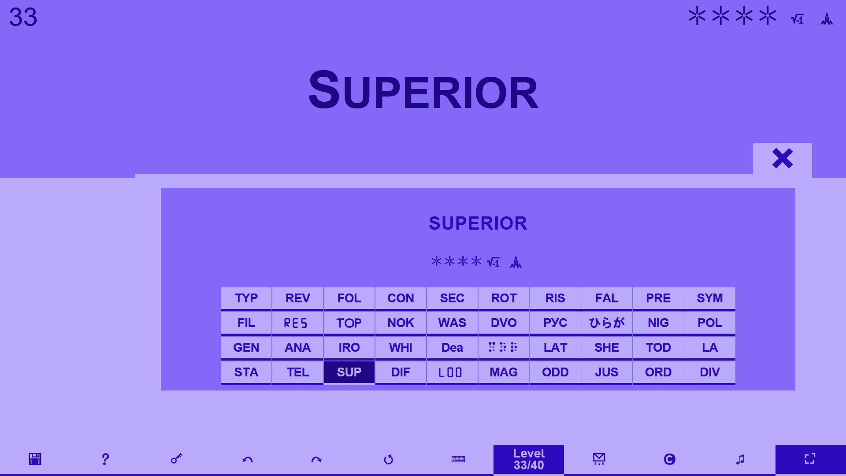
Pick any level freely
4 stars is hard, 5 is hardest
Pictograms
A these mean “numbers” and “building blocks”
Show/hide the level selector

