Slide 1
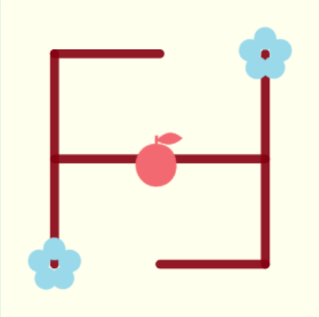

Slide 2
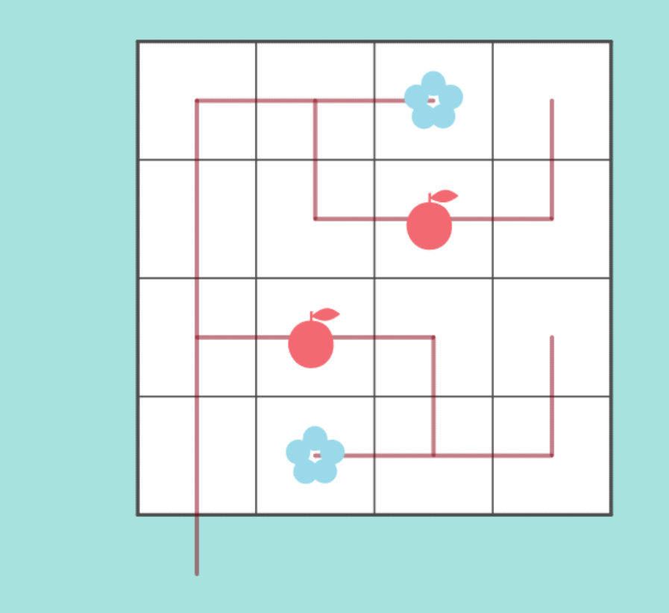

Slide 3
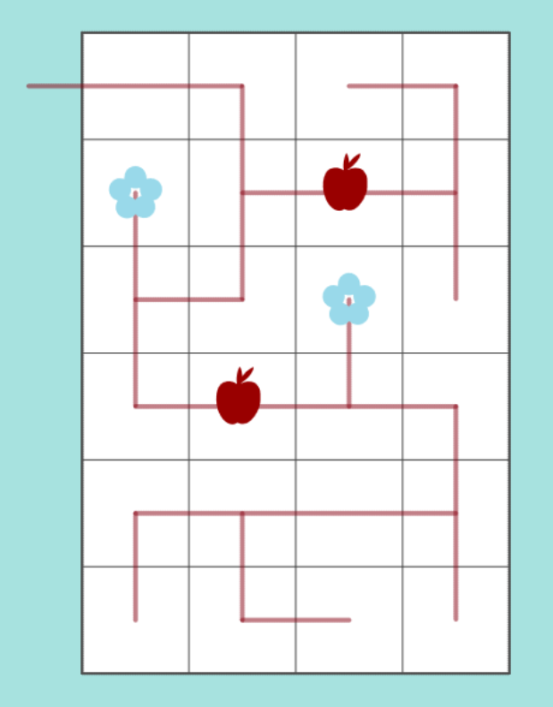
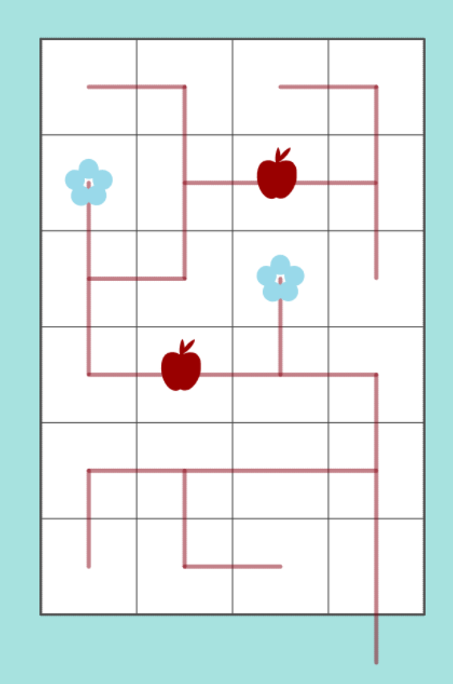
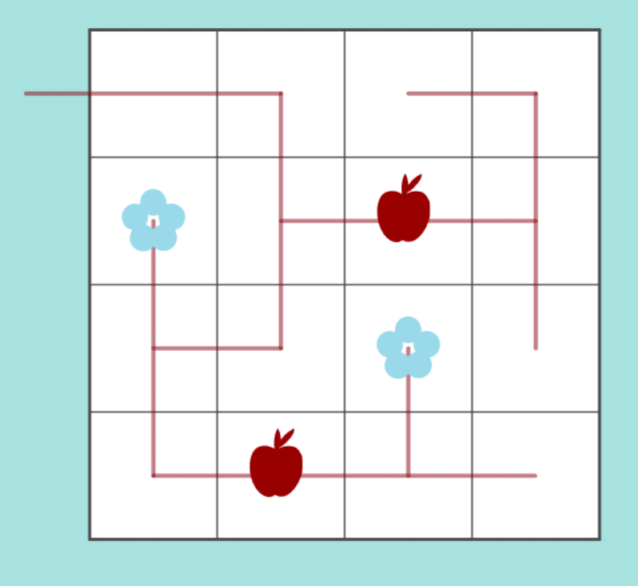
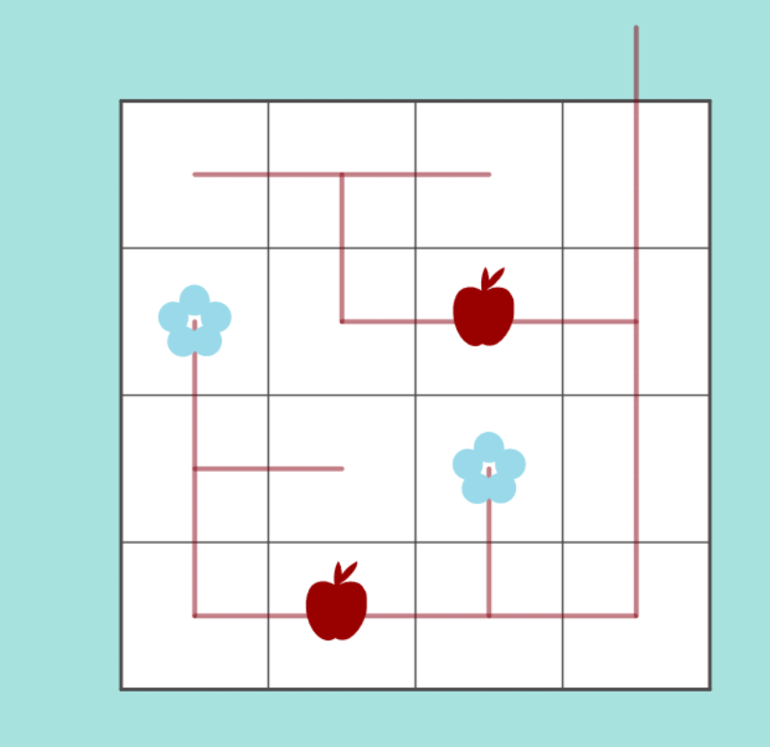
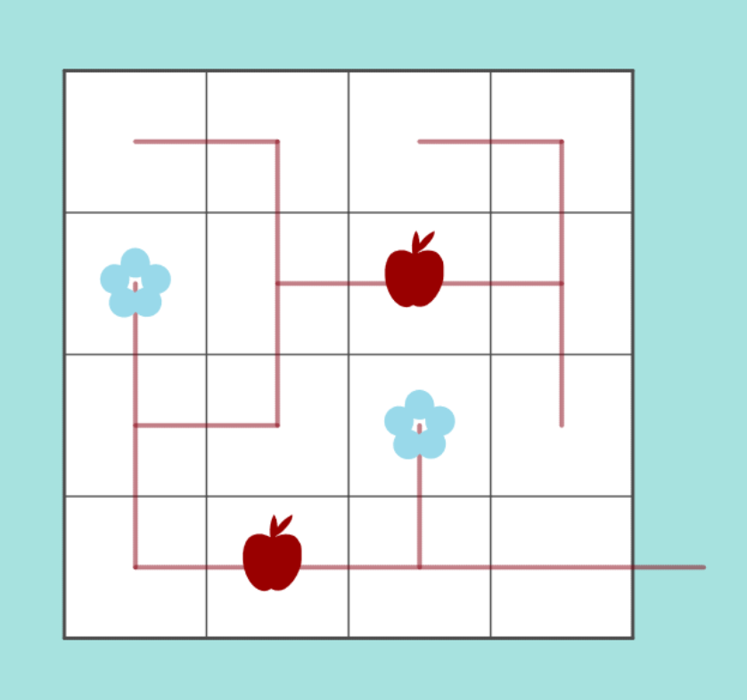
file:///C:/Github/pedropsi.github.io/kudamono.html?W=5&L=w8a8a4w1&S=1RRDDRRUL7DDR2RRUR16D&G=b

Slide 4
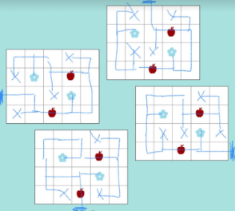
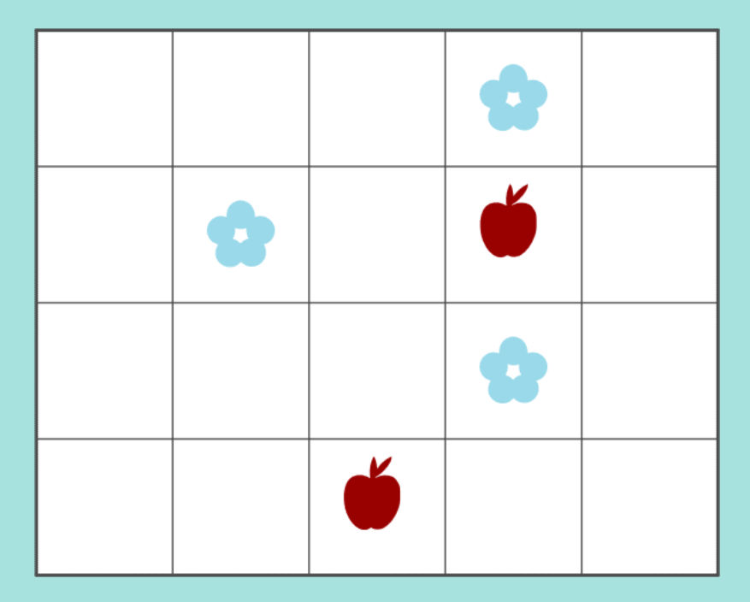
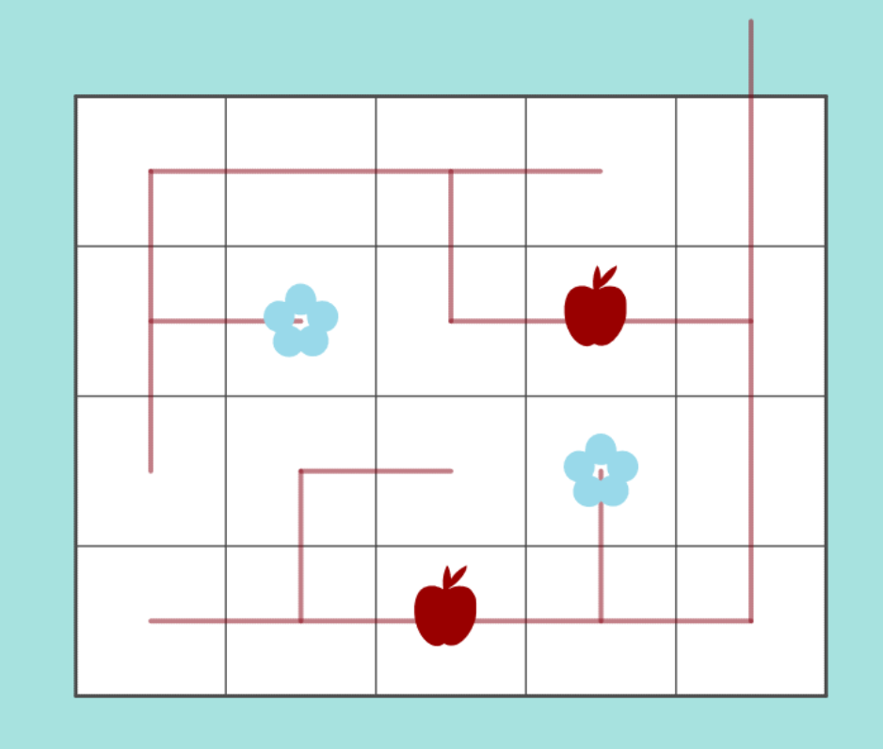
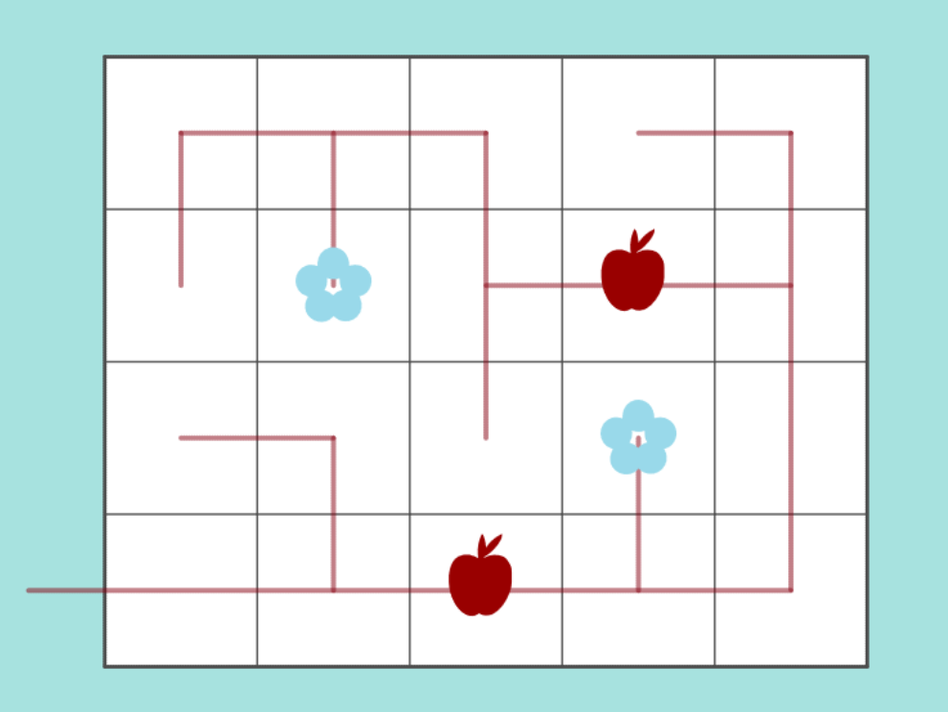
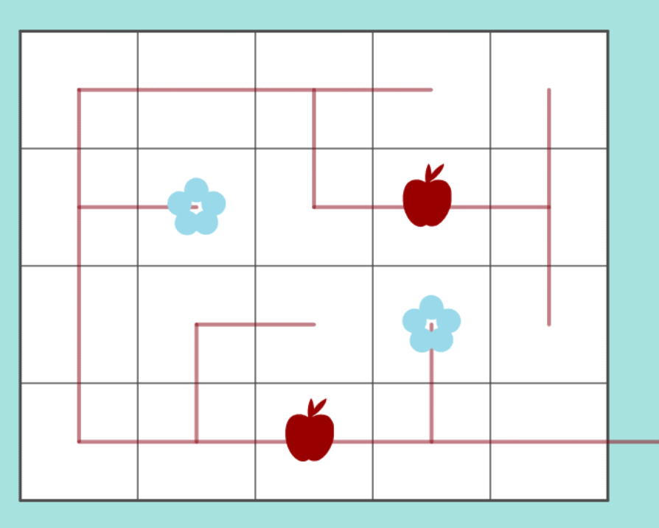
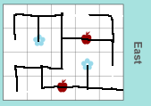
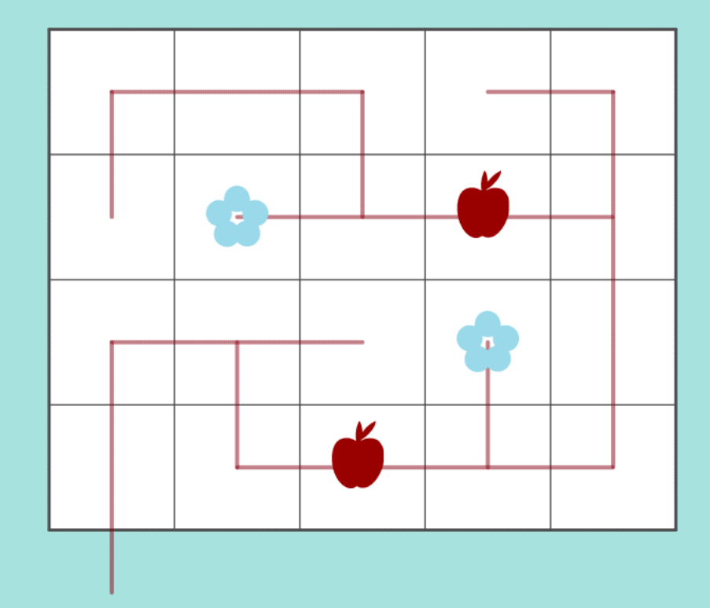
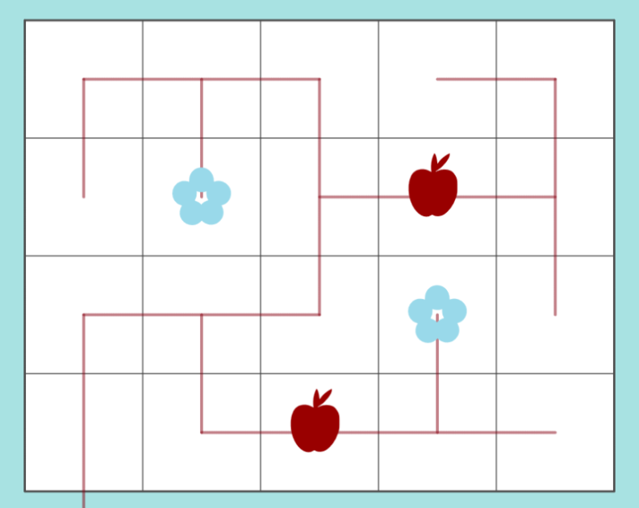

Slide 5
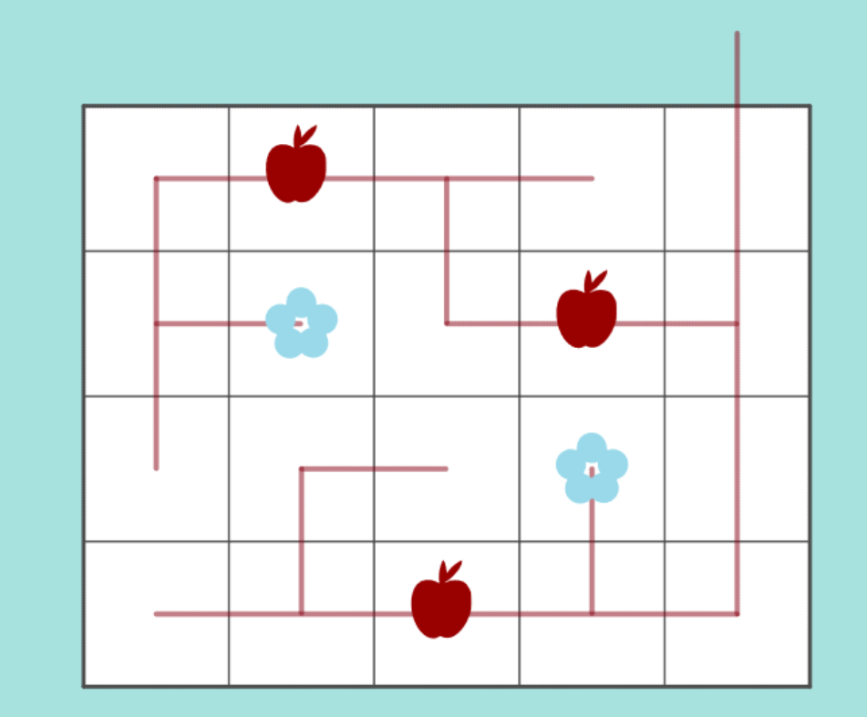
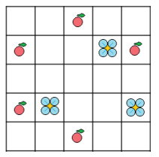
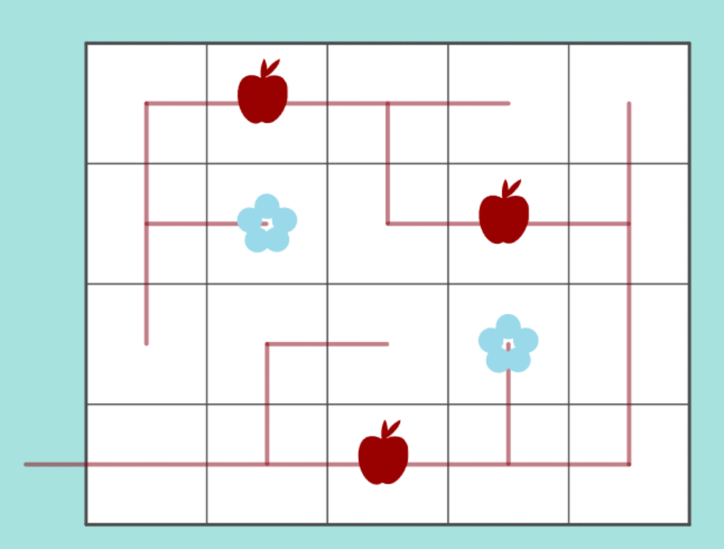
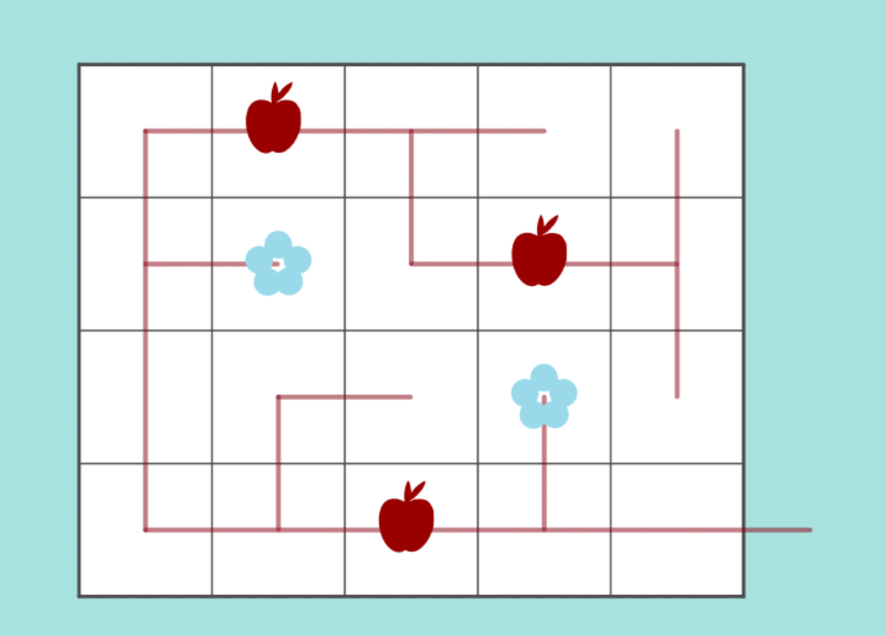
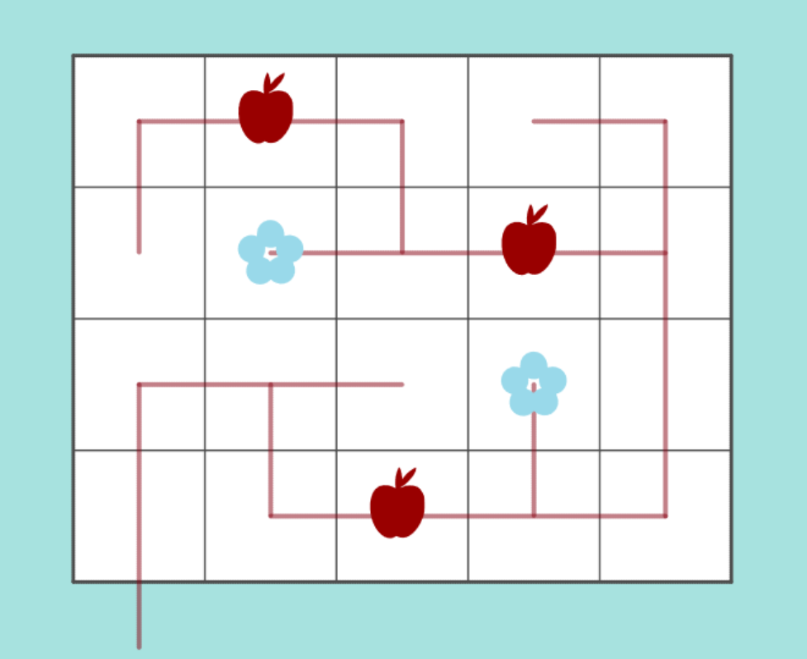

Slide 6
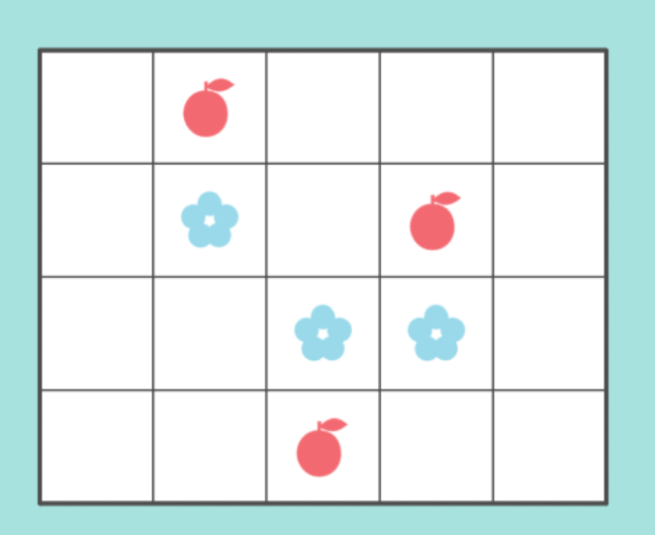
Bonsai
North
The trunk rooted on any of the 4 cardinal directions
West
East
South
#43 “Cardinal” by Pedro PSI – 21st of January 2021
pedropsi.github.io/kudamono.html?W=6&H=5&L=f13w1w7f1f4w1&G=b

Slide 7
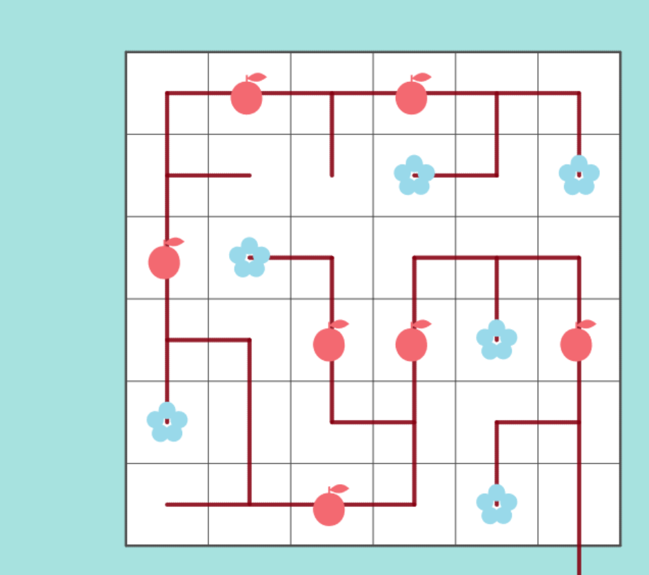

Slide 8
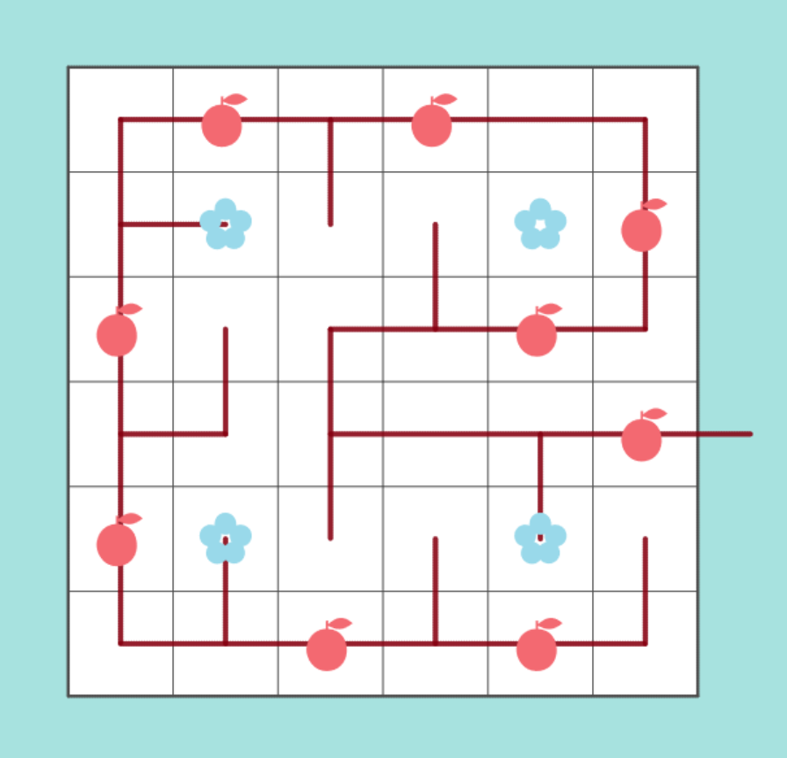
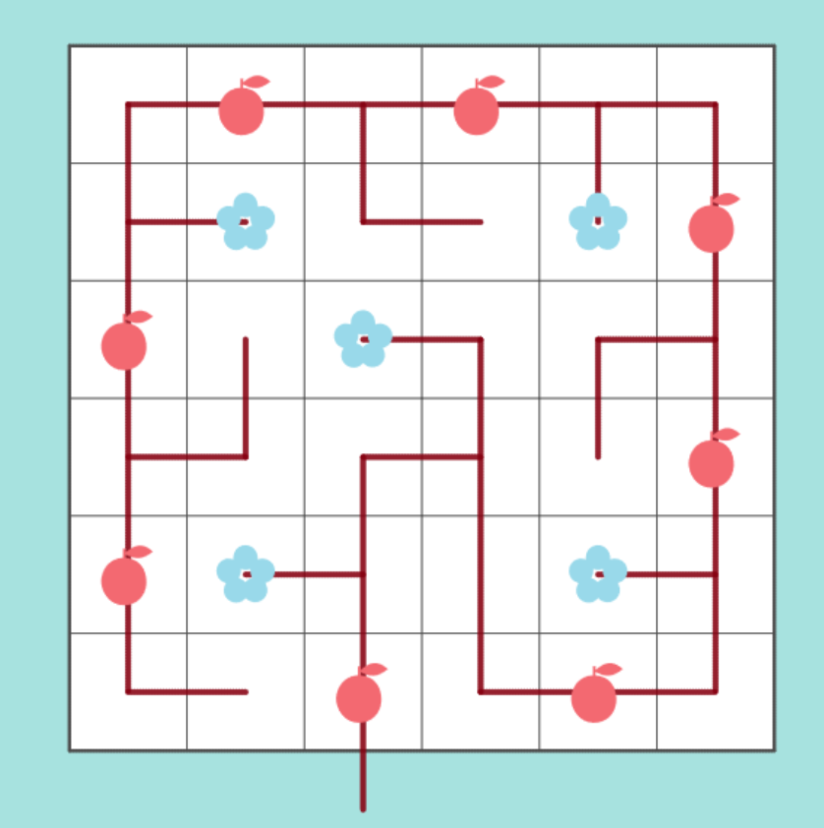
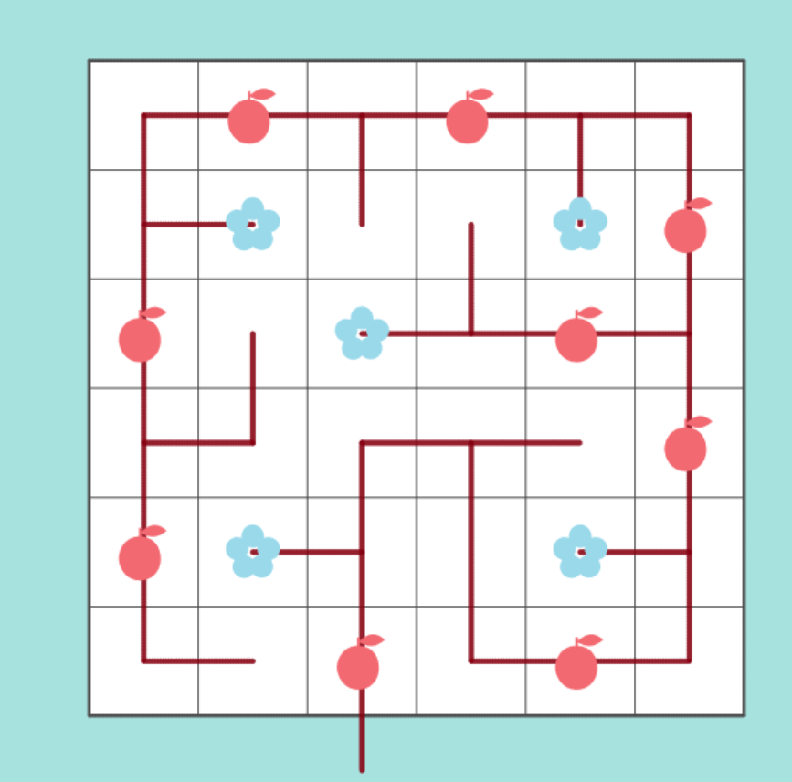
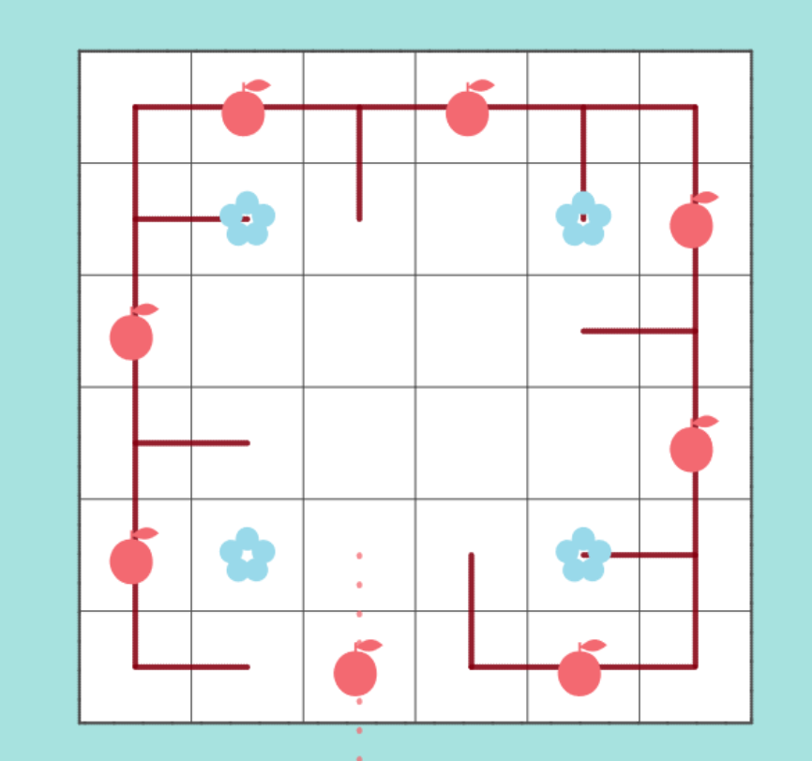
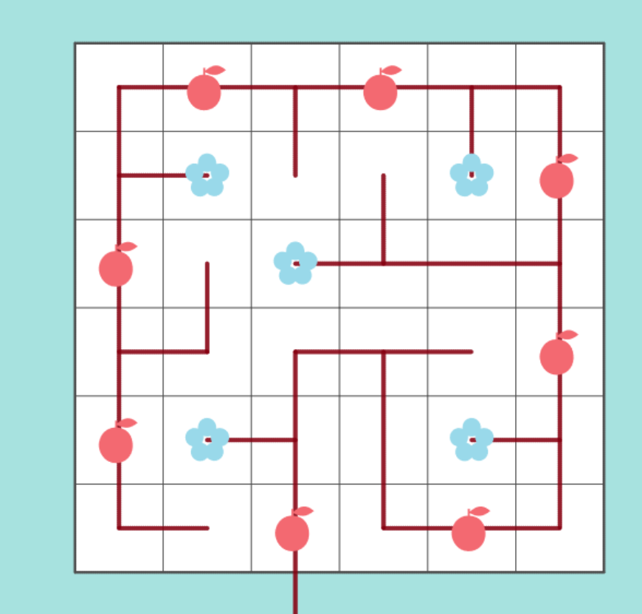
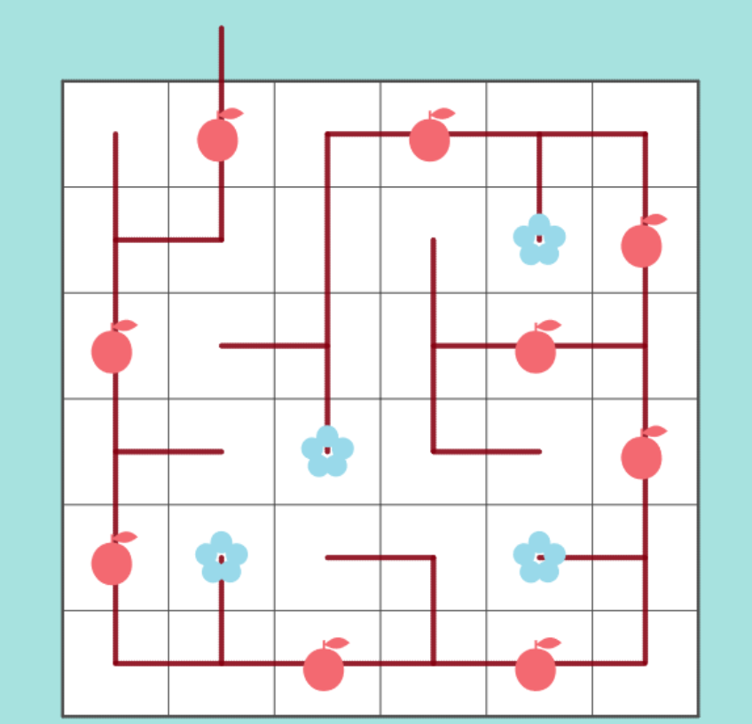
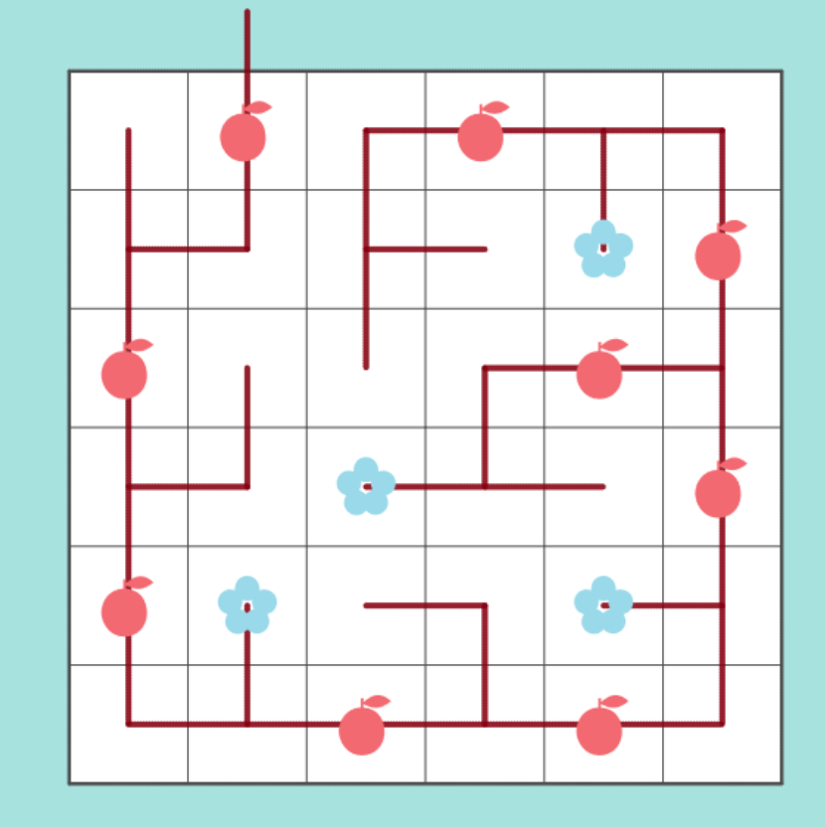
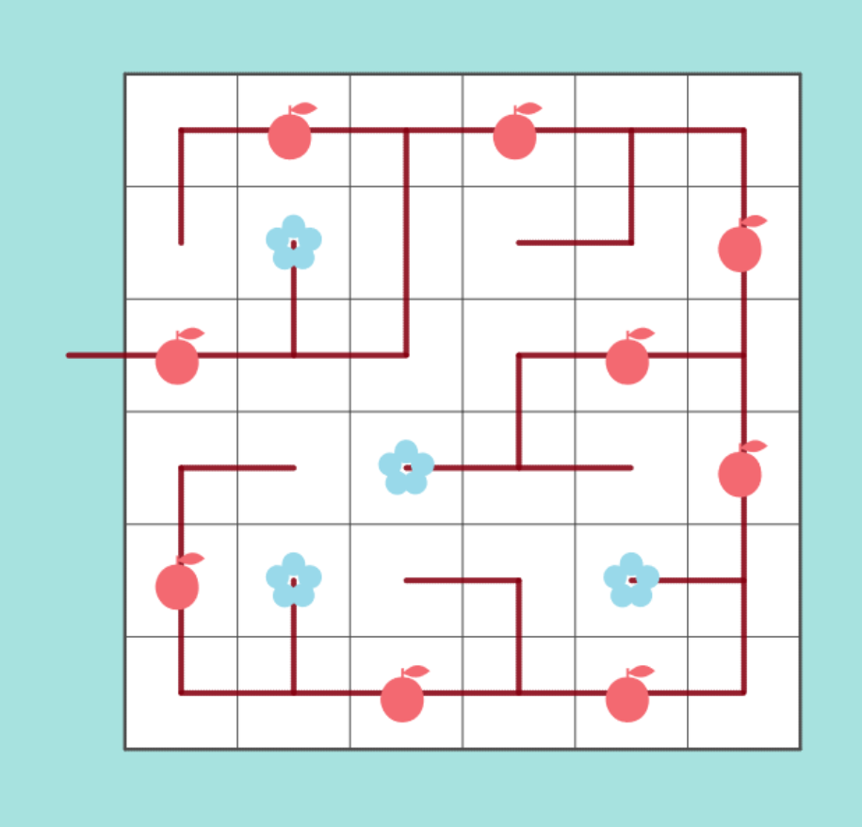
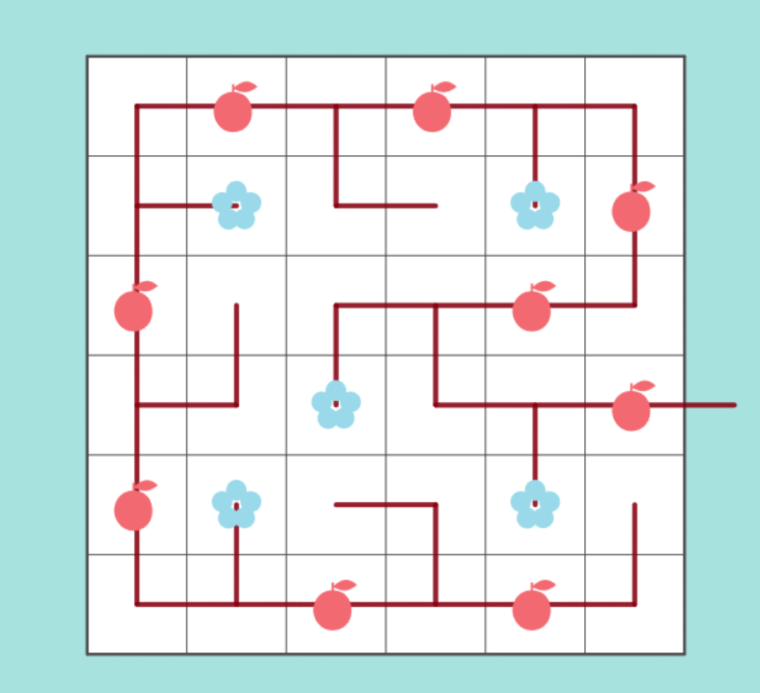
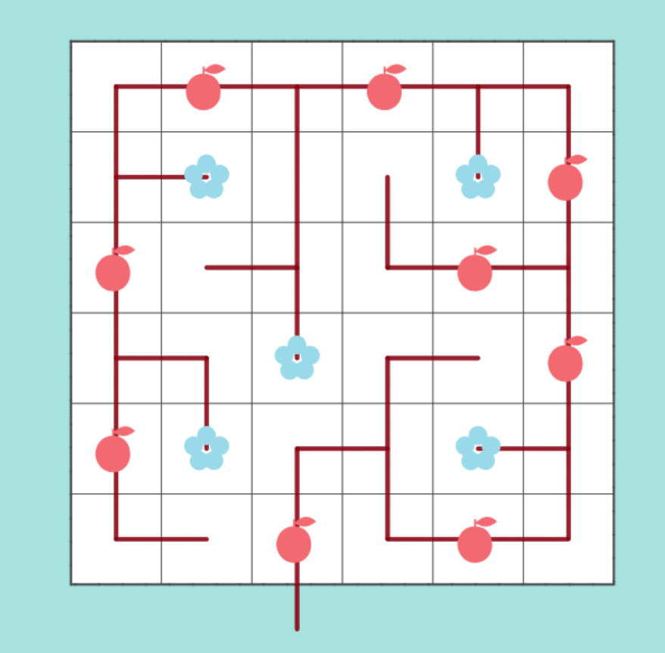

Slide 9
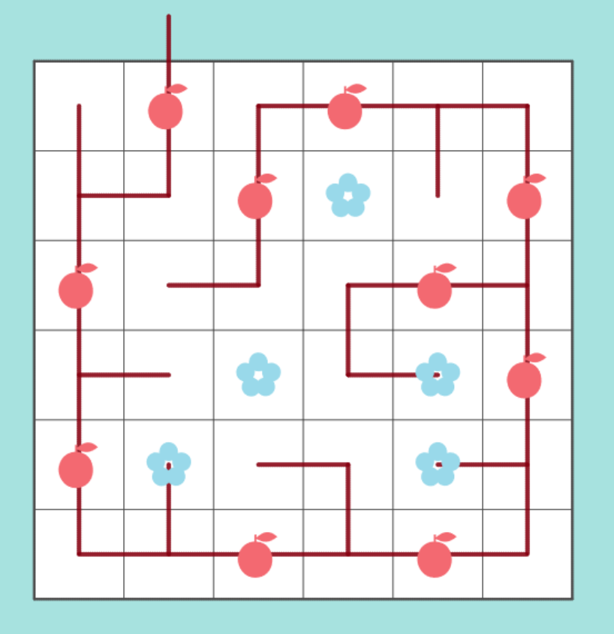
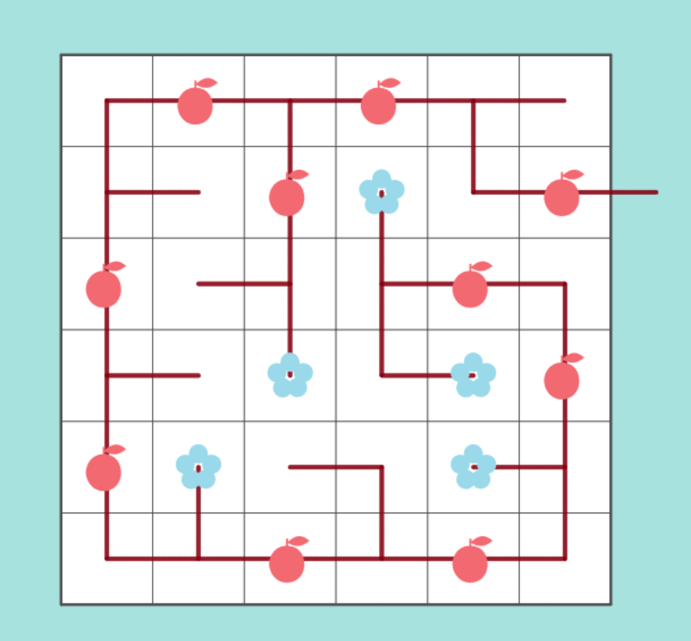
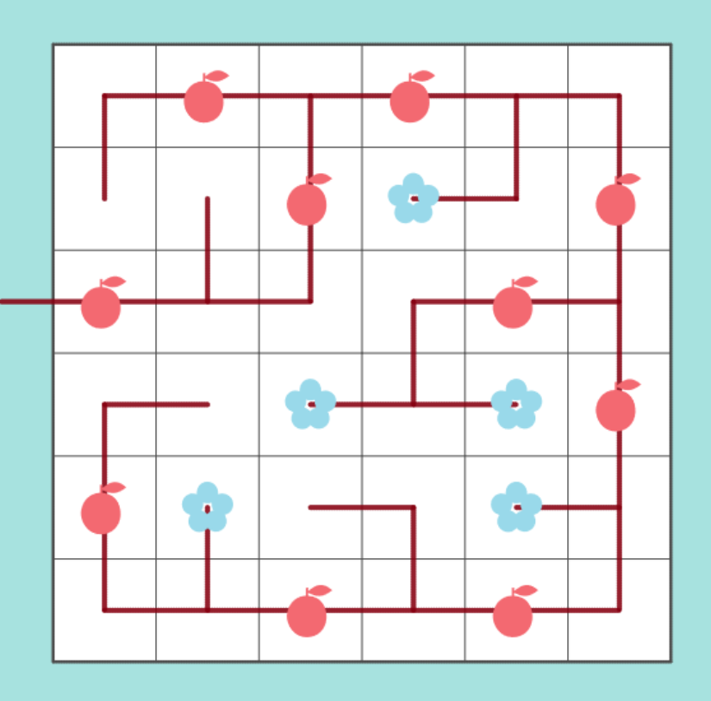
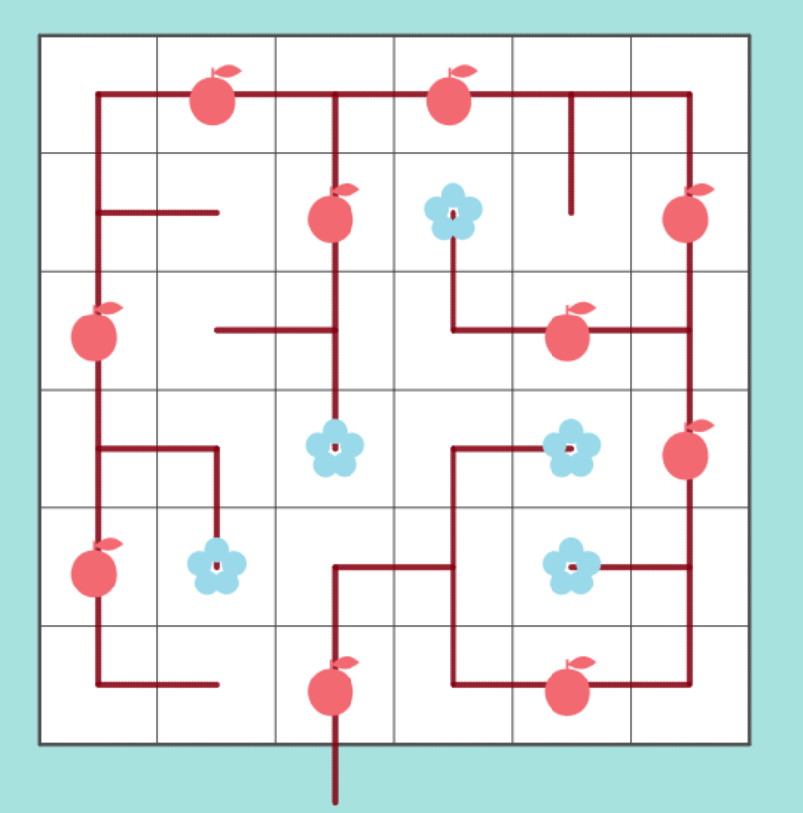

Slide 10
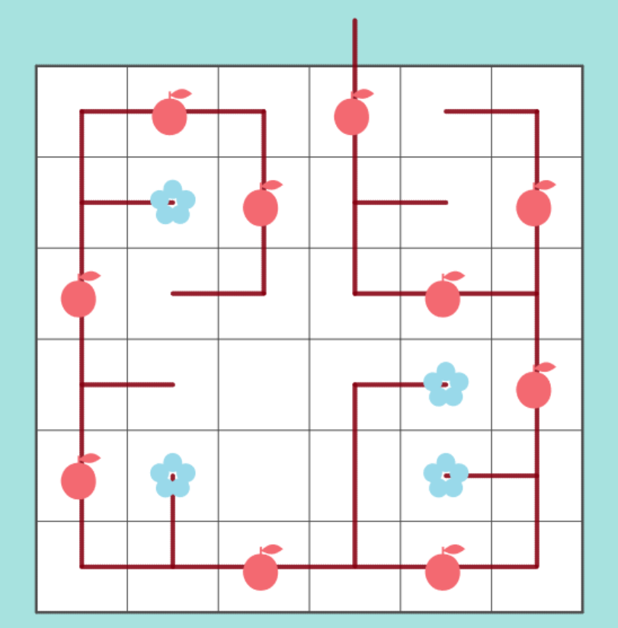

Slide 11
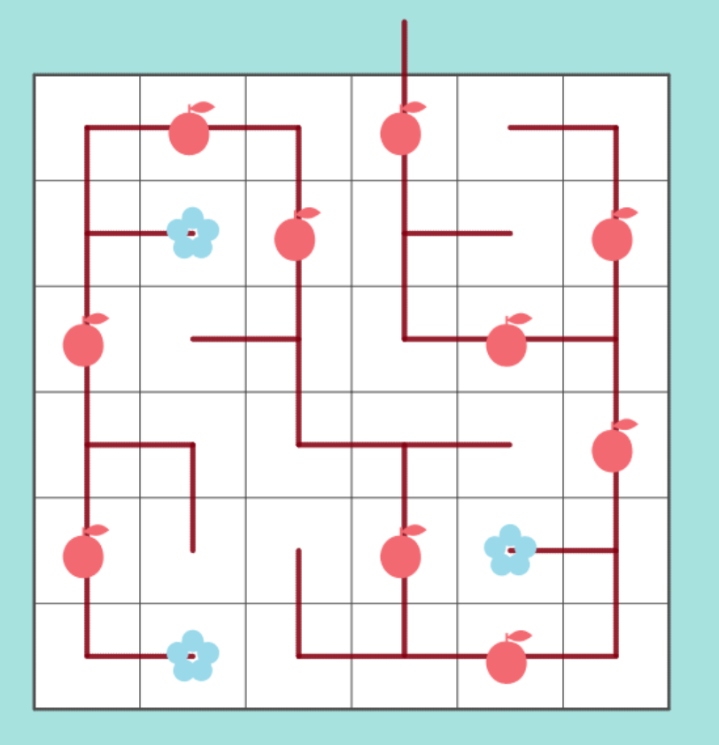
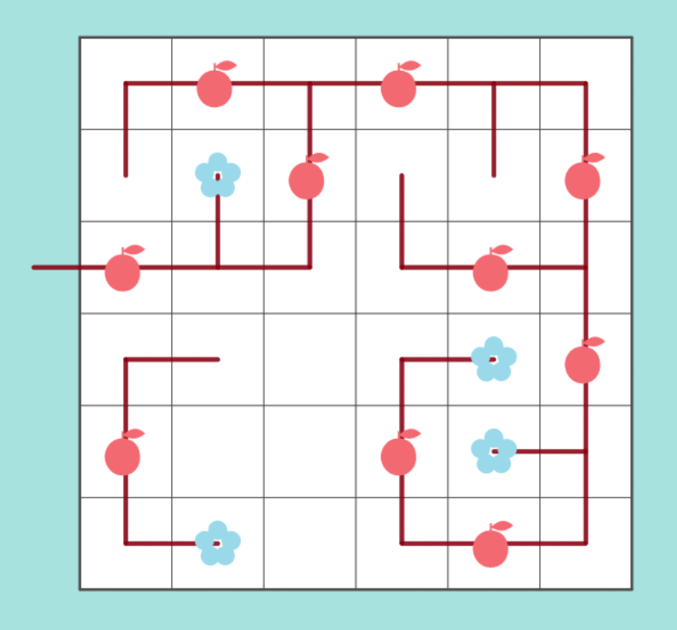
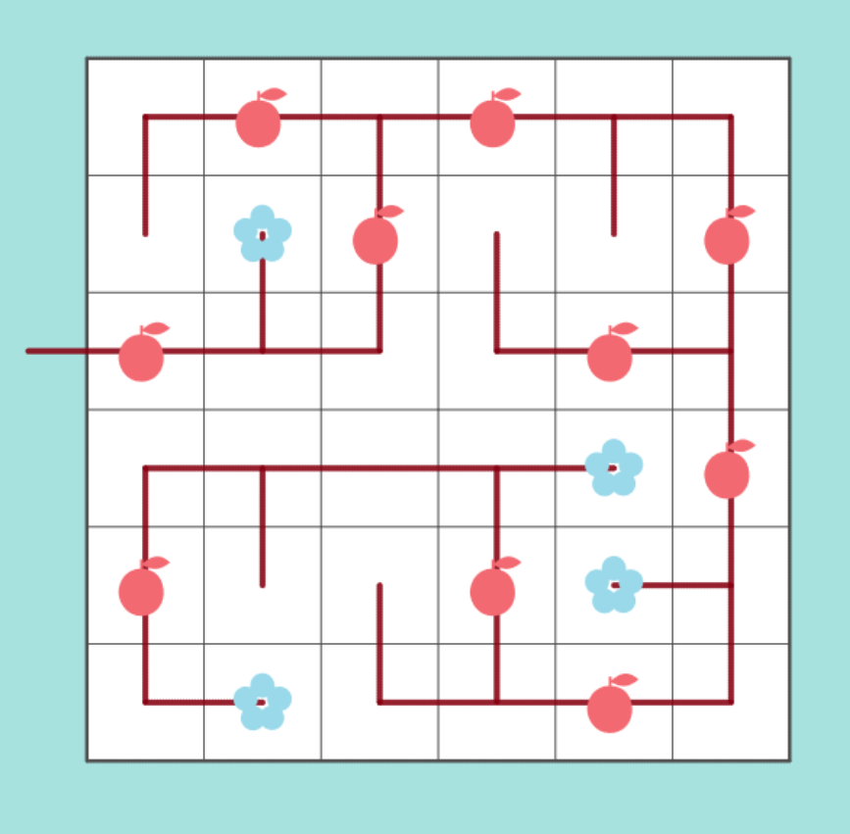
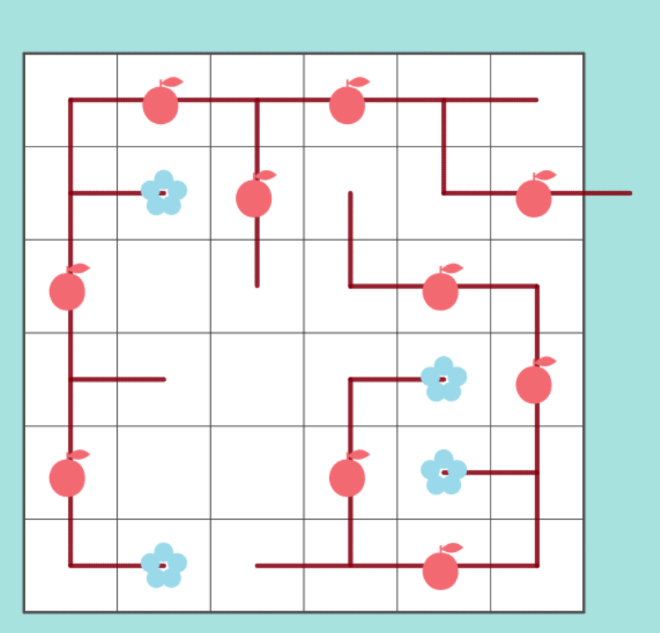
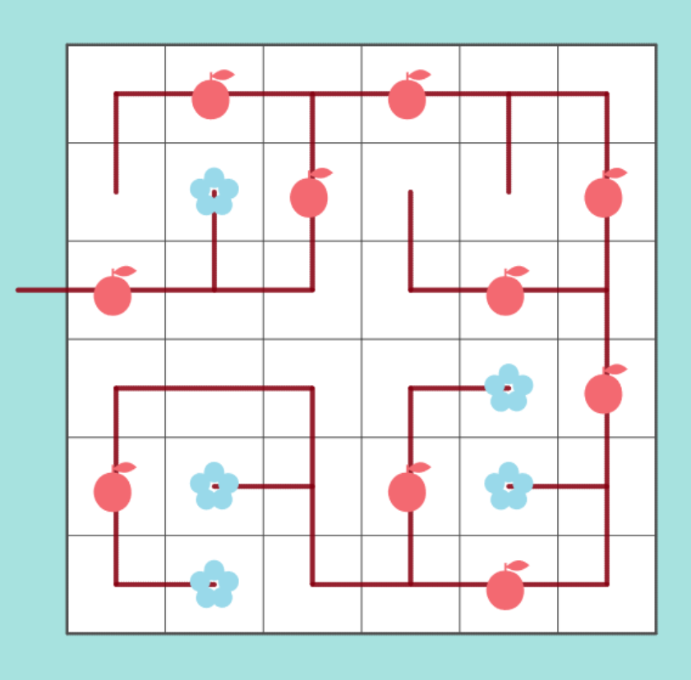
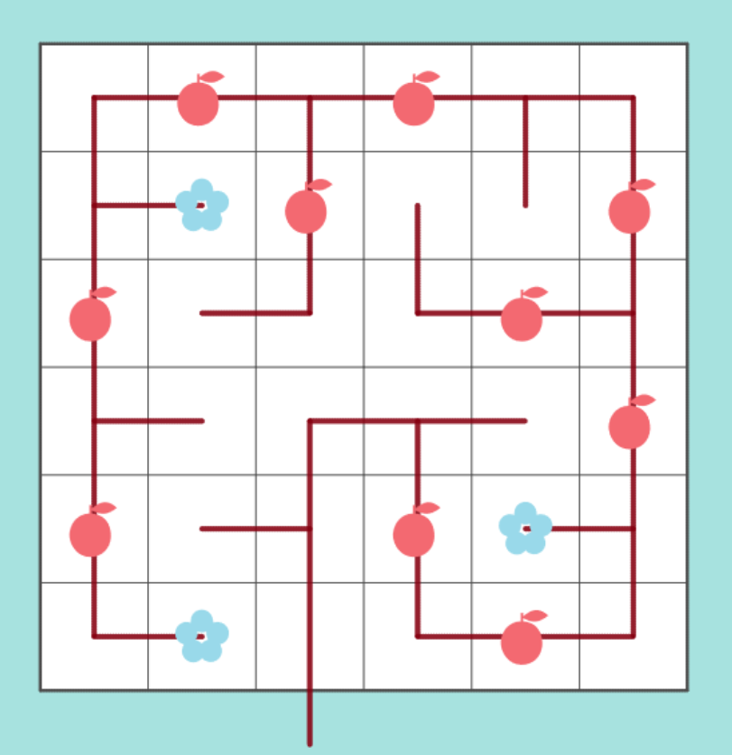

Slide 12
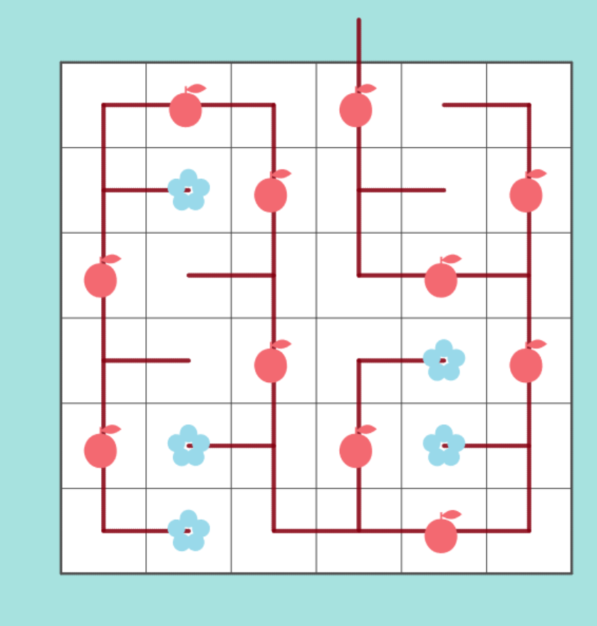
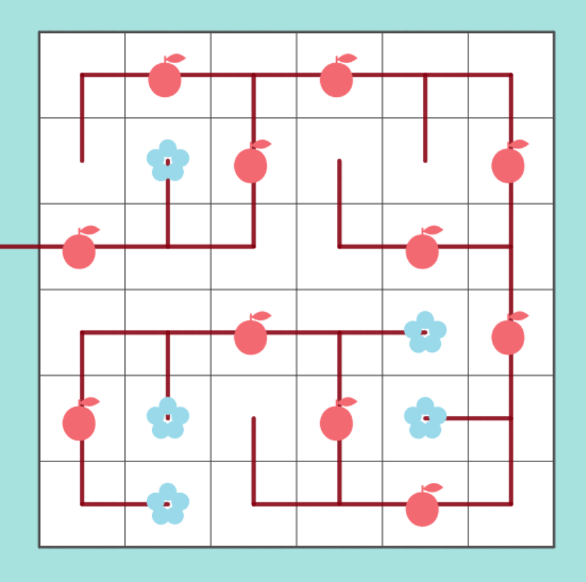
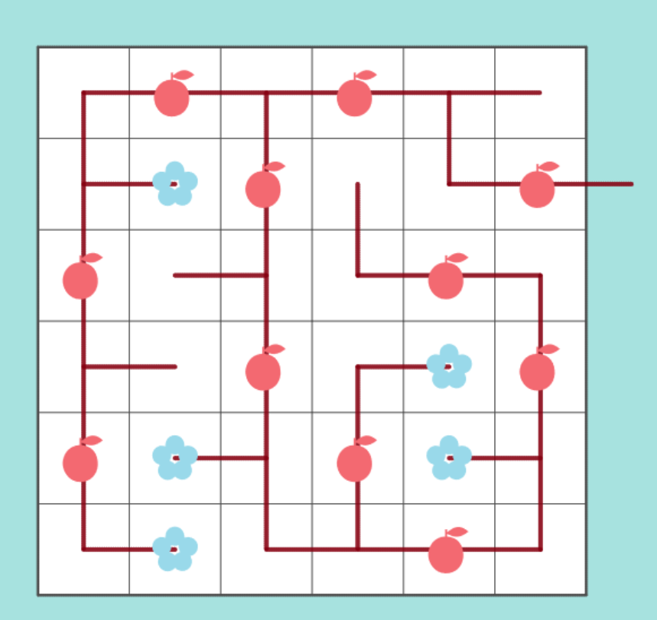
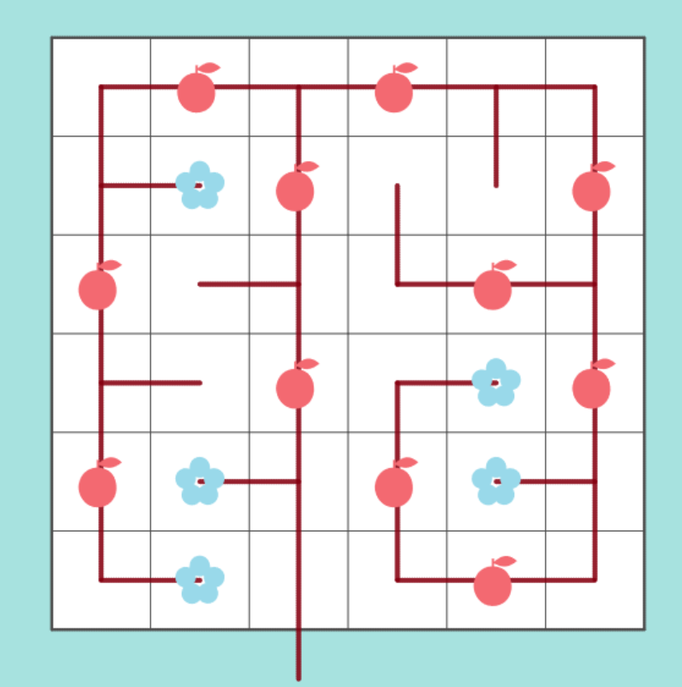

Slide 13
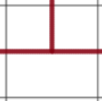

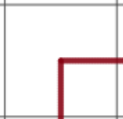
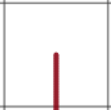

Bonsai (4-way)
Types:
straight
turning
branching
Draw a continuous path through every grid square using the given pieces
(rotations allowed) such that no consecutive pieces belong to the same type, and:
flowers are at endpoints (1-pieces);
fruits are at straight 2-pieces;
the trunk is a straight 2-piece, rooted outside the board, in the indicated direction.
3-pieces
Sizes:
2-pieces
1-pieces
North
West
East
South
Bonsai was invented by Le Slo
4-way Bonsai was suggested by Andrea Gilbert (clickmazes)
#44 “Four way” by Pedro PSI – 26th of January 2021
pedropsi.github.io/kudamono.html?W=7&L=f11f2f4w1w3w1f4f2f5f4f6w1w1f1f4f2&G=b

Slide 14

file:///C:/Github/pedropsi.github.io/kudamono.html?W=6&L=w8f15f1f1&S=8DRUR8RRDLLDLDDR2RRDRDD8R3RDDL&G=b&T=Triparityte

Slide 15

W=7&L=w14w6w1w1w6w1w13w1w6w1&S=11DDDR9ULURRURRDR2RUR4RDLD9DDDRRUULU18D&G=b&T=Narrow

Slide 16

file:///C:/Github/pedropsi.github.io/bonsai.html?W=6&L=q10q7f1q4w2q2h4q1q7&S=8RDLDDDRRDRRUULD4R4DR7URRD3R13D&G=b&D=2020-02-08&A=Pedro PSi&T=Questioning

Slide 17


