Slide 1
Kudamono An experimental paper puzzle on fruits
by Pedro PSI 2020
If you make your own Kudamono fruit puzzles,
please send them to Pedro PSI for dissemination

Slide 3
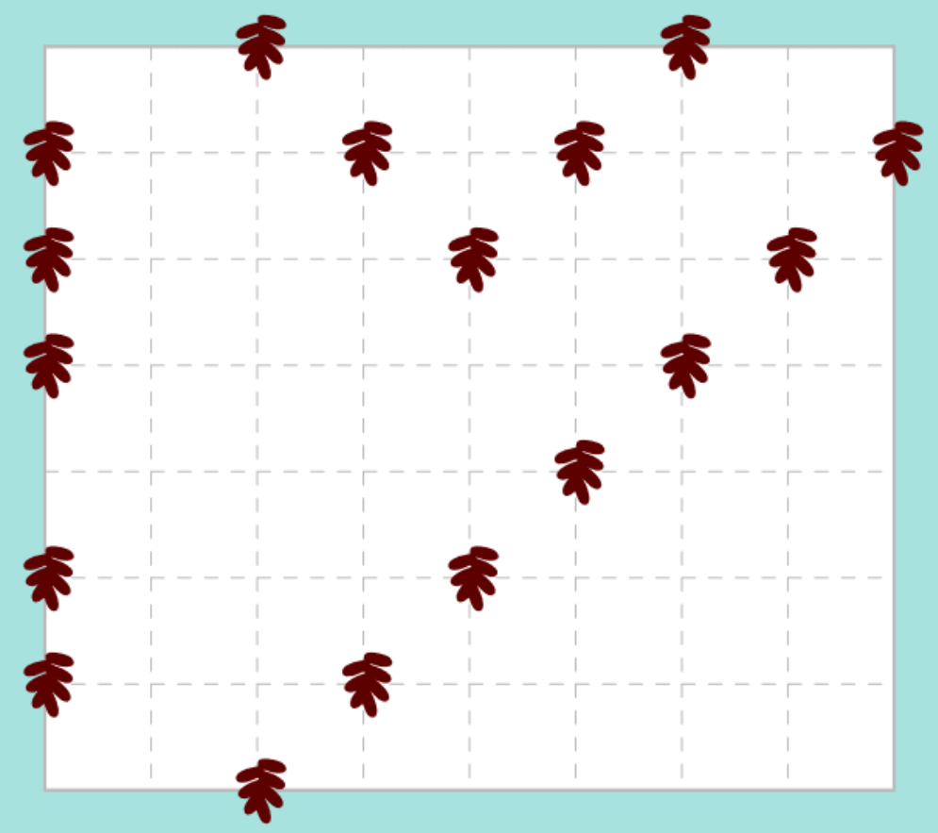
Kudamono
Draw paths of a single fruit type along the grid, each containing at least two fruits.
Unless otherwise indicated, paths do not loop, cross, branch or dangle.
The first two Dates connect via a straight line. Non-endpoints may spawn up to one straight branch ending at a Date.
#37 by Pedro PSI – 12th of January 2021
pedropsi.github.io/kudamono

Slide 4
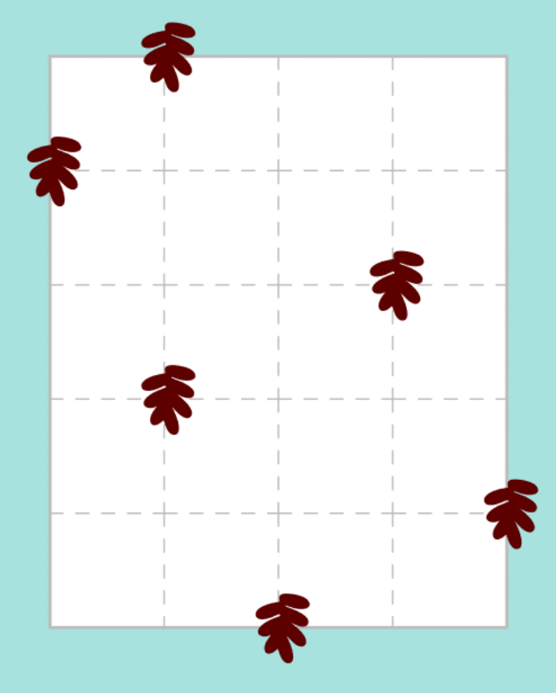
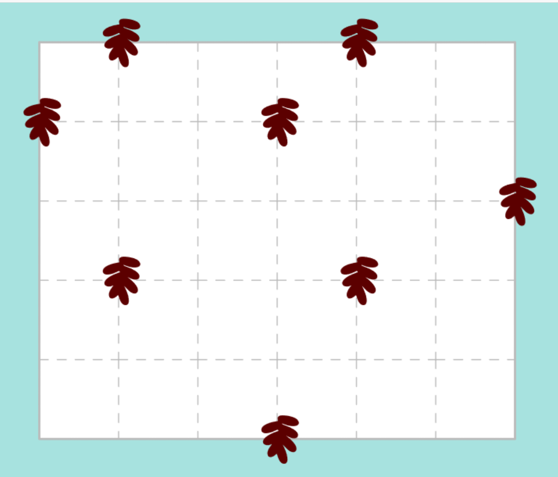
Kudamono
Draw paths of a single fruit type along the grid, each containing at least two fruits.
Unless otherwise indicated, paths do not loop, cross, branch or dangle.
The first two Dates connect via a straight line. Non-endpoints may spawn up to one straight branch ending at a Date.
#36 by Pedro PSI – 11th of January 2021
pedropsi.github.io/kudamono

Slide 5
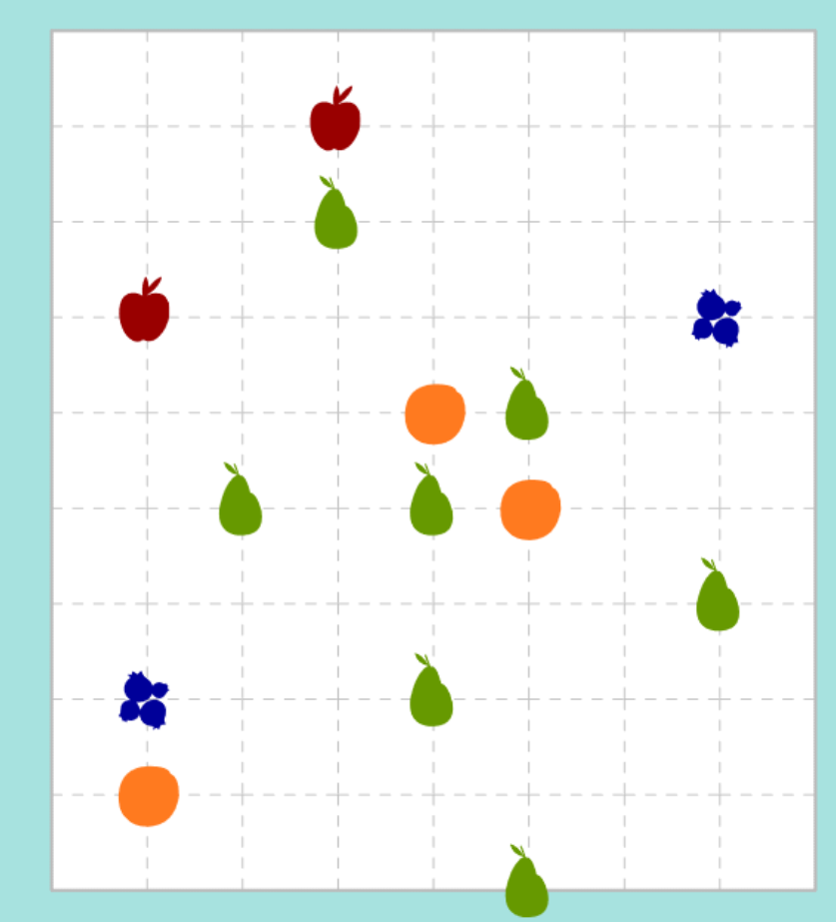
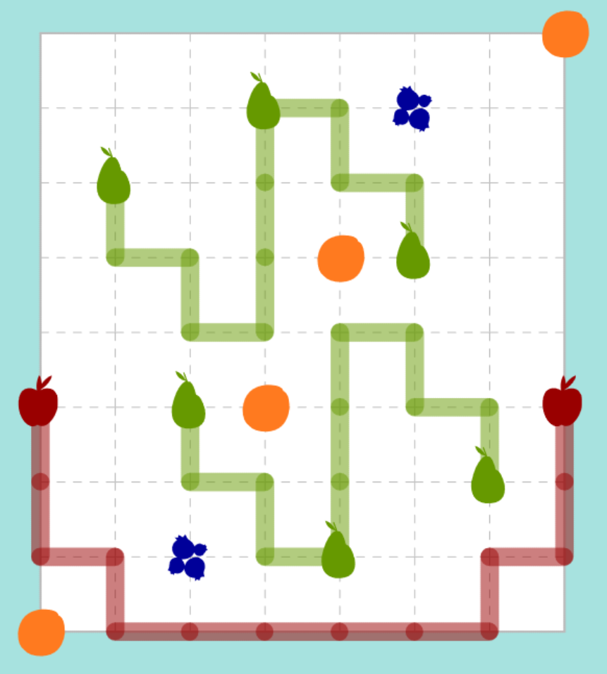
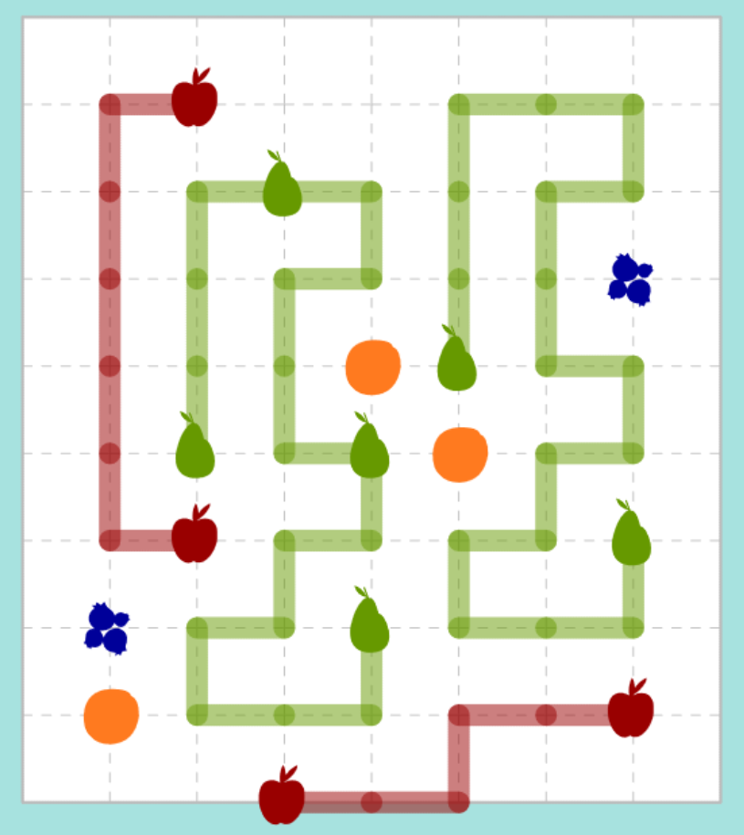
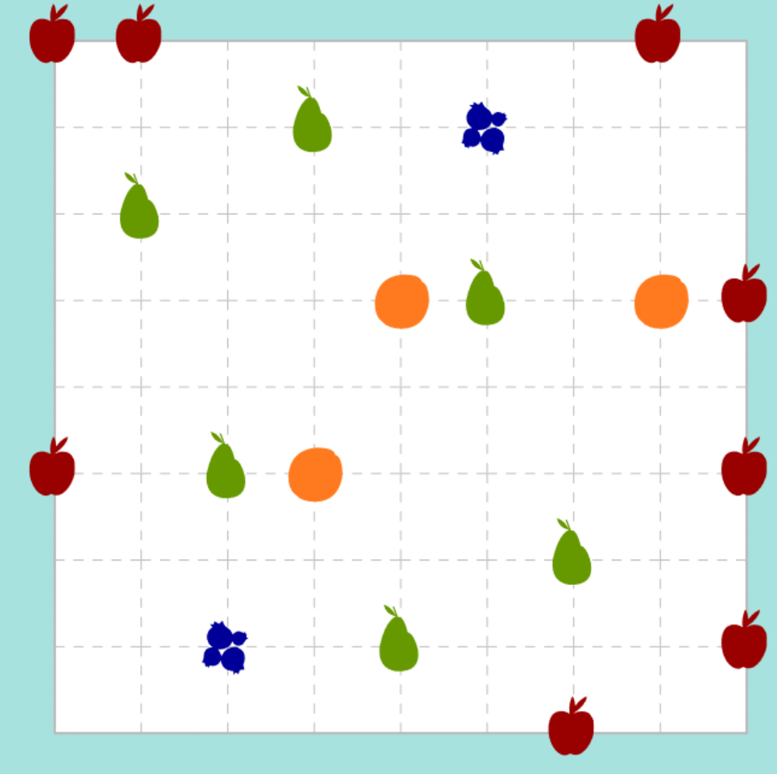
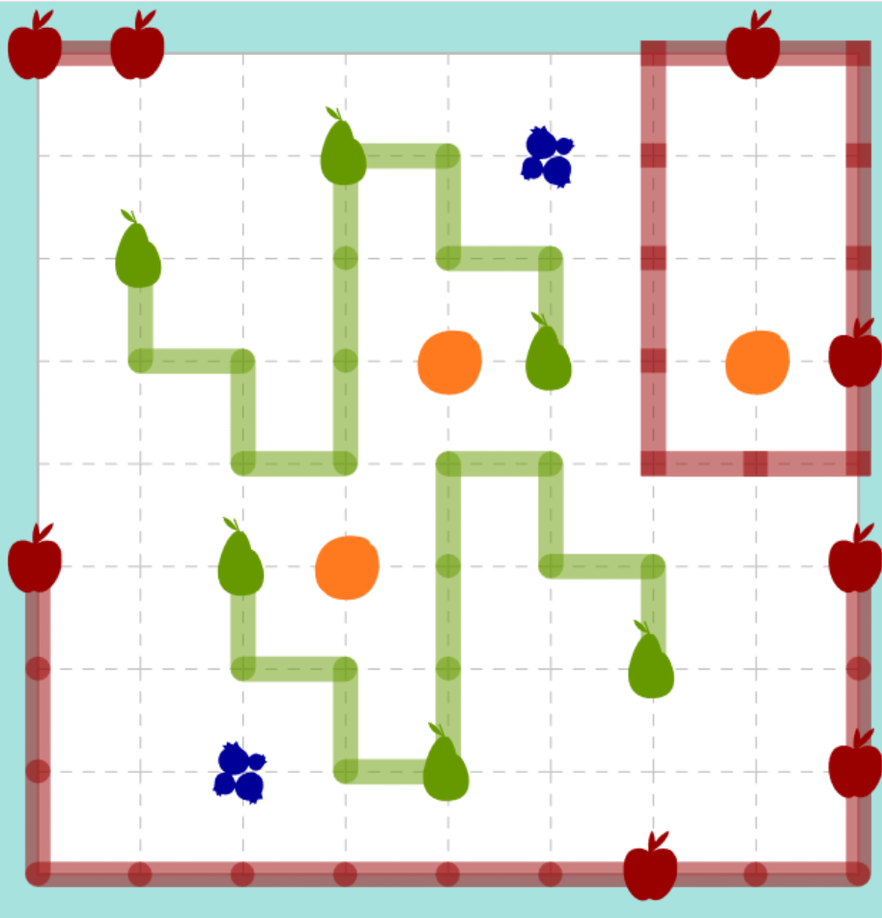
Kudamono
Draw paths of a single fruit type along the grid, each containing at least two fruits.
Unless otherwise indicated, paths do not loop, cross, branch or dangle.
\
Every Apple is on a mirror or rotationally symmetric path. Loops are allowed.
All paths under Pears are exact translations, and there is more than one.
No Orange is connectable with another (no path could be drawn).
Every Blueberry is connectable with at least one other (as if a path were drawn).
#35 by Pedro PSI – 11th of January 2021
pedropsi.github.io/kudamono

Slide 6
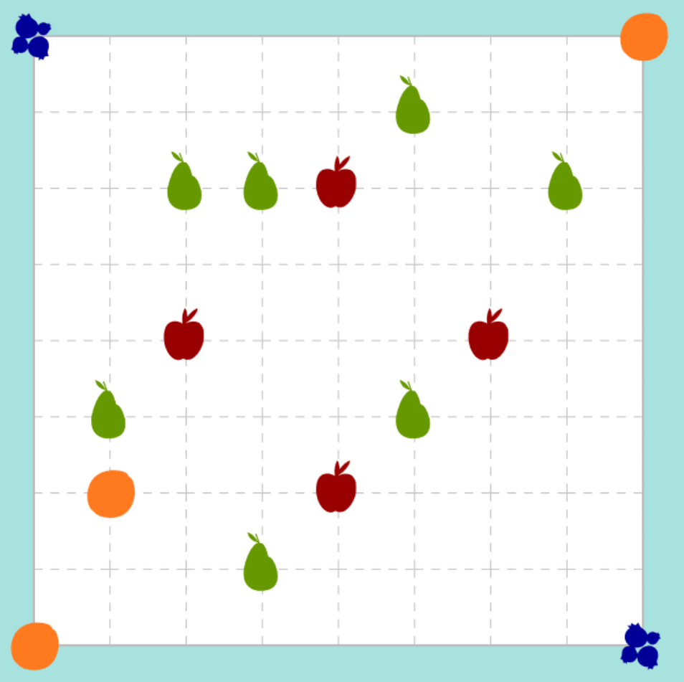
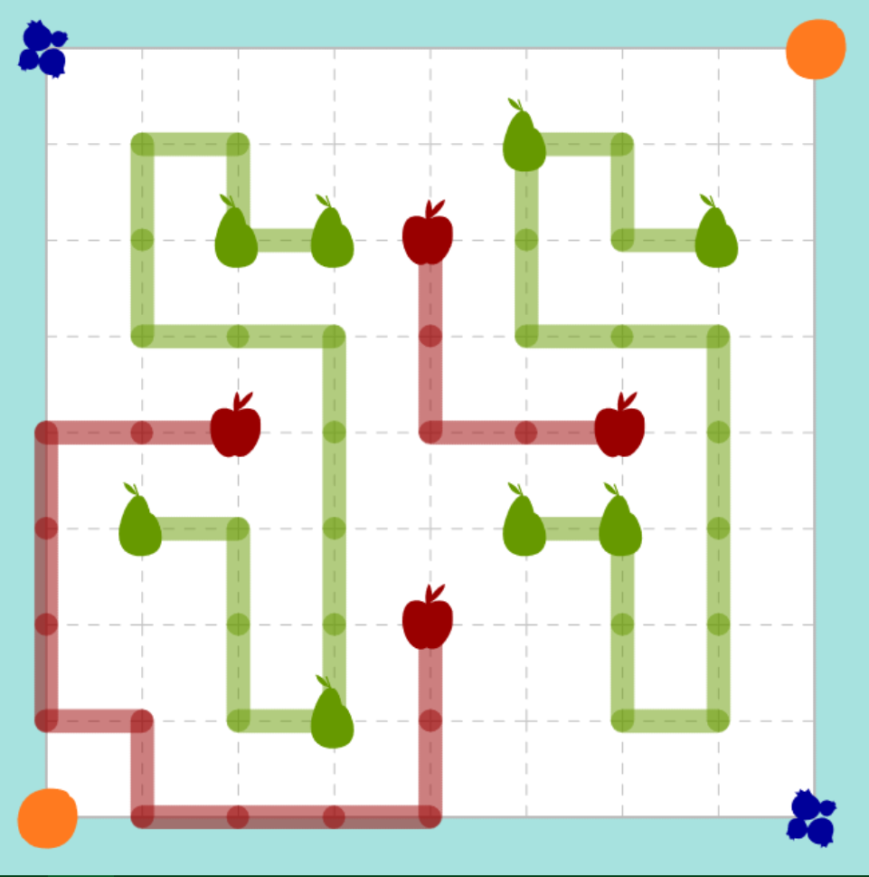
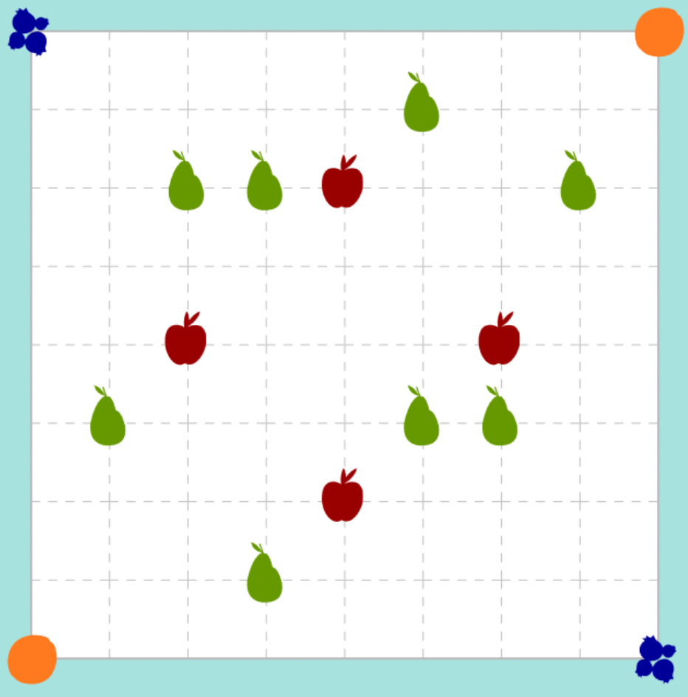
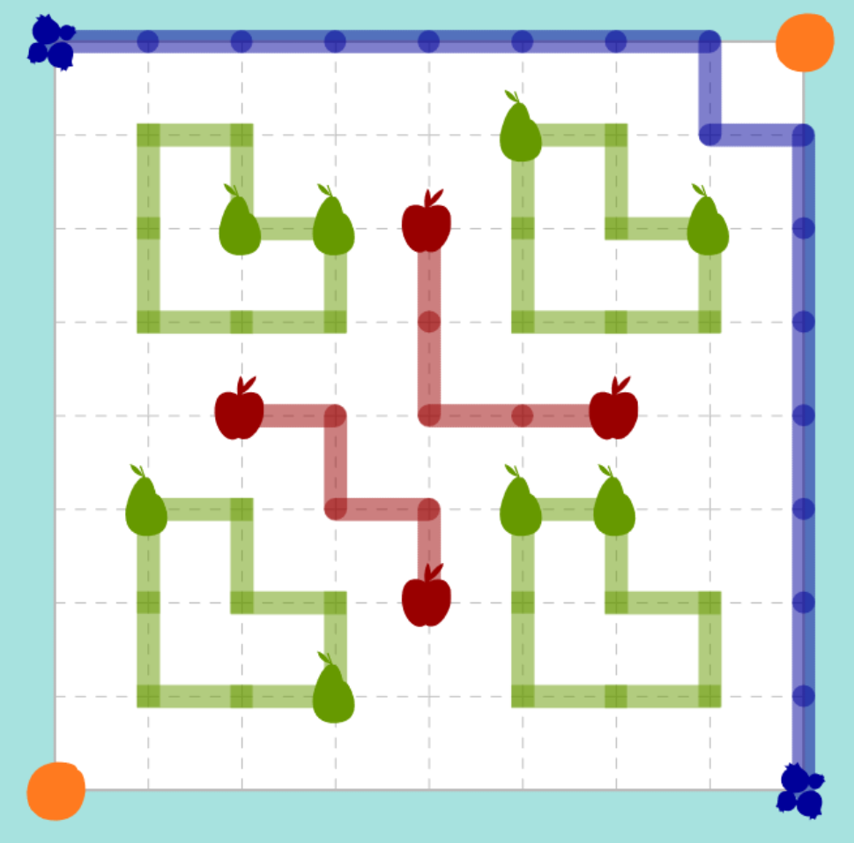
Kudamono
Draw paths of a single fruit type along the grid, each containing at least two fruits.
Unless otherwise indicated, paths do not loop, cross, branch or dangle.
\
Every Apple is on a mirror or rotationally symmetric path. Loops are allowed.
All paths under Pears are exact translations, and there is more than one.
No Orange is connectable with another (no path could be drawn).
Every Blueberry is connectable with at least one other (as if a path were drawn).
#34 by Pedro PSI – 10th of January 2021
pedropsi.github.io/kudamono

Slide 7
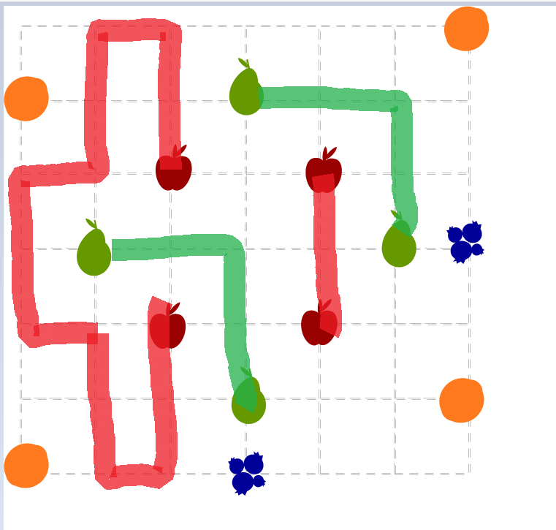
Kudamono
Draw paths of a single fruit type along the grid, each containing at least two fruits.
Unless otherwise indicated, paths do not loop, cross, branch or dangle.
\
Every Apple is on a mirror or rotationally symmetric path. Loops are allowed.
All paths under Pears are exact translations, and there is more than one.
No Orange is connectable with another (no path could be drawn).
Every Blueberry is connectable with at least one other (as if a path were drawn).
#32 by Pedro PSI – 31th of December 2020
pedropsi.github.io/kudamono

Slide 8
Kudamono rules
Draw paths of a single fruit type along the grid, each containing at least two fruits.
Unless otherwise indicated, paths do not loop, cross, branch or dangle.
Cherries connect only in pairs.
All Grapes are connected by a single path.
Melons belong to closed loops.
No path passes through a Lemon.
Every Apple belongs to a mirror or rotationally symmetric path.
Loops are allowed.
All paths under Pears are exact translations. There is more than one.
No Orange is connectable with another (no path could be drawn).
Every Blueberry is connectable with at least one other (as if a path were drawn).
by Pedro PSI
pedropsi.github.io/kudamono

Slide 9
Kudamono rules simplification idea II
What if we just change the pears:
All Pear paths match exactly. No path uses all Pears.
Would this be better, puzzlewise?
(we may think about more suitable fruits if needed)

Slide 10
Kudamono
Set II
Draw paths of a single fruit type along the grid. paths don’t cross, branch or dangle. Symmetries: mirror & rotation.
Apples seek perfection norms,
as Pears prefer unique forms.
Eat a Blueberry, you’ll want another,
or eat an Orange and you won’t bother!
Every Apple belongs to a symmetric group.
Every Pear belongs to an asymmetric group. All Pear groups are different, even under symmetries.
Every Blueberry is connectable with at least one other (if paths were drawn).
No Orange is connectable with another.

Slide 11
Kudamono
Set II
Draw paths of a single fruit type along the grid. paths don’t cross, branch or dangle. Symmetries: mirror & rotation.
Apples seek perfection norms,
as Pears prefer unique forms.
Eat a Blueberry, you’ll want another,
or eat an Orange and you won’t bother!
Every Apple belongs to a symmetric group.
Every Pear belongs to an asymmetric group. All Pear groups are different, even under symmetries.
Every Blueberry is connectable with at least one other (if paths were drawn).
No Orange is connectable with another.
#29 by Pedro PSI – 27th of December 2020
pedropsi.github.io/kudamono
With thanks to Portponky and dohz

Slide 12
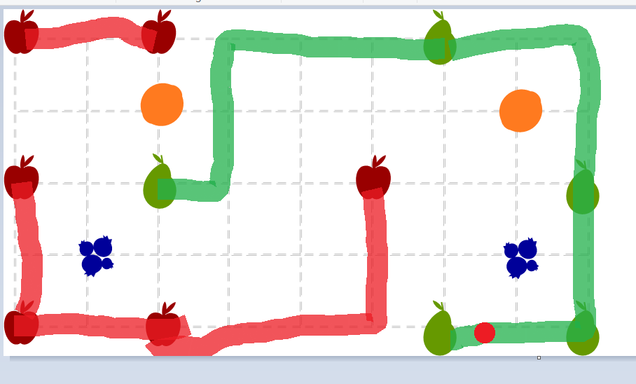
Kudamono
Set II
Draw paths of a single fruit type along the grid. paths don’t cross, branch or dangle. Symmetries: mirror & rotation.
Apples seek perfection norms,
as Pears prefer unique forms.
Eat a Blueberry, you’ll want another,
or eat an Orange and you won’t bother!
Every Apple belongs to a symmetric group.
Every Pear belongs to an asymmetric group. All Pear groups are different, even under symmetries.
Every Blueberry is connectable with at least one other (if paths were drawn).
No Orange is connectable with another.
#27 by Pedro PSI – 23rd of December 2020
pedropsi.github.io/kudamono
With thanks to skymoo and dohz

Slide 13
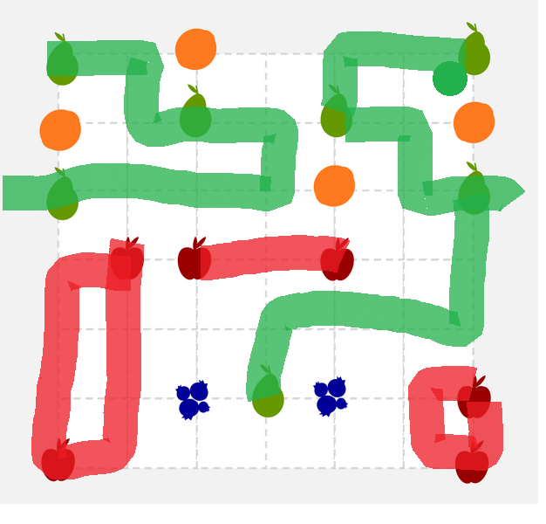
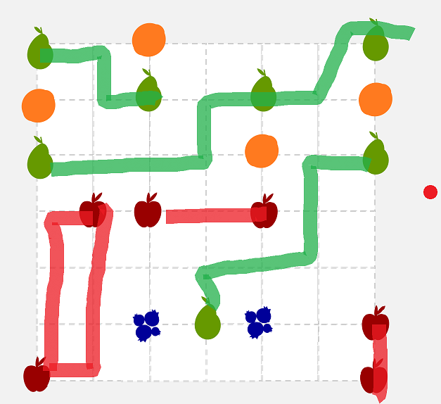
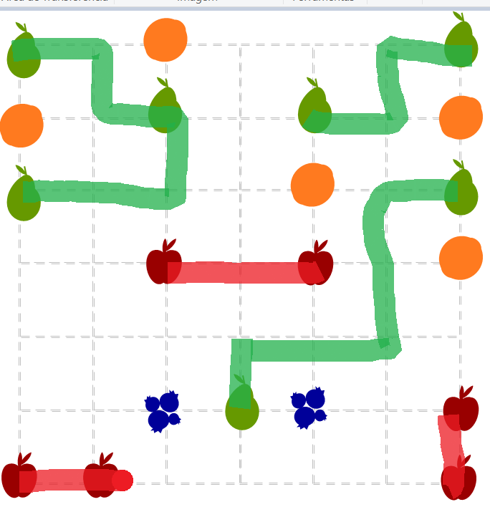
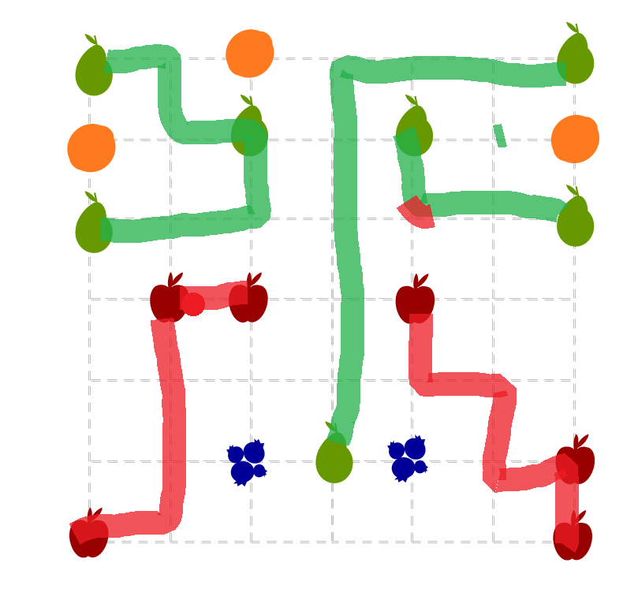
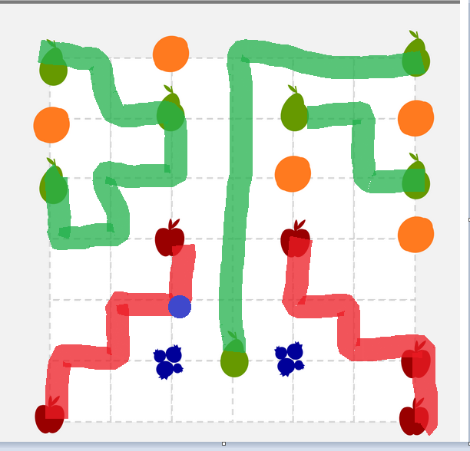
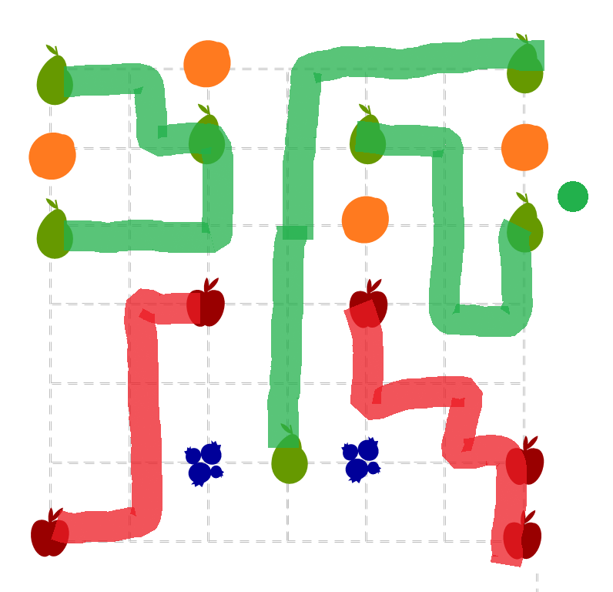
Kudamono
Set II
Draw paths of a single fruit type along the grid. paths don’t cross, branch or dangle. Symmetries: mirror & rotation.
Apples seek perfection norms,
as Pears prefer unique forms.
Eat a Blueberry, you’ll want another,
or eat an Orange and you won’t bother!
Every Apple belongs to a symmetric group.
Every Pear belongs to an asymmetric group. All Pear groups are different, even under symmetries.
Every Blueberry is connectable with at least one other (if paths were drawn).
No Orange is connectable with another.
#30 by Pedro PSI – 28th of December 2020
pedropsi.github.io/kudamono

Slide 14
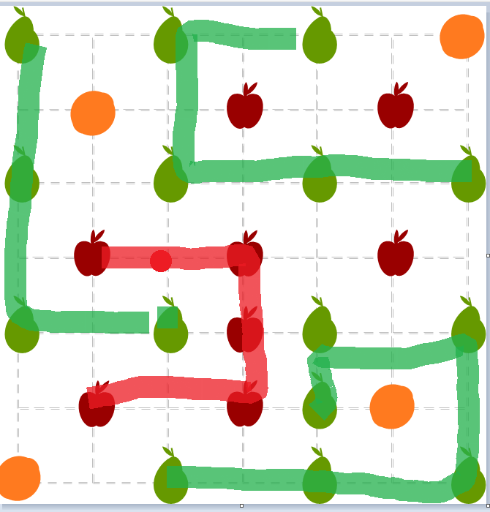
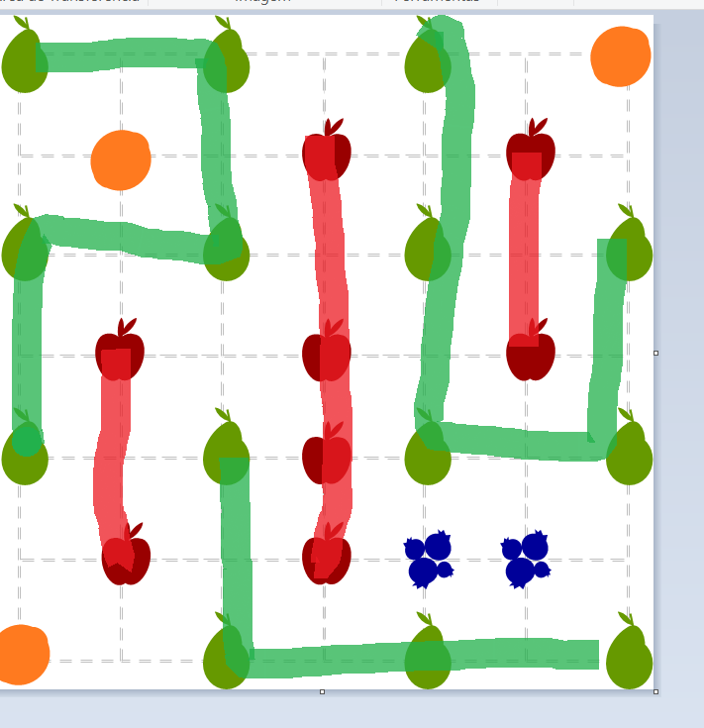
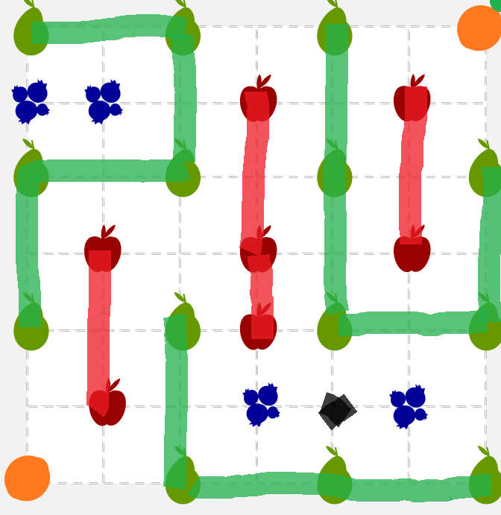
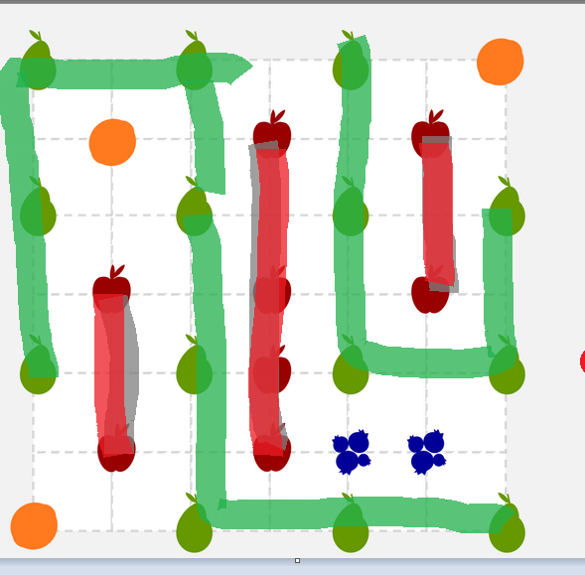
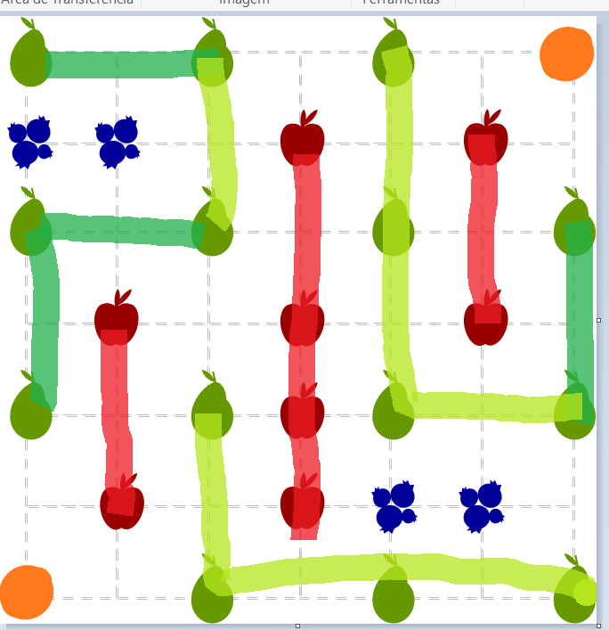
Kudamono
Set II
Draw paths of a single fruit type along the grid. paths don’t cross, branch or dangle. Symmetries: mirror & rotation.
Apples seek perfection norms,
as Pears prefer unique forms.
Eat a Blueberry, you’ll want another,
or eat an Orange and you won’t bother!
Every Apple belongs to a symmetric group.
Every Pear belongs to an asymmetric group. All Pear groups are different, even under symmetries.
Every Blueberry is connectable with at least one other (if paths were drawn).
No Orange is connectable with another.
#31 by Pedro PSI – 28th of December 2020
pedropsi.github.io/kudamono

Slide 15
Set II
Kudamono: issue examples
An Apple lacks a group.
A Pear lacks a group.
Some Apple groups are not symmetric
symmetries: any mirroring or rotation
A Pear group is symmetric.
Some Pear groups are symmetric to each other.
A path passes at a Blueberry.
A path passes at an Orange.
Some Blueberries are not connectable.
Some Oranges are connectable.
A path is dangling (ending not at a fruit).
A path branches.
Different fruit paths overlap at least at a point.
Solved!
#28 by Pedro PSI – 27th of December 2020
pedropsi.github.io

Slide 16
An Apple lacks a group.
A Pear lacks a group.
Some Apple groups are not symmetric
symmetries: any mirroring or rotation
A Pear group is symmetric.
Some Pear groups are symmetric to each other.
A path passes at a Blueberry.
A path passes at an Orange.
Some Blueberries are not connectable.
Some Oranges are connectable.
A path is dangling (ending not at a fruit).
A path branches.
Different fruit paths overlap at least at a point.
Solved!

Slide 18
Kudamono
ruleset 1
Draw paths of a single fruit type along the grid. paths don’t cross or branch.
Grapes share a bunch,
Cherries seek their pair.
Melons stay unbroken,
and Lemons sour alone.
All Grapes are connected by a single path (not a loop).
Cherries connect only in pairs (not in a loop).
Melons belong to closed loops (over 1 melon per loop).
No path passes through a Lemon.

Slide 19
Kudamono: issue examples
Some Melons are not part of a loop.
Not all Grapes are connected.
Some paths are branching.
Some paths are crossing..
One loop has less than two Melons.
One Cherry is disconnected.
More than 2 Cherries form a group.
A path is crossing a Lemon.
Solved!
#22 by Pedro PSI – 16th of December 2020
pedropsi.github.io

Slide 20
Kudamono
Grapes share a bunch,
Cherries seek their pair.
Melons stay unbroken,
and Lemons sour alone.
All Grapes are connected by a single path (not a loop).
Cherries connect only in pairs (not in a loop).
Melons belong to closed loops (over 1 melon per loop).
No path passes through a Lemon.
#20 by Pedro PSI – 15th of December 2020
pedropsi.github.io/kudamono
With thanks to dohz

Slide 21
Kudamono
Grapes share a bunch,
Cherries seek their pair.
Melons stay unbroken,
and Lemons sour alone.
All Grapes are connected by a single path (not a loop).
Cherries connect only in pairs (not in a loop).
Melons belong to closed loops (over 1 melon per loop).
No path passes through a Lemon.
#21 by Pedro PSI – 16th of December 2020
pedropsi.github.io/kudamono
With thanks to dohz

Slide 22
Kudamono
Grapes share a bunch,
Cherries seek their pair.
Melons stay unbroken,
and Lemons sour alone.
All Grapes are connected by a single path (not a loop).
Cherries connect only in pairs (not in a loop).
Melons belong to closed loops (over 1 melon per loop).
No path passes through a Lemon.
#23 by Pedro PSI – 16th of December 2020
pedropsi.github.io/kudamono
With thanks to dohz and Portponky

Slide 23
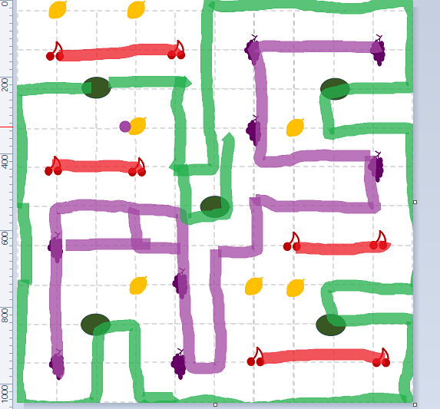
Kudamono
Grapes share a bunch,
Cherries seek their pair.
Melons stay unbroken,
and Lemons sour alone.
All Grapes are connected by a single path (not a loop).
Cherries connect only in pairs (not in a loop).
Melons belong to closed loops (over 1 melon per loop).
No path passes through a Lemon.
#24 by Pedro PSI – 19th of December 2020
pedropsi.github.io/kudamono
With thanks to dohz

Slide 24
The Melons are not part of a loop.

Slide 25
Not all Grapes are connected.

Slide 26
One Cherry is disconnected.
A group of Cherries has more than two.

Slide 27
Some paths are branching.
Some paths are crossing..

Slide 28
A path is passing through a Lemon.

Slide 29
Solved!

