Slide 1
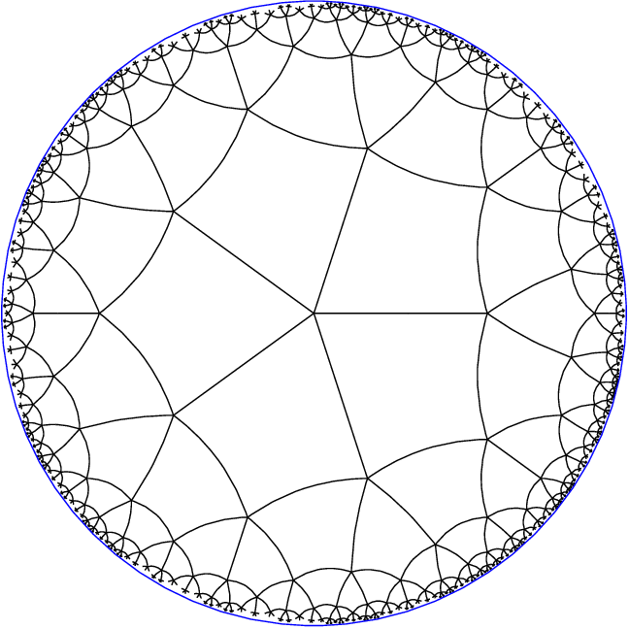

Slide 2
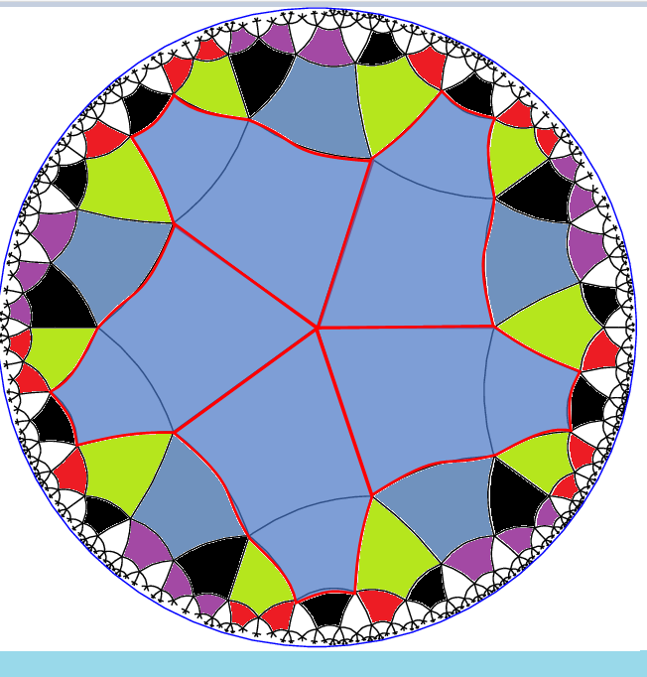
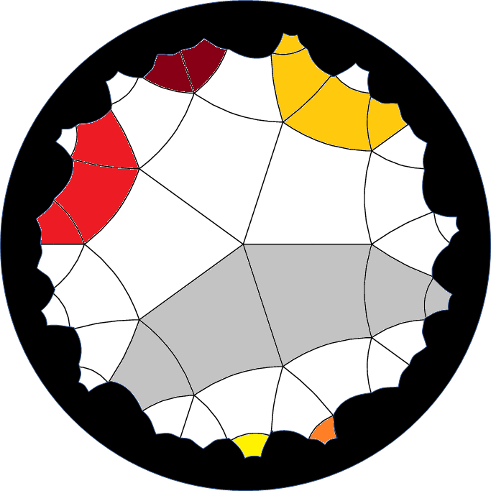

Slide 3
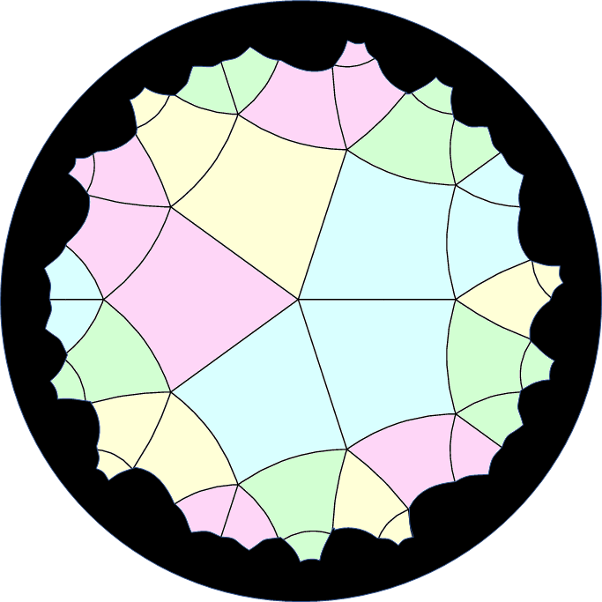
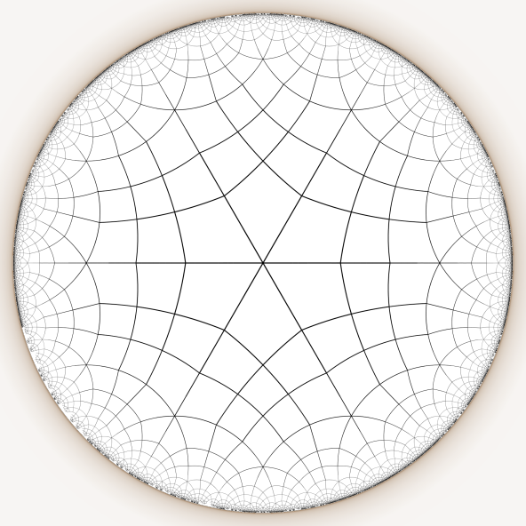
Hyperbolic Star Battle 1 ★ v.1.2
Place exactly one star per line and region.
Polygons with stars share no vertices.
A
1
B
3
W
4
4
3
B
C
D
G
2
2
C
E
Z
Y
A
1
F
Z
E
Q
G
X
H
I
Y
H
U
F
X
J
V
K
W
J
V
L
S
T
I
M
U
T
K
L
D
R
N
S
P
M
N
O
O
R
P
Q
#5 (very easy) by Pedro PSI – 11th July 2020

Slide 4
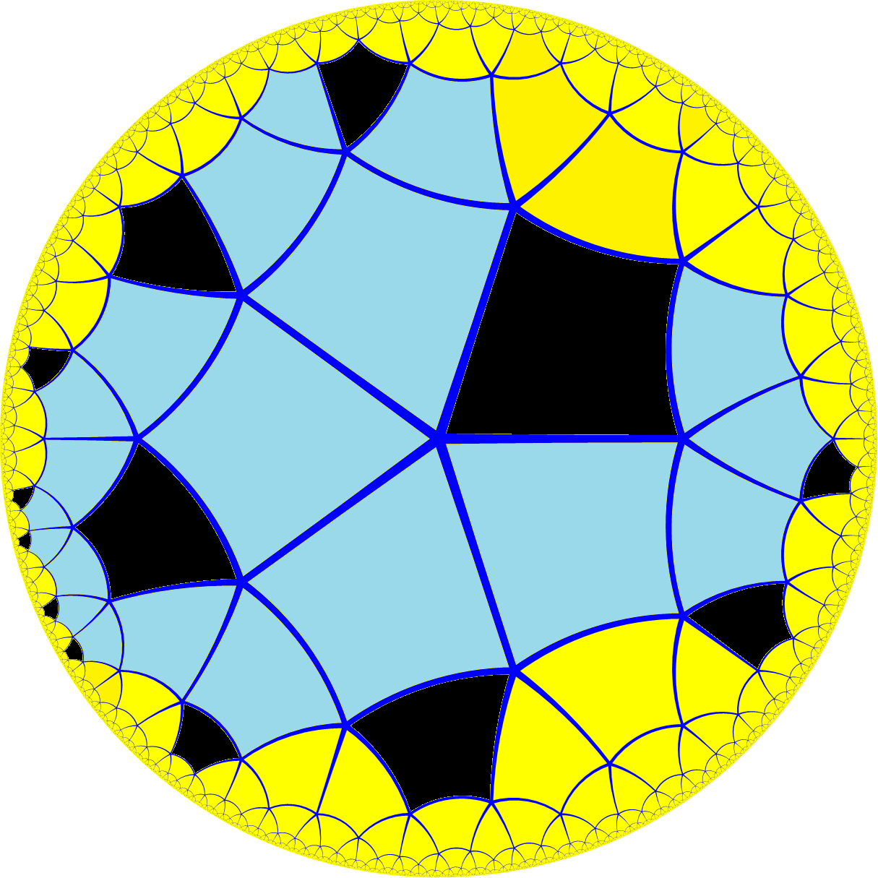
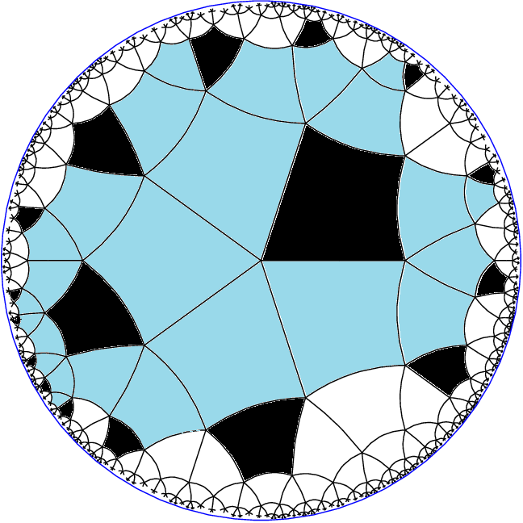

Slide 5
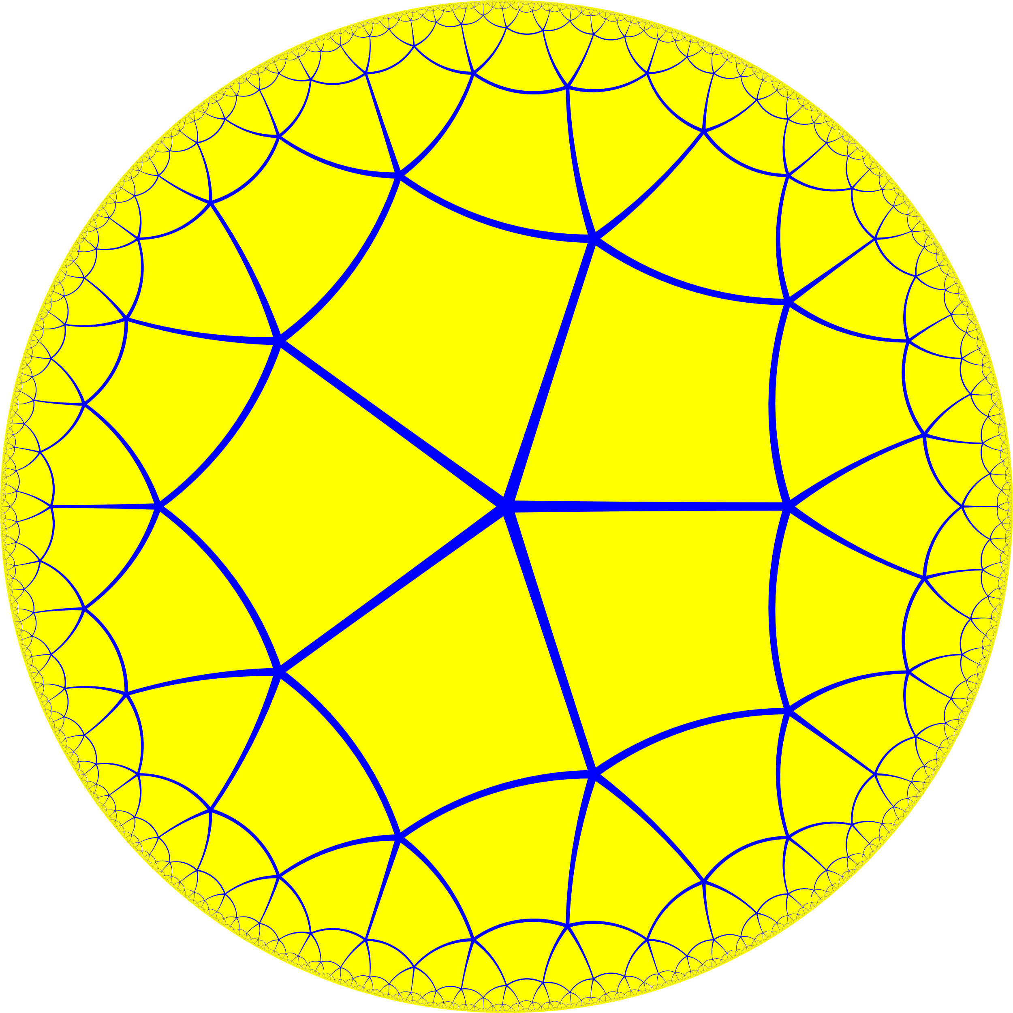
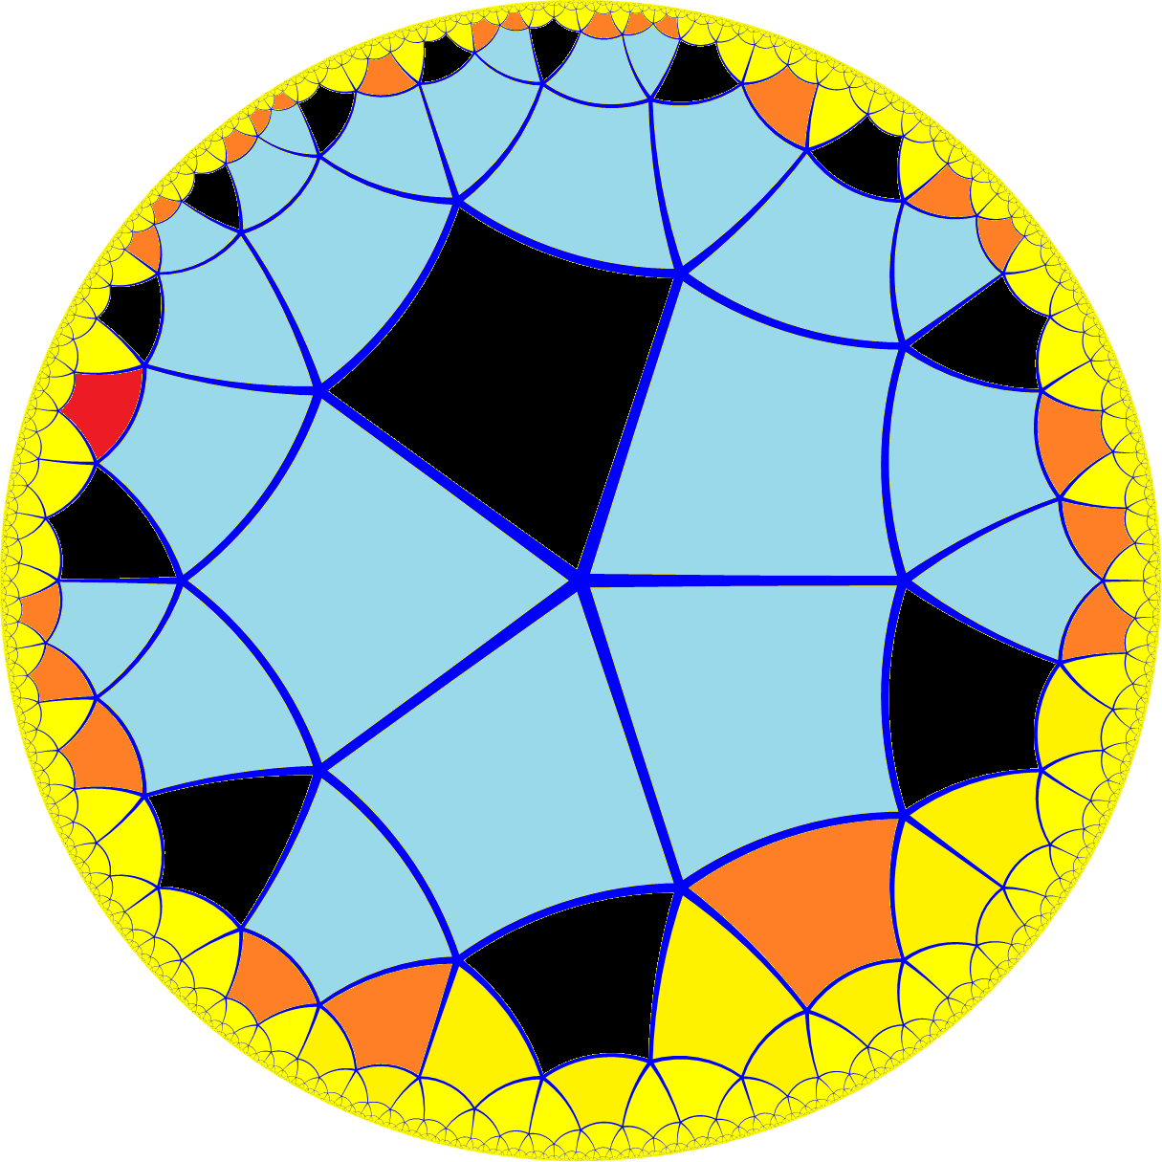

Slide 6

1
B
3
W
4
4
3
B
C
D
G
2
2
C
E
Z
Y
A
1
F
Z
E
Q
G
Hyperbolic Star Battle 1 ★ v.2
X
H
I
Y
H
Place exactly one star per line.
U
F
X
J
Quadrilaterals with stars share no vertices.
V
K
W
J
V
L
S
A
C
F
Y
B
D
A
E
B
I
Z
D
Z
T
U
X
M
Y
F
W
G
H
U
T
K
L
X
K
D
V
G
R
W
I
N
S
S
M
V
E
O
R
P
P
N
O
T
J
Q
U
T
I
O
K
R
S
L
Q
J
R
M
C
P
L
H
Q
M
P
N
N
O
#6 (easy) by Pedro PSI – 11th July 2020

