Slide 1
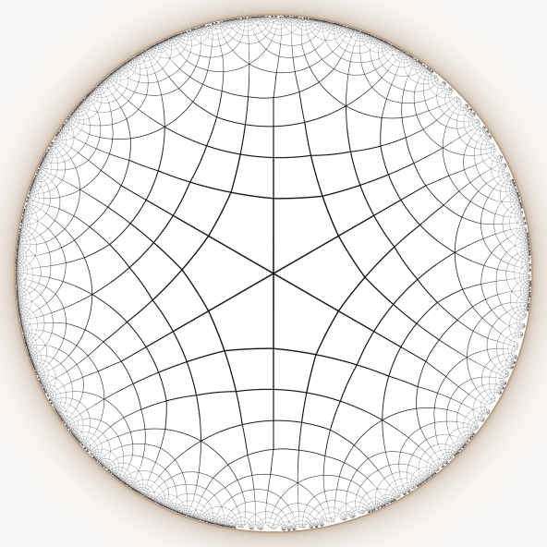
Hyperbolic Star Battle 1 ★
{4,6} grid – medium
Place exactly one star per line and region.
Cells with stars share no vertices.
G
A
B
E
F
C
D
H
G
H
I
I
P
J
Q
K
R
L
A
B
E
F
C
D
M
M
N
N
O
Q
P
J
K
L
O
R
with thanks to ZenoRogue for the grid
#6 by Pedro PSI – 12th July 2020, v.1

Slide 2
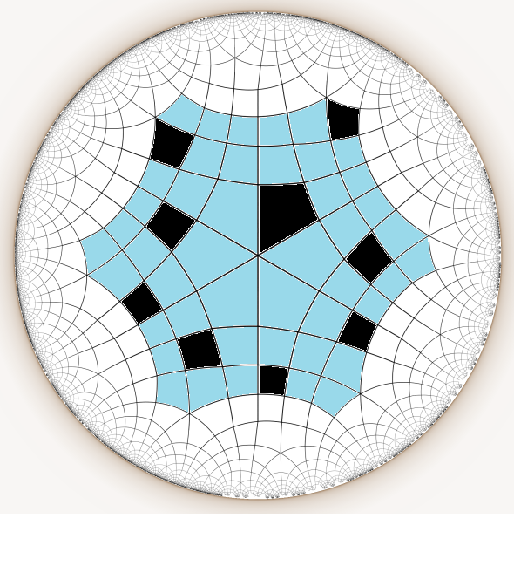

Slide 3
