Slide 1
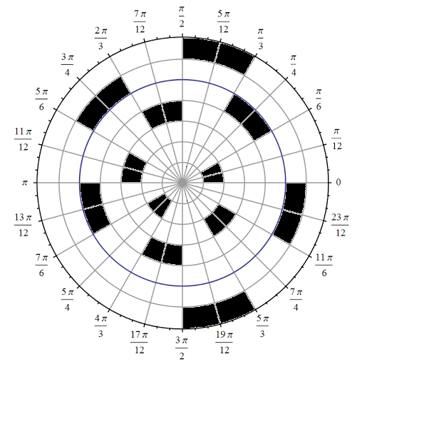

Slide 2
<<<<<<<<<<<<<<<

Slide 3
Polar Star Battle 2★
Place exactly two stars per diameter, ring and region.
Cells with stars share no vertices.
F
A
E
B
D
C
C
D
B
E
A
F
#7 by Pedro PSI – 01st of August 2020
pedropsi.github.io/star-battle

