Slide 1

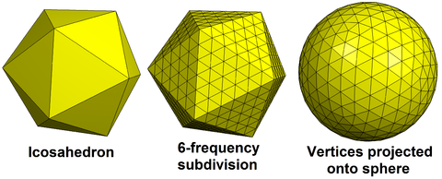

Slide 4
Star Battle in space – icosahedron 2★
Fold the icosahedron, then place exactly two stars per line and region. Cells with stars share no vertices.
A
B
B
A
C
D
D
C
E
F
F
E
G
H
H
G
I
J
J
I
K
L
L
K
#8.2 by Pedro PSI – 09th of August 2020
pedropsi.github.io/star-battle

Slide 5
