Slide 1
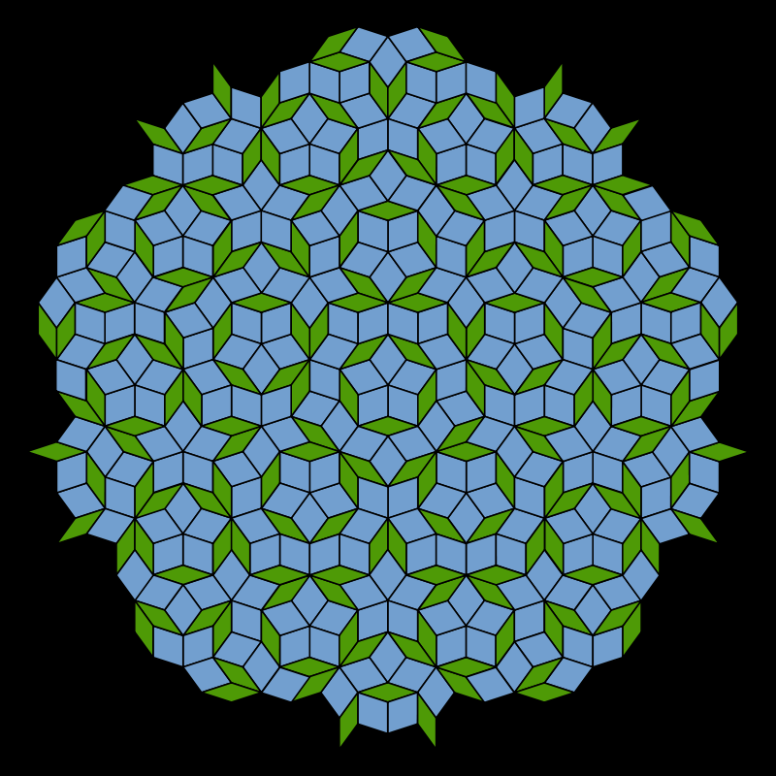

Slide 2


Slide 3
Penrose Star Battle 1★
Place exactly one star per line and region.
Cells with stars share no vertices.
I
J
A
B
G
C
D
D
H
E
F
F
C
G
J
A
E
H
B
I
#9 by Pedro PSI – 11th of August 2020
pedropsi.github.io/star-battle

