Slide 1
Ammann-Beenker Star Battle 1★
Place exactly one star per line and region.
Cells with stars share no vertices.
I
A
O
B
K
C
P
D
E
E
M
F
G
G
N
H
A
I
J
J
C
K
L
L
P
D
F
M
O
B
H
N
#11 by Pedro PSI – 04th of September 2020
pedropsi.github.io/star-battle

Slide 2
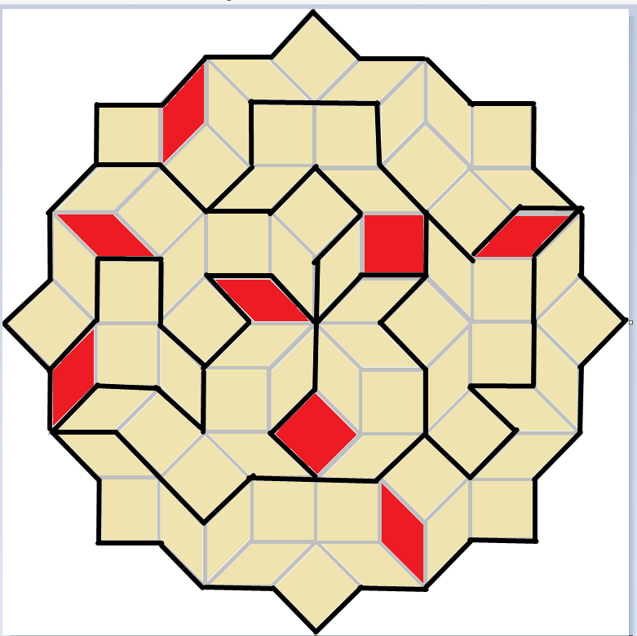

Slide 3
